Slide 1
LAUNCH WEBINAR:
2026 World Population Data Sheet
October 27, 2026

Slide 2
Key Findings from the 2026 World Population Data Sheet
Toshiko Kaneda, Ph.D., Senior Technical Director
October 27, 2026

Slide 3

One in Three People Live Where Older Adults Outnumber Children
One in three people (2.8 billion) live where adults age 65 and over outnumber children under age 15.
Found in 55 countries and territories.
Source: PRB, 2026 World Population Data Sheet. Countries of 1 million or more people; ties at 24% ranked by population.
Notes:
Let me start with what I think is one of the MOST striking findings in this year's World Population Data Sheet.
One in three people globally, or 2.8 billion people, NOW live in countries that have MORE older adults 65 and over than children under age 15.
This pattern is found in 55 countries and territories.
As you can see in the chart, in Japan, 29% of the population is 65 and over and JUST 11% is under 15.
[Suggested, to match the new chart: Among countries with 1 million or more people, Japan has the highest share of older adults, followed by Italy at 25%, and Greece, Bulgaria, and Finland at 24%. Croatia and Estonia also have 24%.]

Slide 4
Pop Pop Quiz #1: Population Aging
Notes:
Now I want to give you a population pop quiz, Pop Quiz #1.
Which of the countries below has more older adults than children under 15?
A. Ireland
B. Vietnam
C. United States
D. Argentina

Slide 5
The U.S. Has More Older Adults Than Children
It’s not just Japan and Europe: the U.S., China, Thailand, Cuba and many others also have more older adults than children.
Two long-term trends:
  Women having fewer children
  People living longer
Source: PRB, 2026 World Population Data Sheet.
Notes:
The answer is C, the US.
So it's NOT ONLY countries like Japan and those in Europe, as you might expect, but ALSO countries like the U.S., China, and Thailand.
The US has 19% older adults compared to 17% children.
The finding highlights JUST HOW widespread population aging has become.
How did we get here? Today's aging populations reflect two major demographic changes unfolding over decades: declining fertility and people living longer.
Today's older population reflects births many decades ago, while today's children reflect more recent fertility patterns. So what we're seeing is the cumulative effect of demographic changes over generations.

Slide 6
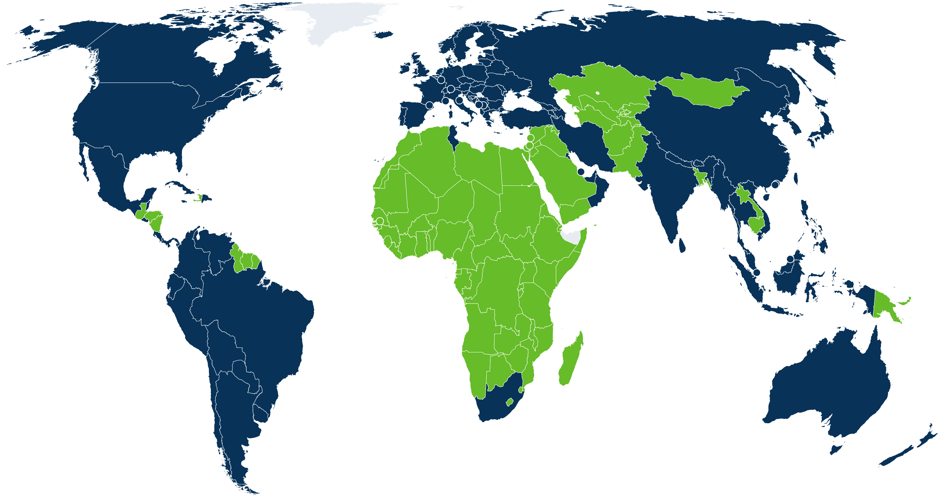
Seven in Ten People Live Where Fertility Is at or Below Replacement
At or below replacement (2.1 births per woman): 121 countries and territories
Above replacement: 89
Source: PRB, 2026 World Population Data Sheet.
Notes:
Another major finding is just HOW COMMON LOW FERTILITY IS around the world.
Today, about seven in ten people globally live in countries where fertility is AT OR BELOW replacement level, around 2.1 births per woman.
That's 121 countries and territories.

Slide 7
Pop Pop Quiz #2: Population Decline
Notes:
Now I have Pop Quiz #2. Which of these is a sure sign that a country's total population is declining?
A. An aging population
B. Fertility below replacement level
C. More deaths than births
D. None of the above

Slide 8

Aging, Low Fertility, or More Deaths Than Births Do Not Always Mean Population Decline
58 of the 121 countries and territories at or below replacement fertility are projected to be larger in 2050 than today.
Age structure and migration help explain why.
Countries with similarly low fertility can follow very different population trajectories.
Notes:
The answer is D, none of the above. [Note: the original script said "E"; there is no option E, so this was changed to D.]
This might be a little counterintuitive, but out of 121 countries with fertility at or below replacement level, 58 countries, almost half, are still projected to grow through 2050.
Globally, the population is projected to continue growing from 8.2 billion today to 9.6 billion in 2050.
Neither below-replacement fertility NOR population aging, or even having more deaths than births, necessarily means population decline right away. Age structure and migration also play important roles, as I'll explain.

Slide 9
Age Structure Changes the Result
Population momentum: a young population has many people entering their childbearing years, so the population keeps growing even as women have fewer children
  e.g., India, Mexico, the Philippines
Momentum fades as smaller generations reach childbearing age.
Notes:
There are two important reasons why countries with low fertility can continue growing.
First is AGE STRUCTURE. Countries with relatively young populations have large numbers of women entering their childbearing years. So even when women have fewer children on average, the total number of births can remain high.
This is what demographers call population momentum: when a population continues growing for decades, even after fertility falls below replacement level, because of its young age structure. India is a good example.
So it's not just HOW MANY CHILDREN each woman has, but also how many women there are of childbearing age.
But population momentum doesn't last forever. As smaller generations eventually reach childbearing age, the number of births may decline, even if fertility rates don't fall further.
So countries can be at very different stages of demographic change. Some reached low fertility recently and are still growing, while others have experienced low fertility for decades and are seeing the effects of smaller generations.

Slide 10
Migration Can Also Change the Result
Net migration = Immigration minus Emigration
Positive net migration (more people moving in than out) can offset more deaths than births
  e.g., Spain, Finland
Negative net migration (more people moving out than in) can shrink a population even when there are more births than deaths
    e.g., Marshall Islands, St. Vincent and the Grenadines
Notes:
The second factor is MIGRATION. In some countries, deaths already outnumber births, but immigration can offset that loss and sustain population growth. Spain is a good example.
Migration also works the other way. When more people leave than arrive, population can decline, EVEN when there are more births than deaths.
THAT'S WHY fertility alone doesn't tell us where a population is headed.

Slide 11
Population Growth is Concentrated in Relatively Few Places
Four countries—India, Nigeria, Pakistan and the Democratic Republic of Congo—are projected to account for about 40% of global population growth through 2050
Together, projected to add about 570 million people
Source: PRB, 2026 World Population Data Sheet.
Notes:
Now, looking at where future population growth will occur, ANOTHER striking finding is HOW CONCENTRATED that growth will be.
Just four countries (India, Nigeria, Pakistan, and the Democratic Republic of Congo) are projected to account for about 40% of global population growth between now and 2050.
Together, they're projected to add about 570 million people.

Slide 12
Sub-Saharan Africa Is Projected to Account for About 60% of Global Growth
Driven by high fertility and a young age structure
    Average total fertility rate: 4.3 births per woman
    Average percent of the population under age 15: 40 percent
    Globally, 24 of the 25 countries with fertility of 4.0 or more are in the region (Afghanistan is the exception)
Planning needs differ for young, fast-growing vs. much older populations
Source: PRB, 2026 World Population Data Sheet.
Notes:
Now I've been talking about individual countries, BUT if we look at REGIONS instead of countries, sub-Saharan Africa alone is projected to account for about 60% of global population growth through 2050.
Sub-Saharan Africa remains much younger and has higher fertility, with an average total fertility rate of 4.3, and 40% of the population under age 15. It is also home to 24 of the 25 countries with total fertility rates of at least 4.0, with Afghanistan being the exception.
So future population growth will be CONCENTRATED in relatively few places.
These patterns matter for planning, because the needs of countries with rapidly growing young populations can be quite different from those of countries with much older populations.

Slide 13
Similar Fertility Rates Can Emerge Through Different Pathways
Birth rates peak in the 30s
Birth rates peak in the 20s
Age
Source: PRB, 2026 World Population Data Sheet.
Notes:
Another finding I want to highlight is that countries with similarly low fertility rates can differ a lot in the timing of births.
This chart compares the age patterns of childbearing in four countries with similarly low fertility, all between 1.0 and 1.3 children per woman.
We OFTEN associate low fertility with women having kids LATER IN LIFE. And that's definitely one pattern. In Germany and Spain, for example, birth rates are HIGHEST among women in their 30s.
But in Colombia and Thailand, which reached low fertility relatively more recently, birth rates STILL peak earlier, among women in their 20s.
Why does this matter? Because the same overall fertility rate can reflect quite different changes in childbearing behavior.
In some countries, declining fertility has been accompanied by a substantial shift toward having children later in life. In others, fertility has fallen sharply even though childbearing remains concentrated at younger ages.
These differences can reflect a combination of factors, including when people marry or form partnerships, changing expectations around family formation, economic circumstances, and access to reproductive health services.
So a low fertility rate tells us how many children women would have on average if current birth rates continued, but it doesn't tell us when women are having those children, or the social circumstances behind those patterns.
So even when fertility rates are similar, countries may have followed different paths to low fertility, and we shouldn't assume that they face the same circumstances and challenges.

Slide 14
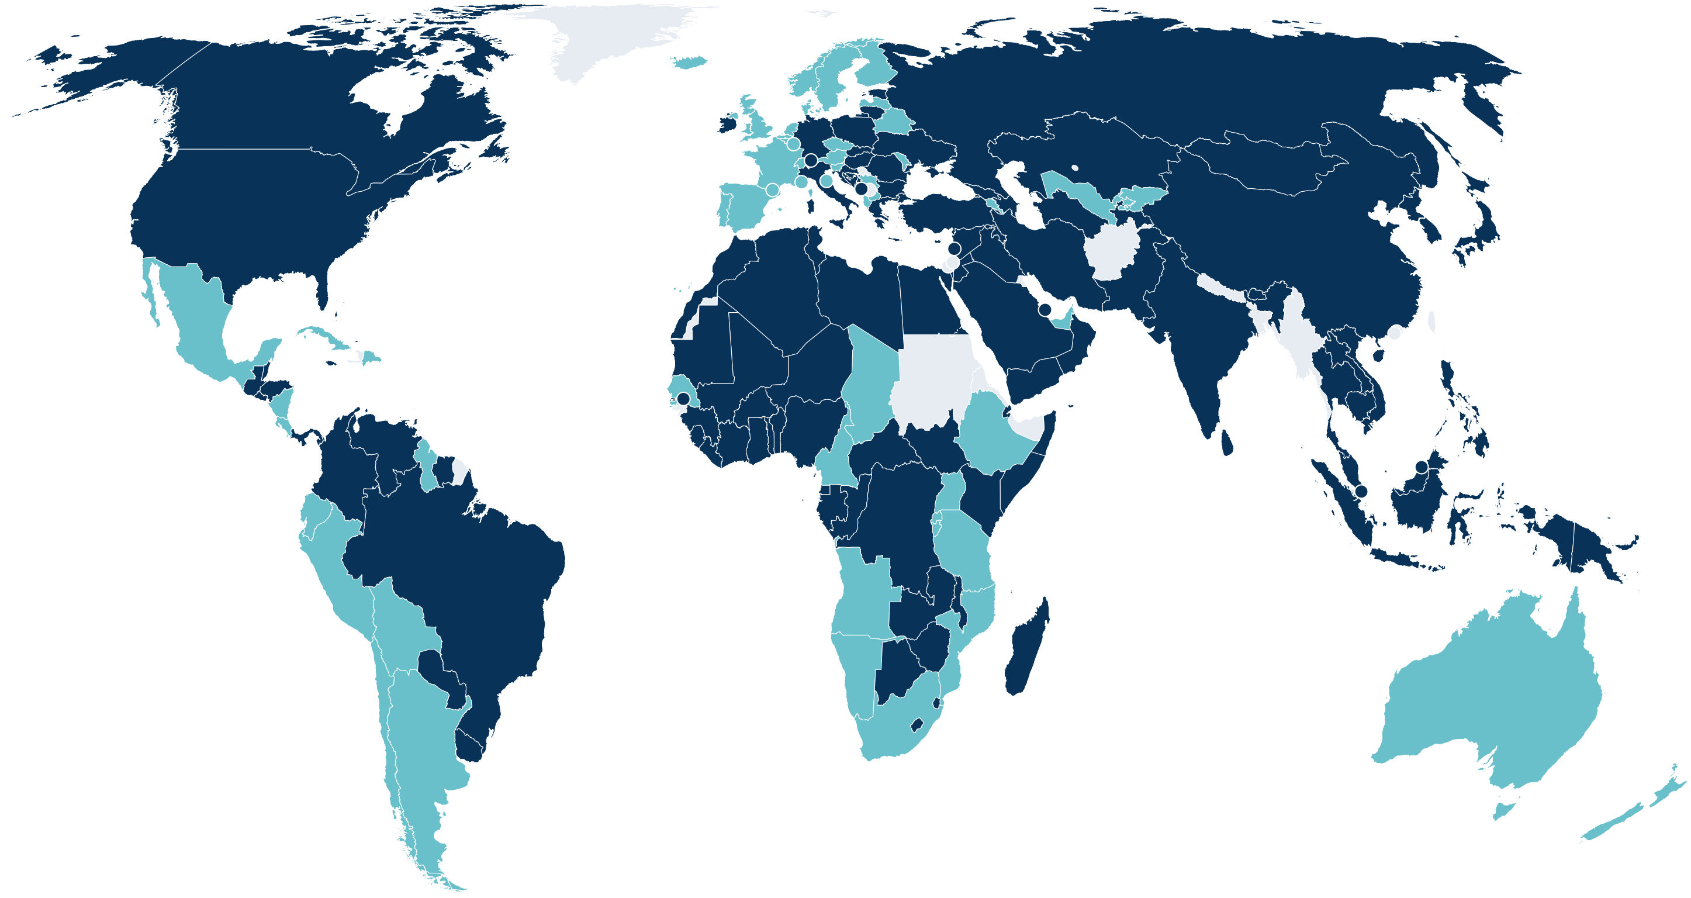
Women Remain Underrepresented in Political Decision-Making
In 127 countries, including the U.S., women hold less than a third of parliamentary seats
Less than one-third: 127
One-third or more: 57
No data: 26
Source: PRB, 2026 World Population Data Sheet.
Notes:
This year's Data Sheet ALSO includes a special focus on gender equality and well-being.
One finding is that women remain greatly UNDERREPRESENTED in political decision-making.
In 127 countries, including the US, women hold less than a third of parliamentary seats.

Slide 15
Pop Pop Quiz #3: Women's Political Representation
Notes:
I'm going to give you my last pop quiz now. According to this year's data sheet, in how many countries do women hold at least half of the seats in parliament?
A. 7
B. 34
C. 61
D. 109

Slide 16
Women Hold at Least Half of Parliamentary Seats in Only Seven Countries
Source: PRB, 2026 World Population Data Sheet.
Notes:
The correct answer is A. In ONLY SEVEN countries, women hold at least half the parliamentary seats: Rwanda (64%), Cuba (57%), Nicaragua (55%), Bolivia (51%), and Mexico, the United Arab Emirates, and Andorra (50% each).

Slide 17
Equal Schooling Has Not Meant Equal Labor Force Participation
Women and men have nearly the same years of schooling:
  Mexico 9.6 vs. 9.9
  Sri Lanka 10.8 vs. 10.9
But far fewer women are in the labor force
Closing the gap likely takes more than education
Labor force participation rate, ages 15-64 (%)
Women
Men
52%
82%
Mexico
36%
73%
Sri Lanka
0
25
50
75
100
Source: PRB, 2026 World Population Data Sheet.
Notes:
Another point is that while the gender gap in educational attainment has narrowed greatly, a SUBSTANTIAL GAP remains in labor force participation.
Mexico and Sri Lanka offer striking examples. In both countries, women and men have similar years of schooling today. But in Mexico, only about 52% of women participate in the labor force, compared with about 82% among men.
In Sri Lanka, the gap is EVEN greater: 36% versus 73%.
Why do these gaps persist even when educational attainment is similar? Education is certainly important, but whether women can participate in paid work also depends on other conditions.
Women often shoulder a disproportionate share of unpaid caregiving and household responsibilities. Access to childcare, the availability of suitable jobs, workplace conditions, and social expectations can all influence whether women are able to enter or remain in the labor force.
So improving women's access to education is an important achievement, but it doesn't automatically remove the other barriers to economic participation.
Taken together, these findings remind us that gender equality is multidimensional. Progress in one area doesn't necessarily mean the same progress has occurred in others.

Slide 18

THANK YOU
Low fertility is increasingly widespread, but countries are not all on the same path
Age structure, migration and other factors lead to different futures
The Data Sheet reveals these differences and points to where populations are headed
Notes:
The correct answer is A. In ONLY SEVEN countries, women hold at least half the parliamentary seats: Rwanda (64%), Cuba (57%), Nicaragua (55%), Bolivia (51%), and Mexico, the United Arab Emirates, and Andorra (50% each).

Slide 19
Protecting the Data That Protect People
Kaitlyn Patierno, Senior Program Director
October 27, 2026

Slide 20

Data infrastructure are under threat around the world
69%
35
All 13
of NSOs in LMICs reported budget cuts in 2025.
countries did not conduct a census in the 2020 round.
U.S. principal federal statistical agencies cut staff since Jan. 2025; six lost a third of their workforce.
ISWGHS NSO Survey
UNFPA
PRB, 2026 WPDS
When censuses, registration systems, and surveys weaken, decision-makers act on an incomplete picture.
20
Notes:
Talking points:
- The termination of DHS is part of a broader set of pressures on data and statistics systems.
- 69% of national statistical offices in LMICs reported budget cuts in 2025 (ISWGHS NSO Survey).
- 35 countries did not conduct a census during the 2020 census round (UNFPA).
- The U.S. is not immune: since January 2025, all 13 principal federal statistical agencies have reduced staffing, and six have lost at least one-third of their workforces.
- Many interrupted DHS surveys have since resumed with support from new and existing funders and partner governments, but the fragility of these systems must still be addressed.
- Jennifer Sciubba: when censuses, registration systems and surveys weaken, policymakers risk acting on an incomplete picture of who people are and what they need.
[Sources]
ISWGHS NSO Survey; UNFPA; 2026 WPDS press release (draft, 10/12/26).

Slide 21
Regular data collection is essential for reliable population estimates
Tracking Demographic Trends and Unexpected Changes
Strengthening Population Estimates and Projections
Models rely on updated empirical data to evaluate estimates, test assumptions, and improve population projections.
Regular surveys, censuses, and vital registration systems help track demographic trends and reveal changes, including those caused by major events such as pandemics and conflicts.
Reliable demographic data are public infrastructure.
5
21
Notes:
Source: PRB analysis reflected in the approved 2026 WPDS key findings.,Speaker cue: Avoid treating every low-fertility country as if it faces the same causes or needs the same policy response.

Slide 22



You can’t fix what you can’t measure
Demographic and health data don’t just inform policy. They shift power.
Direct scarce resources
Ministries and legislators rely on accurate, timely data.
Advance equity and accountability
Data make underserved communities visible and leaders accountable.
Reveal what models miss
Direct observations show where estimates need updating.
Counting people is about visibility, power, and the right to be seen.
22
Notes:
- From national budgets to local service delivery, decisions that shape millions of lives depend on a simple premise: you can't fix what you can't measure.
- Health ministries allocate scarce resources. Legislators design policies. Civil society advocates for underserved communities. All rely on accurate, comparable, and timely data.
- Equity and accountability: without reliable data, policymaking becomes less precise, less equitable, and less accountable. When data systems falter, blind spots widen, inequities deepen, and progress becomes harder to track or sustain.
- Example: the latest DHS infant mortality estimates in Ethiopia, DR Congo, Senegal and Malawi were 6 to 8 deaths per 1,000 live births higher than modeled estimates in the latest UN World Population Prospects, equivalent to 6,000-8,000 deaths per million births. Progress may be slower than expected, and thousands of infant deaths may be missing from figures used for decision-making.
- Close: counting people (their births and deaths, their health and wellbeing, their access and exclusion) is about visibility, power, and the fundamental right to be seen in the decisions that shape their lives.
[Sources]
PRB writing on data access and integrity (prb.org/what-we-do); 2026 WPDS press release (draft, 10/12/26), 'Gaps in Population Data' section.

Slide 23
PRB connects evidence to the people who can act
The 2026 Data Sheet is part of a broader strategy.
Keep essential data visible and useful
Combine observations and modeled estimates for 200+ countries and territories.
1
Make the stakes clear
Show what is missed when data gaps grow, as with infant mortality.
2
Mobilize users and decision-makers
Equip data users with tools like the new Data Explorer.
3
Data users are infrastructure.
23
Notes:
Talking points:
- Keep essential data visible and useful: the Data Sheet draws on censuses, civil registration and vital statistics, nationally representative surveys, and modeled estimates where observations are incomplete, bringing them together so differences can be seen and assumptions tested.
- Make the stakes clear: evidence like the infant mortality gap shows decision-makers what is lost when data systems weaken.
- Mobilize users and decision-makers: data infrastructure is defended by its users. The new Data Explorer lets users compare indicators across countries and examine the conditions behind regional and global totals.
- Transition: hand off to the Data Explorer demo.
[Sources]
2026 WPDS press release (draft, 10/12/26). Template slide 3 notes: Data Stewardship theory of change draft (PRB as translation layer; data infrastructure is defended by its users).

Slide 24
Data Explorer Demo: Exploring Population Aging
Shreya Arora, Research Assistant
October 27, 2026

Slide 25





Today’s Demo: Where in the world are populations aging?
Beeswarm
Bar chart
Scatter plot
Map
Country profiles show every indicator for one place and allow comparison with up to three others.
Notes:
I have structured this demo around different ways we can explore the question: where in the world are populations aging?
To answer that question, I’ll walk you through our four ways of visualizing the data: a beeswarm chart, a bar chart, a scatter plot, and a map. Today’s demo uses screenshots of the Explorer. Everything you’ll see is available online and we will be sharing the link to the Explorer in the chat now, so you can try each step yourself afterward.
Alongside these four views, every country has its own profile, which brings all indicators together on one page and allows for comparison with up to three other countries or regions. The same approach works for any indicator in the Data Sheet.
→ Next slide, please.

Slide 26
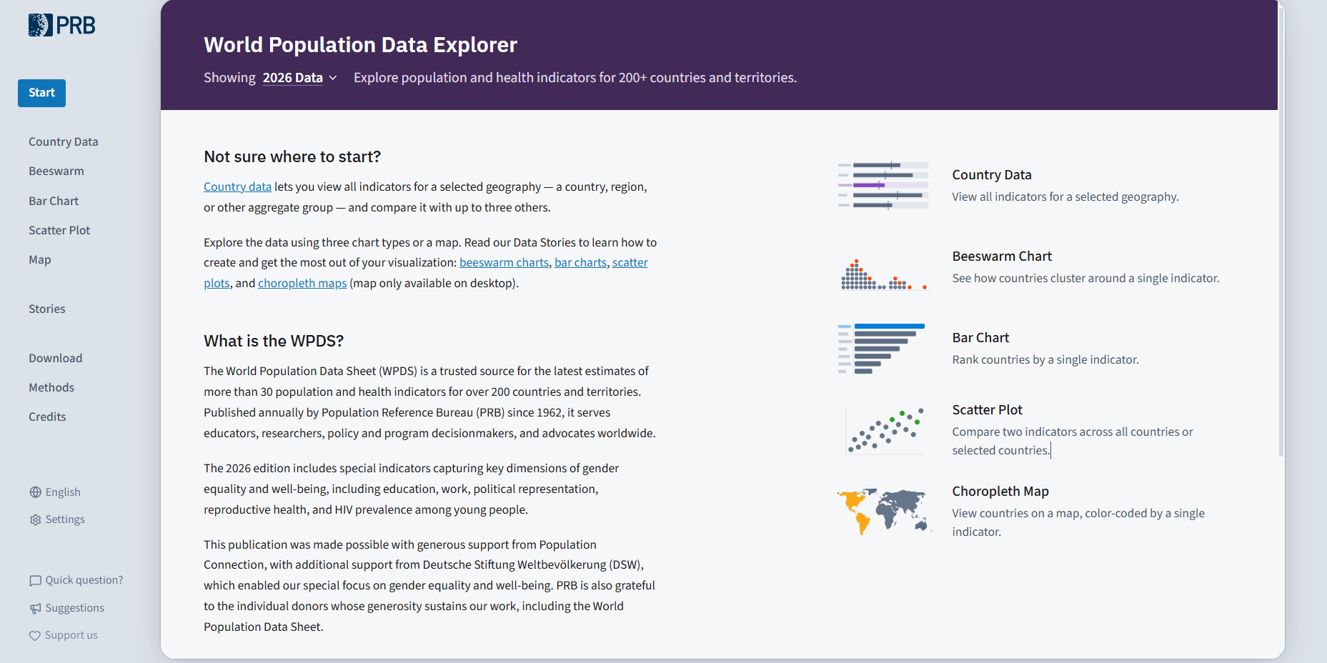
Landing Page Overview
Source: PRB, 2026 World Population Data Sheet.
Notes:
This is the landing page for the Explorer. The navigation panel on the left takes you to each part of the site: Country Data, the three chart types, the map, and the Data Stories.
At the top of the page, you can see that we are viewing the 2026 data. The page also gives a brief overview of the World Population Data Sheet itself.
The Download and Methods pages give you the full dataset and the details behind each indicator. The Data Stories are narratives prepared by PRB staff that walk you through different patterns in the data.
→ Next slide, please.

Slide 27
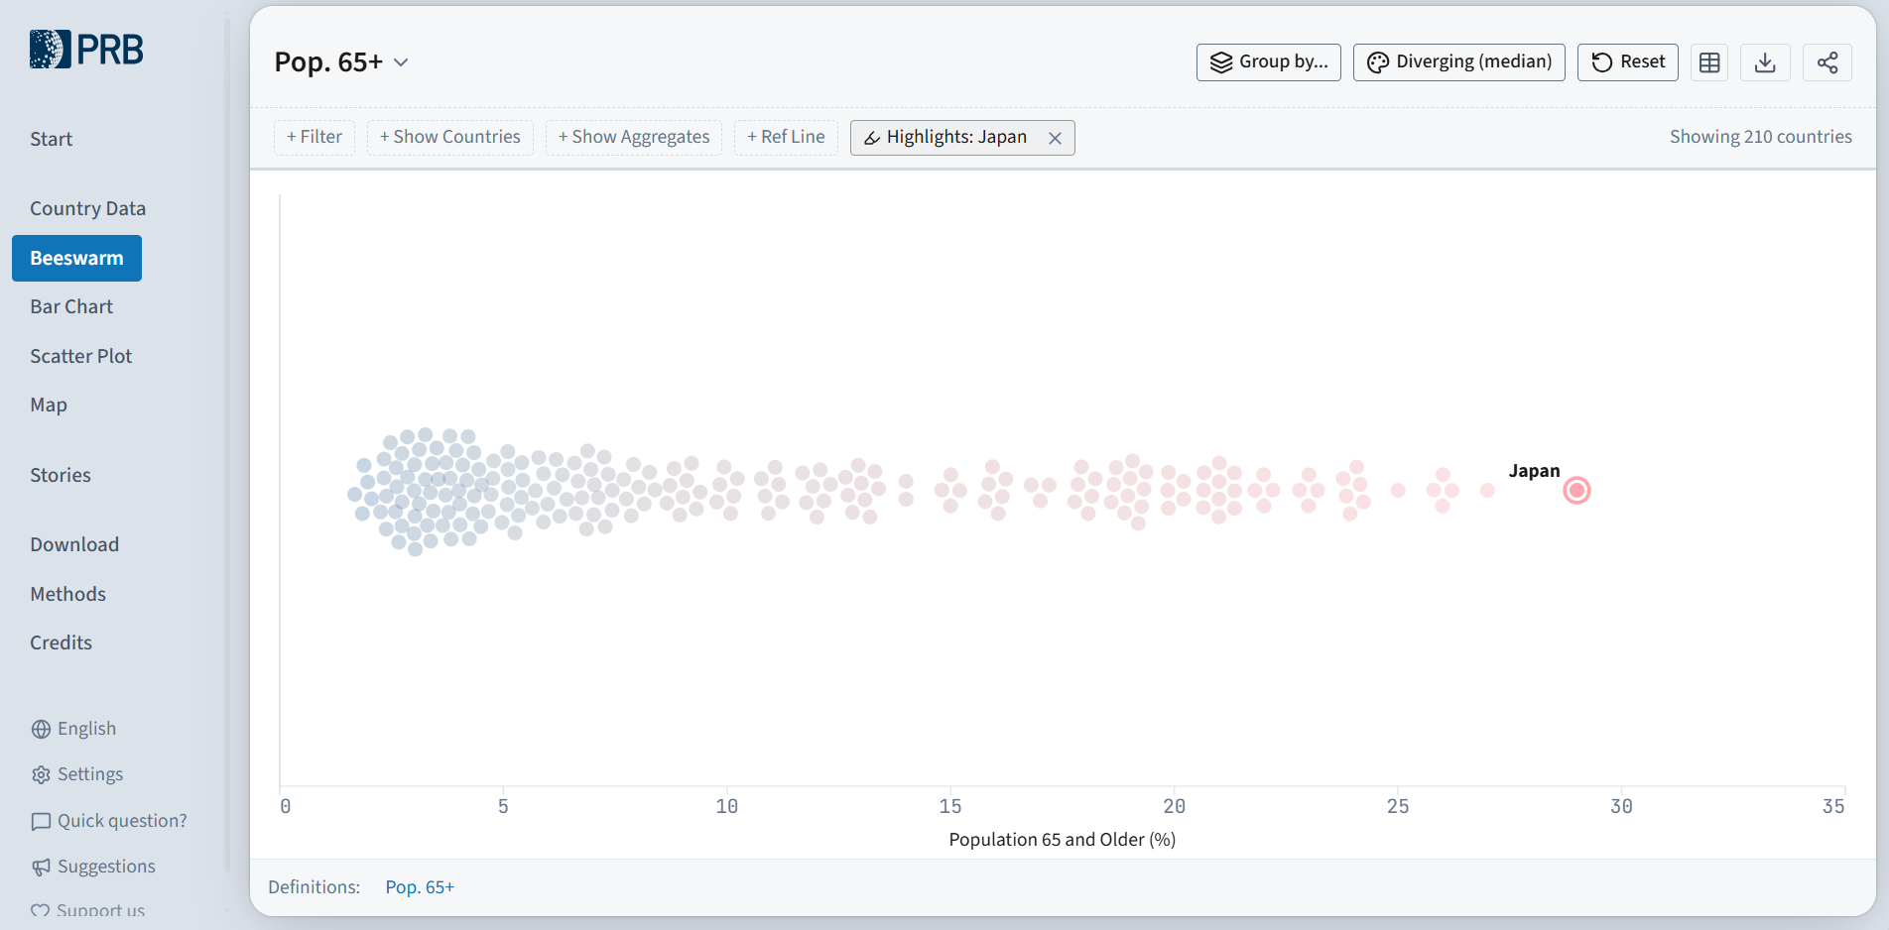
Most countries have fewer than 10% of people aged 65+
VIEW 1 · BEESWARM
WHAT IT SHOWS
Each dot is a country. Most cluster at the low end, while a long tail reaches Japan at 29%.
FEATURES AVAILABLE
Filter countries, highlight any country, group by region or income, and add reference lines.
Source: PRB, 2026 World Population Data Sheet.
Notes:
First, let’s look at the beeswarm chart for the indicator “percent of population aged 65 and older.” Beeswarm charts show the distribution of the data. They are useful when you want to see where countries cluster, how much variation exists, and whether some countries stand apart from the broader pattern.
For this indicator, each dot represents a country, positioned according to the percent of its population aged 65 and older. Countries below the median are shaded blue, and countries above the median are shaded pink, with darker shades meaning farther from the median. I use the same color scale for the following charts.
What stands out right away is the shape. Most countries cluster at the lower end of the scale, while a long tail stretches toward much older populations. Highlighted at the far right is Japan, where 29 percent of the population is 65 or older.
Hovering over any dot tells you which country it is. You can also filter the countries shown, highlight a particular country, and add reference lines. One of the most useful options is “Group by”, which I will show you next.
→ Next slide, please.

Slide 28
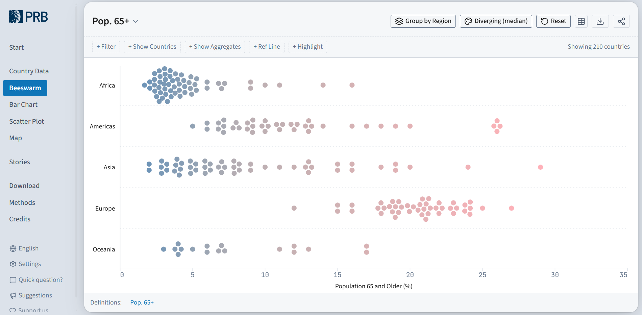
Asia shows the widest range in population 65 and older
VIEW 1 · BEESWARM
WHAT IT SHOWS
Africa clusters at 2–5%, Europe mostly at 15–27%, and Asia spans from about Qatar and UAE’s 2% to Japan’s 29%.
HOW TO
Choose Group by, then Region or Income Group.
Source: PRB, 2026 World Population Data Sheet.
Notes:
When we group the countries by region, the differences become striking. In Africa, countries cluster tightly at 2 to 5 percent aged 65 and older. Most European countries fall between 15 and 27 percent.
Asia shows the widest range of any region, from about 2 percent in Qatar and the United Arab Emirates to Japan at 29 percent. And in the Americas, a small group of Caribbean territories stands out at about 26 percent.
To try this yourself, choose Group by and then select Region or Income Group. Now, let us see which countries rank at the very top.
→ Next slide, please.

Slide 29
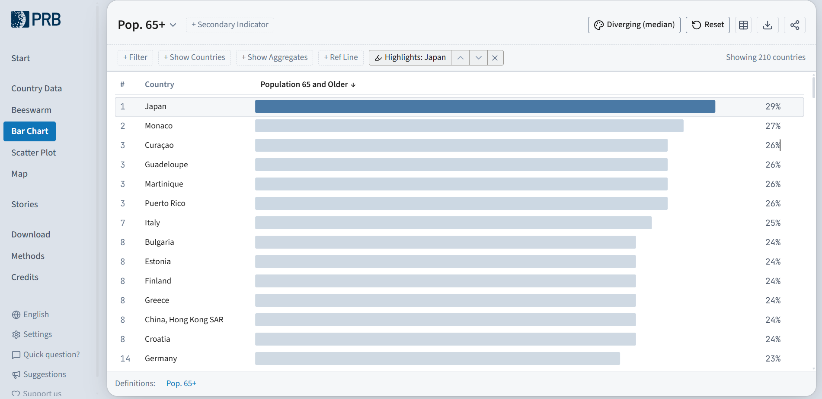
Japan has the oldest population at 29%
VIEW 2 · BAR CHART
WHAT IT SHOWS
Countries ranked on one indicator. Japan leads, followed by Monaco at 27%.
TRY THIS
Use Highlight to pick out any country in the ranking.
Source: PRB, 2026 World Population Data Sheet.
Notes:
Here, let’s look at the same data in a bar chart. Bar charts are best for ranking. They enable you to sort countries by the value for one indicator.
As Toshiko highlighted in her presentation, when we sort by percent of population aged 65+ or older, Japan has the oldest population, at 29 percent aged 65 or older. And you see the rest of the countries according to their ranks.
If you are interested in a particular country, the Highlight option, also found at the top of the page, makes it easy to find it in the ranking and see where it sits relative to others.
→ Next slide, please.

Slide 30
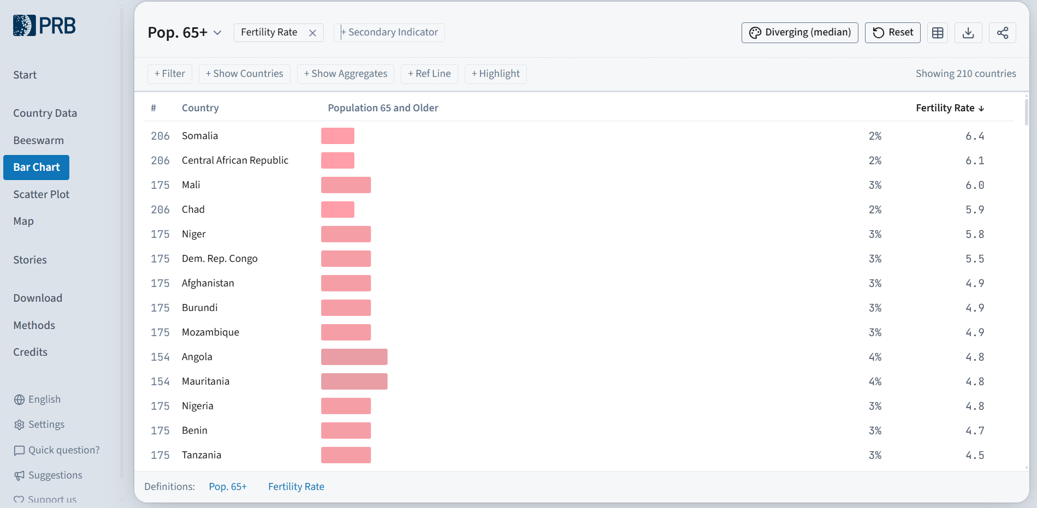
Countries with the highest fertility have the youngest populations
VIEW 2 · BAR CHART
ADD A COMPARISON
Total Fertility Rate, added as a secondary indicator.
WHAT IT SHOWS
Most of the youngest countries have fertility well above 2.1, the level needed to replace each generation.
Source: PRB, 2026 World Population Data Sheet.
Notes:
The bar chart also allows you to add a secondary indicator alongside the first. Here, I have added the total fertility rate, a well-known driver of population aging to see how these two indicators are associated. This view re-sorts the bar chart by total fertility rate, showing the share of older adults in the countries with the highest fertility at the top.
Nearly all of the countries with the highest fertility are in sub-Saharan Africa. Somalia has the highest fertility rate, at 6.4 children per woman, followed by the Central African Republic at 6.1. In both countries, only 2 percent of the population is aged 65 or older.
You can also sort the chart by lowest fertility rate and find that many of the countries with the highest shares of older adults appear at the top.
Next, we will view these same two indicators in a scatter plot.
→ Next slide, please.

Slide 31
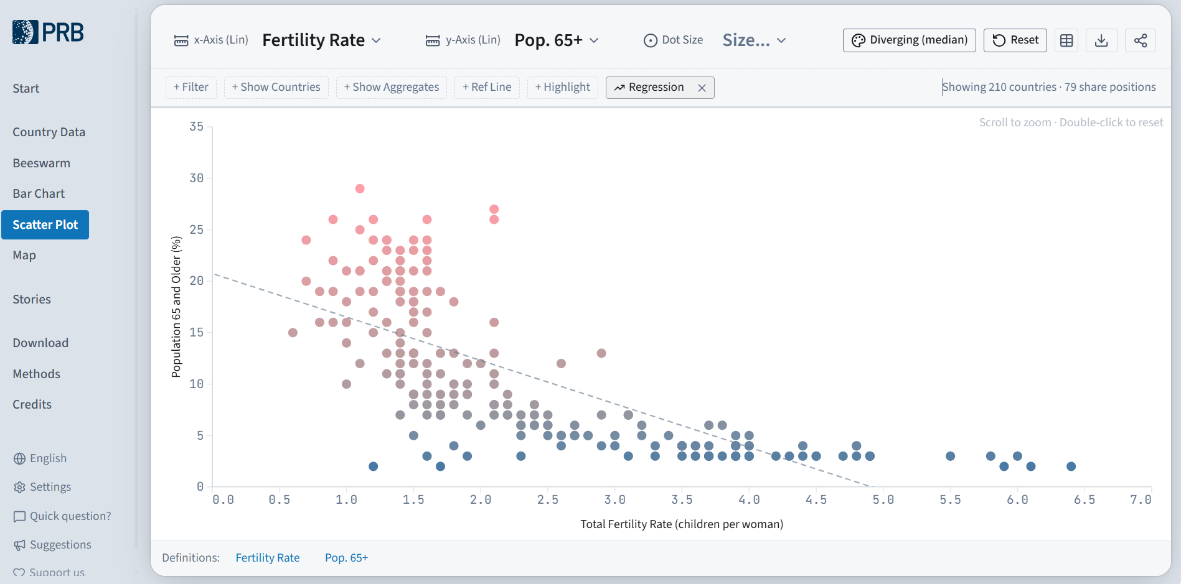
Where fertility is low, populations tend to be older
VIEW 3 · SCATTER PLOT
WHAT IT SHOWS
Percent aged 65+ on the vertical axis, fertility rate on the horizontal. The dashed regression line shows the overall trend.
KEY PATTERN
Every country with fertility above 2.1, the replacement level, has less than 15% aged 65+.
Source: PRB, 2026 World Population Data Sheet.
Notes:
The scatter plot gives us another way to look at the same association we just saw in the bar chart. Here, the total fertility rate runs along the horizontal axis, and the share of the population aged 65 and older runs up the vertical axis.
Each dot is a country. You can change the indicators by clicking the dropdowns listed at the top of the page. And the colors correspond to the value of the indicator you pick for the Y-axis.
The dashed regression line slopes downward, showing us that where fertility is low, populations tend to be older. On the left, among countries with fertility at or below 2.1, the replacement level, we find the oldest populations, with 15 percent or more aged 65 and older. As fertility rises, the share of older people falls. On the far right, the countries with the highest fertility, above six children per woman, have only about 2 to 3 percent of their populations aged 65 and older.
Next, let us turn to the map to see where aging is concentrated.
→ Next slide, please.

Slide 32
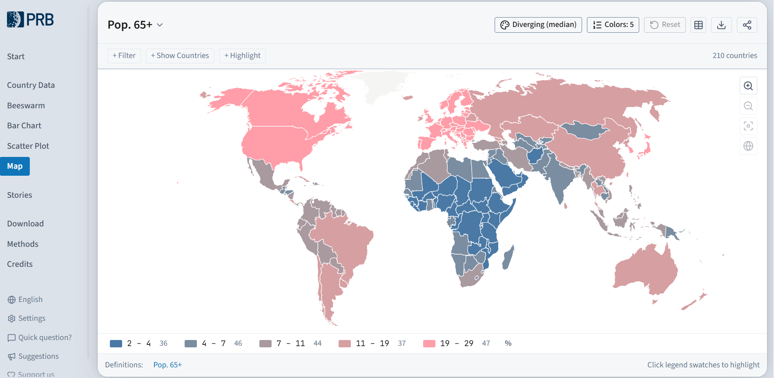
Aging is highest in Europe, North America, and East Asia
VIEW 4 · MAP
19–29%
aged 65+ in 47 countries, across Europe, North America, and parts of East Asia
2–4%
aged 65+ in 36 countries, mostly in sub-Saharan Africa and the Arabian Peninsula
Map view is available on desktop only.
Source: PRB, 2026 World Population Data Sheet.
Notes:
Finally, we can look at the map to show geographic patterns in the data. The map shows where population aging is concentrated. In the highest category, 19 to 29 percent of the population is 65 or older. That category covers 47 countries across Europe, North America, and parts of East Asia.
At the other end, 36 countries have just 2 to 4 percent aged 65 and older, mostly in sub-Saharan Africa and on the Arabian Peninsula. Clicking a category in the legend at the bottom of the page highlights just those countries.
One small note: the map view is available on desktop and laptop computers only.
→ Next slide, please.

Slide 33



Getting started with the Explorer
Data Stories
Step-by-step narratives that walk you through the data, highlighting patterns and context along the way.
Any device
Country profiles and charts work on phones and tablets; the map requires a desktop or laptop.
New indicators to explore
Special focus on gender equality and well-being, with indicators on education, labor force participation, political representation, health and childbearing across more than 200 countries and territories.
Notes:
During this demo, we used four views to answer one question, and each step added a new layer, from the overall spread, to the rankings, to a related indicator, and finally to the geography.
If you would like to explore on your own, there are a few good ways to get started. Each chart type has a short Data Story that walks you through it step by step, so you can repeat this process with any indicator.
The Explorer works on any device. The country profiles, beeswarm, bar charts, and scatter plots all work on phones and tablets, while the map requires a desktop or laptop.
And a good place to begin is this year's new indicators on gender equality and well-being, covering education, labor force participation, political representation, health, and childbearing across more than 200 countries and territories. Next slide, please.

Slide 34
Up next: Q&A
Explore the data: wpds.prb.org/2026
Notes:
Thank you very much for your time and attention. You can explore all of the data at wpds.prb.org/2026. We will now begin our Q&A.

