Slide 1
LESSON PLAN
2022 World Population
Data Sheet
Notes:
PRB’s World Population Data Sheet is an excellent reference and data analysis tool. Teachers are encouraged to have their students use the Data Sheet for a variety of topics and activities. The following series of short activities allows students to access a wealth of data on the world, regions, and individual countries, and develop their data literacy skills and knowledge of geography. Two versions of this lesson plan are available for download: a Word document and a PowerPoint presentation.
These activities may also be used with PRB’s International Data Center (https://www.prb.org/international/), which houses all the data from the most recent World Population Data Sheet except net migration. Data can be accessed and displayed as a map or table and downloaded. PRB’s Population Handbook, 6th edition (2011) is also a valuable resource.

Slide 2
ACTIVITY 1
PRB’s World Population Data Sheet
at a Glance

Slide 3
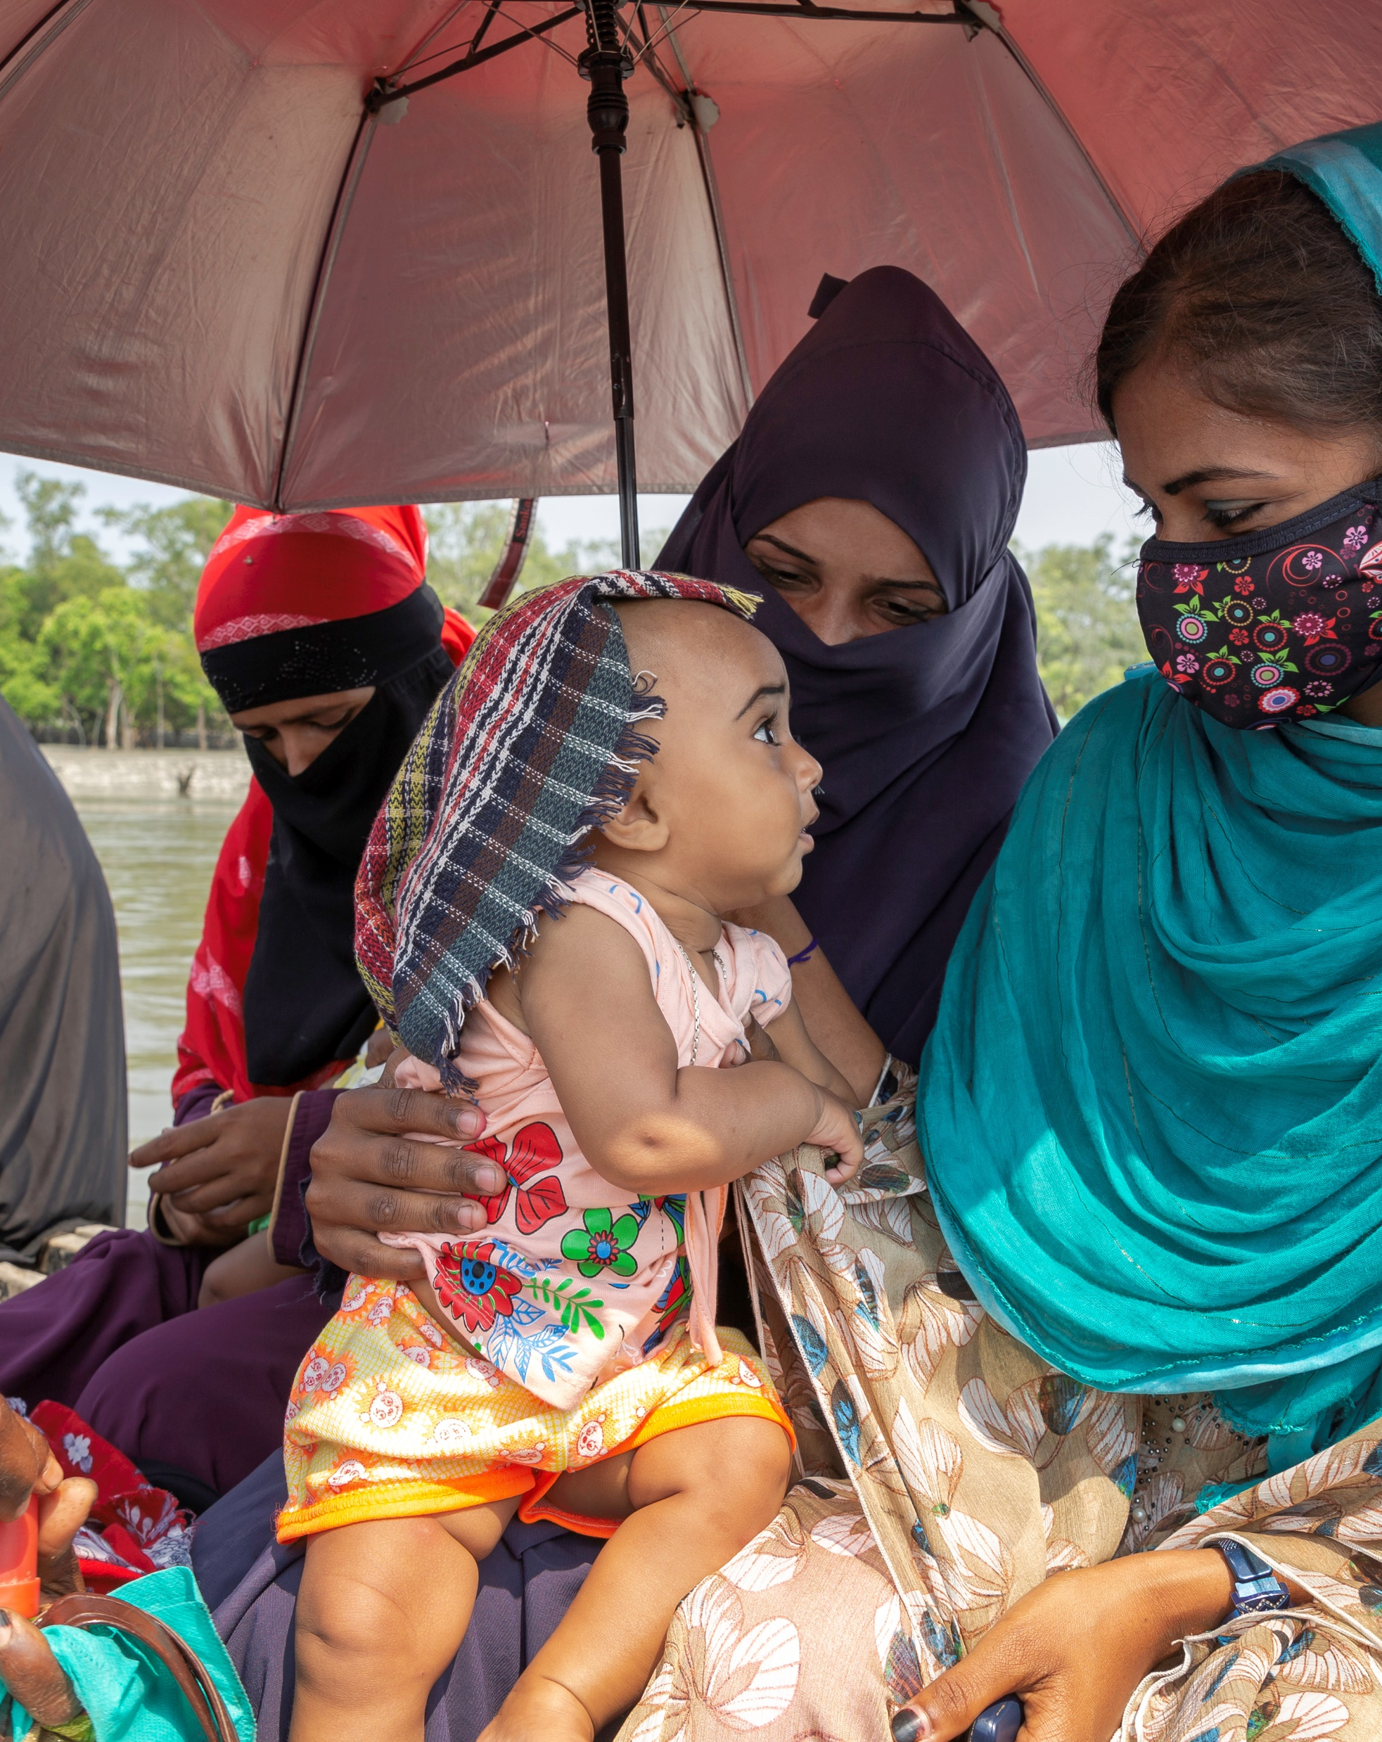
Activity 1.
PRB’s World Population Data Sheet at a Glance
Learning Objectives
Select a country’s population characteristics using PRB’s World Population Data Sheet.
Identify countries that rank highest/lowest in a population indicator.

Slide 4
Activity 1
Find the answers to the following questions using the World Population Data Sheet:
1. What is the population of the world?
2. Rank the 10 countries with the largest populations, from largest to smallest.

Slide 5
Activity 1
3. Rates are often used instead of absolute numbers to tell how frequently a population or demographic event occurs. Rates show how common an event is (often expressed as per 1,000 people).
List the types of information on the World Population Data Sheet that are reported by rate.

Slide 6
Activity 1
4. The death rate is the annual number of deaths per 1,000 people.
Which country (or countries) has the highest death rate, and what is that rate?
Which country (or countries) has the lowest death rate, and what is that rate?

Slide 7
Activity 1
5. The infant mortality rate measures the number of deaths each year to infants under one year of age per 1,000 live births.
Which country (or countries) has the highest infant mortality rate and what is it?
Which country (or countries) has the lowest rate and what is it?

Slide 8
Activity 1
6. The total fertility rate (TFR) is the average number of children women would have if they maintained the current level of childbearing throughout their reproductive years.
Which country (or countries) has the highest TFR and what is it?
Which country (or countries) has the lowest TFR? What is it?

Slide 9
Activity 1
7. Which country (or countries) has the youngest population—that is, the highest share of population under age 15?
Which country (or countries) has the oldest population—the highest share of population ages 65 and older?

Slide 10
Activity 1
8. In which country (or countries) are women expected to live the longest at birth? Where are men expected to live the longest at birth?
Which country (or countries) has the lowest life expectancy for women at birth? Where do men have the lowest life expectancy at birth?

Slide 11
Activity 1
9. Which country (or countries) has the highest share of people living in urban areas in… ?
  Africa
  Asia
  Europe
  Latin America and the Caribbean
  Northern America
  Oceania

Slide 12
Activity 1
10. Gross national income purchasing in power parity per capita (GNI PPP) converts income into “international” dollars and indicates the amount of goods and services one could buy in the United States with a given amount of money.
Which country (or countries) is the wealthiest in terms of GNI PPP? Which is the second wealthiest?

Slide 13
Activity 1
11. A population projection is a computation of future trends in population numbers based on assumptions about future trends in fertility, mortality, and migration.
Which categories on the World Population Data Sheet are shown as projections?

Slide 14
Activity 1
12. Rank the 10 countries with the largest projected populations for both mid-2035 and mid-2050 from largest to smallest.
Which country’s (or countries’) population is projected to drop out of the top 10 by mid-2050? Which will be added to the top 10?
Look back to the rankings for the current year. What are the major shifts in this ranking from now to mid-2050?

Slide 15
Activity 1
13. Rank the regions according to population size from largest to smallest.

Slide 16
Activity 1
14. What share of the world’s people lives in… ?
  Africa
  Asia
  Europe
  Latin America and the Caribbean
  Northern America
  Oceania

Slide 17
Activity 1
14, continued. What are the projected population shares for these regions?
Draw a bar chart showing the regional distributions of the world’s population for this year, mid-2035, and mid-2050.

Slide 18
Activity 1
15. What share of the world’s people live in less-developed countries (LDCs) in the current year? In more-developed countries (MDCs)?
What share is projected to live in LDCs in mid-2035? In mid-2050?
What share is projected to live in MDCs in mid-2035? In mid-2050?

Slide 19
ACTIVITY 2
Profile a Country
Notes:
The purpose of this activity is to introduce students to the demographic indicators listed on the Data Sheet by providing them with a tool to organize population information an about a country. As students study different countries, they can accumulate country profiles in their notebook. Students will need to use the World Population Data Sheet and the Country Profile Worksheet.

Slide 20

Activity 2. Profile a Country
Learning Objectives
Practice organizing a country’s population information into a country profile.
Hypothesize about the data in the country profile.
You will need a Country Profile Worksheet.
This lesson was adapted from a lesson developed by Jane Moriarty of the Michigan Geographic Alliance.

Slide 21
Activity 2
Note: The rate of natural increase is the rate at which a population is increasing (or decreasing) in a given year because of a surplus (or deficit) of births over deaths, expressed as a percentage of the base population.
To calculate the rate, subtract death rates from birth rates, then divide by 10. This rate does not include the effects of immigration or emigration.

Slide 22
Activity 2
1. In the Country Profile Worksheet, complete the profile of the United States.
Define the indicators as they are mapped out on the worksheet.
After completing the country comparison blocks, discuss.

Slide 23
Activity 2
2. Complete a new Country Profile Worksheet for every country you study.
Before you begin: Develop a hypothesis about the country’s population characteristics and use the mapping activity (Activity 3) to test your hypothesis.
Compare each new country’s profile with the profile of the United States.
Notes:
As students learn more about the country, they can add other information from the Data Sheet (or other sources) to their profiles.

Slide 24
ACTIVITY 3
Map the Data

Slide 25
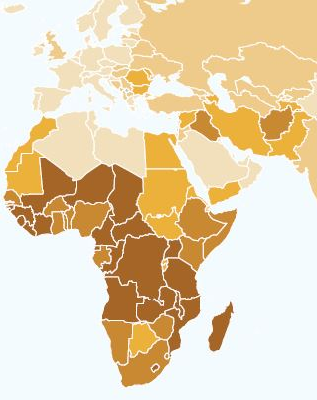
Activity 3. Map the Data
Learning Objectives
Illustrate countries’ selected population characteristics on a map.
Compare the illustrated population characteristics of selected countries.
You will need a Country Outline Map.
This activity was adapted from exercises submitted by Eugene J. Kinerney of the University of the District of Columbia and Basheer K. Nijim of the University of Northern Iowa.
Notes:
Mapping data is often a good method for analysis. Most of the demographic characteristics on the World Population Data Sheet lend themselves to mapping.

Slide 26
Activity 3
Definition: A map that uses color is called a choropleth map. Areas are distinguished from one another using different colors or different shades of the same color based on the values they represent.
Brighter colors or dark shades of the same color indicate greater values. Dimmer colors or lighter shades indicate lesser values.

Slide 27
Activity 3
Resource: PRB’s International Data Center (https://www.prb.org/international) is particularly useful for this activity. It includes all the data from the most recent World Population Data Sheet except net migration.
Data can be displayed in PRB’s Data Center as a map or table and downloaded.

Slide 28
Activity 3
Choose one of the following demographic indicators using the World Population Data Sheet and map the world or regional distribution of that indicator on a world or regional country outline map.
Infant Mortality Rate
Total Fertility Rate
% Population Ages 65+
% Population Under Age 15
GNI per Capita, PPP
Birth Rate
Death Rate
Life Expectancy (Males)
Life Expectancy (Females)

Slide 29
Activity 3, Create a Choropleth Map
Determine the mapping categories by finding the range of values for that indicator.
Identify the number of categories to be used for your map and the interval of each category.

Slide 30
Activity 3, Create a Choropleth Map
For example…
1. After choosing the variable, determine the highest and lowest values for that measure.
2. Subtract these two numbers to calculate the range for the data.

Slide 31
Activity 3, Create a Choropleth Map
3. Divide the range by the number of mapping categories planned for the map. Four to five categories will be adequate for most measures.
The number produced by the division will indicate how many numbers to include in each category.

Slide 32
Activity 3, Create a Choropleth Map
4. Always construct categories so that the numbers in one category do not overlap with those in adjacent categories.
5. Arrange a color code or shading pattern for each category. Colors or patterns should increase from light to dark, from lowest to highest category.

Slide 33
Activity 3, Create a Choropleth Map
6. Determine the proper mapping category for each country and color or shade the country on an outline map.
  Title the map.
  Place a legend on the page.
  Indicate the source.

Slide 34
Activity 3, Interpret the Map
After the map has been drawn, interpret it using the following as a guide:
    Describe the patterns observed on the map.
    What accounts for the variation?
    Discuss the factors that could lead to the range of outcomes within this distribution.

Slide 35
Activity 3, Draw Another Map
Draw another map to examine the relationships that may exist between two variables or compare results with another student who has mapped a different variable.
Possible pairs of variables to compare include:
Infant Mortality Rate and Life Expectancy (Males or Females)
Infant Mortality Rate and GNI per Capita, PPP
Death Rate and Percent of Population Under Age 15
Birth Rate and Percent of Population Ages 65 and Older

Slide 36
Activity 3, Engage With the Data
1. Does there appear to be a relationship between the two variables mapped?
If so, is the relationship positive or negative? For example, are the countries with the highest rates of one variable the same countries with the highest rates of the other variable? If yes, the relationship is positive. If not, the relationship is negative.

Slide 37
Activity 3, Engage With the Data
2. Discuss whether the factors that contribute to the patterns in one variable affect the patterns in another variable.

Slide 38
www.prb.org/worldpopdata/
Communications@prb.org

