Slide 1
Population and Economic Development 2012 Data Sheet

Slide 2
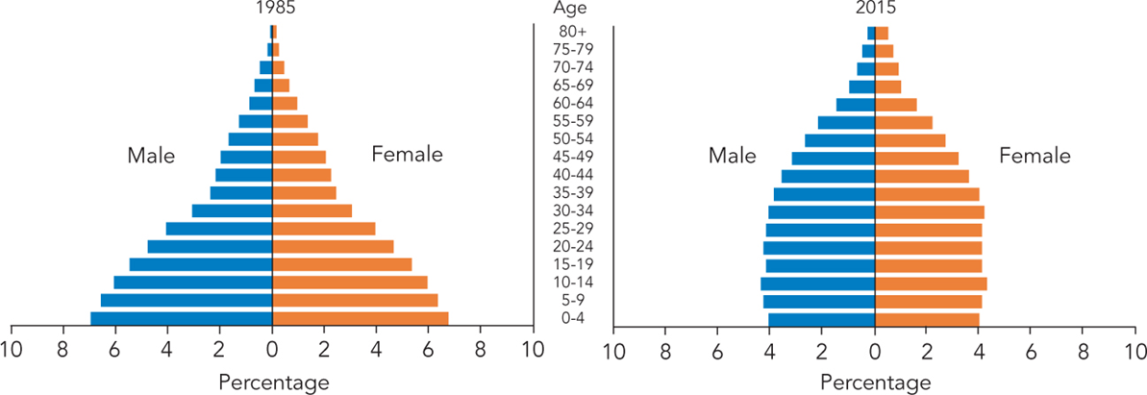
Population of Indonesia, by Age and Sex, 1985 and 2015
Source: United Nations Population Division, World Population Prospects: The 2010 Revision (2011).
Notes:
Population of Indonesia and Honduras, by Age and Sex
The challenges and opportunities a country faces in supporting its population in the short and long term are defined by its age and sex structure. Understanding the implications of changing age structures is essential in assessing a country’s economic potential. When there are more people concentrated in the working-age group (generally ages 15 to 64) relative to the rest of the population, a “demographic dividend” can begin to occur. This period of economic growth and productivity can last for several decades, but also requires a healthy, educated population with means of employment.
Indonesia
Indonesia’s fertility transition from high to low birth rates has shifted the population distribution away from a concentration in the youngest age groups, allowing the country to reap the benefits of a burgeoning working-age population and falling child dependency ratio. Fewer resources will need to be allocated to youth dependents, and a larger working-age group increases overall productivity and encourages economic growth.

Slide 3
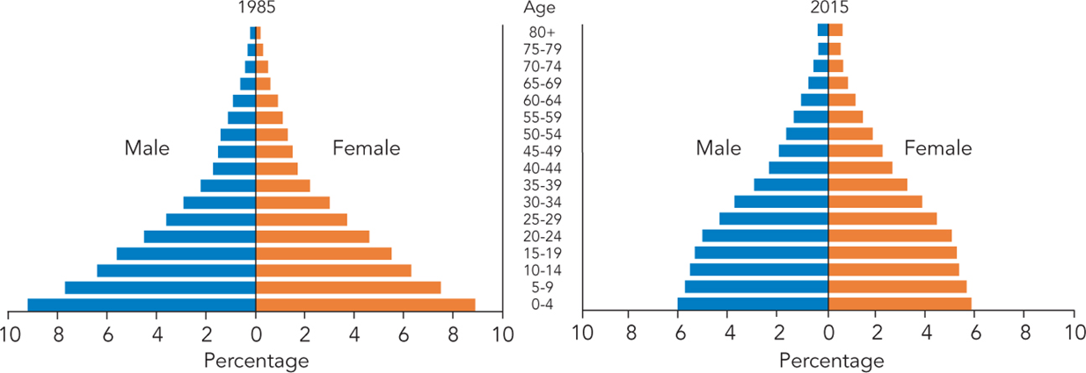
Population of Honduras, by Age and Sex, 1985 and 2015
Source: United Nations Population Division, World Population Prospects: The 2010 Revision (2011).
Notes:
In Honduras, the more recent transition from high to lower fertility is now beginning to show its effects on the age structure. With a relatively youthful population, a sustained decline in fertility will be necessary to reach a potential period of demographic dividend.

Slide 4
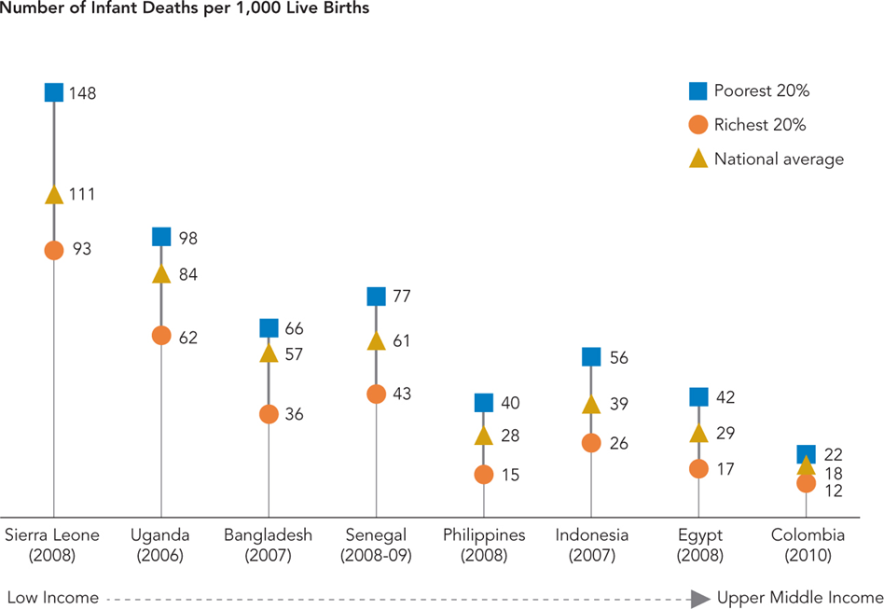
Infant Mortality Rate by Wealth
Note: Country order reflects income level based on GDP per capita.
Sources: ICF Macro, Demographic and Health Surveys; and World Bank, World Development Indicators Database
Notes:
Child health and survival generally reflects a country’s level of economic development. In poorer countries, infant mortality tends to be higher. Within countries, the health risks to infants are worse in poorer households. Poorer families tend to have more children, and those children are less likely to receive preventive health care and treatment, resulting in a health gap. Improving overall income levels, reducing income inequality within countries, and increasing access to maternal and child health services, especially by targeting poorer households, can contribute to the improvement of child health and survival.

Slide 5
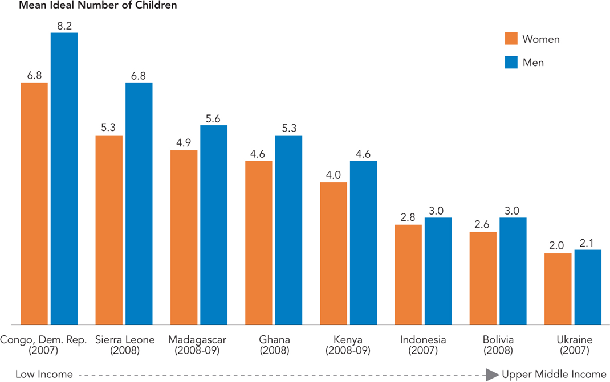
Ideal Number of Children Among Men and Women
Note: Country order reflects income level based on GDP per capita.
Sources: ICF Macro, Demographic and Health Surveys; and World Bank, World Development Indicators Database
Notes:
A couple’s fertility preferences depend on various cultural and socioeconomic factors, resource constraints, and individual desires, all of which also vary with age and the current number of children in the family. In addition, men and women also have different opinions regarding ideal family size. In most countries, men tend to desire more children than women, although couples in wealthy countries and in countries where total fertility is low more often have similar fertility preferences. Reproductive health policies must reach out appropriately to both men and women when promoting family planning programs and healthy birth spacing.

Slide 6
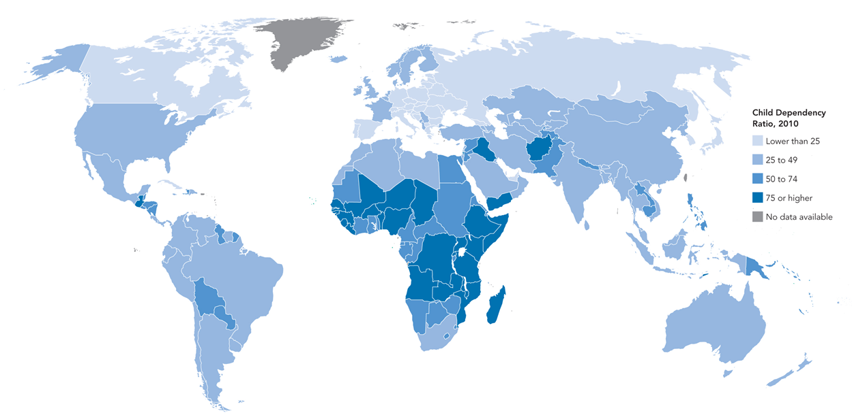
Child Dependency Ratio
Source: United Nations Population Division, World Population Prospects: The 2010 Revision (2011).
Notes:
As fertility declines, the child dependency ratio, or the number of children under age 15 per 100 working-age adults (typically defined as ages 15-64), also declines. A large workforce with fewer child dependents creates a window of economic opportunity to increase savings on health care and other social services, improve the quality of education per child, increase output and productivity, and create the wealth needed to cope with the future aging of the population. This window of opportunity is often referred to as the “demographic dividend.” The demographic dividend eventually diminishes when the workforce ages and relatively fewer workers have to support increasing numbers of older people. But the period of potential growth and productivity can last for several decades.
Child dependency ratios vary substantially across countries, reflecting different trends in fertility in the recent past. Even many of the countries with high child dependency ratios today are projected to see them decline in the coming decades. The degree to which countries are ready to take advantage when such a window of opportunity opens will have a great impact on their future economic growth.

Slide 7
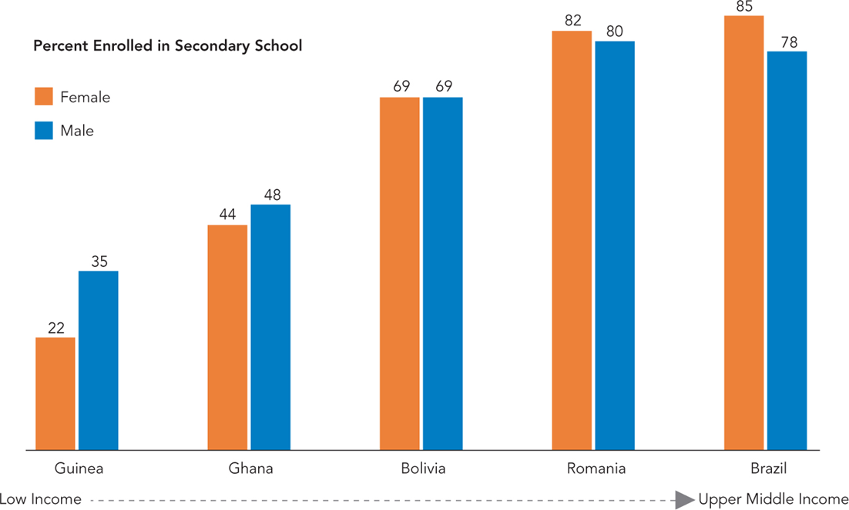
Net Secondary School Enrollment by Gender, 2009
Note: Country order reflects income level based on GDP per capita.
Source: UNESCO Institute for Statistics Database.
Notes:
Although gender disparities in primary and secondary school enrollments have begun to narrow in some low- and middle-income countries, the overall enrollment rates for both boys and girls remain generally low. Developing nations face numerous challenges to achieving universal primary and secondary education, such as poor student attendance and retention rates, high teacher absenteeism, and a lack of educational resources in schools. Moreover, the value of education is often overlooked in low-income countries—for example, children may be needed to work in agriculture or contribute to household chores. In such societies, the short-term and long-term benefits of higher education, especially for girls, may not be appreciated or well understood. As income levels rise, so do secondary school enrollments. In the upper-middle-income level, girls’ enrollment often catches up to and even exceeds that of boys. More and better education, particularly of girls, can help lower fertility by delaying marriage and childbearing, can increase productivity of the labor force, and can reduce poverty—all contributing to a country’s economic development.

Slide 8
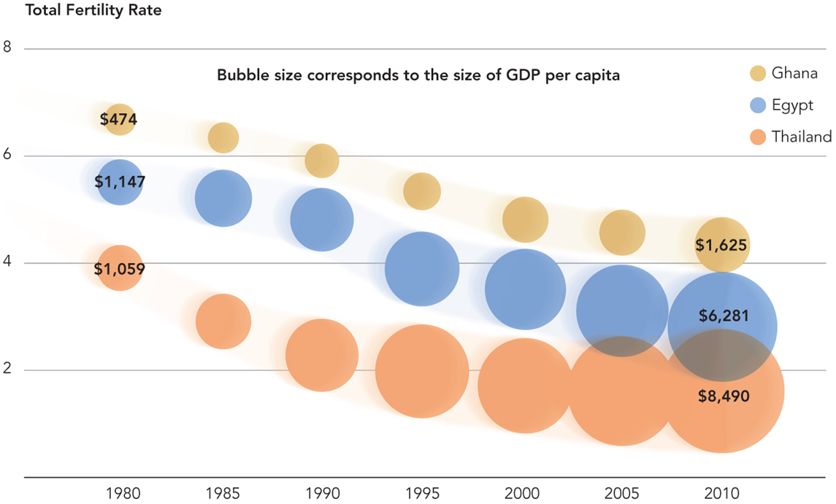
GDP per Capita and Total Fertility Rates
Sources: United Nations Population Division, World Population Prospects: The 2010 Revision (2011); and World Bank, World Development Indicators Database.
Notes:
While the link between fertility and economic development is complex, slower population growth tends to provide the potential for increased economic growth. Several Asian countries, including Thailand and Indonesia, moved from low-income status to middle-income status within a generation’s time. A drop in the fertility rate was one of the key factors.
Modern economies depend on smaller, highly productive labor forces rather than on a large number of unskilled workers. Declining fertility implies that more resources can be allocated to improving the quality of the labor force through increased educational and health expenditures per worker. Lower fertility also allows for higher levels of savings and investment, which drive the development of the economy.

