Slide 1

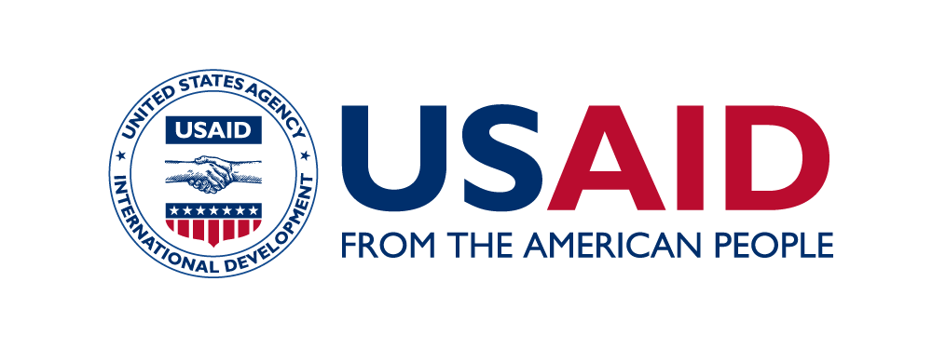

Engaging Boys and Men in Contraceptive Use and Family Planning
Photo © Jake Lyell/Alamy Stock Photo

Slide 2
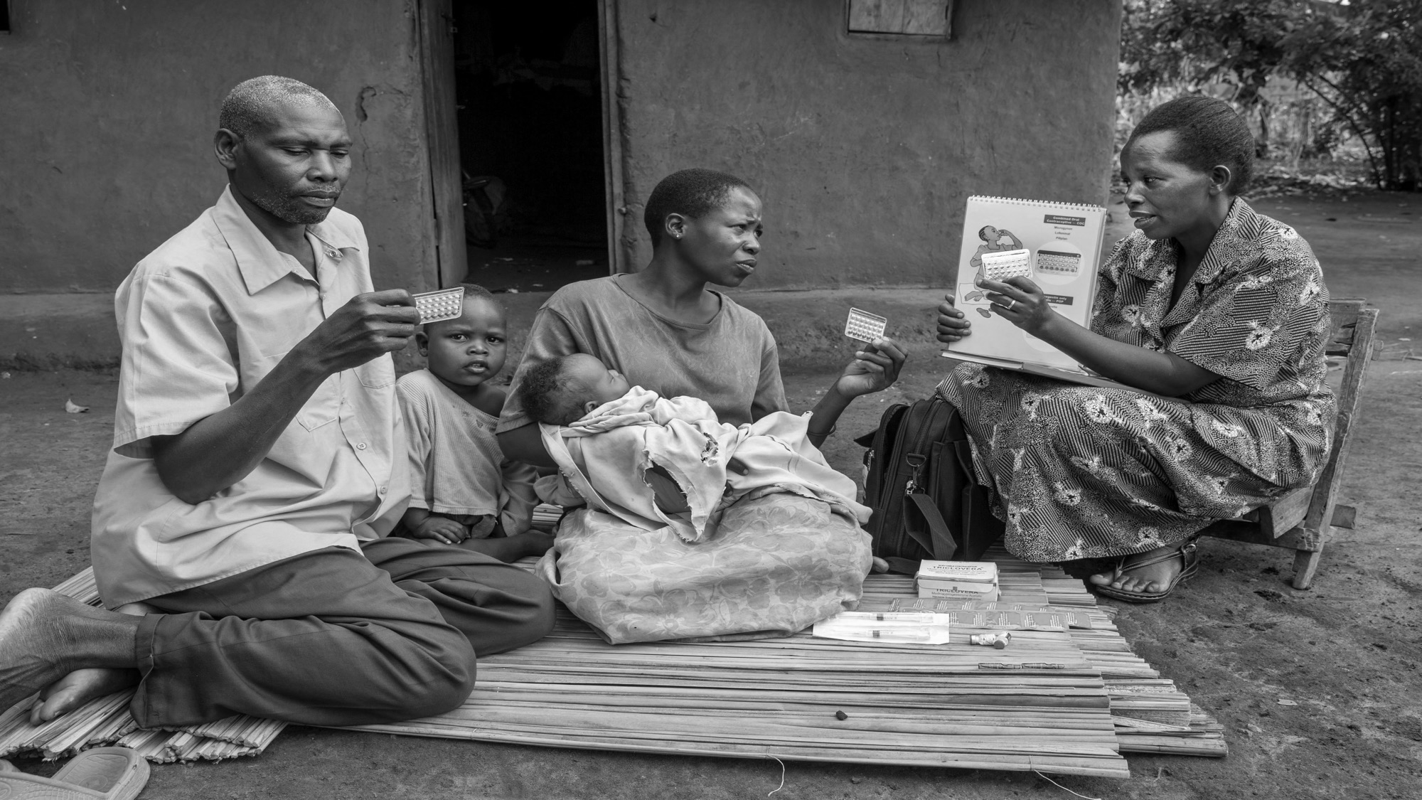
Men have an important
role to play in family planning
and contraceptive use.
Photo © Jonathan Torgovnik/Reportage by Getty Images
Notes:
International agreements have long recognized the positive role that men can play in family planning and reproductive health. Declarations, such as the Programme of Action adopted at the 1994 International Conference on Population and Development, called for increased engagement of men to share the responsibility for family planning and reproductive health with women.
In many countries, men have dominated household decisionmaking around family size, contraception, and access to or use of health services. This has furthered harmful gender inequities and left women unable to make family planning decisions or access services without their male partners’ permission or financial support. Engaging men as supportive partners can lead to improvements in couple decisionmaking and better health outcomes for men, women, and their families.
Source:
United Nations, “Framework of Actions for the Follow-Up to the Programme of Action of the International Conference on Population and Development Beyond 2014 Report of the Secretary-General,” (2014), accessed at www.unfpa.org/sites/default/files/pub-pdf/ICPD_beyond2014_EN.pdf.
Rebecka Lundgren et al., “Engaging Men in Family Planning Services Delivery: Experiences Introducing the Standard Days Method in Four Countries,” World Health & Population 14, no. 1 (2012): 44-51.

Slide 3

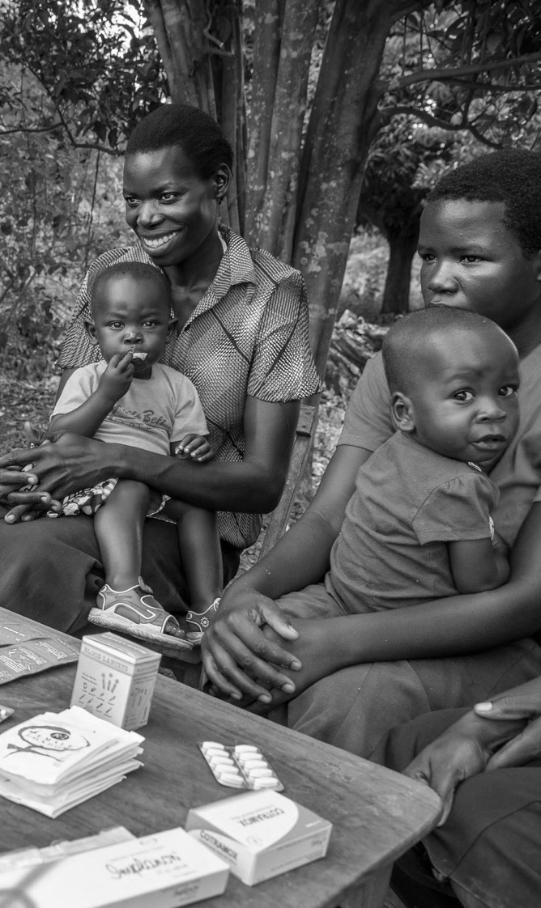

More couples prefer smaller families.
More men agree that contraception is a shared responsibility of both men and women.
Women make up
the majority of contraceptive users.
Photo © KidStock/MNPhotoStudiosImages
Photo © Jonathan Torgovnik/Reportage by Getty Images
Photo © Jonathan Torgovnik/Reportage by Getty Images
Notes:
Demographic Health Surveys (DHS) reveal that the number of young women and couples that prefer smaller families is increasing, and more married women in developing countries want to stop child-bearing. Yet, despite a shared preference for smaller families by both men and women, women still make up the majority of contraceptive users. We are missing a significant opportunity for potential work and impact by ignoring men as contraceptive users and supportive partners.
Meeting the Family Planning 2020 target and the Sustainable Development Goals will be challenging without the active participation of men.
Source:
Karen Hardee, Melanie Croce-Galis, and Jill Gay, “Men as Contraceptive Users: Programs, Outcomes, and Recommendations,” Working Paper (2016), accessed at http://evidenceproject.popcouncil.org/wp-content/uploads/2016/09/Men-as-FP-Users_September-2016.pdf.
Charles F. Westoff, “Desired Number of Children: 2000-2008,” (2010), accessed at https://dhsprogram.com/pubs/pdf/CR25/CR25.pdf.
United Nations, Department of Economic and Social Affairs, Population Division, “Trends in Contraceptive Use Worldwide 2015,” (2015), accessed at www.un.org/en/development/desa/population/publications/pdf/family/trendsContraceptiveUse2015Report.pdf.

Slide 4
In some countries, men and women show a growing
preference for smaller families.
GHANA
MALAWI
TANZANIA
Average ideal number of children among married women
Average ideal number of children among married men
Source: Charles F. Westoff, 2010.
Notes:
A review of DHS surveys conducted in 60 countries between 1998 and 2008 showed that the number of children desired by both men and women has declined in most of the developing world with the exception of some countries in western and middle sub-Saharan Africa.
Source:
Charles F. Westoff, “Desired Number of Children: 2000-2008,” (2010), accessed at https://dhsprogram.com/pubs/pdf/CR25/CR25.pdf.

Slide 5
A majority of men in 26 DHS countries in sub-Saharan Africa agree that contraception is a shared responsibility of both men and women.
Source: Kristin Bietsch, 2015.
Notes:
Most men surveyed in 26 countries across sub-Saharan Africa between 2005 and 2011 agreed that contraception is the responsibility of both the man and the woman.
Source: Kristin Bietsch, “Men’s Attitudes Towards Contraception in sub-Saharan Africa,” African Journal of Reproductive Health 19, no. 3 (2015): 41-54.

Slide 6
Why involve men? Studies show that men can be the stepping stone to couple contraceptive use and gender norm transformation.
5x
In Nigeria, men who support contraception are five times more likely to have spouses who desire to use contraception.
Programs involving men can enhance spousal communication and improve gender equitable attitudes.
Sources: Echezona E. Ezeanolue et al., 2015; Melanie Croce-Galis, et al. 2014.
Notes:
Why involve men? When men know about and support family planning, it can influence their spouses’ desire to use contraception and improve their ability to communicate with their partners.
A study in Nigeria revealed that when men support the use of contraception, their spouses are five times more likely to want to use a family planning method. Other studies show that interventions that engage men can improve communication and shared decisionmaking between couples.
Source:
Melanie Croce-Galis, Elizabeth Salazar, Rebecka Lundgren, “Male Engagement in Family Planning: Reducing Unmet Need for Family Planning by Addressing Gender Norms,” (2014), accessed at http://irh.org/wp-content/uploads/2014/10/Male_Engagement_in_FP_Brief_10.10.14.pdf.
Echezona E. Ezeanolue et al., “Impact of male partner’s awareness and support for contraceptives on female intent to use contraceptives in southeast Nigeria,” (2015), accessed at https://bmcpublichealth.biomedcentral.com/articles/10.1186/s12889-015-2216-1.

Slide 7
Men’s use of contraception is low.
Global contraceptive
prevalence, 2015 (as reported by married women
ages 15-49)
Source: United Nations, Department of Economic and Social Affairs, Population Division, 2015
Notes:
Currently, men’s use of contraception is low compared to women’s use of contraception.
Male-controlled methods—methods that men use themselves such as vasectomy, male condoms, and withdrawal—made up only 21 percent of all contraceptive use worldwide in 2015. And in least-developed countries, use of male-controlled and cooperative methods is much lower.
Source:
United Nations, Department of Economic and Social Affairs, Population Division, “Trends in Contraceptive Use Worldwide 2015,” (2015), accessed at www.un.org/en/development/desa/population/publications/pdf/family/trendsContraceptiveUse2015Report.pdf.

Slide 8
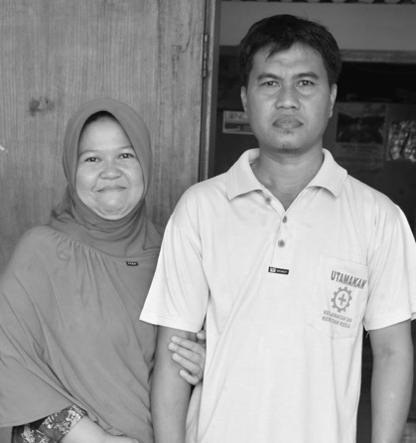
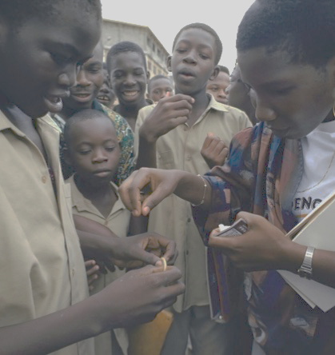
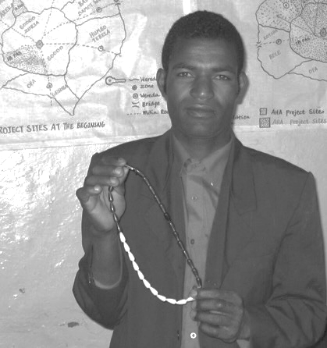
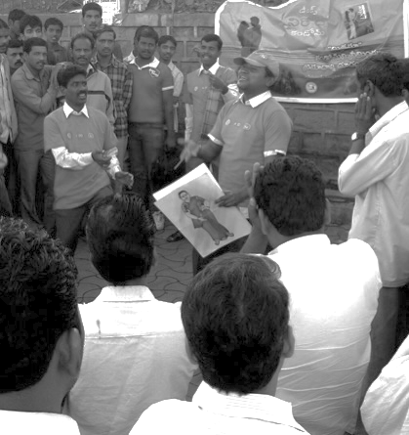
Men can choose among four male-controlled and cooperative methods.
Withdrawal
Global prevalence: 3%
Male Condoms
Global prevalence: 8%
Standard Days Method
Global prevalence: 0.6%
Male Sterilization/
Vasectomy
Global prevalence: 2.4%
Photo credits, left to right: © 2016 Radha Rajan, Courtesy of Photoshare; © Karen Kasmauski; © Mengistu Asnake (Courtesy of Photoshare); © Lindsey Leslie (Courtesy of Photoshare)
Source: United Nations, Department of Economic and Social Affairs, Population Division, 2015
Notes:
Here we focus on four specific male-controlled and cooperative methods:
The first method is the withdrawal method. Withdrawal is NOT a modern method of contraception. It is a male-controlled traditional contraceptive method and is the second most common method used by men. Three percent of all married women of reproductive age reported using withdrawal with their partner, while in least-developed countries, only 1.4 percent of married women reported using this method with their partner.
The male condom is a male-controlled contraceptive method and is the most common method used by men. Globally, about 8 percent of married women of reproductive age reported using a male condom with their partner. But use of condoms by married women in least-developed countries is much lower at 2 percent.
The Standard Days Method is a cooperative modern contraceptive method, which is a method that requires the participation of both partners. It uses beads to track a woman’s fertile days. At the moment it is not widely used, but in countries where it is measured, less than 1 percent (0.6 percent) of married women reported using this method.
Male sterilization or vasectomy is the MOST EFFECTIVE yet least used male-controlled contraceptive method. Globally, 2.4 percent of married women report relying on their partner’s vasectomy for family planning. In least-developed countries, however, use of vasectomy as reported by women is much lower at less than 0.4 percent.
Source:
United Nations, Department of Economic and Social Affairs, Population Division, “Trends in Contraceptive Use Worldwide 2015,” (2015), accessed at http://www.un.org/en/development/desa/population/publications/pdf/family/trendsContraceptiveUse2015Report.pdf.
Kerry MacQuarrie et al., “Men and Contraception: Trends in Attitudes and Use,” (2015), accessed at https://dhsprogram.com/pubs/pdf/AS49/AS49.pdf.
Georgetown University, “CycleBeads Plan and Prevent Pregnancy Naturally,” (2016), accessed at https://www.cyclebeads.com/cyclebeads.

Slide 9
KNOWLEDGE,
FERTILITY PREFERENCE,
& ATTITUDES
Notes:
A 2015 DHS study of 18 countries in Africa, Asia, and Latin America and the Caribbean reveals that men's knowledge of and attitudes toward contraceptive use and family planning has changed over time.

Slide 10

Men’s knowledge of contraceptive methods has increased in a number of countries.
Source: Kerry MacQuarrie et al., 2015; ICF International, 2015
Photo © Julien Harnels
Notes:
Of the 18 DHS countries, 16 had data on men’s knowledge of contraceptive methods from at least two survey rounds. The DHS surveys indicated a pattern of increased knowledge of contraceptive methods over time. Here we see that knowledge of contraceptive methods among men in Rwanda increased from about seven methods in 1992 to about 11 methods in 2015. In Tanzania, men’s knowledge of contraceptive methods doubled from four methods in 1992 to more than eight methods in 2016. Knowledge of contraceptive methods among men in Ethiopia also increased from about four methods in 2000 to about seven methods in 2016.
Source:
Kerry MacQuarrie et al., “Men and Contraception: Trends in Attitudes and Use,” (2015), accessed at https://dhsprogram.com/pubs/pdf/AS49/AS49.pdf.
ICF International, STATcompiler, (2015), accessed at www.statcompiler.com.

Slide 11

Men ages 35-45 have the most knowledge of contraceptive methods.
Source: Kerry MacQuarrie et al., 2015
Photo © Astalor
Notes:
Moreover, men’s age and education level is associated with their knowledge of contraceptive methods. For instance, older men know more contraceptive methods compared to younger men, many of whom are not yet married.
Source:
Kerry MacQuarrie et al., “Men and Contraception: Trends in Attitudes and Use,” (2015), accessed at https://dhsprogram.com/pubs/pdf/AS49/AS49.pdf.
Image: Photoshare: 48560-8

Slide 12



RWANDA
9
11
Men with
Primary Education
reported knowing
9 contraceptive methods.
Men with
Higher Education
reported knowing
11 contraceptive methods.
CAMEROON
Men with
Higher Education
reported knowing about
7 more contraceptive methods
than men with no education.
+7
Source: Kerry MacQuarrie et al., 2015
Photo © 2012 Kim Burns Case/JHUCCP, Courtesy of Photoshare
Notes:
…and data gathered from surveys in Rwanda showed that men with primary education knew about nine contraceptive methods, while men with higher education knew about 11 methods. Cameroon shows a similar pattern with men with higher education knowing seven additional methods than men with no education.
Source:
Kerry MacQuarrie et al., “Men and Contraception: Trends in Attitudes and Use,” (2015), accessed at https://dhsprogram.com/pubs/pdf/AS49/AS49.pdf.
Image Photoshare, rwanda man 8091-28.jpg

Slide 13

Which men prefer smaller families?
Better educated
Monogamous
Wealthier
Urban dwellers
Source: Kerry MacQuarrie et al., 2015.
Notes:
The 2015 DHS study revealed that men who are better-educated, have more wealth, are monogamous, or live in urban areas prefer smaller families. For example, the 2011 DHS survey in Cameroon showed that men with no education reported wanting about 12 children, while men with higher education reported wanting about five children. Other DHS surveys also indicate that men in rural areas tend to want one to three more children than men in urban areas.
Source:
Kerry MacQuarrie et al., “Men and Contraception: Trends in Attitudes and Use,” (2015), accessed at https://dhsprogram.com/pubs/pdf/AS49/AS49.pdf.

Slide 14
A significant proportion of men in 28 DHS countries in sub-Saharan Africa approve of using contraception to avoid pregnancy.
Source: Kristin Bietsch, 2015.
Notes:
Another review of DHS surveys conducted between 1996 and 2006 found that a significant proportion of men in sub-Saharan Africa approve of using contraception to avoid a pregnancy.
Source:
Kristin Bietsch, “Men’s Attitudes Towards Contraception in sub-Saharan Africa,” African Journal of Reproductive Health 19, no. 3 (2015): 41-54.

Slide 15
BARRIERS &
CHALLENGES
Notes:
Yet despite a growing preference for smaller families and increased recognition that contraception is a shared responsibility between men and women, men’s use of contraception remains low due to multiple barriers and challenges that keep them from accessing and receiving the reproductive health information and care they need.

Slide 16
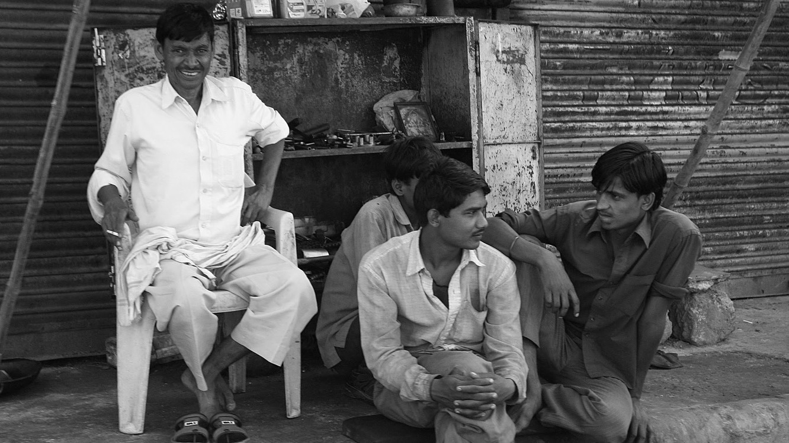
Inequitable gender norms perpetuate stereotypes that exclude men’s role in sexual
and reproductive health.
Photo © carol mitchell
Notes:
Many factors contribute to men’s and boys’ lack of involvement in family planning and contraceptive use. Inequitable gender norms, such as equating “being a man” with toughness and sexual risk-taking, and associating contraceptive use and child care as a woman’s responsibility, can negatively influence men’s attitude toward sexual and reproductive health and discourage them from accessing health services, including family planning.
Source:
Jerker Edstrom et al., “Engendering Men: A Collaborative Review of Evidence on Men and Boys Social Change and Gender Equality,” (2015) accessed at www.promundoglobal.org/resources/engendering-men-summary-of-evidence-review/.
Dean Peacock et al., “Men, HIV/AIDS, and Human Rights,” (2009), accessed at www.ncbi.nlm.nih.gov/pmc/articles/PMC2853958/pdf/nihms173256.pdf.
Erin Stern et al., “Lessons Learned From Engaging Men in Sexual and Reproductive Health as Clients, Partners, and Advocates for Change in the Hoima District of Uganda,” Culture, Health, & Sexuality 17, sup2 (2015): 190-205.

Slide 17
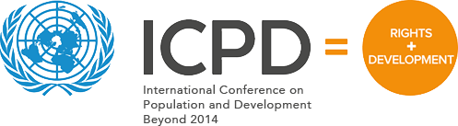
Few governments commit to engaging men and addressing gender norms.
As of 2014, only 22 percent of governments prioritized gender norms and male engagement.
22%
Notes:
National policies and guidelines do not effectively engage men in supporting their partners to use contraceptives nor do they promote men’s use of male methods.
In fact, a review that evaluated the 179 countries that signed onto the 1994 ICPD Programme of Action, a document that recognized that reproductive health and rights and gender equality are cornerstones of population and development, found that only 22 percent of governments prioritized gender norms and male engagement.
An analysis of Family Planning Costed Implementation Plans from Ghana, Malawi, Uganda, Senegal, and Tanzania revealed that most programming for men focused on increasing men’s support for their partners’ use of contraception, but gave little attention to increasing men’s own use of contraception.
On the other hand, some countries have successfully integrated policies regarding men’s involvement in sexual and reproductive health. For example, in 2003 Cambodia integrated guidelines on reaching men as family planning users and supportive partners into its 2006–2010 National Strategic Framework for Reproductive and Sexual Health in Cambodia.
Source:
Karen Hardee, Melanie Croce-Galis, and Jill Gay, “Are Men Well Served by Family Planning Programs?” (2017), accessed at www.reproductive-health-journal.biomedcentral.com/articles/10.1186/s12978-017-0278-5.
United Nations, “Framework of Actions for the Follow-Up to the Programme of Action of the International Conference on Population and Development Beyond 2014 Report of the Secretary-General,” (2014), accessed at www.unfpa.org/sites/default/files/pub-pdf/ICPD_beyond2014_EN.pdf.
Jane Kato-Wallace et al., “Adolescent Boys and Young Men: Engaging Them as Supporters of Gender Equality and Health and Understanding of Their Vulnerabilities,” (2016), accessed at https://www.unfpa.org/sites/default/files/pub-pdf/Adolescent_Boys_and_Young_Men-SINGLE_PAGES-web.pdf

Slide 18
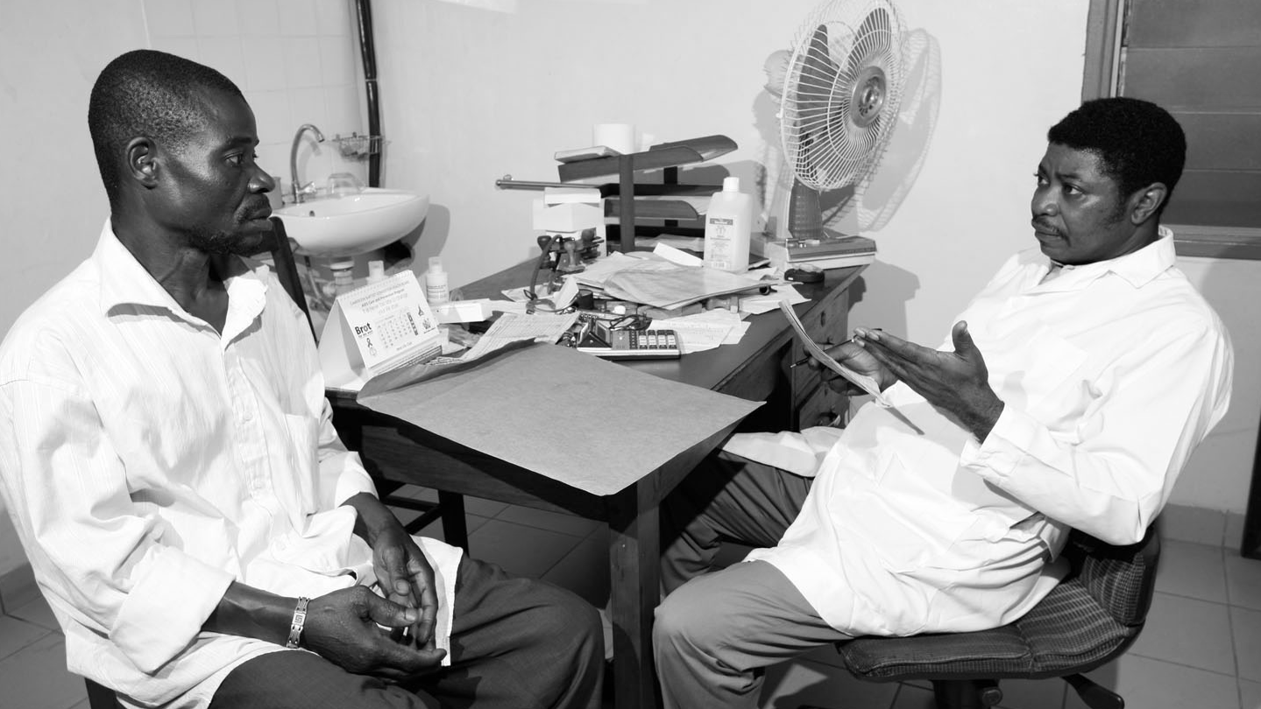
Men face many challenges
accessing reproductive health services.
Photo © imageBROKER / Alamy Stock Photo
Notes:
Health programs, services, and infrastructure are generally geared towards women and often prevent men and boys from accessing family planning and reproductive health information and services.
Clients depend on health providers for accurate information and guidance on the appropriate contraceptive method to use. Yet health providers carry biases that may influence the care and family planning methods they offer men and couples.
Sources:
Dominick Shattuck et al., “A Review of 10 Years of Vasectomy Programming and Research in Low-Resource Settings,” (2016), accessed at www.ghspjournal.org/content/4/4/647.full.
Peter Ndidi Ebeigbe, Gabriel Oseremen Igberase, and J. Eigbefoh, “Vasectomy: A Survey of Attitudes, Counseling Patterns, and Acceptance Among Nigerian Resident Gynaecologists,” (2011), accessed at www.ncbi.nlm.nih.gov/pmc/articles/PMC3266141/.
Ademola Adelekan, Philomena Omoregie, and Elizabeth Edoni, “Male Involvement in Family Planning: Challenges and Way Forward,” (2014), accessed at https://www.hindawi.com/journals/ijpr/2014/416457/.

Slide 19

    Provider bias: 4 in 5 doctors in Nigeria believe men will not accept vasectomy as a contraceptive method.
Source: Peter Ndidi Ebeigbe et al., 2011.
Notes:
A 2011 study of 104 physicians in Nigeria found that four in five doctors are convinced that Nigerian men will not accept vasectomy.
Source:
Peter Ndidi Ebeigbe, Gabriel Oseremen Igberase, and J. Eigbefoh, “Vasectomy: A Survey of Attitudes, Counseling Patterns, and Acceptance Among Nigerian Resident Gynaecologists,” (2011), accessed at www.ncbi.nlm.nih.gov/pmc/articles/PMC3266141/.

Slide 20
    Provider bias: 3 in 5 doctors believe that female sterilization is a more “appropriate” permanent method of contraception.
Source: Peter Ndidi Ebeigbe et al., 2011.
Notes:
…and three in five doctors believe that female sterilization is a more “appropriate” permanent method of contraception in Nigeria. When asked why they opposed vasectomy, they cited sociocultural (21%), religious (13%), psychological (41%) reasons, and 25% had no specific reason.
Source:
Peter Ndidi Ebeigbe, Gabriel Oseremen Igberase, and J. Eigbefoh, “Vasectomy: A Survey of Attitudes, Counseling Patterns, and Acceptance Among Nigerian Resident Gynaecologists,” (2011), accessed at www.ncbi.nlm.nih.gov/pmc/articles/PMC3266141/.

Slide 21
  Health clinics often fail to meet men’s needs:
  9 in 10 men feel that family planning services are not male-friendly.
Source: Ademola Adelekan et al, 2014
Notes:
Men often complain that most reproductive health programs fail to address their needs as contraceptive users or supportive family planning partners.
A study of men ages 18-50 in Nigeria found that nine in 10 feel that family planning services are not male-friendly. When asked about what makes services not friendly or welcoming of men, they mentioned a lack of knowledge among health workers to provide quality family planning and contraceptive methods to men, clinic services and programs that predominantly cater to the family planning and contraceptive needs of women, and negative attitudes among health workers toward male clients.
Source:
Ademola Adelekan, Philomena Omoregie, and Elizabeth Edoni, “Male Involvement in Family Planning: Challenges and Way Forward,” (2014), accessed at www.hindawi.com/journals/ijpr/2014/416457/.

Slide 22
ADOLESCENTS
Notes:
Adolescents, including adolescent boys, face additional challenges when accessing reproductive health information and services.

Slide 23

  “If you come for condoms every day at the health unit, the health worker gets scared that you are having too much sex and can tell your parent. Youth are shy and fear to be reported to their parents.”
  - Unmarried young male, age 15-19, Uganda
Photo © peeterv
Notes:
In Kenya, Laos, and Zambia for example, almost half of providers surveyed were unwilling to provide any contraceptives to adolescents. And even when providers are willing to give adolescents contraceptives, providers may be poorly trained in delivering sexual and reproductive health services in general, especially to adolescents. Adolescents in Uganda reported that judgmental views from contraceptive service providers and the lack of privacy and confidentiality in health clinics, deter them from seeking contraceptive services and using contraceptive methods.
Source:
Allison Glinski et al., “Understanding the Adolescent Family Planning Evidence Base,” (2014), accessed at www.icrw.org/wp-content/uploads/2016/10/FINAL-Understanding-the-Adolescent-Family-Planning-Evidence-Base-7.30.pdf.
Gorrette Nalwadda et al., “Persistent High Fertility in Uganda: Young People Recount Obstacles and Enabling Factors to Use of Contraceptives,” (2010), accessed at www.ncbi.nlm.nih.gov/pmc/articles/PMC2940919/pdf/1471-2458-10-530.pdf.

Slide 24
Young boys say they are often too embarrassed or shy to access sexual and reproductive health services.
Percentage of young boys that feel afraid, embarrassed or shy
    Burkina Faso
    40%
    Ghana
    59%
    Malawi
    38%
    Uganda
    44%
Source: Ann E. Biddlecom et al., 2007.
Notes:
Social barriers and stigma contribute to the low use of sexual and reproductive health services among youth.
A study of surveys of 12-19 years olds in Burkina Faso, Ghana, Malawi, and Uganda that were conducted in 2004 revealed that adolescent boys often cite fear or embarrassment as barriers to obtaining contraceptive methods.
Source:
Ann E. Biddlecom et al., Adolescents’ Views of and Preferences for Sexual and Reproductive Health Services in Burkina Faso, Ghana, Malawi and Uganda,” (2007), accessed at www.ncbi.nlm.nih.gov/pmc/articles/PMC2367115/pdf/nihms42619.pdf.

Slide 25
Youth population is growing and cannot be ignored.
Youth population in 2015:
(ages 10-19 years)
1.2 billion
worldwide
623 million
adolescent boys
ages 10-19 years
9 in 10
live in
less developed
regions
107 births
per 1,000 women
ages 15-19 years
in least-developed
countries
Source: United Nations, Department of Economic and Social Affairs, Population Division, 2017; Population Reference Bureau, 2017.
Notes:
There are 1.2 billion young people in the world today, of which more than 620 million are adolescent boys. A majority of youth live in less developed regions where, in the poorest countries, the adolescent fertility rate is as high as 107 births per 1,000 women ages 15-19 years.
With such a large number of youth, especially young boys, who are or will soon be sexually active, it is critical that they receive age-appropriate sexual and reproductive health information that can empower them to make informed decisions about their health and well-being.
Source:
United Nations, Department of Economic and Social Affairs, Population Division, World Population Prospects: The 2017 Revision (New York: UN, 2017).
Toshiko Kaneda and Genevieve Dupuis, 2017 World Population Data Sheet (Washington, DC: PRB, 2017).

Slide 26
Studies show that a substantial proportion of youth, especially young boys, are sexually active before age 15.
Source: Vanessa Woog and Anna Kågesten, 2017.
Notes:
DHS surveys include data for adolescents ages 15 to 24 years, but often exclude younger adolescents. Yet, studies show that a substantial proportion of youth became sexually active before age 15.
Source: Vanessa Woog and Anna Kågesten, ‘’The Sexual and Reproductive Health Needs of Very Young Adolescents Aged 10–14 in Developing Countries: What Does the Evidence Show?’’ (2017), accessed at https://www.guttmacher.org/sites/default/files/report_pdf/srh-needs-very-young-adolescents-report_0.pdf.

Slide 27

In developing regions, the very young adolescents age group (VYA)–those between ages 10 and 14– is projected to reach 600 million by 2030.
Million
Million
Million
Million
Source: United Nations, Department of Economic and Social Affairs, Population Division, 2017; Population Reference Bureau, 2017.
Photo Courtesy of Jonathan Torgovnik/Getty Images Reportage. Some rights reserved.
Notes:
The knowledge, attitudes, and skills acquired during the ages 10 and 14 years set the stage for future relationships. It is a time when boys and girls are beginning to solidify their identities and develop attitudes and skills that lay the foundation for future sexual and reproductive health and well being.
The VYA age group presents a window of opportunity to intervene before most youth become sexually active and before inequitable gender roles and norms that lead to negative sexual and reproductive health consequences become solidified.
Source:
United Nations, Department of Economic and Social Affairs, Population Division, World Population Prospects: The 2017 Revision (New York: UN, 2017).
Louise Palmer, “Advancing Promising Program and Research/Evaluation Practices for Evidence-based Programs Reaching Very Young Adolescents: A Review of the Literature,” (2010), accessed at www.irh.org/wp-content/uploads/2013/04/Promising_Practices_for_VYA_Programs_Literature_Review_IRH_Sept2010.pdf.

Slide 28


GrowUp Smart
A nine-week education program on puberty, self-care, and gender equality for very young adolescents ages 10 to 14 years and their parents.
Photo © UN Photo
Notes:
Results achieved from programs aimed at VYAs are encouraging:
GrowUp Smart
The GrowUp Smart Project, implemented in eight districts in Rwanda from October 2014 to June 2015, sought to foster gender equality, fertility awareness, body literacy, and age-appropriate safety and risk-reduction skills for very young adolescents (VYA) ages 10 to14 years and their parents through an interactive nine-week education program. Participants learned information about puberty, self-care, and health-seeking behaviors from storybooks, brochures, a CycleSmart kit, and interactive games.
Source:
Institute of Reproductive Health, GrowUp Smart ICFP Poster

Slide 29
VYAs who participated in the
GrowUp Smart project showed improved knowledge of the menstrual cycle.
Endline
Endline
Baseline
Baseline
Photo © UN Photo
Notes:
By the end of the program, very young adolescents’ knowledge of the menstrual cycle improved significantly, increasing scores by up to 70 percentage points.
Source: Institute of Reproductive Health, GrowUp Smart ICFP Poster

Slide 30
The GrowUp Smart project increased VYA’s body literacy and awareness of pregnancy risks.
Endline
Endline
Baseline
Endline
Baseline
Baseline
Photo © UN Photo
Notes:
The program also increased VYA’s knowledge of their bodies and pregnancy risks. For instance, in the beginning of the project, only 7 percent of young boys had correct knowledge of when, during the menstrual cycle, a girl is more likely to get pregnant. By the end of the project, more than 60 percent of young boys answered the question correctly. VYAs, including young boys, also showed improved knowledge of the risk of pregnancy from unprotected sex and of fertility.
Moreover, communication between VYAs and their parents also improved: 20 percent more VYAs felt comfortable talking with an adult about romantic relationships; 25 percent more felt comfortable talking to a trusted adult about puberty; and 40 percent more talked with an adult about puberty changes.
Source:
Institute of Reproductive Health, Georgetown University, GrowUp Smart, at http://irh.org/projects/a3_project.

Slide 31




What programs are effective at improving the health and well-being of VYAs?
Provide a space to learn about puberty, fertility, and sexuality.
Address gender inequities.
Allow exploration
of attitudes.
Link adolescents to caring parents and other adults, schools, health services, and supportive communities.
Notes:
So what types of programs are effective at improving the SRH of VYAs? Experts suggest that successful programs tend to:
Provide a safe space for VYAs to learn about their bodies;
Address issues of gender inequity and bias that can lead to harmful health outcomes, such as gender norms that expect older VYA boys to experiment sexually to become “real men,” yet expect girls to be sexually passive; and
Link adolescents to caring parents, schools, health services, and communities that support youth and help them sustain healthy behaviors.
Source:
Cicely Marston and Eleanor King, “Factors that Shape Young People’s Sexual Behaviour: A Systematic Review,” Lancet 368, no. 9547 (2006): 1581–1586.
Susan M. Igras, Marjorie Macieira, Elaine Murphy, Rebecka Lundgren, “Investing in Very Young Adolescents’ Sexual and Reproductive Health,” (2014), accessed at www.ncbi.nlm.nih.gov/pmc/articles/PMC4066908/.

Slide 32
BENEFITS OF INVOLVING MEN AND BOYS IN CONTRACEPTIVE USE AND FAMILY PLANNING
Notes:
Men can benefit by using contraceptives and getting involved in family planning.

Slide 33
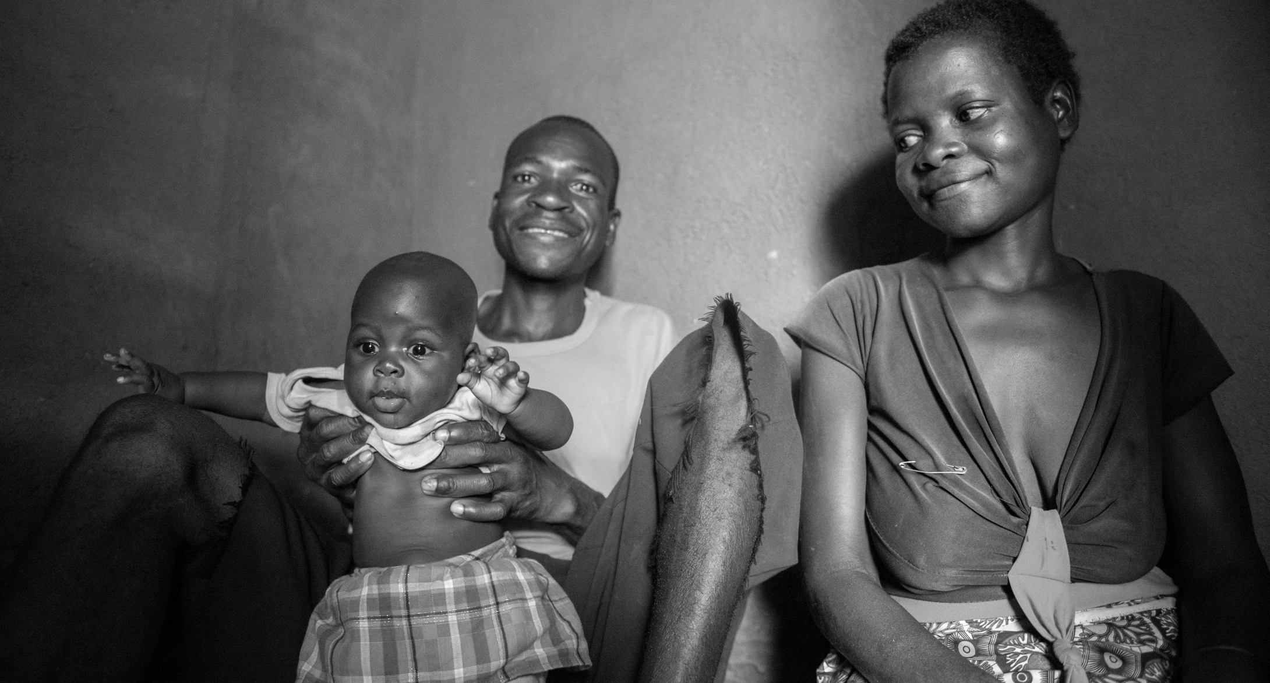
  “I was convinced that the [increased] number of children in the home contributes to ill health of both parents and children...
  The children become malnourished, as well, since there are not enough resources in the home.”
  - Married male, Malawi
Photo © 2017 Eric Bond / Elizabeth Glaser Pediatric AIDS Foundation, Courtesy of Photoshare
Notes:
When men are involved in family planning they are more engaged in the well-being of their partner and children.
Family planning can help ease the financial pressure that men feel as the main provider of the household. A smaller, well-spaced family will have fewer expenses, which frees up more income that can go toward housing, food, clothing, education, and other household needs. When fathers and couples are better able to meet the health needs of their family, children are healthier and are less likely to get sick, reducing costly medical bills. And if the mother is healthy, she can participate in economic activities and contribute to household expenses.
Source:
Dominick Shattuck et al., “Encouraging Contraceptive Uptake by Motivating Men to Communicate About Family Planning: The Malawi Male Motivator Project,” (2011), accessed at www.ncbi.nlm.nih.gov/pubmed/21493931.
FHI360, “Family Planning: What and Why? (Key Information),” accessed at www.fhi360.org/sites/default/files/media/documents/need-family-planning-handouts.pdf.
malawi family, Photoshare 61189-3.jpg

Slide 34
Male involvement can lead to positive health outcomes for men and their families.
More fulfilling relationships.
Improved communication with partners.
Improved mental and physical health.
Improved maternal health outcomes.
Improved child development outcomes.
Source: Gary Barker, 2014; FHI360, 2017
Notes:
Experts agree that engaging men in family planning and maternal and child health can have positive effects on men, their partners, and children.
Source:
Gary Barker, “Men, Masculinities and Health Emerging Research and Program Experiences From the Global South” presentation, (2014), accessed at www.jhsph.edu/departments/population-family-and-reproductive-health/news-and-events/wednesday-seminars/2013-2014-presentations/01_29_14%20Gary%20Barker.pdf, on July 17, 2017.
FHI360, “Family Planning: What and Why? (Key Information),” accessed at www.fhi360.org/sites/default/files/media/documents/need-family-planning-handouts.pdf.

Slide 35
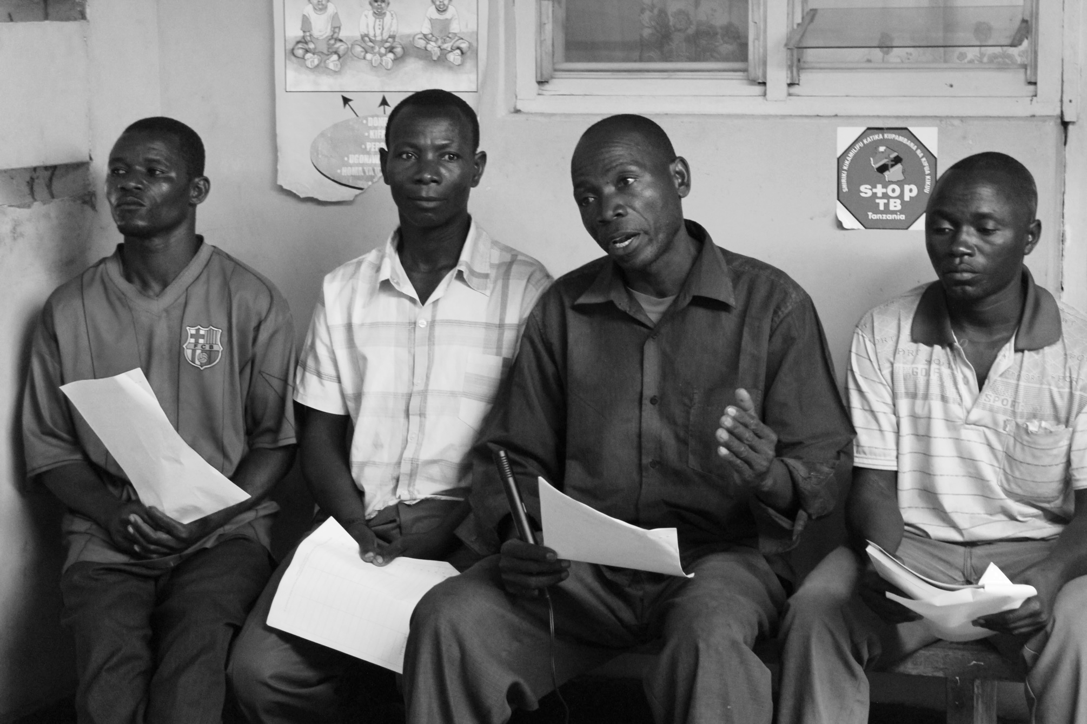
  Engaging men in family planning services can be an entry point into the health care system.
Photo © Katy Woods
Notes:
Engaging men in family planning services has the potential to serve as an entry point into the health care system and lead men to secure primary health care prevention and treatment services.
Source:
Demetrius J. Porche, “Men: The Missing Client in Family Planning,” (2012), accessed at http://journals.sagepub.com/doi/pdf/10.1177/1557988312459340.

Slide 36
CASE STUDIES
Notes:
Although programs that address boys’ and men’s sexual and reproductive health, including contraceptive use and family planning, are scarce, there are several promising interventions that demonstrate boys’ and men’s desire for health information and services.

Slide 37
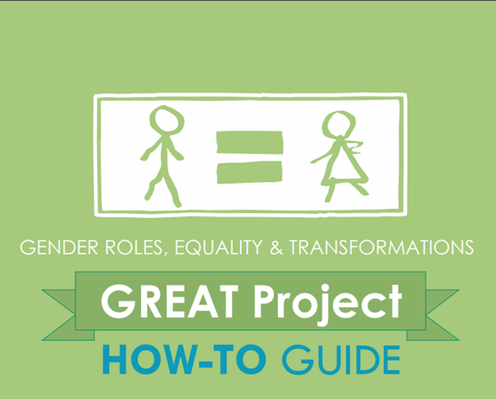
The Gender Roles, Equality, and Transformations (GREAT) project
Reduce gender-based violence and improve sexual and reproductive health outcomes.
Photo © UN Photo
Notes:
The Gender Roles, Equality & Transformations (GREAT) project in Uganda implemented community-based interventions that promoted gender-equitable attitudes and behaviors among boys and girls age 10 to 19 years and adults with the goal of reducing gender-based violence and improving sexual and reproductive health outcomes. Key interventions included community gatherings that promoted adolescent well-being, a serial radio drama, adolescent-friendly health services, and a toolkit for community groups and school clubs.
Source:
Institute for Reproductive Health, Georgetown University, Pathfinder International, Save the Children, “The GREAT Project,” (2016), accessed at http://irh.org/wp-content/uploads/2015/07/GREAT_Results_Brief_global_07.10_8.5x11.pdf.
Institute for Reproductive Health, Georgetown University, “GREAT Project Endline Report,” (2016), accessed at http://pdf.usaid.gov/pdf_docs/PA00KXRW.pdf.

Slide 38


Youth who participated in the GREAT project held more gender-equitable attitudes.
Gender-equitable attitudes and behaviors
Believe men
and women are equal
(ages 15-19 years)
Report experiencing or engaging in inappropriate touching (ages 15-19 years)
37%
48%
12%
4%
(not exposed to GREAT)
(exposed to GREAT)
(not exposed to GREAT)
(exposed to GREAT)
Notes:
The GREAT project observed significant differences in attitudes and behaviors between youth who participated in the project compared to those who were not exposed to the project. For instance, youth ages 15 to19 years who participated in GREAT held more equitable gender attitudes and behaviors compared to adolescents who did not participate in the program.
Source:
Institute for Reproductive Health, Georgetown University, Pathfinder International, Save the Children, “The GREAT Project,” (2016), accessed at http://irh.org/wp-content/uploads/2015/07/GREAT_Results_Brief_global_07.10_8.5x11.pdf.
Institute for Reproductive Health, Georgetown University, “GREAT Project Endline Report,” (2016), accessed at http://pdf.usaid.gov/pdf_docs/PA00KXRW.pdf.

Slide 39


Youth who participated in the GREAT project were more likely to use family planning.
Use of and intention to use family planning, among 15-19 year-olds
Sought family planning services from health workers
in the past 6 months
(among newly married/parenting adolescents)
Intend to use a family planning method in the future
(among older adolescents
who are not using family planning)
MALE
FEMALE
MALE
FEMALE
21%
17%
57%
55%
Not exposed to GREAT
Not exposed to GREAT
42%
30%
71%
66%
Exposed to GREAT
Exposed to GREAT
Notes:
Newly married or parenting couples who participated in GREAT also showed improved attitudes and behaviors related to sexual and reproductive health and reported a higher likelihood of using family planning.
Source:
Institute for Reproductive Health, Georgetown University, Pathfinder International, Save the Children, “The GREAT Project,” (2016), accessed at http://irh.org/wp-content/uploads/2015/07/GREAT_Results_Brief_global_07.10_8.5x11.pdf.
Institute for Reproductive Health, Georgetown University, “GREAT Project Endline Report,” (2016), accessed at http://pdf.usaid.gov/pdf_docs/PA00KXRW.pdf.

Slide 40




ACQUIRE Project –
Get a Permanent Smile
Generate demand and increase the use of no-scalpel vasectomy (NSV)
in the community.
NSV procedures
increased from
26 (2003) to
81(2004)
Increased awareness of NSV from
30% (2003) to
60% (2004)
Proportion of men who would consider a vasectomy doubled from 1 in 10 (2003) to
1 in 5 (2004)
Notes:
ACQUIRE Project - Get a Permanent Smile,
The Get a Permanent Smile Project—implemented in Ghana between 2004 and 2008—increased the use of vasectomy among men and couples who did not want any more children and were interested in a permanent family planning option. The project built the capacity of physicians to provide no-scalpel vasectomy (NSV) services and trained clinic staff on “male-friendly” services. It also implemented an extensive community outreach campaign using television, radio ads, printed promotional materials (posters, brochures, etc), as well as a telephone hotline to raise awareness about NSV, counter misconceptions, and promote NSV as an appropriate method for men that can enhance their ability to care for their partner and children.
The results were encouraging and show potential. For instance, during the first phase of the project (2003-2004) NSV procedures at service sites increased from 26 procedures in 2003 to 81 in 2004, and attitudes and knowledge around NSV improved among trained health staff. Awareness of NSV among men in the community increased from 30 percent at the start of the project to 60 percent by the end of the project; and the proportion of men who would consider a vasectomy doubled from one in 10 at baseline to one in five by the end of the project.
Source:
The ACQUIRE Project, “Get a Permanent Smile—Increasing Awareness of, Access to, and Utilization of Vasectomy Services in Ghana,” (2005), accessed at http://pdf.usaid.gov/pdf_docs/pdacg819.pdf.
Cindi Cisek and Joan Taylor, “Revitalizing Underutilized Family Planning Methods: Assessing the Impact of an Integrated Supply-Demand Vasectomy Initiative in Ghana,” (2008), accessed at www.meridian-group.com/wp-content/uploads/2015/08/Revitalizing-Underutilized-Family-Planning-Methods-Assessing-the-Impact-of-an-Integrated-Supply-Demand-Vasectomy-Initiative-in-Ghana_Report.pdf.

Slide 41
A CLOSER LOOK: VASECTOMY
Notes:
Let’s take a closer look at vasectomy, which is currently the most reliable and highly effective male-controlled modern method available to men.

Slide 42
Vasectomy remains one of the least-known and least-used contraceptive methods.
Vasectomy
Source: United Nations, Department of Economic and Social Affairs, Population Division, 2015
Notes:
Although vasectomy is highly effective, simpler to perform, has fewer side effects than female sterilization, and has high levels of satisfaction among users, globally it remains one of the least-known and least-used contraceptive methods.
Source:
United Nations, Department of Economic and Social Affairs, Population Division, “Trends in Contraceptive Use Worldwide 2015,” (2015), accessed at http://www.un.org/en/development/desa/population/publications/pdf/family/trendsContraceptiveUse2015Report.pdf.

Slide 43
Global use of vasectomy has decreased.
Use of vasectomy vs. female sterilization
  Prevalence: 4.6% (1994) vs. 2.4% (2015)
Notes:
Unfortunately, use of vasectomy has decreased. Only 2.4% of all women married or in union relied on vasectomy as their family planning method in 2015 compared to 4.6% in 1994. Meanwhile, use of female sterilization among married women remains constant at about 19% making it the most common family planning method used by women and couples.
A lack of knowledge or bias among service providers, widespread misconceptions among men and their communities, and gender norms that place the responsibility of family planning on women, contribute to men’s low use of and limited access to vasectomies.
Source:
James D Shelton and Roy Jacobstein, “Vasectomy: A Long, Slow Haul to Successful Takeoff,” (2016), accessed at www.ghspjournal.org/content/4/4/514.full.pdf+html.
EngenderHealth, “A Matter of Fact, A Matter of Choice: The Case for Investing in Permanent Contraceptive Methods,”(2014), accessed at www.respond-project.org/pages/files/6_pubs/advocacy-materials/Case-for-Perm-Methods-White-Paper-2014.pdf.
United Nations, Department of Economic and Social Affairs, Population Division, “Trends in Contraceptive Use Worldwide (2015),” 2015, accessed at www.un.org/en/development/desa/population/publications/pdf/family/trendsContraceptiveUse2015Report.pdf.

Slide 44
THE POTENTIAL FOR VASECTOMY UPTAKE:
A Focus on Ethiopia
Notes:
When countries add vasectomy to the contraceptive mix, it helps individuals and couples achieve their desired family size, expands the choice of effective permanent methods for individuals and couples, and generates greater savings for the country.
Let’s explore the potential for vasectomy uptake in Ethiopia.

Slide 45
Is there potential for vasectomy in Ethiopia?
5
million
women who no longer
want children are not
using any method at all.
1 3
men and women of reproductive age do not want any more children.
<2%
of women who no longer want children are using a permanent method.
in
Source: Brian Perry et al., 2016; Central Statistical Agency (CSA) [Ethiopia] and ICF. 2016; United Nations, Department of Economic and Social Affairs, Population Division, 2017.
Notes:
Ethiopia
In Ethiopia, almost one-third of both men (29 percent) and women (31 percent) of reproductive age do not want any more children. Yet, less than 2 percent of women who no longer want children are using a permanent method and more than 5 million women who no longer want children are not using any method at all.
Ethiopia has set a goal to increase its contraceptive prevalence rate, or the percentage of couples currently using a contraceptive method, from 36 percent in 2016 to 55 percent by 2020. Increasing the capacity and demand for vasectomy in Ethiopia could help achieve national family planning goals, improve the contraceptive mix for men and couples who want to limit births, and generate more savings for the country.
Source:
Ethiopia Central Statistical Agency (CSA) and ICF. Ethiopia Demographic and Health Survey 2016: Key Indicators Report (Addis Ababa, Ethiopia, and Rockville, MD: CSA and ICF, 2016).
United Nations, Department of Economic and Social Affairs, Population Division (2017). World Population Prospects: The 2017 Revision, DVD Edition.
Brian Perry et al., “Promoting Vasectomy Services in Ethiopia,” (2016), accessed at www.fhi360.org/sites/default/files/media/documents/resource-vasectomy-evidence-ethiopia-final.pdf.

Slide 46
By 2020, one-third of married couples in Ethiopia will want to limit childbearing.
Estimated Market Size for Permanent Methods in Ethiopia, 2020
Want to limit childbearing*
Married
women ages
15–49 years:
16,099,000
Married
men ages
15–49 years:
16,428,000
*Excludes men and women who report prior sterilization or infecundity.
Source: Brian Perry et al., 2016; Central Statistical Agency (CSA) [Ethiopia] and ICF. 2016; United Nations, Department of Economic and Social Affairs, Population Division, 2017.
Notes:
By 2020, one-third of couples in Ethiopia will have achieved their family size. This means that by 2020, about 10 million men and women will no longer want any more children.
Source:
Ethiopia Central Statistical Agency (CSA) and ICF. Ethiopia Demographic and Health Survey 2016: Key Indicators Report (Addis Ababa, Ethiopia, and Rockville, MD: CSA and ICF, 2016).
Brian Perry et al., “Promoting Vasectomy Services in Ethiopia,” (2016), accessed at https://www.fhi360.org/sites/default/files/media/documents/resource-vasectomy-evidence-ethiopia-final.pdf.

Slide 47
Vasectomy is one of the most cost-effective contraceptive methods available.
Cost of Contraceptive Provision per Couple Years of Protection (CYP) in Ethiopia, 2015
$6.11
$5.58
$5.69
$3.60
P
$1.08
$1.29
$1.03
Copper
IUD
Vasectomy
Female
Sterilization
Male Condom
Three-Year
Implant
Pill
Three-Month Injectable
Source: Brian Perry et al., 2016; Central Statistical Agency (CSA) [Ethiopia] and ICF. 2016.
Notes:
Vasectomy is a best buy—protecting couples against an unwanted pregnancy for less money than any other contraceptive methods provided in Ethiopia, other than an IUD.
[Definition: Couple Years of Protection (CYP) is the estimated protection provided by contraceptive methods during a one-year period, based upon the volume of all contraceptives sold or distributed free of charge to clients during that period.]
Source:
Ethiopia Central Statistical Agency (CSA) and ICF. Ethiopia Demographic and Health Survey 2016: Key Indicators Report (Addis Ababa, Ethiopia, and Rockville, MD: CSA and ICF, 2016).
Brian Perry et al., “Promoting Vasectomy Services in Ethiopia,” (2016), accessed at https://www.fhi360.org/sites/default/files/media/documents/resource-vasectomy-evidence-ethiopia-final.pdf.
United States Agency for International Development, Couple Years of Protection (CYP) (April 2014), accessed at
https://www.usaid.gov/what-we-do/global-health/family-planning/couple-years-protection-cyp.

Slide 48
A modest increase in vasectomy use generates substantial savings and impact.
Cumulative Cost-Effectiveness and Public Health Impacts (2016-2020)
 | Current Method Mix* | Method Mix* including 5 percent vasectomy CPR
Cost per CYP | $5.51 | $4.55
Total CYP | 6,999,000 | 8,448,000
Unintended pregnancies averted | 2,016,000 | 2,433,000
Maternal deaths averted | 14,000 | 16,000
Infant deaths averted | 119,000 | 144,000
Unsafe abortions averted | 362,000 | 437,000
Abortion case-fatalities averted | 1,900 | 2,300
*Among married women (30–49) who want to limit births
Source: Brian Perry et al., 2016; Central Statistical Agency (CSA) [Ethiopia] and ICF. 2016.
Notes:
Even if by 2020 only 5 percent of married women who wish to limit births had the option to choose from a wide variety of family planning methods, and were to voluntarily switch from using a short-term method to relying on their partner’s vasectomy, it would improve the cost effectiveness of the method mix and its public health impact by about 20 percent.
Creating an enabling environment for vasectomy programming, encouraging the demand for vasectomy, and increasing the supply of vasectomy services are essential to successfully and effectively include vasectomy in Ethiopia’s contraceptive method mix.
In the following section, we propose a set of recommendations and best practices for policymakers and program implementers to guide future efforts in engaging and involving boys and men in contraceptive use and family planning, including vasectomy services.
Source:
Ethiopia Central Statistical Agency (CSA) and ICF. Ethiopia Demographic and Health Survey 2016: Key Indicators Report (Addis Ababa, Ethiopia, and Rockville, MD: CSA and ICF, 2016).
Brian Perry et al., “Promoting Vasectomy Services in Ethiopia,” (2016), accessed at https://www.fhi360.org/sites/default/files/media/documents/resource-vasectomy-evidence-ethiopia-final.pdf.

Slide 49
RECOMMENDATIONS
Notes:
Engaging men and boys in family planning and reproductive health programs helps to share the responsibility for family planning with women.
We call for a paradigm shift whereby men are viewed as active consumers of family planning services and products.
The following section highlights effective recommendations to consider when developing sexual and reproductive health programs for men and boys.
We have six concrete recommendations…

Slide 50


RECOMMENDATIONS
1. Start Early!
Work with VYAs and youth to set the stage for boys to become future contraceptive users and supportive and responsible partners.
Photo © Jonathan Torgovnik/Reportage by Getty Images
Notes:
Attention to boys’ and men’s family planning and reproductive health and rights must start early and continue throughout their lives. Teach adolescent boys, including very young adolescent boys, about body literacy and pregnancy prevention to promote shared responsibility for contraception, and healthy sexual relationships. Young people need access to comprehensive, youth-friendly health services in safe environments, and support from their communities and families.
Source:
Karen Hardee, Melanie Croce-Galis, and Jill Gay, “Are Men Well Served by Family Planning Programs?” (2017), accessed at https://reproductive-health-journal.biomedcentral.com/articles/10.1186/s12978-017-0278-5.
Ruti Levtov et al., “State of the World’s Fathers,” (2015), accessed at http://sowf.men-care.org/.

Slide 51
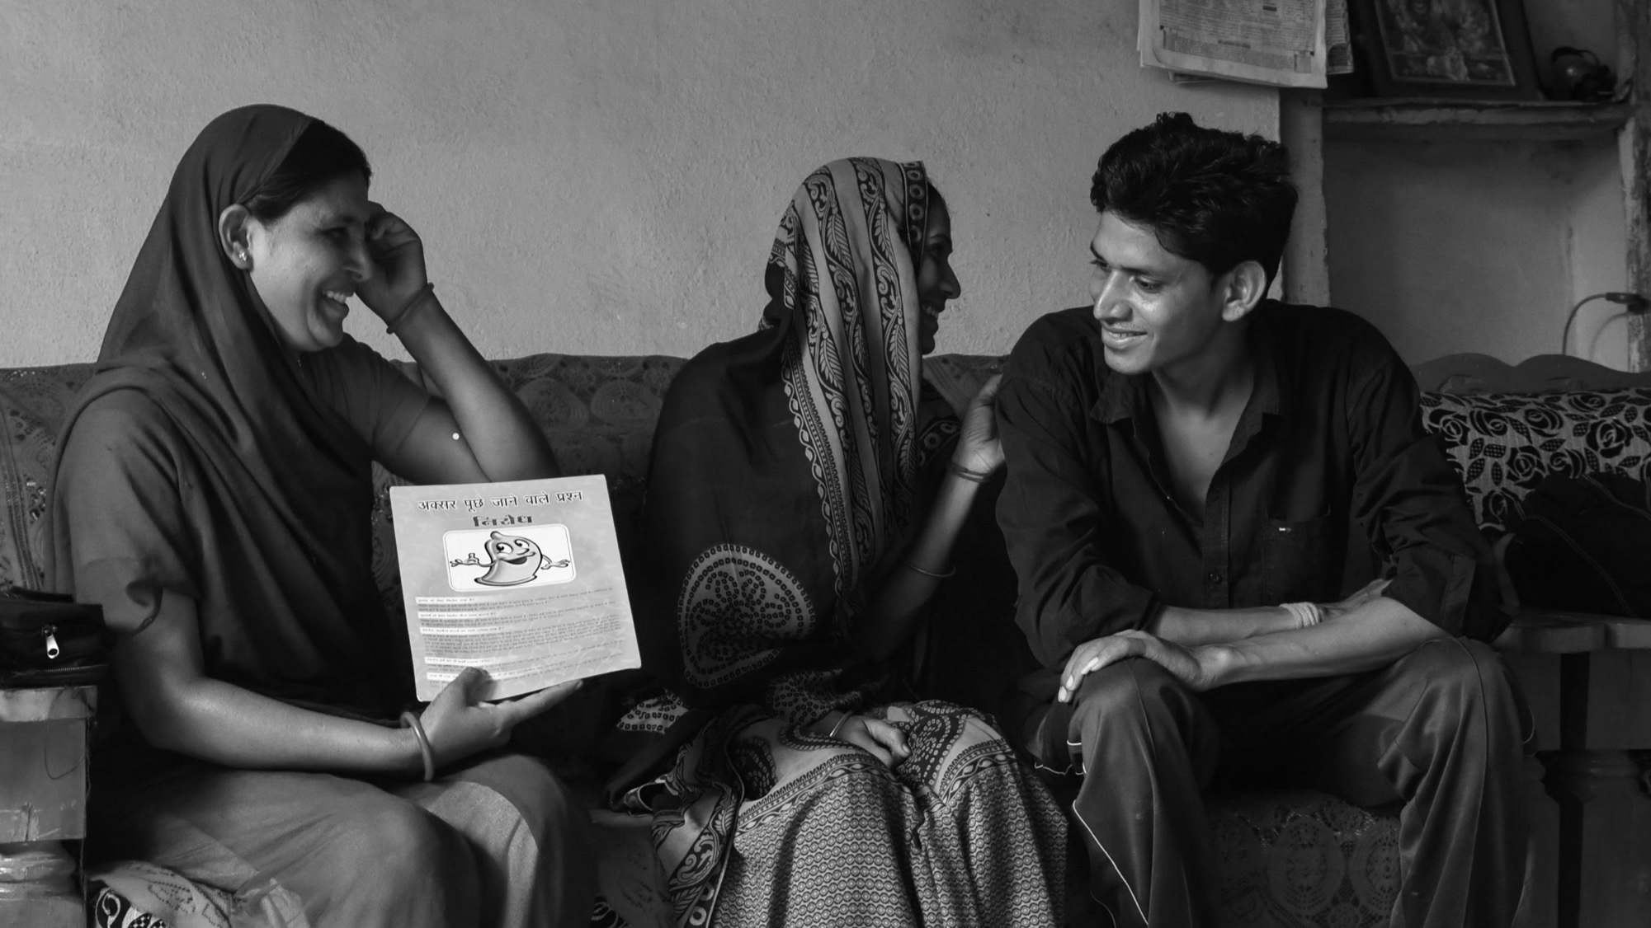
RECOMMENDATIONS
2. Increase men’s awareness of and demand for contraceptive methods and family planning services.
Photo © 2016 Arvind Jodha/UNFPA, Courtesy of Photoshare
Notes:
Invest in programs that increase men’s and boys’ knowledge of and demand for family planning services. Address gender norms that affect young men and men’s use of contraceptive methods and reproductive health services by dispelling the idea that family planning is only a woman’s issue and by promoting couple communication and joint decisionmaking. In addition, extreme care must be taken to ensure that efforts to involve men in contraceptive use and family planning decisionmaking does not take away from women’s autonomy.
Source:
Ruti Levtov et al., “State of the World’s Fathers,” (2015), accessed at http://sowf.men-care.org/.
Karen Hardee, Melanie Croce-Galis, and Jill Gay, “Are Men Well Served by Family Planning Programs?” (2017), accessed at https://reproductive-health-journal.biomedcentral.com/articles/10.1186/s12978-017-0278-5 on February 3, 2017.

Slide 52

RECOMMENDATIONS
3. Strengthen the capacity of health systems to deliver quality services to men, boys, and couples.
Photo © Sanofl Pasteur
Notes:
Address the bias of decisionmakers and health providers. Providers may have certain expectations and biases about men and their role in family planning and these must be addressed if they are to successfully engage men in family planning services. Providers must also acknowledge the sexual and reproductive health needs of adolescents, including young boys.
Provide male-friendly family planning and reproductive health information and services to men and boys where and when they need it. Invest in programs that employ creative outreach to men and couples using multiple channels, such as radio and community events, and a variety of providers, including male and female counsellors or educators who can reach both men and women together and demonstrate equitable communications.
Source:
Melanie Croce-Galis, Elizabeth Salazar, Rebecka Lundgren, “Male Engagement in Family Planning: Reducing Unmet Need for Family Planning by Addressing Gender Norms,” (2014), accessed at http://irh.org/wp-content/uploads/2014/10/Male_Engagement_in_FP_Brief_10.10.14.pdf.
Karen Hardee, Melanie Croce-Galis, and Jill Gay, “Are Men Well Served by Family Planning Programs?” (2017), accessed at https://reproductive-health-journal.biomedcentral.com/articles/10.1186/s12978-017-0278-5.
Karen Hardee et al., “Voluntary Family Planning Programs That Respect, Protect, and Fulfill Human Rights: A Conceptual Framework” (2013), accessed at www.engenderhealth.org/files/pubs/family-planning/Voluntary_Family_Planning_Programs_A_Conceptual_Framework.

Slide 53
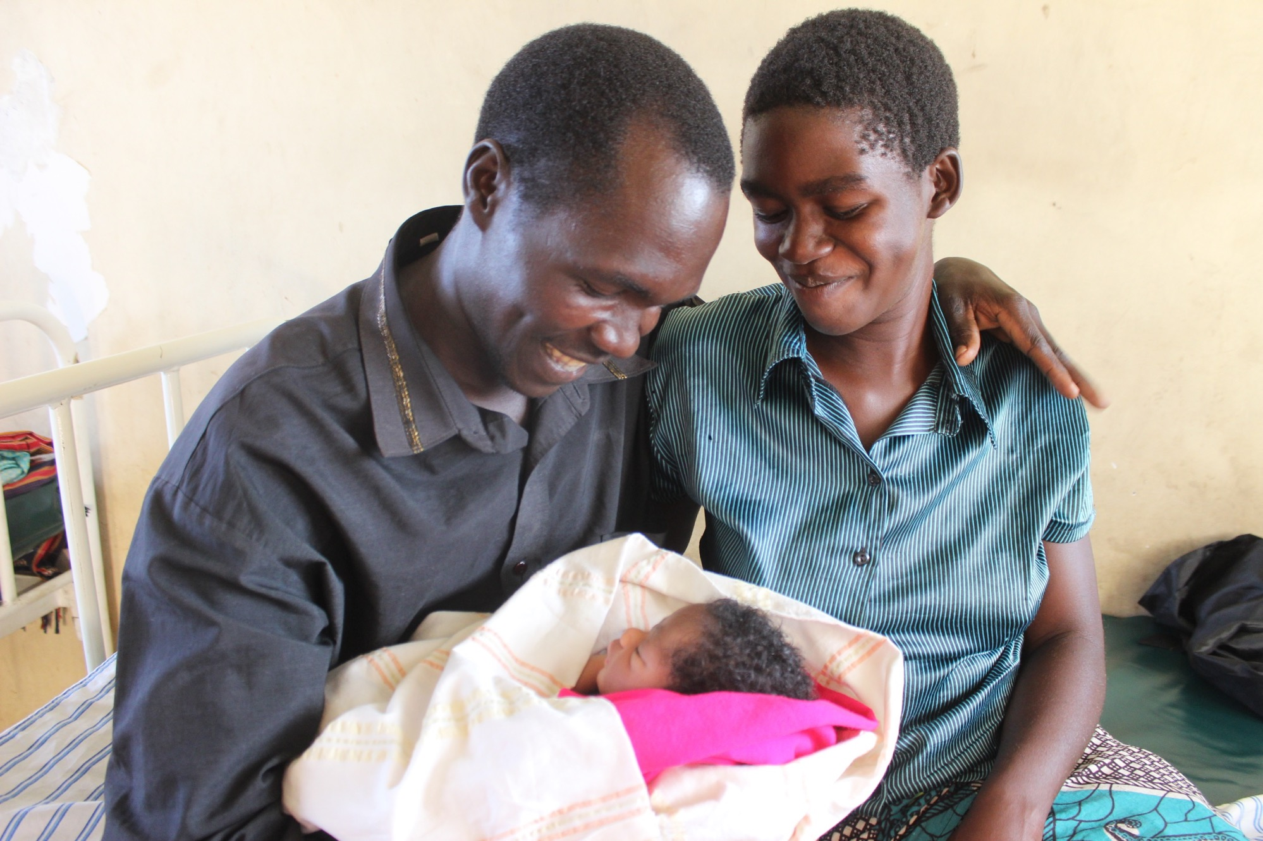
RECOMMENDATIONS
4. Provide men and couples with a broad range of methods that meet their contraceptive and family planning needs at different life stages, including making vasectomy a viable option.
Photo © The White Ribbon Alliance
Notes:
Provide men and couples with a range of methods that meet their reproductive health needs, including expanding the method mix to include vasectomy for men and couples who do not want any more children. Governments should invest in strengthening healthy systems to provide vasectomy services by training health providers on the procedure, ensuring that counselors are equipped to provide information to potential clients by increasing the capacity of counselors to provide couples counseling, and investing in community outreach to increase community awareness and address misconceptions about vasectomy.
It is critical that family planning programs and services uphold the rights of individuals and couples to determine the number and timing of their children, and endorse the principles of voluntarism, informed choice, rights, and equity.
Source:
Melanie Croce-Galis, Elizabeth Salazar, Rebecka Lundgren, “Male Engagement in Family Planning: Reducing Unmet Need for Family Planning by Addressing Gender Norms,” 2014, accessed at http://irh.org/wp-content/uploads/2014/10/Male_Engagement_in_FP_Brief_10.10.14.pdf.
Karen Hardee, Melanie Croce-Galis, and Jill Gay, “Are Men Well Served by Family Planning Programs?” 2017, accessed at https://reproductive-health-journal.biomedcentral.com/articles/10.1186/s12978-017-0278-5.
Karen Hardee et al., “Voluntary Family Planning Programs That Respect, Protect, and Fulfill Human Rights: A Conceptual Framework” (2013), accessed at www.engenderhealth.org/files/pubs/family-planning/Voluntary_Family_Planning_Programs_A_Conceptual_Framework.

Slide 54
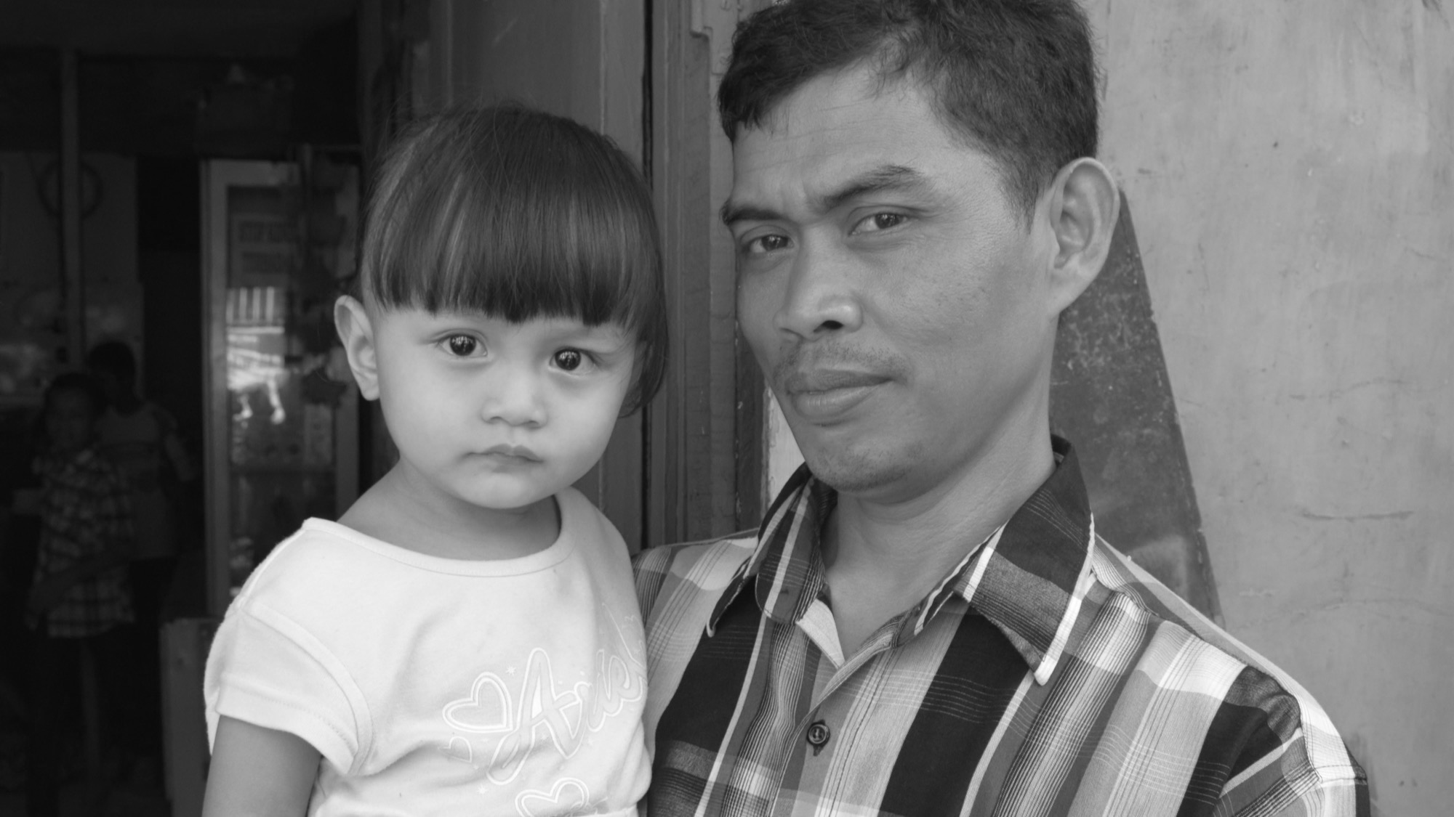
RECOMMENDATIONS
5. Develop national policies and guidelines that include men and boys as family planning clients and contraceptive users, and scale up proven interventions.
Photo © 2015 Radha Rajan, Courtesy of Photoshare
Notes:
Government health agencies must establish policies and political infrastructure that strategically engage men and include men in the reproductive health agenda, such as operational policies that improve and expand reproductive health services and programs for men and policies that support the expenditures and commodities needed to provide relevant reproductive health services to men. Country governments and global institutions must also address gender disparities in health policies and programs.
Governments can start by increasing investments and allocating resources to scale up and evaluate programs that have been proven effective or promising in engaging boys and men in family planning and sexual and reproductive health. There is enough evidence that points to boys’ and men’s desire and need for family planning information and services, and the benefits from their involvement in family planning and sexual and reproductive health to justify added investments in programming and research in this area.
Source:
Karen Hardee, Melanie Croce-Galis, and Jill Gay, “Are Men Well Served by Family Planning Programs?” 2017, accessed at https://reproductive-health-journal.biomedcentral.com/articles/10.1186/s12978-017-0278-5.
Sara Hawkes and Kent Buse, “Gender and Global Health: Evidence, Policy, and Inconvenient Truths,” (2013), accessed at www.thelancet.com/pdfs/journals/lancet/PIIS0140-6736(13)60253-6.pdf.
Karen Hardee, Melanie Croce-Galis, and Jill Gay, “Men as Contraceptive Users: Programs, Outcomes, and Recommendations,” Working Paper (2016), accessed at http://evidenceproject.popcouncil.org/wp-content/uploads/2016/09/Men-as-FP-Users_September-2016.pdf.
Ruti Levtov et al., “State of the World’s Fathers,” (2015), accessed at http://sowf.men-care.org/.

Slide 55

RECOMMENDATIONS
6. Fill knowledge gaps by collecting more data on men and adolescent boys.
Photo © Michele Burgess / Alamy Stock Photo
Notes:
Collect more data on men and boys to better understand the factors that enable or undermine their engagement as contraceptive users, consumers of FP services and supporters of women’s health. Currently, data collected for men through Demographic and Health Surveys (DHS) are more limited than data collected for women (72 countries have data on men vs. 91 for women). In addition, large-scale surveys and small localized studies include only a minimal recognition of the role that gender has in SRH, particularly for men’s health. More analysis is needed to explore the connections between gender, masculinities, sex, and reproduction.
Source:
Karen Hardee, Melanie Croce-Galis, and Jill Gay, “Are Men Well Served by Family Planning Programs?” 2017, accessed at https://reproductive-health-journal.biomedcentral.com/articles/10.1186/s12978-017-0278-5.
Sara Hawkes and Kent Buse, “Gender and Global Health: Evidence, Policy, and Inconvenient Truths,” (2013), accessed at www.thelancet.com/pdfs/journals/lancet/PIIS0140-6736(13)60253-6.pdf.
Karen Hardee, Melanie Croce-Galis, and Jill Gay, “Men as Contraceptive Users: Programs, Outcomes, and Recommendations,” Working Paper (2016), accessed at http://evidenceproject.popcouncil.org/wp-content/uploads/2016/09/Men-as-FP-Users_September-2016.pdf.
Ruti Levtov et al., “State of the World’s Fathers,” (2015), accessed at http://sowf.men-care.org/.

Slide 56

Engaging boys and men in family planning and contraceptive use leads to improved health outcomes for men and their families.
Photo © Randy Plett
Notes:
Men have an important role to play in family planning, particularly in deciding with their partners the number of children to have and the contraceptive method to use. Engaging men in family planning programming is feasible and need not detract from meeting women’s needs. Men sharing responsibility for family planning improves access and use of contraception, equalizes commitment to health, and improves overall wellbeing. Moreover, it can increase modern contraceptive use, promote shared decision making between couples, and help shift the belief that family planning is only a woman’s issue.
Engaging boys and men at different life stages as contraceptive users and family planning clients is an opportunity to meet FP2020 targets, remain on track to achieve the SDGs by 2030, and ultimately improve men’s reproductive health and well-being.
Source:
Miriam Hartmann et al., “Changes in Couples’ Communication as a Result of a Male-Involvement Family Planning Intervention,” Journal of Health Communication, (2012): 1-18.
Mihretie Kassa, Amanuel Abajobir, and Molla Gedefaw, “Level of Male Involvement and Associated Factors in Family Planning Services Utilization Among Married Men in Debremarkos Town, Northwest Ethiopia,”BMC International Health and Human Rights 14, no.33 (2014).
FHI 360, “Increasing Male Involvement in Family Planning in Jharkhand, India,” (2013), accessed at https://www.fhi360.org/sites/default/files/media/documents/india-male-involvement-family-planning.pdf.
Melanie Croce-Galis, Elizabeth Salazar, and Rebecka Lundgren, “Male Engagement in Family Planning: Reducing Unmet Need for Family Planning by Addressing Gender Norms,”(2014), accessed at http://irh.org/wp-content/uploads/2014/10/Male_Engagement_in_FP_Brief_10.10.14.pdf.
Erin Stern, et al., Lessons Learned from Engaging Men in Sexual and Reproductive Health as Clients, Partners, and Advocates for Change in the Hoima District of Uganda,” Culture, Health, & Sexuality 17, sup2 (2015): 190-205.
Ruti Levtov et al., “State of the World’s Fathers,” (2015), accessed at http://sowf.men-care.org/.
Karen Hardee, Melanie Croce-Galis, and Jill Gay, “Are Men Well Served by Family Planning Programs?” 2017, accessed at https://reproductive-health-journal.biomedcentral.com/articles/10.1186/s12978-017-0278-5.

Slide 57



This slide deck was produced by Jessica Kali, policy analyst at PRB. Special thanks to Michal Avni, Afeefa Abdur-Rahman, Joan Kraft, and Charlotte Feldman-Jacobs for their insight and support, and to Heidi Worley, Jessica Woodin, and Prographics for editing and design.
This document was funded by the U.S. Agency for International Development (USAID) under cooperative agreement AID-OAA-A-16-00002, the Policy, Advocacy, and Communication Enhanced for Population and Reproductive Health (PACE) project. The information provided in Engaging Boys and Men in Contraceptive Use and Family Planning is the responsibility of PRB, is not official U.S. government information and does not necessarily reflect the views or positions of USAID or the United States Government.
© 2018 Population Reference Bureau. All rights reserved.

