Slide 1

COMMUNICATION FOR IMPACT
How to Engage With Policymakers and the Media During the COVID-19 Pandemic
Notes:
Today we will be discussing strategic communications in the context of COVID-19: how to best engage with decisionmakers and the media on safe abortion during the pandemic.
I will start out by emphasizing that I am not an expert—rather, this session is intended to create an atmosphere of exchange that will allow each of you the opportunity to share your advocacy experiences around safe abortion in the context of the COVID-19.

Slide 2
SESSION OUTLINE
I: Introduction and summary
II: Challenges and impacts
III: Focusing attention
  Practical communication approaches
  Communication formats
V: Conclusion
Notes:
We will start with a short summary of the strategic communications principles that are particularly important in a period of crisis. Then, we will examine the challenges and limitations we are facing in conducting policy communications in the context of COVID-19, and we will discuss strategies to continue to draw the focus of decisionmakers and the media to our advocacy objectives despite the current challenges.
If you are interested in learning more about strategic communications principles, we encourage you to review module 2 in PRB’s online Policy Communication Toolkit.

Slide 3
SECTION I:
Introduction and Summary of Strategic Communication
Notes:
To start, let’s revisit some key principles of strategic communications.

Slide 4
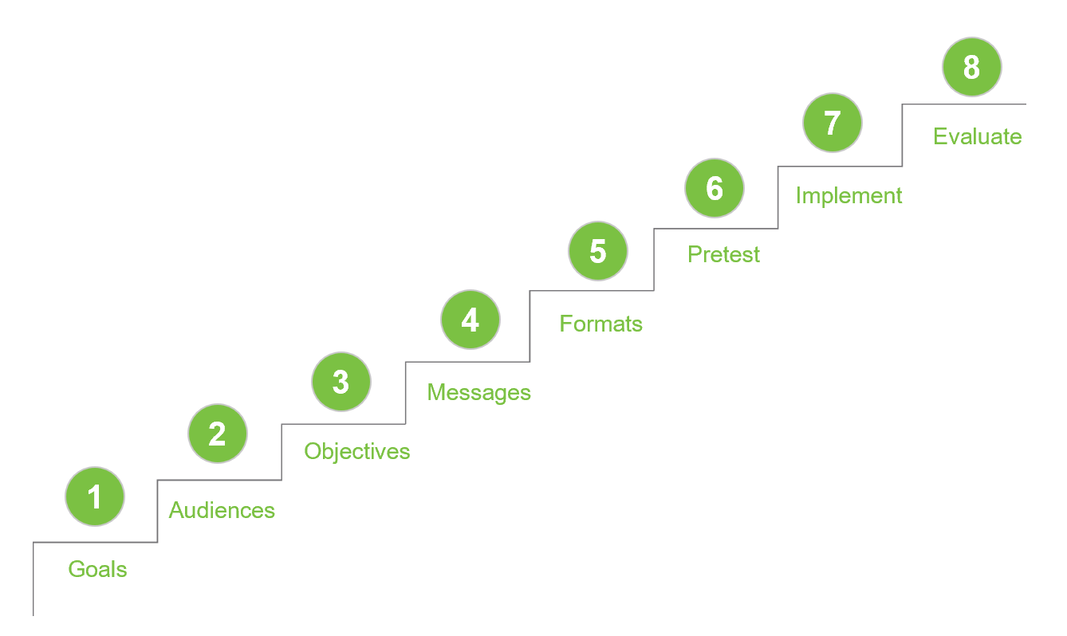
STRATEGIC COMMUNICATION
8 Elements of Strategic Communication
Notes:
Strategic communication is even more of a priority in the changed context of COVID-19. These central concepts and the approach to strategic communication don’t change, but the COVID-19 context can mean that certain challenges demand the adaptation of certain methods within your advocacy.
The eight key elements of strategic communication are [read]:
[Question for the group] Which points have you specifically noted with regard to your strategic communications around safe abortion? What useful approaches have you noted from the previous presentations?

Slide 5
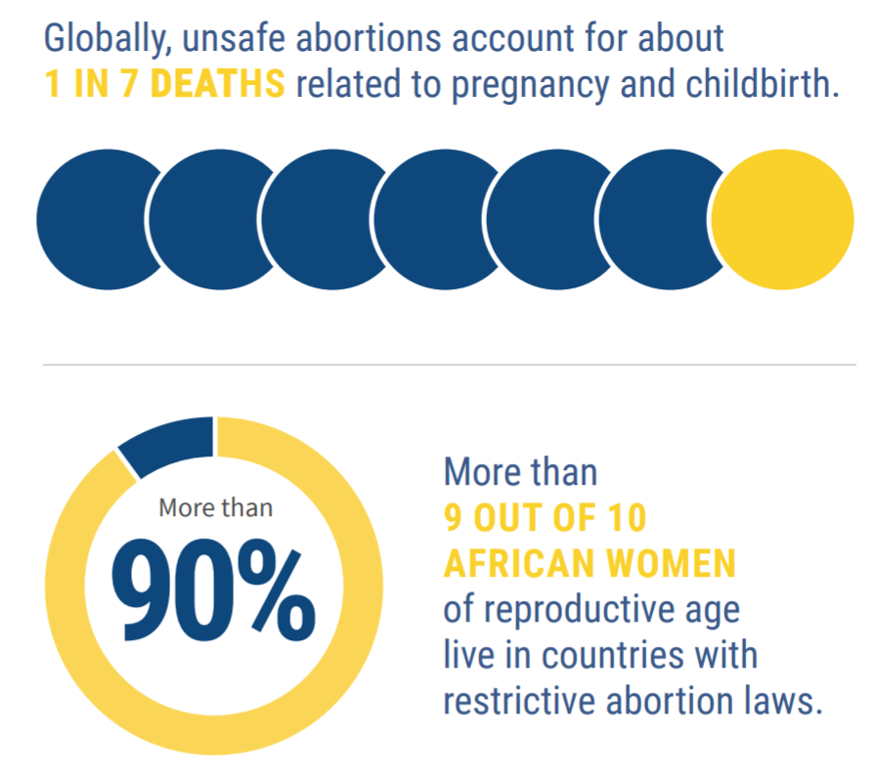
STRATEGIC COMMUNICATION
Use of data to:
  Define the problem.
  Explain the implications.
  Propose a solution.
Source: Population Reference Bureau. Applying the Maputo Protocol Can Reduce Unsafe Abortions, 2019
Notes:
It is essential to base your strategic messages on evidence to identify the problem and its implications, and then propose feasible solutions for your target audience.
For example, these data were taken from a PRB factsheet on the application of the Maputo Protocol to expand access to safe abortion in Africa. What implications could you suggest from these data? What would be your recommendation for action?

Slide 6
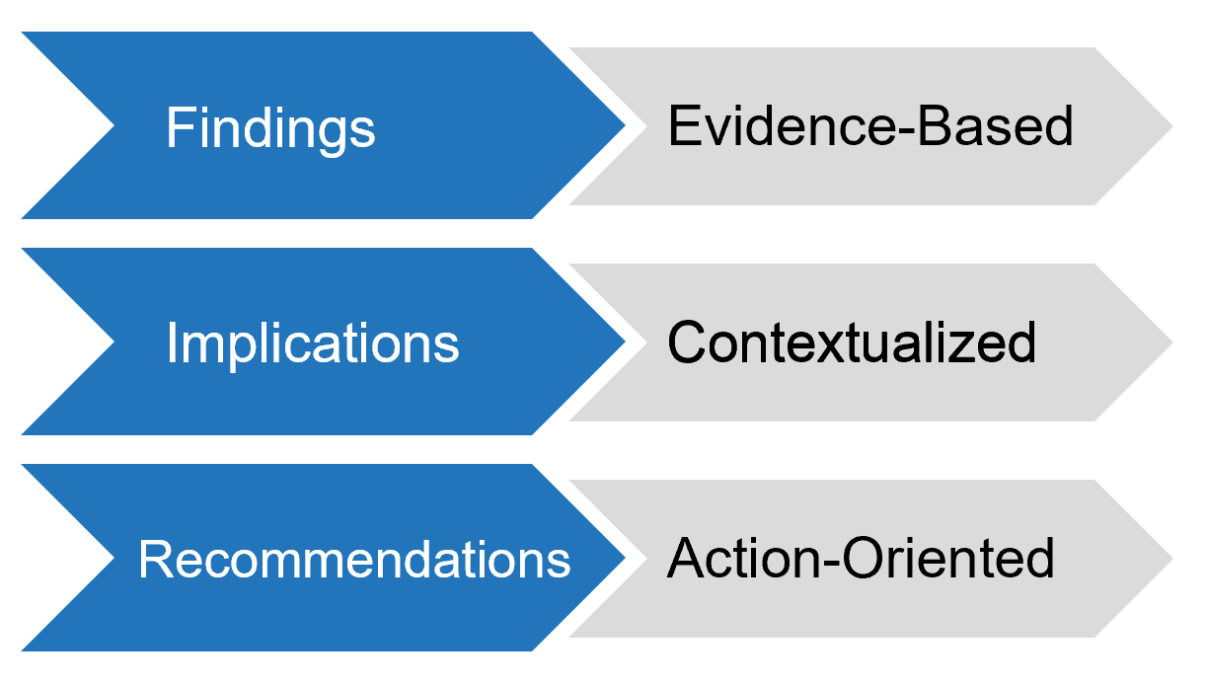
STRATEGIC COMMUNICATION
Define evidence-based, contextualized, action-oriented messages.
Notes:
Finally, we noted that effective messages are evidence-based, contextualized, and action-oriented.
Data furnish the findings that will inform your key messages. From these findings, you gather implications, which must be contextualized to fit your subject. Finally, your recommendations are based on the implications from your findings and are formulated with an emphasis on action.

Slide 7
SECTION II:
Communication Challenges and Impacts
Notes:
These guiding principles of strategic communications remain pertinent for any situation, including in the context of crises like COVID-19.
Decisionmakers are always the focus of intense competition from others who want their attention. To gain their limited attention, you must ensure that your messages are pertinent, evidence-based, and targeted.
In the context of COVID-19, this competition for attention has intensified. Issues and questions placed before decisionmakers have taken on an additional urgency, just as resources and the means to address those issues may be more limited—both for you and for decisionmakers.

Slide 8
CHALLENGES AND LIMITATIONS
Unanticipated shifts in agenda
Limited resources (financial, human resoures, time)
Working conditions—telework, virtual meetings
Technological concerns—internet accessibility, outages
Sources: “Protecting Women’s Health and Rights During COVID-19: Experiences and Feminist Perspectives From West African Civil Society,” Equipop, July 13, 2020, https://equipop.org/our-latest-report-protecting-womens-health-and-rights-in-during-covid-19/; Photo: unsplash.com.
Notes:
The effects of COVID-19 have caused the advocacy environment to transition to a state of crisis. Timeframes are shortenend, action is more urgent, resources are more limited, and your target audience is engaged in rapid responses to other questions.
Some potential challenges related to your strategic communication: [read]

Slide 9
CHALLENGES AND LIMITATIONS
Lack of coordination
Competition between agendas
Political, economic pressures
Changing management guidelines for the pandemic
Misinformation or lack of information
Sources: Unsplash.com.
Notes:
What other challenges or limitations have you faced regaring your ability to conduct strategic policy communications during this period?

Slide 10
WHAT IMPACTS YOUR ADVOCACY?
Notes:
The challenges and limitations of the changes that the COVID-19 pandemic has wrought on the policy environment may impact certain aspects of your strategic communication.
*Click to show first arrow*
GOALS:
Your policy goal may shift during the COVID-19 crisis as new challenges affect the safe abortion environment in your country. For example, if your focus was previously on the process of disseminating Standards and Guidelines on Comprehensive Abortion Care, perhaps now you have revised your focus to ensure that reproductive health services—including access to safe abortion—are prioritized as essential services by the government.
*Click*
AUDIENCES:
Have your policy audiences shifted? Perhaps you need to consider other audiences now, such as government task forces charged with implementation of COVID-19 response or other government ministries.
*Click*
OBJECTIVES:
With a change in your goals, it is also possible that your policy objectives have changed. Perhaps you planned to sensitize policymakers on Maputo Protocol indications for safe abortion care—and now, for example, in the context of COVID-19, your priority has shifted to soliciting their support to reinforce the supply chain for essential medicine.
*Click*
MESSAGES:
According to potential shifts in your goals, audience, and objectives, you will also need to tailor your messages. How can you underline the importance of maintaining access to safe abortion during the pandemic? How can you emphasize the potential consequences to women’s health if service delivery is interrupted or highlight the new risks they face under the pandemic?
*Click*
FORMAT:
Many of the traditional means of communication may not be accessible or strategic to use during the pandemic, as gatherings may be limited and as other measures restrict interaction between people and groups. How will you interact with policymakers if government convenings are no longer in session? If your key targets are working from home, or have limited connectivity? Do your targets have access to tools and resources they need to continue work effectively? How is the government coordinating and disseminating important information?
With these adjustments to your strategic communication, you will be armed to test and implement your advocacy messages, while taking into account the specific needs and changes in your country context.

Slide 11
SECTION III:
Focusing Attention: Practical Approaches
Notes:
These suggested approaches draw from different targeted response strategies to adapt your communication effectively to the challenges brought on by the COVID-19 pandemic.

Slide 12
FOR POLICYMAKERS
Notes:
Some principles that guide your communications with decisionmakers and policymakers remain valid in the COVID-19 context.

Slide 13
POORLY TRANSLATED INFORMATION IS NOT USED
Translating research is an acquired skill.
Policymakers have information overload.
Policymakers prefer information that is:
  Concise
  Focuses on main points
  Has unambiguous implications of findings
  Provides clear guidance on how to proceed
Notes:
It is true that poorly translated information is not used. However, one can learn how to translate research for use in policy communication.
Policymakers and, increasingly, the general public have information overload. This is, as we have noted, especially true in the context of crisis situations.
Research into what policymakers want consistently finds that they prefer information that is: [read final four bullets].

Slide 14
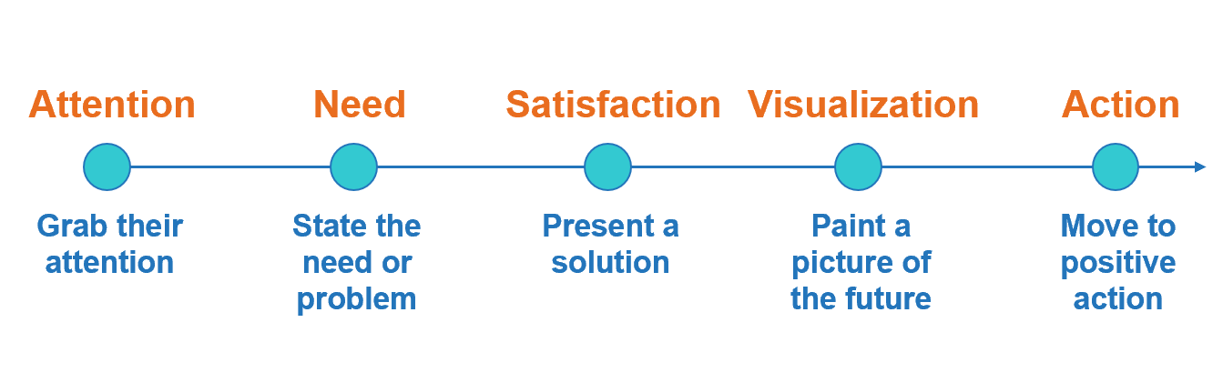
PRESENTING A PERSUASIVE MESSAGE
Notes:
This sequence is a five-step presentation structure that follows people’s normal thought patterns, motivating an audience to respond to the speaker’s purpose.
Attention: The opening should seize the audience’s attention, direct that attention toward your topic, and make the audience want to listen to what follows. For example, a physician might say, “Three out of five people in this room will die of heart disease.”
Need: State the need or problem that exists, explaining why it’s important to your listeners. Here is the body of the presentation. You may include findings, quotes, examples, or any illustrations that describe a need and build a solid, logical foundation for the solution you will present.
Satisfaction: Presenting solutions to the need or problem provides satisfaction. What can be done? Support your position with evidence, if it exists. If necessary, overcome objections.
Visualization: Evidence can help you do visualize your message. Evidence can be data, stories, or quotes from people with lived experiences. Visualization can be supported with actual images where appropriate.
Action: Move the audience to positive action. This is where your recommendations come in—and remember that you should be thinking about these final recommendations from the very beginning.

Slide 15
FOR THE MEDIA
Notes:
Guiding principles for interacting with the media, in the context of COVID-19 and otherwise.

Slide 16
KNOW THE MEDIA LANDSCAPE
Not all media are the same. Different media outlets cover different topics and cater to different audiences.
Build a media database.
  Identify which media outlets are relevant to your target audience.
  Track journalists already covering your topic. Note which ones are doing a good job, as well as gaps in coverage.
Notes:
Before contacting the media, it is important to know what type of media or which journalist you should reach out to. A good place to start is with the target audiences and key messages you identified, which can help you identify the appropriate media outlet or journalist to contact.
Your communication strategy likely involves multiple target audiences, such as government officials, program managers, or donors; as well as multiple key messages tailored to each group. The same concept can be applied when selecting the appropriate media organization. We want to target the media outlets that can reach our audiences. Where do your target audiences get their information? You may need to do some research to get an idea of where to focus your media efforts.
Build a media database. Familiarize yourself with the types of content at various newspapers, news television channels, radio shows, etc. Find out which ones cover the issues relevant to your field and target audiences. As you identify these media channels, make a note of the journalists who report on and are interested in subject matters similar to your research topic. Write down their contact information and get to know their work. For instance, check whether they have a blog, see if they are active on social media, read articles they have written. Having a list of relevant media outlets and journalists who are interested in your field can be useful if you plan to use the media to reach your target audience.

Slide 17
HOW TO WORK WITH THE MEDIA
Be cognizant of the deadlines that the journalist is under.
Establish a professional relationship.
  Be available and always respond.
  Find ways to communicate regularly.
  Be helpful, considerate, and honest.
Keep track of the number of times you participate with or contribute to the media.
Notes:
If you contact a journalist to pitch your research or event, recognize that they work under tight deadlines to keep up with the latest controversy, scandal, or issue. For this reason, it is important that you provide information in a timely manner.
If possible, try to develop a professional relationship with the journalist(s). To do this, you first have to read newspapers and listen to or watch broadcast news so you can identify a reporter or reporters who report on subjects relevant to your issues. Then, reach out to those reporters with additional information. You can say “I liked your story and here’s something else you might be interested in pursuing” or “let me know if you ever need help on a story.” That’s the start of a professional relationship. As you foster that relationship, establish and maintain trust by responding promptly when they contact you with questions, continue to reach out to them if you have information or a story that meets the needs of their target audience, and most importantly, be honest and forthright. If you do not know the answer, do not lie or make up an answer. Through these actions, you will gain the reputation as a good source of reliable information.
Keep a record of and monitor the number of times you engage with the media. Track which journalists contact you. Which media organization do they work for? What kinds of information or subject areas do they ask about? Having a record of your encounters can provide more information about the impact of your work on policy issues.

Slide 18
APPROACHES FOR YOUR ADVOCACY
Notes:
And now, suggestions on specific approaches you can implement for advocacy around safe abortion in the current context.

Slide 19
WHAT IS THE ROLE OF
CIVIL SOCIETY?
  Advocate for the community, especially the most vulnerable and least served.
    Maintain government accountability and hold them to their commitments toward the community.
  Provide essential services.
    Perform a key role in ensuring active response and service continuity.
Notes:
Civil society plays an essential role in the COVID-19 pandemic response and in the maintenance of sexual and reproductive health services.
Civil society advocates for communities and maintains pressure on governments to serve the population, as well as provides direct care and services as a key player in technical working groups in the pandemic response.

Slide 20
HOW TO ADAPT YOUR ADVOCACY?
Integrate your problem into the COVID-19 response.
  Think in terms of current priorities—how can you best align your issue or topic with the current urgent priorities?
  What are the potential consequences for the country if this question is not addressed?
Remind policymakers that sexual and reproductive health care, including safe abortion, are essential services.
Notes:
Integrate your problem into the COVID-19 response: If your country has designated sexual and reproductive health services—including safe abortion—as essential care, make use of this angle in your advocacy. If not, insist on this step first in your advocacy.
Make use of the estimated impacts of COVID-19 on sexual and reproductive health, in addition to your government’s development goals, to underline the necessity of reducing negative impacts on sexual and reproductive health and rights during the pandemic and to mitigate taking steps backward on important development indicators and recent gains.

Slide 21
HOW TO ADAPT YOUR ADVOCACY?
Put the question in context.
  Compare statistics on the impacts of COVID-19 and the rate of maternal mortality and morbidity, for example.
Ensure your messages are targeted, succinct, and strategic.
Repeat your key messages.
Notes:
Put the question in context: Show that women and girls are dying at alarming rates due to avoidable causes such as unsafe abortion and how these trends will continue or worsen under the COVID-19 pandemic.
Target your messages: Remember, policymakers are bombarded with urgent, sometimes contradictory messages on all sides. Make sure your messages get through and stick by ensuring they’re targeted, succinct, and strategically deployed. Repeat them as necessary so they will hit home.

Slide 22
HOW TO ADAPT YOUR ADVOCACY?
Make use of collaborations to amplify your message.
  Partnership and participation in larger movements can enhance your legitimacy and extend your voice.
  Counter misinformation with a majority of positive, factual, and coordinated messages.
  Elevate community voices and women’s voices.
  Make the link to decisionmakers at various levels—local, national, regional.
Notes:
Amplify your voice by joining your messages with partners and networks working in similar areas such as gender-based violence, gender equality, women’s rights, etc.
Advocate to policymakers at ALL levels to ensure better coordination and impact of your messages.

Slide 23
HOW TO ADAPT YOUR ADVOCACY?
Construct your advocacy from evidence.
  Estimations of impact.
  Evidence from other health and humanitarian crises.
  Qualitative evidence on COVID-19’s preliminary impacts.
Be flexible!
Notes:
Construct your advocacy from evidence: As always, strong advocacy is first and foremost grounded in solid evidence, which should be central to your messages. As we’ve seen in the presentation on data use in advocacy, evidence forms the base of your problem, provides a link to your implications, and helps you propose actionable solutions.
In the COVID-19 context, even though some data on impact are not yet available, we can use other data to paint a compelling message of the anticipated risks and impacts. Make use of estimations of impact, examples from past health and humanitarian crises, and available qualitative information to speak to the urgent need to address risks to the access to safe abortion care.
Be flexible: This situation demands constant, rapid evolution and adaptation in your policy advocacy. Be flexible and ready to react as information changes, taking these changes into account for your goals, audiences, objectives, messages, and format. Observe what’s working (or not) with partners, what constitutes a barrier, and what seems to be effective in your advocacy, and use these learnings to continually adjust.

Slide 24
HOW TO ADAPT YOUR ADVOCACY?
Look to the future—what adaptations could be sustainable?
  Advocate for innovative approaches to service continuity—and their permanent adoption.
Notes:
Frame the question of how to expand access to comprehensive reproductive health services in this context around adaptation and unexpected opportunity due to the disruptions of COVID-19. How can we use this moment to usher in dramatic, potentially lasting structural improvements, such as introduction of innovative technology?

Slide 25
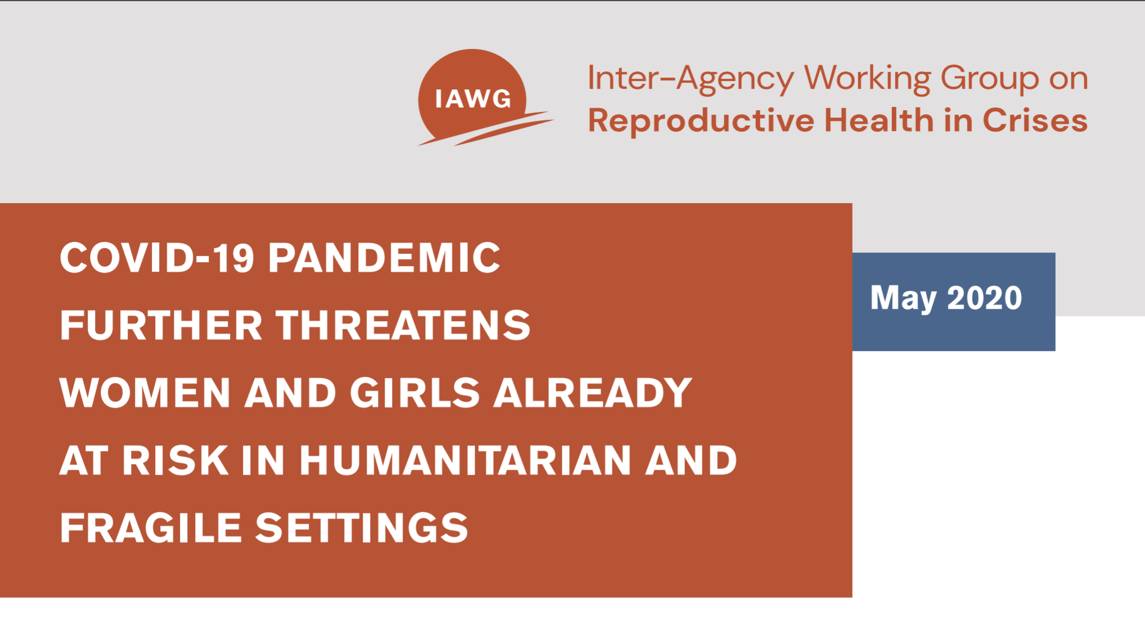
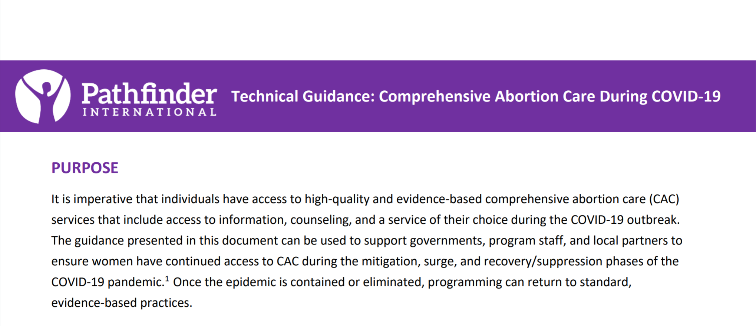
HOW TO ADAPT YOUR ADVOCACY?
Make use of the resources available to you.
  Toolkits
  Factsheets
  Technical guides
  Reports
Sources: IAWG 2020, Pathfinder International 2020.
Notes:
Make use of the resources available to you: Many organizations and agencies have published advocacy guides, toolkits, and other resources that may be useful to enhancing your strategic communications in the context of COVID-19. Take advantage of these resources to amplify your clear messages on shared goals.

Slide 26
SELECTED RESOURCES
Source | Type of Resource
WHO | Technical guides
FIGO | Toolkit
UNFPA | Toolkit
FP2020 | Toolkit
Guttmacher Institute | Impact estimation studies
IAWG | Advocacy statement
IPPF | Advocacy report
Marie Stopes International | Report
Pathfinder International | Technical Guides
ICPF 2021 | Toolkit
PAI | Policy brief
Equipop | Report
…and more!

Slide 27
SECTION IV:
Focusing Attention: Formats
Notes:
Finally, we have noted that communication formats are one element affected by the changes in policy advocacy environment due to the COVID-19 pandemic. Let’s discuss format adaptations to reach policymakers and the media to amplify the impact of your advocacy.

Slide 28
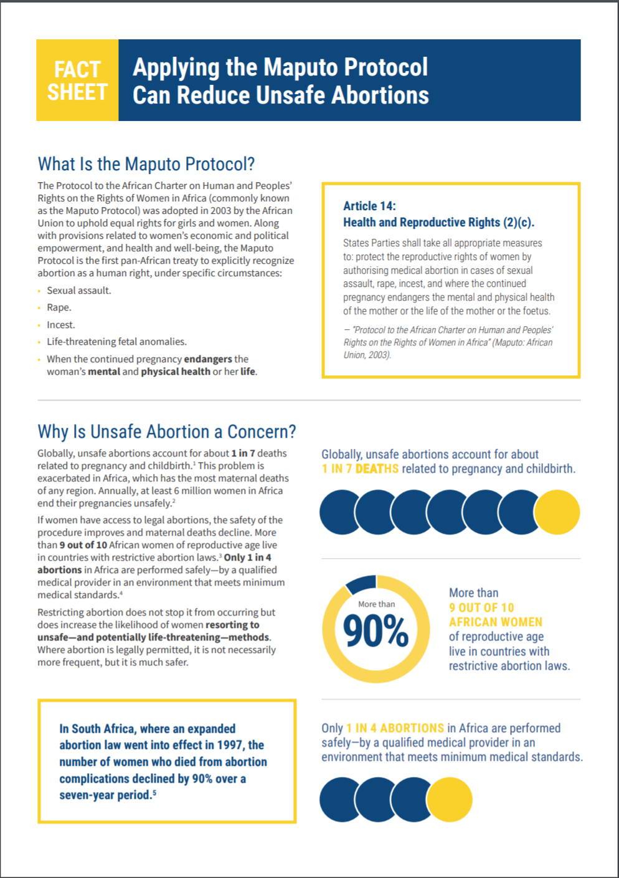
FORMATS BY AUDIENCE
Policymakers
  Policy briefs
  Policy presentations
  Factsheets
Media
  Press releases
  Interviews
  Social Media
Source: Population Reference Bureau, Applying the Maputo Protocol Can Reduce Unsafe Abortions, 2019
Notes:
To reach policymakers and the media to amplify your messages, you need to carefully consider the format best suited to your message and the situation. Traditionally, you may have selected among the formats shown here.
For policymakers, it is most effective to use condensed formats that summarize evidence, with precise implications and SMART recommendations such as policy briefs, policy presentations, or factsheets.
With the media, when the objective is to reach a large, public audience to bring attention to your subject, you may choose a format best suited for the audience you’re hoping to reach such as a press release, an interview, or dissemination of your messages through social media.

Slide 29

HOW TO ADAPT YOUR FORMATS?
Digital formats
  Videos, social media, blogs, etc.
Virtual meetings
  Zoom, GoToMeeting, Skype
Webinars
Online petitions
Discussion groups
Online campaigns
Radio
Source: Unsplash.com.
Notes:
The goal of reaching your target audiences to convince them to take action on your topic has not changed, but limitations in HOW to reach them may affect you, as well as limit the potential for engagement on the part of your target audiences. How can you best transfer your messages into COVID-19-adapted formats?
Online platforms, especially social media platforms such as Facebook, Twitter, and Instagram, and messaging apps such as Whatsapp and others, are even more essential as formats to reach your target audiences as face-to-face meetings are now limited.
Videos can transmit a targeted message in an engaging, visual format to influence a wide audience, and they are easy to post and share online.
I can’t even begin to name all the virtual formats available to share messages and information. I am sure you all have experience now being inundated with invitations for online engagement as in-person meetings transition to virtual webinars, and Zoom meetings are the new normal to continue collaboration.
Of course, not everything is online. Traditional formats such as television and radio are still great options for diffusing messages, especially when it comes to mobilizing the community.
What formats have you been using to spread your messages?

Slide 30
SECTION V:
Conclusion
Notes:
Now, I have done enough of the talking and would like to give you all the floor. In conclusion, I will just say that even as the COVID-19 crisis presents new challenges for us in our work, we can still apply the same key concepts and approaches for strategic communications, with some adaptations and flexibility, to effectively reach decisionmakers and the media with our messages.

Slide 31
CONCLUSION
In crisis situations such as the COVID-19 pandemic, we face different challenges to strategic communications.
The guiding principles of strategic communications are still pertinent.
Remain innovative, flexible, persistent, and clear in your messages to attain your objectives.
Notes:
In conclusion, we see that the current situation brings challenges for strategic communication. It amplifies the importance of reaching decisionmakers and the media to gain support for continued access to sexual and reproductive health services and protection of essential reproductive rights. The principles of strategic communication remain pertinent: Define your audiences, your objectives, and your messages, using evidence to underline implications and actions to take.
Remember to remain flexible, use resources at your disposal, and work in collaboration to amplify your messages and achieve your policy goals.

Slide 32
WHAT SUGGESTIONS DO YOU HAVE FROM YOUR EXPERIENCES?
Notes:
And now, over to you! What have your experiences been regarding communication during the COVID-19 pandemic? What has worked, or not worked? What would you suggest to partners to learn from your experiences?

Slide 33
FURTHER READING
P. Feldman, P. Nadash, and M. Gursen, “Improving Communication Between Researchers and Policymakers in Long-Term Care, or Researchers Are From Mars; Policymakers Are From Venus,” The Gerontologist 41 (2001): 312-21.
M. Hennink & R. Stephenson, “Using Research to Inform Health Policy: Barriers and Strategies in Developing Countries,” Journal of Health Communication 10, no. 2 (2005): 163-80.
K. Hardee and K. Wright, “Expanding the Role of Research Evidence in Family Planning Policy, Program, and Practice Decisionmaking,” working paper (Washington, DC: Population Council, 2015).
IPPF, Ensuring Sexual and Reproductive Safety in Times of COVID-19: IPPF Member Associations’ Advocacy Good Practices & Lessons Learned (2020), https://www.ippf.org/sites/default/files/2020-07/Ensuring%20SRHR%20during%20COVID19.pdf.
K. Moat et al., “Evidence Briefs and Deliberative Dialogues: Perceptions and Intentions to Act on What Was Learnt,” Bulletin of the World Health Organization 92 (2014): 20-8.
“Protecting Women’s Health and Rights During COVID-19: Experiences and Feminist Perspectives From West African Civil Society,” Equipop (2020), https://equipop.org/our-latest-report-protecting-womens-health-and-rights-in-during-covid-19/.

Slide 34
FURTHER READING
E. Smith et al., “An Assessment of Family Planning Decisionmakers’ and Advocates’ Needs and Strategies in Three East African Countries,” International Perspectives on Sexual and Reproductive Health 42, no. 3 (2015): 136-44.
“Connecting People to Useful Information: Guidelines for Effective Data Presentations,” PRB and MEASURE Evaluation.
Richard E. Mayer, “Principles for Multimedia Learning” (2014), https://hilt.harvard.edu/news-and-events/events/research-based-principles-for-multimedia-learning/.

Slide 35
THANK YOU
[Name]
[Email address]

