Slide 1


v
Where Is the Workforce?
Understanding the U.S. Labor Shortage and Working Toward Solutions
September 5, 2024 | 12:00-1:00 p.m. ET

Slide 2



Presenters
R. Alexander Acosta
Former U.S. Secretary of Labor
Diana Elliott
Vice President of Programs, PRB
Misty Chally
Executive Director, Critical Labor Coalition

Slide 3
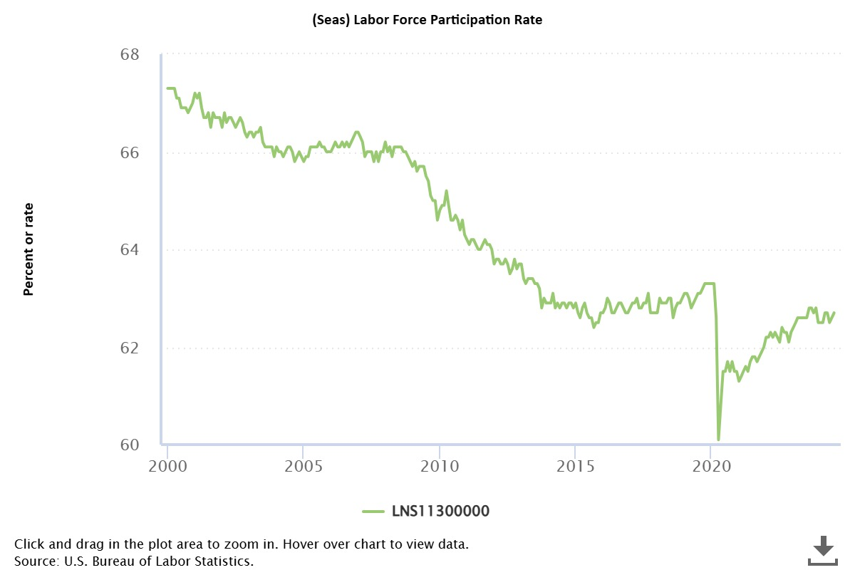

Slide 4
Labor force participation rates by years (using Jan 2000 to avoid COVID distortions)
 | LFP seasonally adjusted | Change
2000 Jan | 67.3
2004 Jan | 66.1 | -1.2
2008 Jan | 66.2 | 0.1
2012 Jan | 63.7 | -2.5
2016 Jan | 62.7 | -1
2020 Jan | 63.3 | 0.6
2024 Jan | 62.5 | -0.8
2028 Jan (BLS projected) | 61.7 | -0.8
2032 Jan (BLS projected) | 61.2 | -0.5

Slide 5
Labor force participation rates of selected groups, by race and Hispanic or Latino ethnicity, annual averages, 2000 and 2015
Group | 2000 | 2015 | Change, 2000–15
Total, 16 to 19 years | 52.0 | 34.3 | –17.7
White | 55.5 | 36.4 | –19.1
Black or African American | 39.4 | 28.1 | –11.3
Asian | 35.8 | 20.6 | –15.2
Hispanic or Latino | 46.3 | 30.9 | –15.4
Total, 20 to 24 years | 77.8 | 70.7 | –7.1
White | 79.9 | 72.7 | –7.2
Black or African American | 71.8 | 68.2 | –3.6
Asian | 63.0 | 52.8 | –10.2
Hispanic or Latino | 78.2 | 71.6 | –6.6
Men, 25 to 54 years | 91.6 | 88.3 | –3.3
White | 92.7 | 89.5 | –3.2
Black or African American | 84.4 | 80.9 | –3.5
Asian | 91.7 | 89.2 | –2.5
Hispanic or Latino | 92.5 | 90.8 | –1.7
Women, 25 to 54 years | 76.7 | 73.7 | –3.0
White | 76.8 | 73.9 | –2.9
Black or African American | 78.9 | 76.5 | –2.4
Asian | 71.3 | 67.8 | –3.5
Hispanic or Latino | 67.6 | 66.3 | –1.3

Slide 6
Men, 55 years and older | 40.1 | 45.9 | 5.8
White | 40.3 | 46.4 | 6.1
Black or African American | 36.0 | 39.9 | 3.9
Asian | 46.6 | 50.6 | 4.0
Hispanic or Latino | 45.2 | 51.2 | 6.0
Women, 55 years and older | 26.1 | 34.7 | 8.6
White | 25.9 | 34.5 | 8.6
Black or African American | 27.0 | 34.7 | 7.7
Asian | 29.2 | 37.6 | 8.4
Hispanic or Latino | 24.0 | 33.3 | 9.3
Note: Persons whose ethnicity is identified as Hispanic or Latino may be of any race. Source: U.S. Bureau of Labor Statistics, Current Population Survey.

Slide 7
Labor Force Participation Rate – BLS Projections | 2023 | 2028 | 2032 | 10 year Change
LFPR Aggregate | 62.6 | 61.7 | 61.2 | (1.40)
20 to 24 | 71.3 | 70.2 | 69.4 | (1.90)
25 to 29 | 83.1 | 82.5 | 82.1 | (1.00)
30 to 34 | 84.4 | 84.1 | 83.8 | (0.60)
35 to 39 | 84.0 | 83.5 | 83.2 | (0.80)
40 to 44 | 83.7 | 83.1 | 82.6 | (1.10)
45 to 49 | 83.8 | 83.5 | 83.3 | (0.50)
50 to 54 | 80.5 | 80.6 | 80.7 | 0.20
55 to 59 | 73.7 | 74.7 | 75.4 | 1.70
60 to 64 | 58.2 | 60.6 | 62.4 | 4.20
65 to 69 | 33.3 | 36.2 | 38.6 | 5.30
LFPR Men | 68.1 | 66.7 | 65.8 | (2.30)
20 to 24 | 72.5 | 70.5 | 68.9 | (3.60)
25 to 29 | 88.1 | 86.8 | 85.7 | (2.40)
30 to 34 | 90.5 | 89.6 | 88.8 | (1.70)
35 to 39 | 90.4 | 89.6 | 89.0 | (1.40)
40 to 44 | 90.1 | 89.3 | 88.7 | (1.40)
45 to 49 | 89.8 | 89.1 | 88.5 | (1.30)
50 to 54 | 85.8 | 85.1 | 84.6 | (1.20)
55 to 59 | 79.2 | 79.1 | 79.0 | (0.20)
60 to 64 | 64.2 | 65.7 | 66.8 | 2.60
65 to 69 | 38.1 | 40.7 | 42.8 | 4.70
LFPR Women | 57.3 | 57.0 | 56.9 | (0.40)
20 to 24 | 70.1 | 70.0 | 69.9 | (0.20)
25 to 29 | 77.9 | 78.3 | 78.6 | 0.70
30 to 34 | 78.4 | 78.6 | 78.8 | 0.40
35 to 39 | 77.6 | 77.5 | 77.4 | (0.20)
40 to 44 | 77.3 | 76.9 | 76.6 | (0.70)
45 to 49 | 77.9 | 78.0 | 78.0 | 0.10
50 to 54 | 75.2 | 76.1 | 76.8 | 1.60
55 to 59 | 68.4 | 70.3 | 71.8 | 3.40
60 to 64 | 52.5 | 55.7 | 58.2 | 5.70
65 to 69 | 29.1 | 32.2 | 34.7 | 5.60

Slide 8
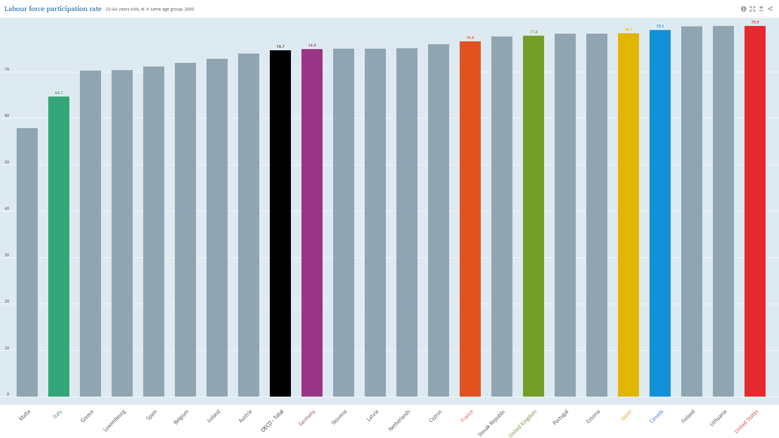

Slide 9
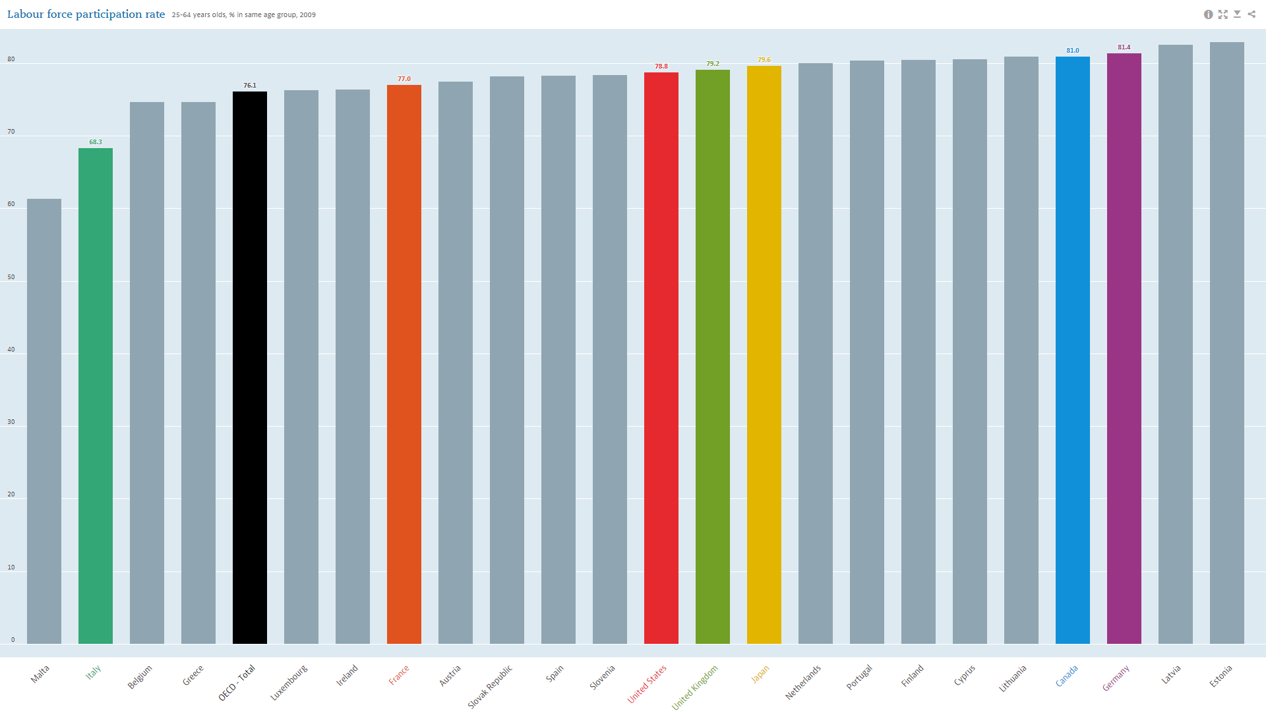

Slide 10
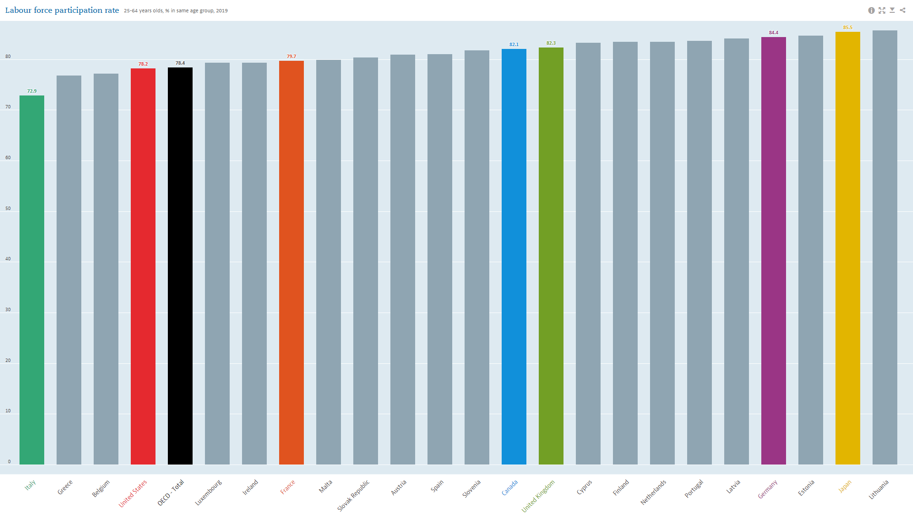

Slide 11
Where Is the Workforce? A Look at Data and Trends
Diana Elliott, Ph.D.
Vice President, Programs, PRB

Slide 12
Where is the workforce (and what about demographics)?
Unemployment (4.3%) is not as low as a year ago (3.5%), but below “full employment” (5%)
But the unemployment rate does not tell the full story –
  June 2024: more job openings (8.2m) than unemployed people (6.8m); 0.8 unemployed people per opening
  Short-term lagging indicator; not long-term, future looking
  Misses nuance and context (Who isn’t working? Why?)
Demography gives clues about “missing workers” now and in the future
  Changing age structure
  Increased death rate; illness
  Immigration
Let’s walk through these trends and why policy also matters
Notes:
Unemployment rate trends here: https://fred.stlouisfed.org/series/UNRATE (July 2024)
JOLTS press release on job openings: https://www.bls.gov/news.release/jolts.nr0.htm
Number of unemployed people: https://www.bls.gov/news.release/pdf/empsit.pdf
Ratio of unemployed people to job openings https://www.bls.gov/charts/job-openings-and-labor-turnover/unemp-per-job-opening.htm#

Slide 13

What does the future of the labor market look like? Older people are exiting the labor force
Between 2000 and 2023, the U.S. median age increased by 3.8 years; 39.1 in 2023
All Baby Boomers—born 1946 to 1964—can access retirement savings and most can claim Social Security
90% projected to stop working by 2030
We cannot rely on large numbers of older workers to address the labor shortage
Photo by Centre for Ageing Better on Unsplash
Notes:
In 2000 Census, median age was 35.3 (https://www2.census.gov/library/publications/decennial/2000/c2kprof00-us/c2kprof00-us.pdf)
In 2023 Pop Estimates, median age was 39.1 (https://www.census.gov/data/tables/time-series/demo/popest/2020s-national-detail.html)
Share of working age people:

Slide 14
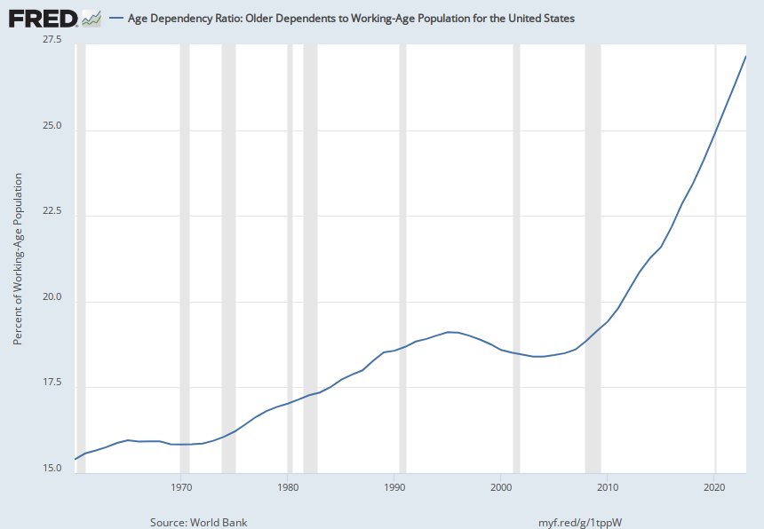
The share of those ages 65+ increases relative to the working-age population (15-64) every year.
Photo by Centre for Ageing Better on Unsplash
Notes:
Interpret this as 27.16 people 65+ per 100 working age people (15-64)
Source:
World Bank
Release:
World Development Indicators
Units:
Percent of Working-Age Population, Not Seasonally Adjusted
Frequency:
Annual
Age dependency ratio, old, is the ratio of older dependents (people older than 64) to the working-age population (those ages 15-64). Data are shown as the proportion of dependents per 100 working-age population.Source Indicator: SP.POP.DPND.OL
World Bank,
Age Dependency Ratio: Older Dependents to Working-Age Population for the United States [SPPOPDPNDOLUSA],
retrieved from FRED,
Federal Reserve Bank of St. Louis;
https://fred.stlouisfed.org/series/SPPOPDPNDOLUSA,
September 4, 2024.

Slide 15

What does the future of the labor market look like? Fewer future workers are being born in the U.S.
Since 2007, total fertility rates are well below replacement level
For context, those born in 2007 are now 17 and entering the workforce
In 2023, the total fertility rate was 1.6 births per woman, down 2% from 2022 (provisional); replacement rate is generally considered to be around 2.1
Fewer young Americans to replace retirees
The labor force is not going to be changed dramatically through youth employment
Photo by Kiana Bosman on Unsplash
Photo by Centre for Ageing Better on Unsplash
Notes:
https://www.cdc.gov/nchs/data/vsrr/vsrr035.pdf

Slide 16
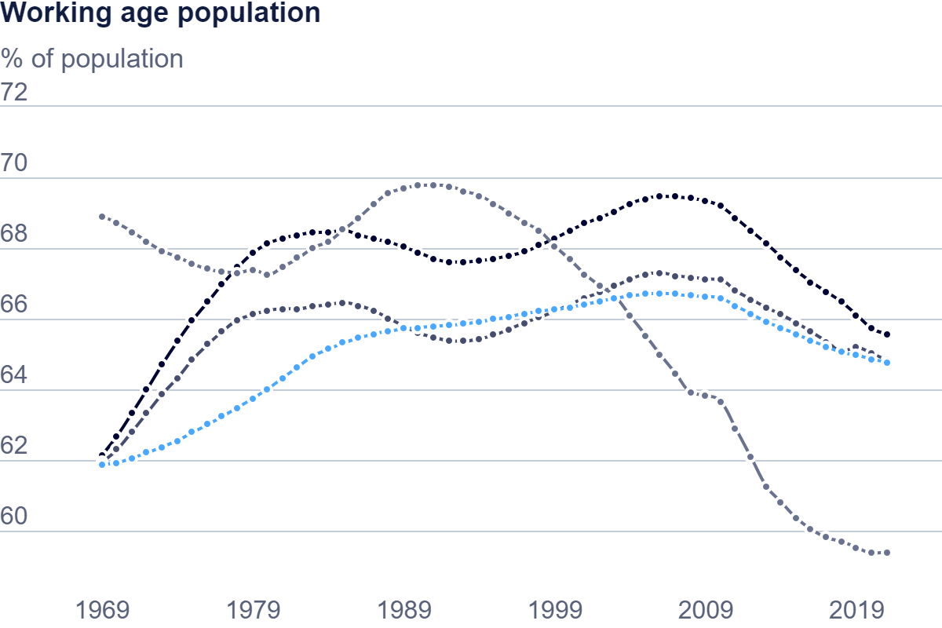
Collective Challenge:
Share of the Working-Age Population, 1970-2021
Canada
OECD avg
U.S.
Japan
Notes:
https://www.oecd.org/en/data/indicators/working-age-population.html?oecdcontrol-d6804ae080-var1=OECD%7CCAN%7CJPN%7CUSA
Canada 65.6
US 64.8
Japan 59.4

Slide 17

What does the future of the labor market look like? Increased death rate
Since 2010, death rates have risen for working-age adults
Trends driven by increases in drug overdoses, alcohol, suicide, diabetes, and obesity-related health conditions
COVID-19 exacerbated the increase; 58 excess deaths per 100,000 people in 2020 (ages 15-64)
Long COVID may be depressing labor force participation, much like the general trend for Americans with disabilities
Photo by Jon Tyson on Unsplash
Notes:
New study using CDC data found that U.S. men’s life expectancy is 6 years less than women
Increase was notable between 2019-2021 related to excess COVID deaths and drug overdoses
Women in U.S. are dying at higher rates, too
PRB’s new report, Losing More Ground, finds women ages 25-34 have lost generational progress due to increased maternal mortality, suicide, homicide
Homicide is now the leading cause of death for pregnant women

Slide 18
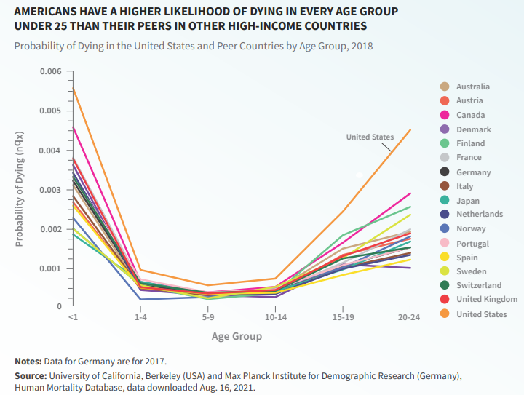
Increased mortality:
Working-age adults (18-24)
Photo by Centre for Ageing Better on Unsplash
Notes:
https://www.oecd.org/en/data/indicators/working-age-population.html?oecdcontrol-d6804ae080-var1=OECD%7CCAN%7CJPN%7CUSA
Canada 65.6
US 64.8
Japan 59.4

Slide 19

What does the future of the labor market look like? Immigration stalled in recent years
Between 2010 and 2018, immigrants and their U.S.-born children were 28% of all U.S. workers and contributed to 83% of labor force growth
In recent years, immigration policies created systemic backlogs
COVID-19 pandemic added administrative delays; border restrictions halted movement
Delays in issuing work permits to immigrants due to congressional challenges setting policy
In 2023, the U.S. added 1.6 million people; post-pandemic recovery in immigration and fewer deaths
Photo by Kerwin Elias on Unsplash
Notes:
https://www.migrationpolicy.org/sites/default/files/publications/immigrant-origin-workers-future-work_final.pdf
https://www.migrationpolicy.org/article/frequently-requested-statistics-immigrants-and-immigration-united-states
https://www.census.gov/newsroom/press-releases/2023/population-trends-return-to-pre-pandemic-norms.html

Slide 20
U.S. Population to Shrink Within the Century; Faster With Low Immigration

Slide 21
Within 20 Years, Deaths Outnumber Births; Faster With Low Immigration

Slide 22

It’s not all demography – policy matters, too
Photo by Helena Lopes on Unsplash

Slide 23

Policy matters in the future labor market:
Women's labor force participation
The U.S. is notable for lack of family-friendly policies; limits women’s full LFP
Women’s LFP (May 2023) is above pre-pandemic levels—77.6% (ages 25-54); lowest for those with young children
Canada’s rate is 84.9% and notable for women with young children; government invested billions to cut childcare costs
Men’s LFP in U.S. is on par with pre-pandemic levels (89.1% for ages 25-54)
Photo by Alexander Dummer on Unsplash
New Mexico stands out: 1) Created the Early Childhood Education and Care Department (2019); 2) Amended state constitution (2022) to increase distributions from permanent school fund for ECE; 3) Expanded subsidies to families
Notes:
https://www.bls.gov/opub/ted/2023/labor-force-participation-rate-for-people-ages-25-to-54-in-may-2023-highest-since-january-2007.htm#:~:text=TED:%20The%20Economics%20Daily&text=The%20rate%20was%2083.4%20percent,pandemic%20level%20in%20April%202023.

Slide 24

Policy matters in the future labor market:
Engaging people with disabilities
People with disabilities are underemployed in the U.S.
COVID/Remote work increased their employment
In 2022, 21% of people with disabilities were employed; up from 19% in 2021
Unemployment rate for those ages16-64 fell from 10.8% (2021) to 8.2% in 2022
Unemployment rate is still 2x higher than those without disabilities
Accommodations matter—nearly half are free and those with one-time cost, typically $300
States are leading the way as model employers
Ohio established the state’s Vocational Apprentice Program in 2019; paid apprenticeship opportunities provided in state government

Slide 25
What is the state of the U.S. labor force?
Births have slowed in the U.S.; few older Americans are likely to work longer
Deaths of younger working-age people trending up; long COVID and other comorbidities may affect how people work
Immigration keeps the U.S. populated – but for how long?
Demography is not destiny!
Bold policy can change the course to engage sidelined workers (e.g., women with family obligations, people with disabilities, immigrants, justice-involved)
Examples to attract, retain, and train workers can be found in other countries and states

Slide 26
Thank you!
Diana Elliott
delliott@prb.org

Slide 27


CRITICAL
Finding solutions to the labor shortage
LABOR
COALITION

Slide 28
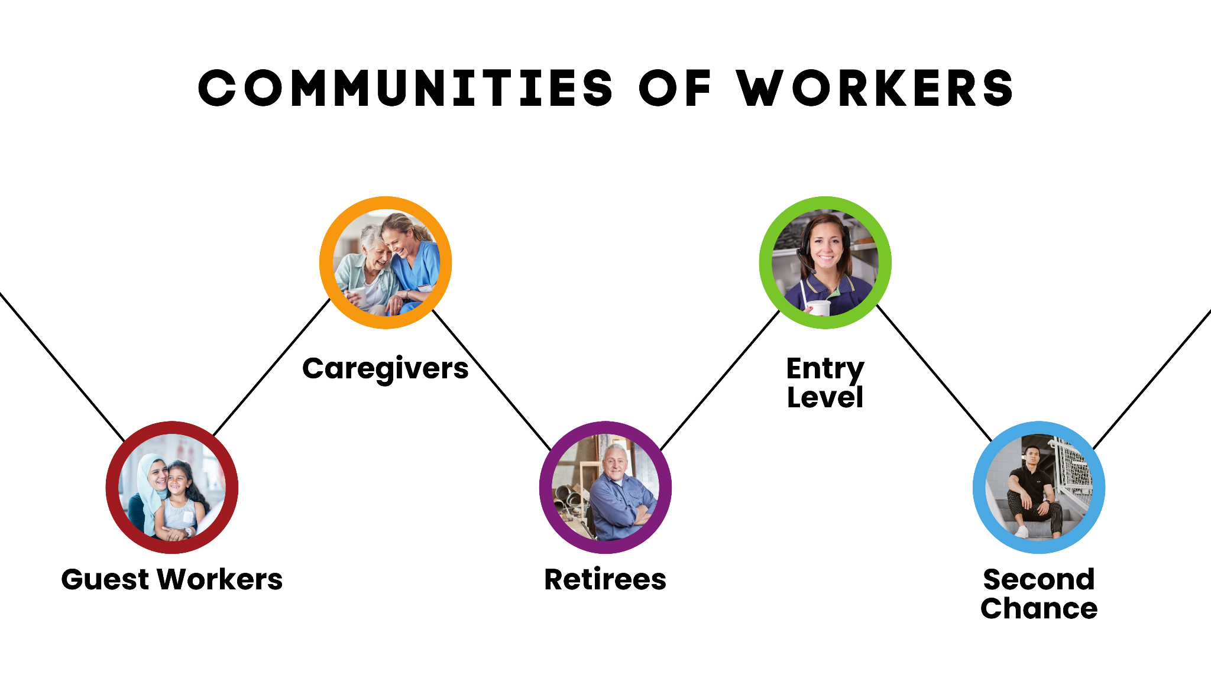

THE CRITICAL LABOR COALITION
A 501(c)4 formed in July 2022 to find solutions to the critical labor shortage.
Comprised of trade associations as well as corporate and individual business owners, CLC advocates for bipartisan policies that incentivize individuals to return to work.

Slide 29
















CRITICAL
Members
LABOR
COALITION

Slide 31
Tax Incentives
“Improve and Enhance WOTC”
Bipartisan house bill – Reps. Smucker (R-PA) and Sewell (D-AL)
Increases maximum credit from 40% to 50% of $6,000
    Has not changed since inception 27 years ago
Additional credit for employees who work at least 400 hours
“EITC for Older Workers Act”
            Bipartisan House bill - Reps. Carey (R-OH), Danny Davis (D-IL)
            Eliminates top age restriction for EITC age eligibility
  “Credit for Caring Act”
    Bipartisan, bicameral bill – Sens. Bennet & Capito, Reps. Carey & Sanchez
    Creates up to a $5,000 nonrefundable tax credit for family caregivers; and
  Applies to incurred family caregiving expenses greater than $2,000

Slide 32
Workforce Growth
Essential Workers for Economic Advancement Act (H.R. 3734)
Bipartisan House bill – Reps. Smucker (R-PA), Cuellar (D-TX)
Creates H-2C non-immigrant visa for non-agricultural, less-skilled based positions
Max 65,000 temporary H-2C visas - can increase or decrease based on need
Economic triggers to ensure workers are needed
Asylum Seeker Work Authorization Act (S. 255, H.R. 1325)
      Bicameral, bipartisan bill - Senators Collins & Murkowski, Reps. Pingree & Salazar
              Shortens the waiting period for asylum seekers to receive work authorizations from 180 to 30 days
  Senate vs. House bill
    Senate: 2-year renewals, “port of entry requirement”
    House: No need to renew, no “port of entry”

Slide 33
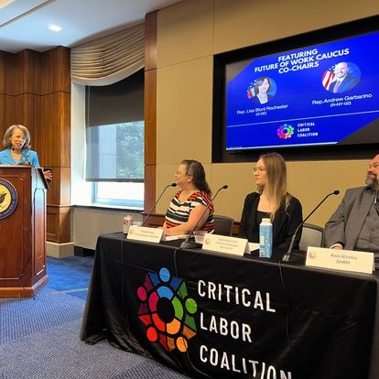

CLC Activities
Congressional Briefings

Slide 34

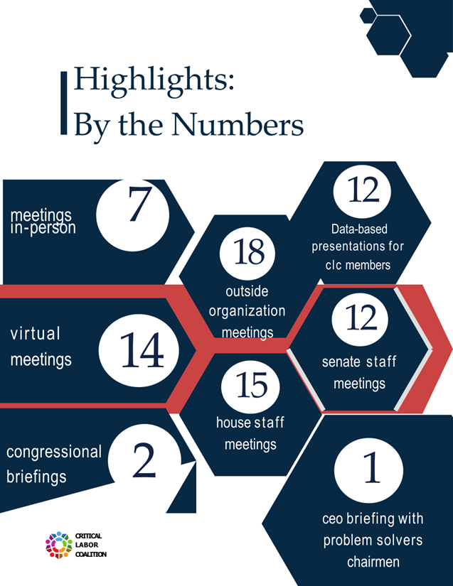

CLC Activities
Meetings and Presentations

Slide 35

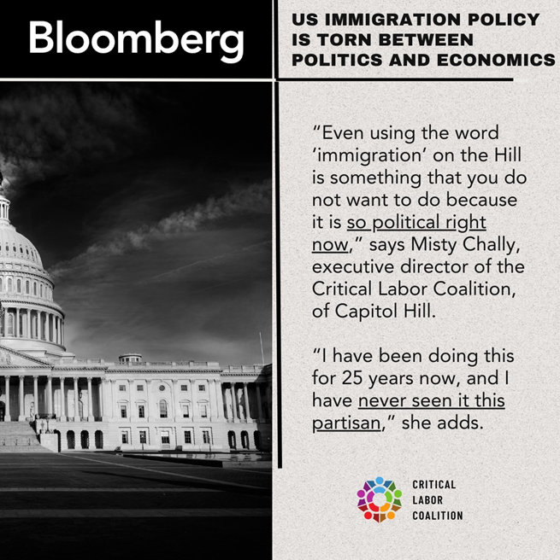

Digital Ads/Media

Slide 36

Digital Media

Slide 37





THE CRITICAL LABOR COALITION
@criticallabor
@criticallaborcoalition
@criticallaborcoalition
Scan the QR code to visit our site
www.criticallaborcoalition.org
Misty Chally
mistyc@clcoalition.net
(202)674-1174

