Slide 1


Influencing
Unit 1.3
Policy
Change
1
IMAGE: SHUTTERSTOCK
Notes:
Welcome back! As a youth advocate, you may be wondering what opportunities there are for you to influence a policy process. This session will assist you in identifying entry points. Entry points are physical or virtual spaces where you can access decisionmakers.

Slide 2



What Is an Entry Point?
TWO TYPES:
Entry points are physical or virtual spaces where you can access decisionmakers
1
2
Existing entry points
that you need to find
Entry points that
you create
IMAGE: UNSPLASH
Notes:
Identifying an entry point is a way to get “a seat at the table,” but it also begs the question, “Once you have a seat at the table, do you know what you’ll do with it?” Remember to set your objectives while searching for and identifying your advocacy entry point. Then, once you have that entry point, you’ll be ready to communicate strategically to meet your policy objective.
Advocacy ntry points can take on many different shapes and forms. In general, entry points can be grouped into two categories: those that already exist but may need to be identified by doing a scan of the policy landscape, and those that you will need to create.

Slide 3


To Identify Entry Points, You Must Understand the Policy Landscape
Who
are the
stakeholders?
How
are these policies
being funded and
implemented?
What
are the policies
that are in
place?
Notes:
To begin to understand entry points, let’s review what we learned about the policy landscape in our previous session. You first need to know WHO is involved—we call these the stakeholders, the people and groups who are affected by your issue. Youth are often an important stakeholder.
Then, you need to know WHAT policies are in place. Are there national policies? Government policies at a lower administrative level? And if so—perhaps more importantly—what do these policies say? How are youth issues featured in these policies? Were youth involved in their creation? Are there gaps in the policies that are in place?
Then, the HOW: How are the policies funded? Are donors funding, and thereby influencing, the programs? What’s the process for creating or changing a particular policy? How are the policies developed, introduced, debated, approved, and reviewed? Are the policies being effectively implemented? Are youth involved in monitoring implementation?
Each of these areas offers a set of entry points for how you, as a youth advocate, can begin to engage on your topic and reach policy audiences with your message. Let’s take each of these areas—stakeholders, policies, and implementation—and think through some ways for youth to be involved.

Slide 4


Stakeholder Entry Points
Who
are the
stakeholders?
Stakeholders are affected by, involved with, and/or influential on an issue or policy
Are you a
stakeholder?
IMAGE: UNSPLASH
Notes:
Who are the stakeholders? Well, earlier we learned that stakeholders include those being impacted by a particular policy. Stakeholders also include people in charge of both creating and implementing a policy, as well as those who have influence over a particular policy issue.
One of the first things to think through is whether you are recognized as a stakeholder and, if so, what your relationship is to the topic. For example, maybe your objective is to focus the attention of the media in your country on how the national child marriage law is not being implemented or enforced. As a young person, whether or not you are married, it is likely that you are a stakeholder because your life is impacted by the existence of the policy and by the degree to which it is implemented. In some situations, youth may be a stakeholder, but not yet recognized as one.
But, why does it matter whether you are a stakeholder? Knowing whether you are a stakeholder can help you determine how to frame your advocacy messages and where some possible inroads may exist for you to engage. Sometimes policymakers or implementers hold stakeholder engagement meetings that could be a possible entry point for you.

Slide 5


ANALYZE STAKEHOLDERS TO…
Stakeholder Entry Points
Identify political platforms for youth engagement
Look for alliances, common ground, and champions
Understand the people that make up the policy landscape
Notes:
In most countries, formal political platforms exist for youth engagement, but you may find that they are not specific to your issue area. For example, many political parties have a youth wing, and these wings vary in their level of direct engagement with policy audiences. These youth wings could be an entry point for you to get involved.
Some countries have nonpartisan youth assemblies that could be an entry point, such as the National Youth Senate in Kenya, which strives for an engaged and informed youth population and increased youth representation in politics.
Sometimes there are youth members of parliament, who may be open and receptive to hearing your ideas.
(FUN FACT: Bhutan has the highest proportion of youth under age 30 elected to upper parliament worldwide. Almost one in 10 members of Bhutan’s upper parliament is under the age of 30. [Source: http://archive.ipu.org/pdf/publications/youthrep-e.pdf])
Next, try to find out who is involved in a policy or has influence over a policy. Knowing the “who’s who” of the policy landscape for your issue is one of the best ways of identifying entry points. Look for potential alliances with those you agree with, common ground with those who share your interests, and champions among those who hold influence over the policy process and are either already supportive of your issue or potentially supportive.
Sometimes your entry point can be a person who opens doors for you as a youth advocate. In other cases, you may want to strategically collaborate with organizations whose opinions are already trusted by policymakers and who hold influence over policy decision-making.

Slide 6







What
are the policies that are in place?
Policy Entry Points
Decide whether a new policy is needed or whether better implementation of existing policies would best improve the situation
Look for policies that are relevant to your issue
Find platforms for engagement
Notes:
Another approach to searching for entry points for advocacy is to scan the policies already in place for those that impact young people’s lives.
Perhaps you start with a youth-focused policy, such as a national adolescent and youth sexual and reproductive health policy, a provincial youth policy, or some other national or subnational policy. To look for youth-focused policies, search health, education, economics, governance, and other sectors and think through how policies in each sector influence or have the potential to influence your life. For example, is primary school free in your country? If so, there is probably a policy that made that a reality. The same is true for many other aspects of life. When you find youth-focused policies, find out as much as you can about them, such as:
When was the policy created?
Who created the policy?
What was the process for creating the policy? Were stakeholders involved?
How long is the policy intended to be in place?
Some policies are created with a particular timeframe in mind, and others are not. For example, in Uruguay, the national youth policy covers a four-year period. Other countries may regularly refresh their youth policies but are not on a particular timetable. Some policies that impact youth can take the shape of annual development plans or “long-term vision” documents.
[Ask:] Does your country have a long-term development policy? [Generate responses. Examples include Nigeria Vision 20:2020 or Kenya Vision 2030.]
Determining how a policy that affects youth is time bound (or not) will help you as a youth leader to figure out potential times for engagement—these are entry points. Sometimes in the policy development process, spaces for public participation are available that can be leveraged as an entry point for greater youth involvement. In addition to public participation in the policy development process, sometimes there are meetings held with youth to provide input into the design of youth-specific policies.
As an example of how to use public participation hearings as an entry point: In 2017 PRB supported youth advocates in Kenya to develop and present memos to county decisionmakers as they revised their five-year County Integrated Development Plans. By participating in public forums, sharing memos, and insisting that particular youth issues be included in the plans, youth champions helped pave the way for stronger commitments over the five-year implementation period for the development plans.
In some countries, monitoring and evaluation of policy occurs. Entry points can exist in the regular monitoring of policy implementation or at the end of a policy timeframe.
Remember, youth have a right to be involved in the development, implementation, and monitoring of ALL policies that influence their lives and communities—not just those pertaining to youth.
[Ask:] Can you think of any policies that impact youth but are not youth-specific? [Generate responses. Examples include environmental policies.]

Slide 7
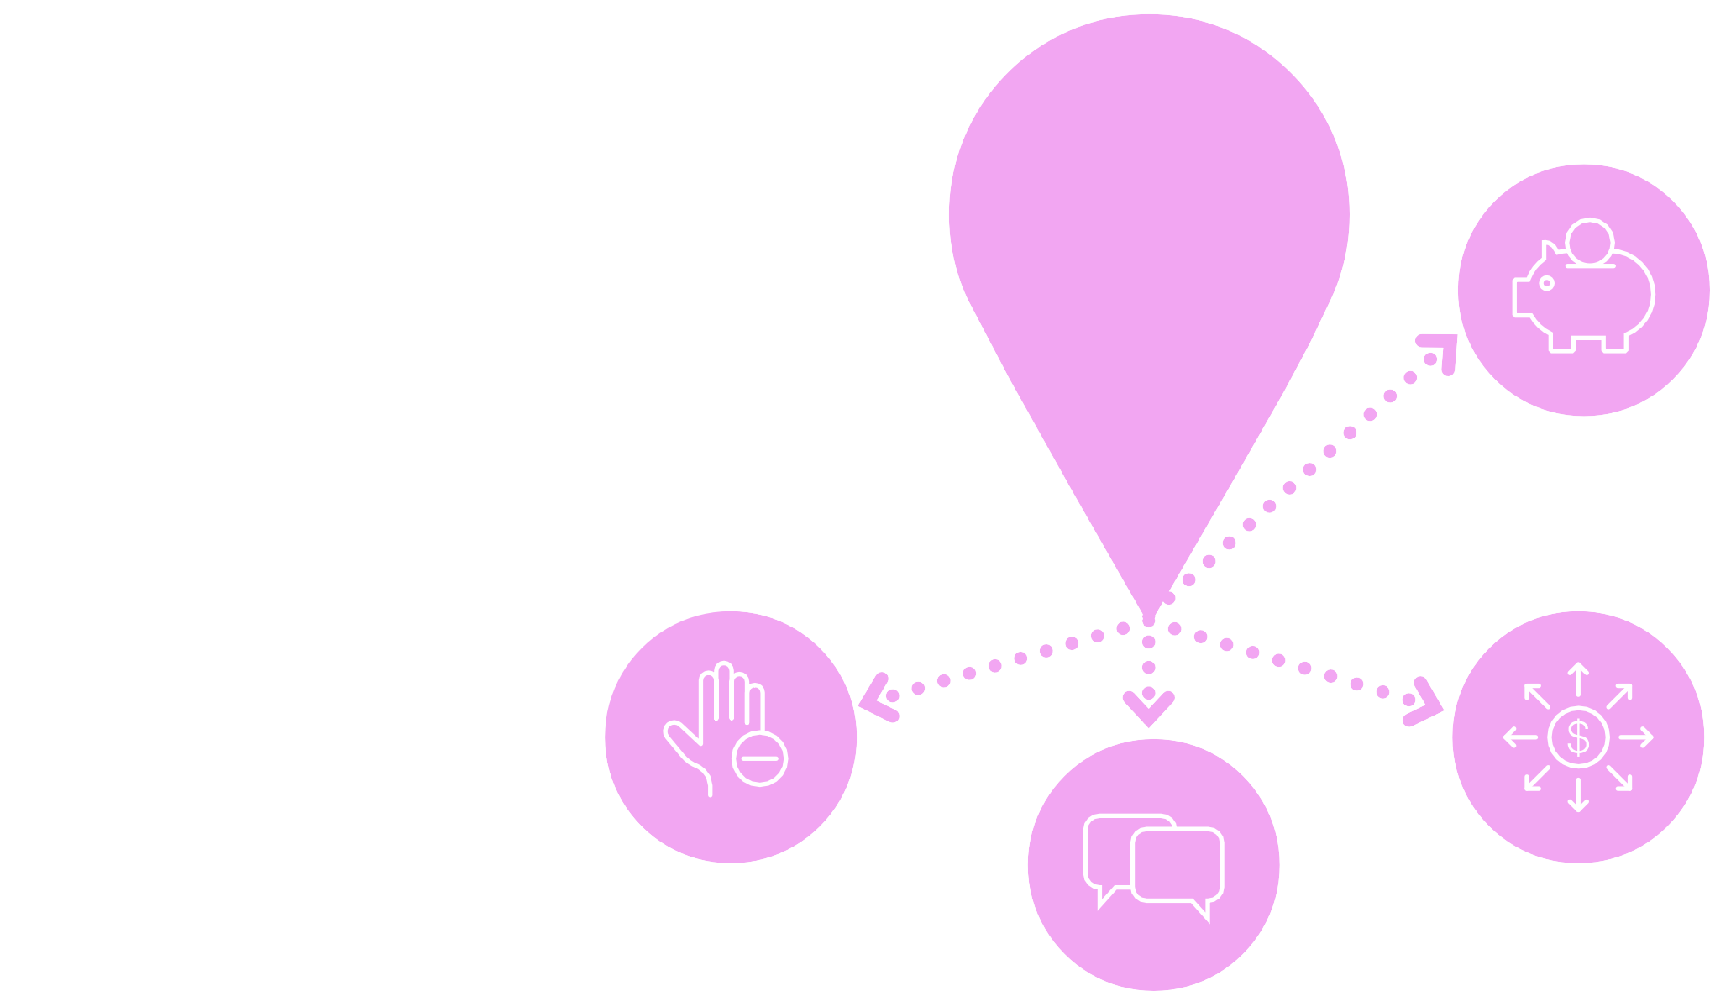
How
Part 1.3 Influencing Policy Change
Funding and Implementation Entry Points
are these policies being funded and implemented?
Who controls the budget?
6
Who is responsible for implementation and enforcement around your issue?
Has money been allocated to regulating your issue of concern?
Find opportunities
to engage
Notes:
To find entry points, you’ll want to consider HOW policies are being funded and implemented. Once you understand how a policy is being funded and implemented (or not!), then you’ll know more about how to engage and who your target audience is.
For example, if the national government passes a policy that ensures youth access to sexual and reproductive health care, you may want to find out how the policy will be implemented and who is responsible for implementation and monitoring. Will subnational leaders be trained on the new policy? Will resources be available for implementation? Is there a government office or a technical committee responsible for policy implementation? Does a monitoring and evaluation plan exist? The answers to these questions will help you determine your entry points.
You’ll also want to look into the funding of the policy and see how it’s being paid for. Once you have determined how a policy will be funded, you may be able to identify an entry point. To return to the youth sexual and reproductive health policy example, your state or provincial government may hold budget hearings during which you could participate and ask for funding to be allocated toward implementing that policy.

Slide 8


Creating Your Own Entry Points
Organize youth to work together to push for change
Leverage the media, including social media
Meet with
decisionmakers
Host a public dialogue
IMAGE: UNSPLASH
Notes:
When we began this presentation, we described the two main types of entry points—those you identify and those you create. Now that we’ve summarized some strategies for identifying an existing advocacy entry point, let’s transition to the second type of entry point: those you create.
Creating your own entry point can be simple, or it can be a complicated endeavor that requires a lot of careful planning. It depends on your policy environment and the goals you have set. We will teach you more about setting your goals and objectives later in the training.
To create your own entry point, one strategy could be to simply request a meeting with a decisionmaker that you identified when you analyzed the policy landscape or approach a decisionmaker during an existing event, like a high-level meeting or conference. If you choose to do this, you will want to introduce yourself clearly and describe the purpose of the meeting. During the meeting, present your ideas concisely. We will go into more detail about how to present your issue to decisionmakers in upcoming sessions.
Another approach is to create your own entry point by hosting a public dialogue on the topic you are hoping to get a decisionmaker to pay attention to. Invite your audience to attend the dialogue and publicize the event widely to ensure good attendance. We will get into more detail on strategies like this in future sessions.
You could also try circulating a petition or policy memo to other youth and presenting it to a policymaker for consideration. Or you could gather a group of young people together for a meeting with a policymaker.
Lastly, you may consider leveraging the media, including social media, to try to access the decisionmaker you are targeting. We’ll talk about how you can integrate multimedia elements into your advocacy campaign in upcoming sessions.
Similar to identifying an entry point, creating your own requires a good understanding of your policy environment and clearly defined goals and objectives.

Slide 9

Why Relationships Matter
Bind your different efforts together
Sometimes take a while to develop
Can be leveraged as entry points
Have the potential to stay with you your whole career
Notes:
What we haven’t discussed in depth yet is relationships. Your professional relationships and networks will be the glue that holds together the different efforts you make throughout your career. The relationships you make now as a youth leader have the potential to stay with you your whole life, so value and respect each connection you make. Also, be sure to leverage the strong relationships you already have when identifying or creating entry points for advocacy. Relationships are a common thread that run throughout all the different types of entry points that we’ve discussed, how you’ll identify them, and how you’ll leverage them.
Lastly, an entry point might allow you to get time with a policymaker to discuss an important issue, but a relationship with that policymaker could take a long time to develop. Be patient as you build trust and rapport in new relationships. Persistence, patience, and consistency will pay off.

Slide 10


Creating a Window of Opportunity for Policy Change
IMAGE; UNSPLASH
Notes:
In this part of presentation we are going to discuss ways in which we as advocates and stakeholders can leverage these entry points to create a window of opportunity for policy change.

Slide 11

Advocacy Must Be Strategic
Processes are not linear or rational
Decision- making is complex
Strategic communication is important
Policymakers consider a host of factors
Notes:
We’ve touched on the fact that when it comes to decision-making around policies, it can be complex. Policymakers are busy; they are bombarded with information; and the processes around decision-making do not necessarily happen in a straightforward, linear, or rational way (as in policymakers receive information, then take action). Rather, it’s a fluid process, and information uptake often happens gradually over time.
So, we must be smart about how we get our messages out to decisionmakers.

Slide 12


A Window of Opportunity for Policy Change
Political environment
WINDOW OF OPPORTUNITY
Problems
Solutions
Notes:
To help you do this, we are going to introduce you to the Multiple Streams Framework for policy change. There are lots of models for policy change, but we like this one because it’s non-linear and was developed with the advocacy process in mind. This model shows how three streams of activity may be going on concurrently—problems, solutions, and political environment—and each has a life of its own.
Problems are recognized and defined from research. Solutions, or policy alternatives, are developed. But until a solution is proposed, no problem can be addressed. And political events flow along in their own unpredictable way. You might have both an identified problem and a feasible solution. But if there is no interest or political will regarding the issue, nothing will happen.
But there can be times when these three streams move together and create a “window of opportunity” for program or policy change in the center. This intersection rarely just happens: Somebody must work to help ensure that these streams come together.
[Source note: This model was first proposed by Kingdon (1984) and modified by Porter (1995) as well as by PRB over the years.]
Let’s now go over the three spheres in more detail:
First, defining problems. For something to be defined as a problem, people must first recognize it as such and believe that something should be done and can be done to change it. Stakeholders need to feel that it is within their control to address the problem.
Next, considering solutions. Different solutions are developed according to their own criteria of selection, whether or not they are solutions to recognized problems or sensitive to political considerations. Solutions should be sensible, cost-effective, feasible, politically palatable, and relevant to the problem at hand. But we must remember that selecting a solution is also not always a rational decision-making process.
Finally, politics and the political environment. Independent of identifying problems and solutions, political events move at their own pace, with their own dynamics and rules. Developments in the political sphere can be powerful in determining the priority of problems and solutions; for instance, a change in government, a change in ministers, or a change in the president of an organization can result in a significant swing in priorities that can move a subject onto or off of a government agenda. Politicians themselves may act based on analysis of the political costs and benefits of addressing a problem, rather than from the technical importance of an issue or proposal alone.
For a window of opportunity to open, all three of these streams need to come together. Oftentimes an issue may fall into one or two circles, but not all three.
[Ask:] Can anyone think of an issue that might fall into one or two of these circles, but not all three? [Generate responses. Possible answer: The issue of climate change is a good example of where we have solutions, and in some cases we have the political will to do something about it, but not everyone agrees it’s really a problem that needs to be addressed.]

Slide 13
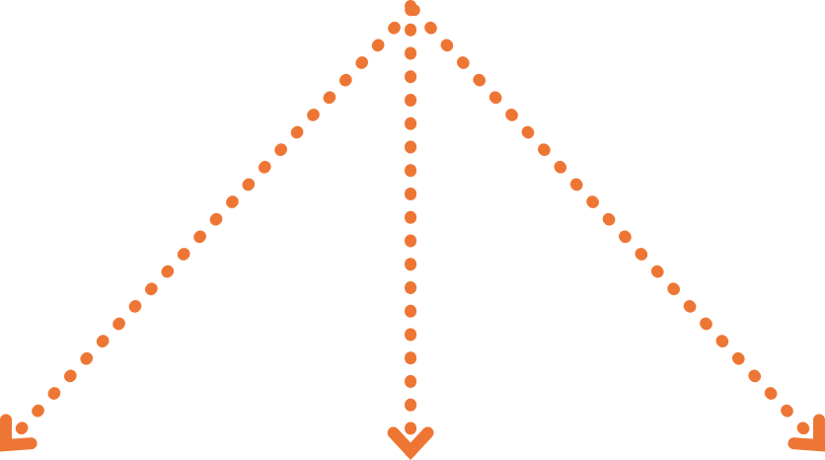
Systematic Elements to Affect Agendas and Influence Policy Change
2
Attention focusing
1
Policy learning
3
Policy community strengthening
Notes:
We believe that there are three basic elements you can use to affect policy change: policy learning, attention focusing, and policy community strengthening.
We’ll define each of these in more detail in a moment, but first let’s look back at our model of policy change.

Slide 14


GLOBAL POLITICAL CONTEXT
POLICY COMMUNITY STRENGTHENING
POLICY LEARNING
Moving the Spheres Together
Political environment
WINDOW OF OPPORTUNITY
Problems Solutions
ATTENTION FOCUSING
Notes:
These three elements fit around the outside of our model. By influencing policy learning, attention focusing, and policy community strengthening, you can exert pressure to move the three circles together.
The first element that we will discuss is policy learning.

Slide 15
Policy Learning: Motivating Dialogue and Action
1
Communicate information about problems and solutions in ways that motivate action
Create space for policy dialogue
Policymakers are more likely to act when presented with clear solutions
Help policymakers see the picture clearly
Repeat messages in an ongoing stream
Notes:
In the context of policy change, “policy learning” refers to how decisionmakers learn about new information, data, or findings.
It is an ongoing, incremental flow of information. This flow should involve disseminating multiple sources of information to reach decisionmakers through multiple channels. Sources of information, such as policy briefs, videos, or websites, need to be accessible to policy audiences.
[Ask:] What do we mean by accessible? [Generate responses.]
The messages should be articulated and packaged in understandable, non-technical, compelling language. The aim is to increase the capacity and space for policy dialogue among decisionmakers and to spur them to action.
These policy learning efforts need to be continuous and fed in an ongoing stream of information. For example, imagine that just about the time you get one decisionmaker up to speed on an issue, they leave office. We know it is often the case that policymakers are busy and distracted, so they may hear you once, and then forget about it—in one ear and out the other. Making sure they hear it from different sources at different times helps the message to resonate.
Whether a matter can sustain serious attention and rise on a policy agenda depends not only on whether it is indeed a problem. It also matters whether there are feasible solutions. This often depends on whether there is a community of individuals concerned with devising solutions to the problem, and whether that community is successful in generating workable solutions.
Just as you need solutions to create a window of opportunity, you need clear solutions to sustain attention and keep an issue on the agenda. The best policy and program alternatives are those that are sensible, cost-effective, both technically and politically feasible, and relevant to the problem.

Slide 16
GLOBAL POLITICAL CONTEXT
POLICY COMMUNITY STRENGTHENING
POLICY LEARNING
Moving the Spheres Together
Political environment
WINDOW OF OPPORTUNITY
Problems Solutions
ATTENTION FOCUSING
Notes:
Next, we will look at attention focusing.

Slide 17


Draw/keep attention of key audiences (policymakers, the media, the public)
Stimulate action
2
Attention Focusing
Leverage international commitments and days of recognition
Use key indicators
Notes:
Since there is so much information out there and competition among issues, you will need to get attention on your issue, and have it rise above the rest somehow. By drawing attention to your issue, you can help set the agenda—meaning you can help determine what policymakers are thinking and talking about.
The agenda-setting process is an ongoing competition among the proponents of different issues to gain the attention of certain audiences to affect policy change. The top three audiences for advocacy are often the media, the public, and policy or decisionmakers. We know that there are many social problems that never become issues even though proponents and opponents exist. Space and time on “the agenda” are scarce resources, and so to influence policy change, your issue needs to rise to the top.
Sometimes problems come to the attention of decisionmakers because some systematic indicator simply shows that there is a problem out there. These might include indicators like the teen pregnancy rate, HIV prevalence, or air pollution rates. These data points can make a big difference because they help decisionmakers assess the magnitude of a problem and determine whether it is changing for better or worse. They have a uniquely powerful effect on giving visibility to issues.
Sometimes attention is put on an issue or a problem by international organizations or donors. Because it’s something they care about and is on their agenda, it gets put on other agendas as well. One example is the creation of the United Nations Sustainable Development Goals. Because these are now held up as global goals, countries are paying attention to how they can meet them. Tying your issue to such goals can help give it legitimacy.
Another way to bring attention to an issue is to host or tap into existing events or activities like press conferences and international or national days of attention. Examples of international days of attention are World AIDS Day or the International Day of Zero Tolerance for Female Genital Mutilation. These days often provide a timely “hook” for the media to cover certain issues, reaching a wide audience. High-level conferences or meetings can also do this.
[Ask:] Can you think of examples of high-visibility events that might provide a good forum for advocacy? [Generate responses.]

Slide 18
GLOBAL POLITICAL CONTEXT
POLICY COMMUNITY STRENGTHENING
POLICY LEARNING
Moving the Spheres Together
Political environment
WINDOW OF OPPORTUNITY
Problems Solutions
ATTENTION FOCUSING
Notes:
Finally, we will look at policy community strengthening.

Slide 19


3
Policy Community Strengthening
A network of actors from different types of organizations that are committed to a common cause– also known as a coalition
Government
agencies
Universities
Legislatures
NGOs
Professional associations
Notes:
Focusing attention on your problem or solution can be a tireless and continuous job that is often better achieved through broad-based policy communities.
We define “policy communities” as alliances or networks of participants—ideally from a variety of positions in and around government, the academic community, the media, the private sector, and interest groups—who are united in their commitment to a common cause.
[Ask:] Are any of you currently involved in a policy community? [Generate responses.]
Things that you can do to develop or support policy communities and coalitions include joining an existing coalition, starting a new one, or working to strengthen an existing network. One of the most useful things about working with coalitions made up of diverse individuals and institutions is that you can get everyone on the same page, sharing the same messages, in the same ways. We will learn more about how to do this in our session on coalition building.

Slide 20
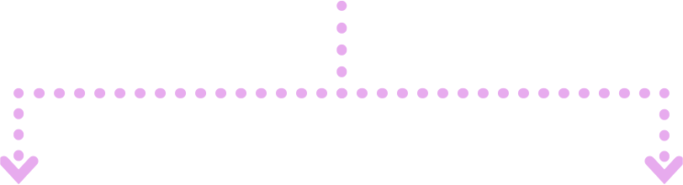
Influencing Policy Change Is Possible
POLICY CHANGE CAN TAKE PLACE WHEN THERE IS:
YOU CAN HELP BRING THESE TOGETHER:
Policy learning
Attention focusing
Policy community strengthening
A clearly articulated problem
Feasible, sensible solutions
A political climate ripe for action
Notes:
In summary, policy change can take place when there is a clearly articulated problem; feasible, sensible solutions; and a political climate ripe for action.
You can help bring these together through policy learning, attention focusing, and policy community strengthening.

Slide 21
GLOBAL POLITICAL CONTEXT
Where Do You Fit In?
POLICY COMMUNITY STRENGTHENING
POLICY LEARNING
Political environment
WINDOW OF OPPORTUNITY
Problems Solutions
There is a role for you in each of these areas. You can help create a window of opportunity for policy change!
ATTENTION FOCUSING
Notes:
So now that we have discussed multiple ways to influence policy change, where do you want to contribute? There are endless ways to get involved in bringing the streams together to create windows of opportunity.

Slide 22


Part 1
Do the Work!
Review the worksheet you completed in Unit 1.2. Consider if you want to modify or add anything
to your answers. Based on your policy landscape, where do you see entry points for advocacy? Add them to the worksheet.
Notes:
[Read slide. Distribute completed Exercise 1.2 Worksheets from previous session (or have participants retrieve them if they held onto them)].
[Allocate 10-15 minutes for participants to add entry points to their worksheets. After the exercise, be sure to collect the worksheets again or have the participants keep them; you will need them in future sessions.]

Slide 23
Part 2
Do the Work!
Brainstorm and discuss opportunities and strategies for creating a window of opportunity for the policy change you want to see. Try to list at least one activity under each category: policy learning, attention focusing, and policy community strengthening.
Notes:
[Read slide. Distribute flip chart paper or notebook paper for participants to write down their ideas. Allocate 15-20 minutes for this activity.]

Slide 24


Learn More
John W. Kingdon, Agendas, Alternatives, and Public Policies (Boston: Little, Brown, and Company, 1984).
Robert W. Porter and Irvin Hicks, Knowledge Utilization and the Process of Policy Formation: Toward a Framework for Africa (SARA Project, U.S. Agency for International Development, 1995).
Jeremy Shiffman and Sharmina Sultana, “Generating Political Priority for Neonatal Mortality Reduction in Bangladesh,” American Journal of Public Health 103, no. 4 (2013): 623-31.
Jeremy Shiffman, “Generating Political Will for Safe Motherhood in Indonesia,” Social Science & Medicine 56, no. 6 (2003): 1197-1207.
Youth Policy Labs, “National Youth Policy Overview.”

