Slide 1

Unit 2.2
Evidence-Based
Advocacy
1
IMAGE: SHUTTERSTOCK
Notes:
Welcome to our training on evidence-based advocacy. Now that you know how to tell a good story about your issue that is appropriately framed in a way that your audience will understand and remember it, we are going to talk about how you can bring data and evidence into your advocacy messages. Being able to do this well will give you more credibility as a messenger, and will help to convince others, including policymakers, that you know what you are talking about.

Slide 2
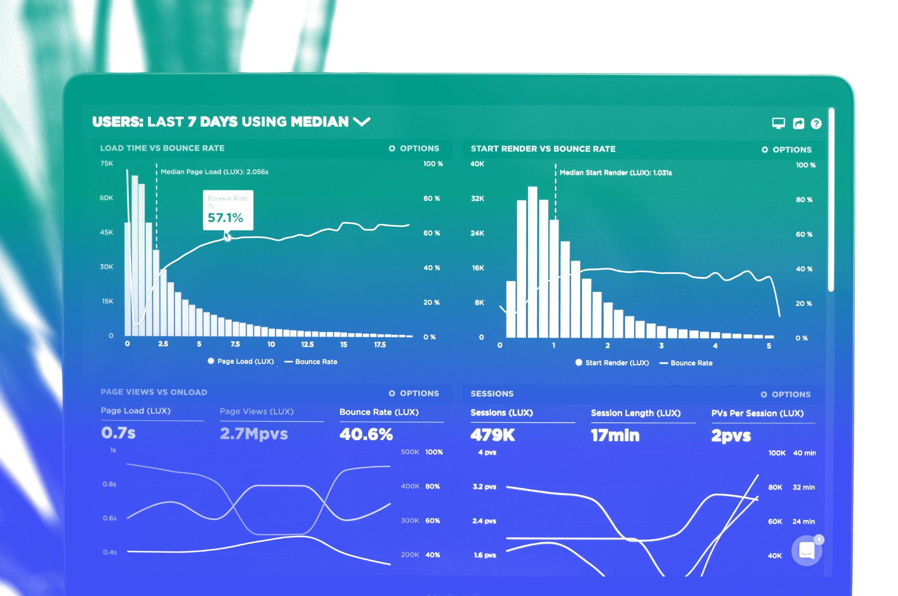

Data
Factual information (such as measurements or statistics) used as a basis for reasoning, discussion, or calculation.
(Merriam-Webster)
PHOTO BY LUKE CHESSER ON UNSPLASH
Notes:
We have mentioned in earlier training sessions that using data and evidence in your advocacy messages will give you more credibility. But what does that even mean? What is data, anyway?
This is a very basic definition that tells us that data are individual facts, statistics, or pieces of information.
[Ask:] Do you have go-to statistics that you use in your work? What are they? Why do you use them? [Generate responses.]

Slide 3

“
Advocates lose credibility by making claims that are inaccurate and slow down progress toward achieving their goals because without credible data, they also can’t measure changes.”
—Cheryl Doss, Yale University
Notes:
Here is an interesting quote from Yale University professor Cheryl Doss. [Read slide.]
[Ask:] Do you understand what she means? Do you think she has a point? [Generate responses.]

Slide 4
Why Is Data Important for Advocacy?
PHOTO BY LUKE CHESSER ON UNSPLASH
Notes:
[Ask:] So, what does integrating data do for your advocacy campaign? What are the benefits? [Generate responses.]

Slide 5







Data Can...
Help convince people to change or act
Support your goal with proof
Help overcome people’s biases and opinions
Make messages memorable
Lend credibility to you and your message
Notes:
To accomplish our goals, we need to convince decisionmakers in our primary audience to change what they’re doing or to take a certain action. So, we need to think about what facts will be most convincing.
We might think that our point is obvious, that everyone will agree it is important, or that if we just say things loudly and forcefully, people will be convinced to join our side. Also, in many instances, we might rely on anecdotes or stories to make a point (such as, “Well, this happened to my brother just the other day….”). We’ve already talked some about storytelling, and I think we all agree that stories are important and useful for making that emotional connection to an issue. Data can complement a story by providing context and filling in details. (Remember, our opponents also have stories and arguments to persuade people to go in a totally different direction.)
Data can help to give people confidence to act. If decisionmakers know that what you’re telling them is true and can’t be disputed, they are much more likely to take action. They don’t want to look bad by being called out on bad information, so if they see strong data from a trusted source, they’ll feel more comfortable to act on it.
Data is also useful to back up your story or point, and can help to overcome people’s biases and opinions (or their own experiences that might be counter to yours).
Using data in your messages can also help it to “hit home.” People may not realize the full extent of the problem until they hear the statistics.
And of course, when you use data and evidence well, you come across as credible. This is a very important point. If you cannot back up your claims with data, after a while people are likely not to trust you. There is an account of an advocate in Kenya who stopped being invited to certain events because they were notorious for sharing misinformation..

Slide 6

How Do We Find and Understand Data?
PHOTO BY MARKUS WINKLER ON UNSPLASH
Notes:
Where can you find data and evidence to back up your messages? There is a lot of great information on the internet, but also a lot of misinformation and speculation. You have to take care and use good judgement to find credible sources of good information.

Slide 7

Common Data Sources
National survey reports
Research journal articles or reviews
Health facility reports
Program evaluations
PHOTO BY ISMAIL ENES AYHAN ON UNSPLASH
Notes:
Here are some of the common sources of data you might use in your advocacy work.
First, there are national survey reports, such as a national risk behavior survey or an HIV surveillance report.
You can also find a lot of data in published research papers or reviews.
Another data source is health facility reports. For example, a hospital may collect data and write an annual report that gives data about the types of patients they’ve served and the cases they’ve seen.
And many organizations conduct evaluations of programs that can give you an idea of whether or not a certain intervention worked. You might have to ask to see these reports, they often are not posted publicly.

Slide 8








Large Surveys
Demographic and Health Surveys (DHS)
Multiple Indicator Cluster Surveys (MICS)
Performance Monitoring for Action
DATA COMPILERS
STATcompiler
PRB Data Sheets
Guttmacher Institute Data Center
UN Population Division
Track20
Notes:
These are a few examples of some of the common data sources at the national level. DHS data is collected in nearly every country and is generally seen as very reliable. Other types of surveys and data compilers can also come in handy if you are looking for certain national health or population data.

Slide 9
Global and Other Data
Topic or facility-specific data
Ministries
National research institutes
Reports from advocacy groups (use with caution)
Global reports with national indicators
WHO reports
UNICEF’s
The State of the World’s Children.
UNAIDS Global AIDS Update
Best practices
Program reports and evaluations
Notes:
For global-level and other data, these examples in the green bubble are some other well-known and well-respected sources of information. Often, these reports include data breakdowns by country.
If you need very specific data, you might find relevant reports from ministries or national research institutes. Although some reports might not be published, these places might be able to give you access to certain types of data if you ask for it.
Ministries, nongovernmental organizations (NGOs), civil society, and others implementing programs—or the donors—often write reports and evaluations that can provide useful information and data, particularly if you’re suggesting that something similar to their program be done or scaled up. Many advocacy groups also conduct and publish their own research on their issues of concern, but you should avoid taking their findings at face value, as they have a vested interest in promoting a certain point of view.
Often, there are also “best practice” documents on certain issues. Try Googling the term “best practices” plus “your issue.” Ensure the sources of these documents are reputable and established! Letting your audience know that what you’re suggesting is recognized as a best practice can lend your recommendation credibility and give them confidence they need to take action.

Slide 10
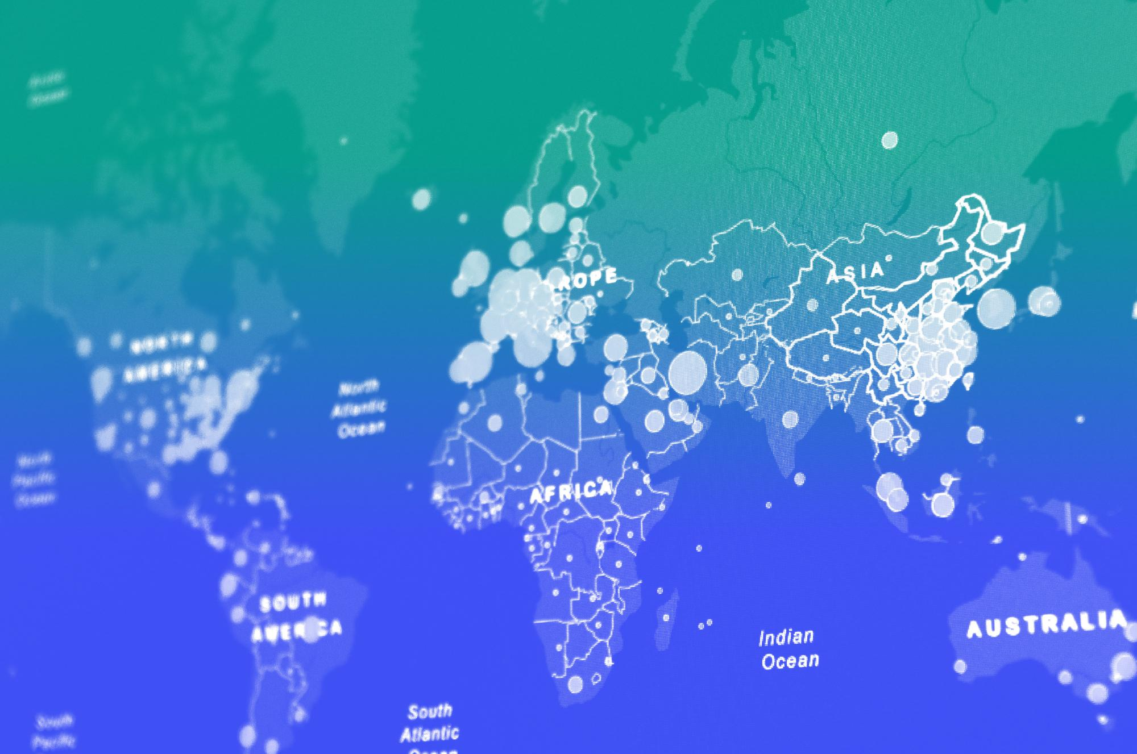
Data Types & Quality
PHOTO BY MARTIN SANCHEZ ON UNSPLASH
Notes:
When it comes to data, it is VERY important that you evaluate it carefully and make sensible judgements about whether it is sound and of good quality. Misleading statistics are everywhere!

Slide 11
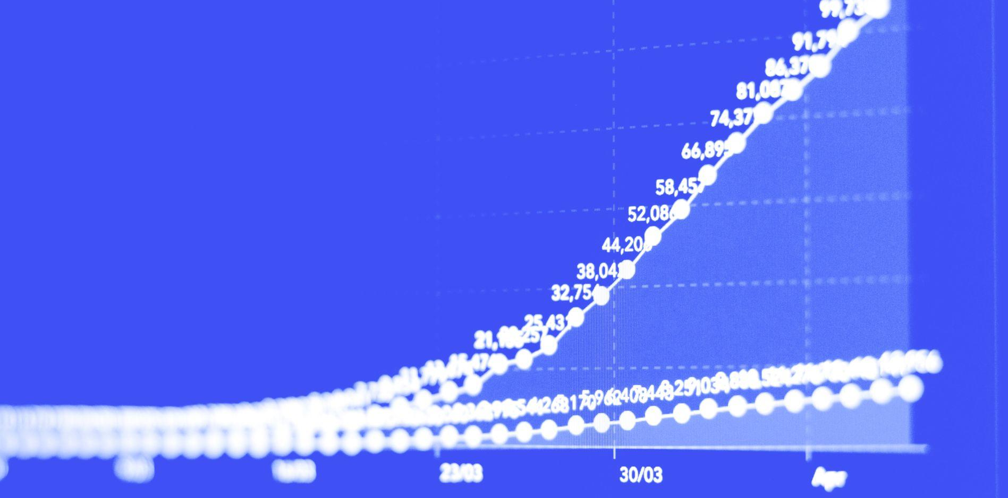
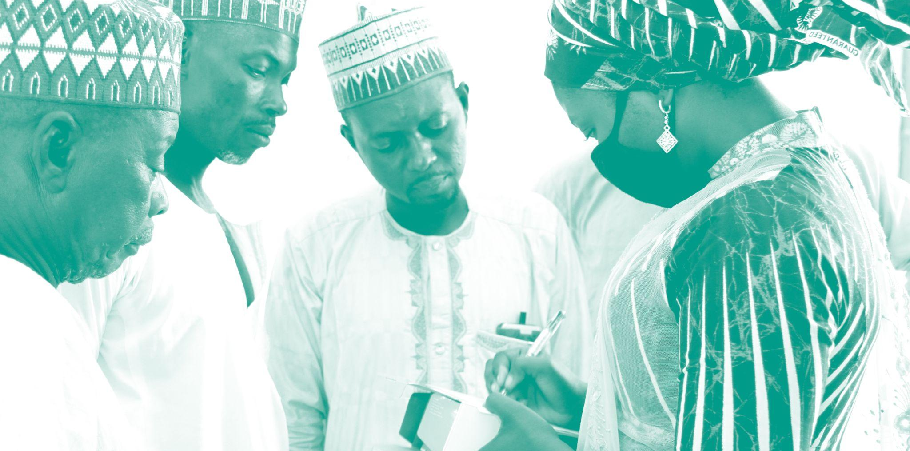
Types of Data
QUANTITATIVE DATA
QUALITATIVE DATA
Numbers
Statistics
Proportions
Rates
Averages
Medians
Quotes
Interviews
Observations
Examples
Descriptions
PHOTOS:UNSPLASH, LEFT, AND BRIDGE CONNECT AFRICA INITIATIVE, RIGHT
Notes:
There are two main types of data that you’ll be using in your work as a youth advocate.
First, there’s quantitative data. We typically think of this data as “the hard numbers.” This is where measures like raw numbers, percentages, rates, averages, means, and medians come in.
Next, there’s qualitative data. This is information that comes from interviews, focus groups, and observations. This type of data might include direct quotes, inferences drawn from a collection of statements, or descriptions. Many research studies collect high-quality qualitative data in a systematic way. And it can offer a powerful complement to the numbers.

Slide 12


Data
Helps Tell a Story
Quantitative data is a good starting point
Data reveals relationships, patterns, and trends
Qualitative data can help…
Highlight issues of interest
Inform quantitative data collection
Explain what the numbers mean
Add richness and context to the numbers
Notes:
Both types of data are important and can help connect the dots in your story, revealing relationships, patterns, and trends.
Quantitative data is usually a good starting point to lay the foundation for your message. It is easiest to compare across areas and population groups.
Qualitative data can be used for many purposes.
It can help to highlight issues of interest. If multiple people tell you the same thing, you may conclude that you should investigate that issue a little more. For example, if several young people tell you they were treated poorly at the local health center, you may take a closer look at how the staff at that health center act toward youth.
Qualitative data can also inform quantitative data collection. For example: “Many young people we interviewed said they have never been to a health facility. Let’s find out how many young people the local health facility served in the last year.”
Qualitative data can also help to explain what the numbers mean. Quantitative info doesn’t give you the “why.” So you see that young people aren’t visiting health facilities… is it because they don’t have transportation? Their parents forbid it? They don’t know what services are available to them? Or the facilities aren’t welcoming to young people? Don’t assume you know the reason.
And of course, qualitative data brings richness and context to the cold, hard numbers. “Let’s talk to one young person who did visit the health facility and find out about their experience.”

Slide 13

Evaluating Data Quality
Reliability
Validity
Representativeness
Applicability
Timeliness
Credibility
PHOTO BY ALINA-GRUBNYAK FOR UNSPLASH
Notes:
Here are six criteria that you can use as a checklist to assess the quality of the data you’re using.
One way to assess these criteria is to read the methods sections of research papers. You can also compare data from different sources or just apply some common sense. It is usually safe to rely on data from large, well-known international or national institutions, as it is part of their mission to ensure high-quality data.
The first of these criteria is reliability. This is the extent to which the data is consistent. One trait of reliable data is that it was obtained the same way each time. For example, if you are looking at trend data, was it collected the same way each time, using the same survey instrument and the same parameters? You cannot compare, for example, rates of HIV testing obtained one way in one year to rates obtained differently in another year. So, if one report says that rates went up in the last 10 years and another says rates went down, you may not be able to trust that either is reliable because there is no consistency in what is being said. Essentially you are asking: If this were done repeatedly, would we get similar results each time?
Then, there’s validity. Here you are trying to determine if the data is correctly measuring what it is aiming to measure. For example, if a survey is trying to assess family planning knowledge, but you notice that the questions used technical terms or complex language, it might have measured understanding of that language rather than knowledge of the information. One way to determine validity is to compare the data to other similar data. Are the estimates similar?
Next is representativeness. You also want to be sure that the data is representative of the population or context that you are focused on. Was there a large population size? Is the data for the same population of interest? It might have been a study among women in Tanzania (which is also your focus), but if the sample was not done randomly, or was not large enough, or was not taken from across the country or community of interest, it may not truly represent the views or behaviors of that group. This is an important consideration for qualitative data, too—do the statements and context come from representative or knowledgeable individuals?
Then, there’s applicability. You want to be sure the data is applicable to the context, population group, or intervention for which you’re making a case. Is it from the same community? If not, is there a strong reason to believe it may still apply? Are the circumstances similar to the situation when the evaluation or study was conducted? Think about what factors might reasonably change the results in your setting. Say, for example, you are working in Zimbabwe, and there is a study showing the effectiveness of an approach in Zambia. Is it reasonable to assume the same approach could work in a different context? Why or why not?
Next is timeliness. Is the data up-to-date, most accurately reflecting the current situation and the connection to current programs and policies? Your credibility is dependent on using the most recently available data. It is hard to make a case for something if, for example, your data is from 2002—people will know that the situation has likely changed since then. Also, is the data timely in terms of your advocacy timeline? Will relevant data be released by when you need to present it? And most importantly, will you have it by the time the decisionmaker needs it?
And finally, there’s credibility. It’s important to look at the source of the data to better understand it. Does it come from a reputable organization or group of researchers? You also want to determine if those who collected the data are objective or whether they might have a bias that motivates them to present the findings a certain way.

Slide 14






Points to Consider
What’s new about the research?
Is it relevant to your audience?
Has it been peer reviewed or fact checked?
Does it appear in a reputable journal or government document?
Who funded it?
What are its strengths and limitations?
Notes:
These are some of the questions you should be asking as you look at a report or dataset to help you gauge its credibility and importance. [Read slide.]
Using inaccurate or bad data is worse than not using data at all. If you aren’t sure if certain research findings are credible or not, ask an expert (like a university professor).

Slide 15

Properly Cite Your Data
Example:
Toshiko Kaneda, Charlotte Greenbaum, and Carl Haub, 2021 World Population Data Sheet (Washington, DC: Population Reference Bureau, 2021), https://interactives.prb.org/2021-wpds/.
When you use data for advocacy, it is important to cite it properly. This matters for credibility. You and anyone who hears your message should know whom to consult for questions about a statistic.
Notes:
You must also cite your data appropriately, both to lend credibility to your message and to make the data source known in case anyone in your audience has questions. You should provide the name of the person or organization that produced the data, survey, research, or analysis, as well as identify the source where the data can be found, either online or in print. Always include the year, either in the citation or in the statement where you use the data. You can see what a citation often looks like on the top of the slide here.

Slide 16
How Do
We Create
Data-Driven Policy Advocacy Messages?
IMAGE: SHUTTERSTOCK
Notes:
Now that you know where to find credible data, let’s think about how to use it effectively in your advocacy messages.

Slide 17



Using Data in Your Messages
1
2
3
Define the problem
Explain the implications
Propose solutions
Notes:
We’re going to talk about three parts of your message where you can use data to strengthen your case.
Data can help as you:
Define the problem.
Explain the implications.
Propose solutions.
In the next few slides, we’re going to talk a bit more about each of these components and why you need data for each, as well as provide some examples.

Slide 18

What are the details surrounding the problem or issue?
How does the problem compare in other places or populations?
What is the context?
Define the Problem
How has the magnitude of the problem changed over time?
What is the magnitude of the problem?
Who does the problem affect?
Why is it a problem?
Notes:
So, to define the problem or issue at hand, you need to give your audience an idea of the details surrounding it. Data can help put the problem in context so you can make a compelling case for addressing your problem.
Here are examples of some questions that data might help you answer…
What is the magnitude of the problem? How big of a problem is this? Is it affecting 20% of the population, or 90%?
Who does the problem affect? Is it affecting the whole community? Or just young people? Or just mothers? Or people living in a certain neighborhood?
How has the magnitude of the problem changed over time? It’s helpful to let your audience know if the current situation reflects a worsening trend over time. Has it been 90% for 10 years? Has it suddenly gotten worse in the last year?
Why is it a problem? What might be some of the causes of the problem? Providing data about this now can help you propose appropriate solutions later.
How does the situation compare in other places or populations? It can be helpful to illustrate the magnitude of your issue in other contexts. Is it 90% here, and just 35% in the neighboring country? Or 90% among women and 50% among men?
You may not need to answer each of these questions to define the problem, but these are good points to consider that will help you provide context and meaning to your issue.

Slide 19

Using Data to
Define the Problem:
An Example
1 in 10
Women (150,000) Give Birth Outside a Health Facility in Malawi
Notes:
This is an example of using data to help give your audience a sense of the magnitude of your problem or issue.
Jacob Mazalale, a participant in a PRB policy communication training in 2016, used this data and diagram to define his problem. Here he makes the point that 1 in 10 women in Malawi deliver their babies outside of a health facility (usually at home, which is generally less safe than giving birth in a health facility with support from skilled health workers).
Then he added more data to show why this figure, which may not sound so compelling at first, is an important problem to address. He applied the proportion to the population, showing us that 150,000 women in Malawi deliver babies without any support from skilled health workers. You can see here how the data helps tell the story and define the problem. The diagram helps to demonstrate the magnitude of the problem in a visually compelling way.

Slide 20

Explain the Implications
Why should this problem matter
to your audience? Why should
they care?
How does it affect health, social, or other outcomes?
How does it relate to the audience’s existing goals and commitments?
How does it match up with the audience’s values and principles?
What are its effects on costs or savings?
1
2
3
4
5
Notes:
Another important part of your message is explaining the implications–or why your problem or issue is important to address. Why does your issue matter to your audience? For this part of your message, data can help lend weight to your point and frame information in a way that resonates with your audience.
These are a few examples of the kinds of questions that data can help you answer to better craft your implications statements.
How does this issue affect health, social or other outcomes? For example, your audience might not have much interest in the environment, but if they see the magnitude of the effects on children’s health, it might motivate them.
How does this relate to existing goals and commitments? Your audiences have likely committed to global or national goals. Reminding them of these indicators can also help show why it’s important to address your issue. You could say something like, “Remember, we are aiming to reduce unmet need in the next five years by 10%, and addressing this problem will help us get there.”
How does the situation align with stated values and principles? Your audience might be known to care about certain issues and have certain values. Remind them of this and show the connection with your issue.
What are the effects on costs or savings? Can you tell your audience how this problem might relate to finances? How much money is being wasted because of this problem? How much productivity is being lost? Issues of money often speak very loudly to decisionmakers.

Slide 21
Using Data to
Explain Implications:
An Example
IPV and HIV: Background
Why does IPV matter?
  Women ages 15-24 account for 31% of all HIV infections in sub-Saharan Africa.
  One in three women in SSA have experienced intimate partner violence (IPV) in their lifetimes
Women who have experienced IPV have HIV infection rates 1.5 times higher than those who have not experienced IPV
Notes:
The data on this slide comes from a policy brief written by a PRB trainee. They make the case that addressing intimate partner violence (IPV) within the context of HIV in sub-Saharan Africa is important.
To contextualize their problem, they show us that young women account for a large proportion of HIV infections in sub-Saharan Africa, and also that a large proportion of women in the region have experienced IPV.
Then, to give a better sense of how these issues are linked and why IPV should be addressed in the context of HIV, they provide more data: Women who experience IPV have higher HIV infection rates.

Slide 22

Propose Solutions
What should be done to address the problem or issue?
Was the solution cost effective?
What kinds of improvements were seen?
Has this solution been tried before?
Can it help many people at once?
What was the magnitude of improvement?
Did it work?
Notes:
The last component of your message is to propose a solution. And even here, evidence and data can help you make a strong case by assuring your audience that what you are suggesting is sound, is likely to work, and will benefit people’s lives.
You might want to provide data that would show, for example:
How many lives could be saved.
How public health could be improved.
How much money could be saved.
How productivity could increase.
These are a few examples of the kinds of questions that data might help you answer about your proposed solution:
Has this solution been tried before? People feel more confident to act when they know that an approach has been tried before and was successful, as it is risky to be the first one to try something.
Can the proposed solution be applied to large groups of people at once? It’s especially reassuring when approaches can be “scaled up,” as decisionmakers are typically dealing with big groups of people affected by similar problems.
Did it work? Can you give information about the effectiveness of the approach? For example, “a neighboring village tried this model and their maternal mortality rate dropped significantly afterward.”
What was the magnitude of improvement? Can you show how effective it was? For example, “this approach saved 2.5 times more newborn lives than the old technique.”
What kinds of improvements were seen? Was it a change in health status? In lives saved? In efficiency? In productivity? Give the numbers whenever possible.
Was it cost effective? Again, money speaks loudly. So, whenever available, give your audience data about cost effectiveness. For example, “We currently spend $5 per newborn saved, but the new approach would only cost $3 per newborn.”
The type of research that produces this kind of information is often referred to as ”implementation research”–it’s research that looks at how and why solutions can be implemented effectively, rather than just what solutions work best in a research environment.

Slide 23
Propose Solutions: An Example
Proposed solution
Supporting data
To help curb the HIV epidemic, implement policies that support increased secondary school attainment
An analysis in Botswana showed that each additional year of secondary school led to an 8 percentage-point reduction in the risk of HIV
Elizabeth Gay, “Interventions to Address the Economic Causes and Consequences of HIV/AIDS,” Population and Poverty Research Network, PRB, July 2016.
Notes:
Let’s now look at a couple of examples of how data can help support the case for the solution you are proposing.
In this example, the proposed solution is to improve school attainment to help curb HIV rates. We as advocates and experts know that staying in school is almost always an effective strategy to improve health, including preventing HIV infection. So, we often recommend policies and programs to boost school achievement. But you need to explain to your audience why. And here’s an example of how data can help with that explanation.
[Read slide].
The data here from Botswana make a strong case for how education leads to a sizeable reduction in HIV risk.
As a word of caution, you should always be careful not to over-rely on the results of just one study. Whenever possible, try to find out if the results hold true more broadly. Provide your audience with multiple examples.

Slide 24
Show Solution Is Cost-Effective
Supporting data
Requires an additional US$1.60 per capita.
Full coverage of 13 interventions could reduce rate of stillbirths by 30% by 2030.
Translates to averting 5,400 stillbirths in 2030.
Proposed solution
Scale up coverage of
13 interventions to reduce stillbirths.
Julia Michalow et al., "Triple Return on Investment: The Cost and Impact of 13 Interventions That Could Prevent Stillbirths and Save the Lives of Mothers and Babies in South Africa," BMC Pregnancy and Childbirth 15, no.39 (2015): DOI: 10.1186/s12884-015-0456-9.
Notes:
This example focuses on the cost-effectiveness of a proposed solution.
The proposed solution is to expand coverage of 13 interventions to reduce stillbirths.
The data gives us the numbers and backing to see exactly how much this increase would cost—$1.60 per person—and also what it would achieve—averting 5,400 stillbirths in the year 2030.

Slide 25
What if You Can’t Find Good Data to Make Your Case?
PHOTO: MARKUS WINKLER ON UNSPLASH
Notes:
What do you do if you can’t find credible data to make your case?
[Ask:] Have you ever had this problem? How did you respond? [Generate responses.]

Slide 26

Working Around Data Gaps
1
2
3
4
Collect and analyze your own data (through surveys, interviews, and focus groups)
Use credible estimates
Make a general claim supported by data from a relevant country or region
Consider changing your messaging or even your objectives if you can’t be sure the evidence is on your side
PHOTO BY BRETT JORDAN ON UNSPLASH
Notes:
It would be wonderful to always have hard-hitting statistics that perfectly fit our issue and context. Unfortunately, this is not often the case. How can you draft evidence-based messages when you don’t have the necessary evidence? Here are some things to try:
First, if you have the time and know-how, do your own research! You can collect quotes and qualitative data by interviewing people or hosting focus group discussions. But be careful not to make sweeping generalizations based on what you hear from just a few people.
Experts on your issue may be able to offer credible estimates based on their own knowledge and experience. Try consulting with local professors and researchers to see if they can help.
If you can’t find data on a particular population or community, but you can find data on a similar community, consider making that connection. For example, “Most families in ABC community use firewood for cooking. Up to 95% of families in XYZ community, 15 kilometers away, cook with firewood.”
The most important thing to remember is that you should never make anything up. If you are not sure that there is evidence to back up a particular claim, you should avoid using it. If you are caught in a lie or give a misleading statement, you will lose your credibility.

Slide 27
Summary
Data makes advocacy messages more credible and convincing
You can use data to…
    Define the problem
    Explain implications
    Propose solutions
Consider data quality and interpret all data carefully
Always cite the source of your data
IMAGE: SHUTTERSTOCK
Notes:
In summary, data can make your advocacy messages more credible and convincing. This can lend weight to stories, help overcome biases, and help compel your audience to act.
You can use data throughout your advocacy. Data can help to define the problem, especially the magnitude or extent of the issue. It can help to explain the implications, or why the issue is a problem. And it can help to propose solutions by sharing evidence of what works.
When using data, tread carefully. There are many good sources of data already available. You don’t need to run out and collect data for it to be useful–there’s a large investment there already that you can make the most of. But, make sure you understand your data. Is it qualitative or quantitative? Are you interpreting it correctly? Make sure you understand the definitions and all the tables and notes.
And finally, make sure that you always cite the source of your data fully and completely.

Slide 28

Do the Work!
In small groups, conduct online research into your advocacy issue. Find and write down at least one data point from a credible source that fits for each category covered in the session (define the problem, explain implications, propose solutions).
Notes:
[Facilitator note: This exercise requires computers and internet access; skip if unavailable, or assign to participants as homework.]
And now it’s time to practice what we’ve learned by digging into the data! You likely already know of some reputable places to find data and evidence relevant to your advocacy issue. Visit those sources and use search engines to find others for this exercise.
[Read slide. Give participants 30 minutes or so to find the best data points they can. If you have time, have them share what they found and briefly discuss as a group.]

Slide 29


Learn More
Advance Family Planning, “AFP SMART: A Guide to Quick Wins PowerPoint.”
Prue Breitrose, “Chapter 30: Principles of Advocacy,” in Organizing for Effective Advocacy, The Community Tool Box (Center for Community Health and Development at the University of Kansas).
Voices of Youth, “How to Use Data for Advocacy.”
Notes:
SOURCES FOR 2.2
Slide 3:
Cheryl Doss, “Killer Factcheck: ‘Women Own 2% of Land’ = Not True. What Do We Really Know About Women and Land?” (March 24, 2014). https://pim.cgiar.org/2014/03/24/killer-factcheck-women-own-2-of-land-not-true/
Slide 23:
Elizabeth Gay, “Interventions to Address the Economic Causes and Consequences of HIV/AIDS,” Population and Poverty Research Network, PRB, July 2016.
Slide 24:
Julia Michalow et al., "Triple Return on Investment: The Cost and Impact of 13 Interventions That Could Prevent Stillbirths and Save the Lives of Mothers and Babies in South Africa," BMC Pregnancy and Childbirth 15, no.39 (2015): DOI: 10.1186/s12884-015-0456-9. https://www.ncbi.nlm.nih.gov/pmc/articles/PMC4337184/

