Slide 1

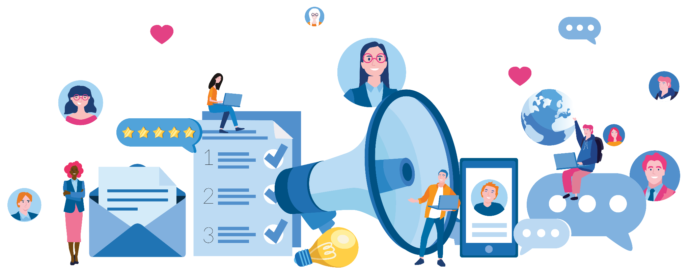
Unit 2.3
Crafting a Clear
Message
1
IMAGE: SHUTTERSTOCK
Notes:
Welcome back! This session will go into depth on how to create advocacy messages that get results. We already introduced some of these concepts in the storytelling session, but it is good to review them because your effectiveness as an advocate relies on the strength of your communication skills.

Slide 2

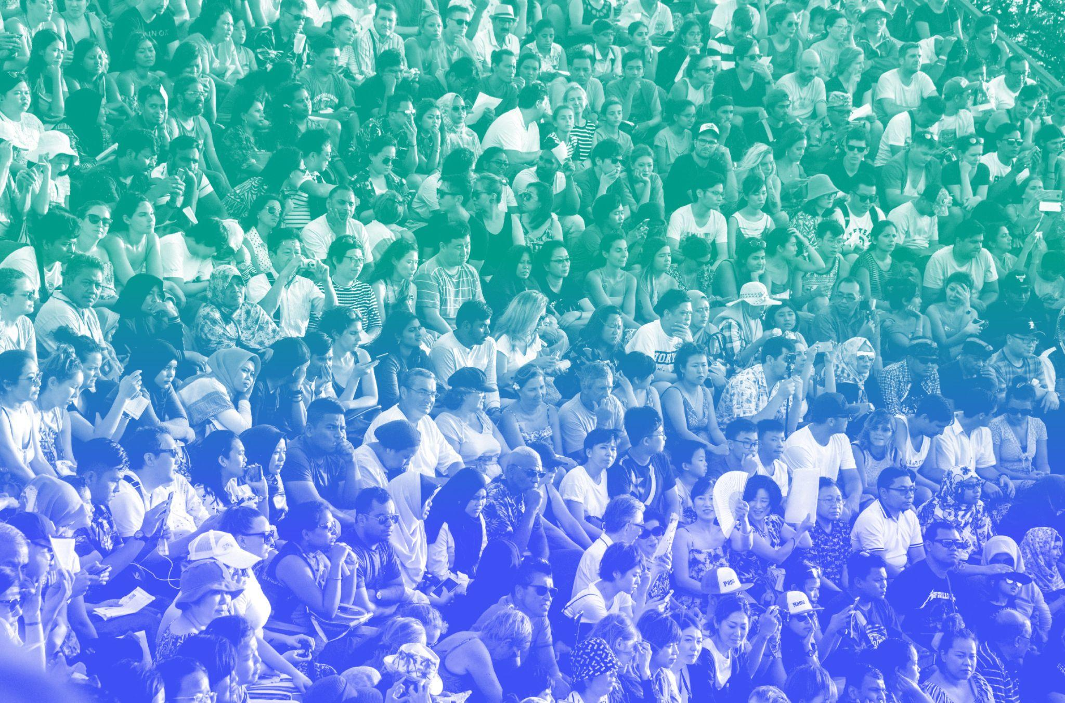


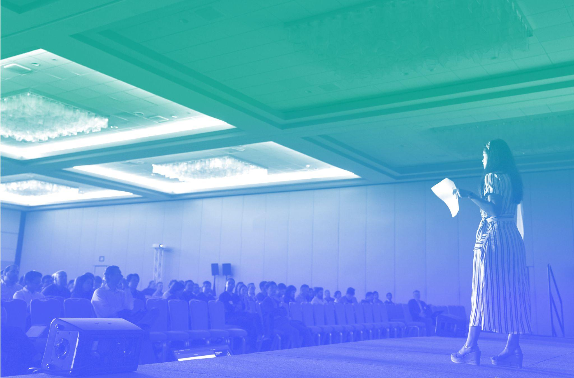
Effective Messaging:
Four Considerations
1
3
AUDIENCE
CONTENT
2
4
OBJECTIVES
DELIVERY
Notes:
Here are four considerations for effective messaging.
First, focus on your audience and tailor your activity, product, or presentation to their needs. Remember, it is not about YOU. It’s about your audience, so put them in the forefront on your mind.
Second, list your communication objectives. It’s imperative to start with steps one and two. Without knowing WHO your audience is, or WHY you are speaking to them, how will you know what information to present?
Third, determine your content. Identify which messages and evidence you will share to best support your objectives.
Lastly, if you plan to present your messages verbally, work on your professional physical and oral presentation skills. Your delivery can be as important as the actual content of your advocacy.
Each of these steps is a lot of work, but the preparation pays off.

Slide 3
Audience
1
PHOTO BY DASHA SHCHUKOVA ON UNSPLASH
Notes:
We’ve said it before and we will probably say it again, but every time you share a message publicly, whether in a policy brief, on social media, or in a formal presentation, you should consider your audience from the very beginning. Who are they? What do they care about? What is their connection to your issue?

Slide 4


Focus on What Your Audience Needs to Know
4. What do you hope they will do as a result of your advocacy?
2. How much knowledge do they have?
3. What motivates them?
1. Who is your audience?
Notes:
Any presentations you make should be focused on sharing what your audience needs to know, rather than on showcasing everything you know. As a youth advocate, it’s also important to consider how your audience relates to you.
[Ask:] Do you have an example of a time when you shared the same information with two different audiences and got two very different responses? [Generate discussion about how much audience matters and how messaging should be tailored to the audience.]
Consider if your audience is interested in hearing youth voices, or are they resistant? You may find that the youth focal person at the Ministry of Health responds differently as your audience than someone from the Ministry of Planning. Are there generational barriers, are there professional barriers, or are there traditional barriers between you and the decisionmaker? What do you need them to hear from you that is unique to your position as a young person? How do you as a youth advocate need to present yourself and your argument to best reach your audience?
Consider how much knowledge your audience has about your issue. If you are concerned about deforestation in your country, the Minister of Environment likely knows quite a bit about the issue, but if you have to convince your country’s parliament to make a new law, some of them might not know anything about deforestation! This why it is important to know what your audience knows and what they need to know.
You also should consider what motivates your audience. Why they are listening to you? What, specifically, do they expect to get from engaging with you as an advocate? How they will react to your message? (To be persuasive, you must convince your audience that your interests coincide with theirs.)
And finally, decide what you hope your audience will DO as a result of this advocacy―what will be your call to action?

Slide 5
Objectives
2
PHOTO BY MAURO GIGLI ON UNSPLASH
Notes:
Once you have a good understanding of your audience, what they know, what they don’t know, and what motivates them, it is time to revisit your own priorities for speaking to them. What are your objectives for this activity, product, or presentation?

Slide 6


Defining Your Objectives
Ask yourself…
How will you know if you have succeeded?
Why do you want to do this advocacy activity?
What do you hope to gain?
Notes:
Start by asking of yourself the same questions you asked about your audience: Why you want to do this activity at all? What do you hope to gain? Are you hoping to introduce a new strategy, explain a problem, or to build relationships with influential people? All of these are objectives seem like they would be achievable, but which is the most important for this particular activity?

Slide 7


Desired Outcome
Policy creation or change
Budget allocations
Political support
Community support
What do I want to happen after sharing my message?
Media attention
Program funding
Resource allocations
Notes:
Your objective for this specific activity will ideally be related to what you want to accomplish with your advocacy overall. It is always a good idea to begin at the end and work backwards. What is your ultimate goal? What policy do you hope will be created or changed? Do you want to see increased political or community support? Media attention? Funding allocation or changes?
If your audience is a mixed group of adults in your community, and your objective in speaking to them is to explain a problem they may not be aware of so they will join your fight for policy change, everything you say should be pointed toward making that case.

Slide 8

Call to Action Versus Desired Outcome
CALL TO ACTION
DESIRED OUTCOME
Tailored to specific audiences
Part of your key messages
What you specifically want your audience to do. Some examples:
  Write a news article
  Call your representatives
  Share a social media post
  Make a public statement
Smaller ask that supports to your policy objectives
Focused on a policy goal
Vision for change in people, communities, the economy or environment
What you want to happen after sharing your story, such as:
  High-level policy change
  Community mobilization
  Larger hope that supports your policy goal
Our purpose for creating a multimedia story!
Notes:
The call to action and your desired outcome are related to each other, but they are not the same thing.
Desired outcomes are focused on large changes in communities or policies—which is what you want to achieve with your policy goal. Calls to action, on the other hand, are much smaller asks of your audience, or what they can immediately do—which will often support your objective.
Here is one example. Say you want to end child marriage in your country, and child marriage is currently legal. Your desired outcome in that case is probably something like passing a law that makes child marriage illegal, with people in charge of enforcing the law and resources allocated to arrest or stop people who try to marry off a child. That is an awful lot to demand in one story or even one campaign. Also, the group or person with the power to pass the law may not be the same group or person in charge of allocating resources for enforcement.
In this case, if you are making a video for an audience of young people, your call to action might be something like “sign this petition” or “call your representative to tell them to pass a law that forbids marriage of anyone under the age of 18.” Your call to action is meant to start progress toward your desired outcome, but it is more short term and concrete. Something your audience can do right away.

Slide 9




Possible Outcomes
Audience is …
Better informed about your issue
Motivated to talk about your issue with others
Ready to take action
Notes:
If you have a clear idea of what your audience needs to know about your issue and what you want them to do, the content of your product or presentation can then be structured around providing the stories, evidence, and facts that help them to be better informed about your issue, motivated to talk about it with others, and ready to take supportive action.

Slide 10
Content
3
PHOTO BY ANDREW NEEL ON UNSPLASH
Notes:
You know your audience, and you know what you want to accomplish with this activity. Now it is time to pull together the substance to make your case.

Slide 11

Key Message
Problem
Context
Implications
What do I need to say to compel my audience to action?
Data and evidence
Personal experiences
Solutions
Motivations
Notes:
Again, it is smart to work backwards. You have a specific action you want your audience to take. What do you need to say to compel your audience to take that action? By now you have an idea of what motivates your audience, so focus on that. Explain the problem you are trying to address. Why does it matter? Who is most affected by it? What evidence do you have that speaks to the problem’s significance? What solutions can you recommend? What personal experiences can you bring in as stories to make your message memorable?

Slide 12



Key Message Components
STATE YOUR POSITION
CALL TO
ACTION
What is the problem and possible solution?
What do you want your audience to do?
SUPPORT WITH EVIDENCE
MAKE IT
MATTER
What are the one or two key pieces of evidence from the research about this issue?
Can you provide an example or narrative for why this issue is important?
Notes:
You might proceed in this order.
Start off by stating your position. What is the problem, and what solution are you proposing for it?
Next, support your position with evidence. What data points can you share that demonstrate your issue is impacting people’s lives? Is your solution proven to be effective? Remember, data and evidence can lend weight to stories, help overcome biases, and compel your audience to act.
Also, to make your message more relatable and memorable, you should bring in a story or personal experience. Why does this issue matter to you or those in your community?
And of course, don’t forget the call to action.

Slide 13
Remember: Less Is More
Use
language
your audience will
understand
Maximum of
3
Be concise
key points, each backed by evidence
Notes:
Remember, advocacy is often an ongoing and complex process―depending on how broad your desired outcome is, you may need to use several different strategies to accomplish the change you want to see. It is unlikely the problem you are working on will be fixed after one or two activities. So don’t go overboard by sharing a lot of information!
Research shows that a concise presentation allows your audience to focus on the key elements and organize them in a way that makes sense. This means that your audience actually learns MORE when LESS is presented―too much information overwhelms them and they don’t learn anything. But be careful not to oversimplify or create gaps in logic by excluding necessary information.
As you focus your content to a maximum of three key points, make sure each point is backed by data and evidence or personal experience. As a youth advocate, adults are often interested in your life, so you can incorporate your own perspective and lived experiences with evidence supporting your issue. Anything you choose to share from your personal experiences should be supported by facts. Just be careful not to overwhelm your audience by sharing too much detail about the supporting evidence.

Slide 14



A Good Key Message
Is concise
Combines data and storytelling
Includes a call to action
Uses language your audience will understand
Speaks to your key audience
Notes:
To summarize what we have already discussed… a good key message:
Is concise.
Uses language your audience will understand.
Combines data and storytelling.
Speaks to your key audience.
And includes a call to action.

Slide 15
Delivery
4
PHOTO BY PRODUCT SCHOOL ON UNSPLASH
Notes:
Your messages and call to action are clear and specific, you have the data and stories to back them up, now it is time to communicate with your audience! Sometimes that means you have to stand in front of a group and verbally present your message.
As you embark on activities as a youth leader, you may want to practice and focus on your physical and oral delivery. Your style and delivery are a key part of how well you will be able to reach your audience.

Slide 16





Clear, Concise, Conversational
Memorize key parts of your message
Focus on clarity―use short, simple words
Make eye contact
Write your notes in your speaking style
If using slides, fully describe graphs and tables
Notes:
When writing your notes or script, focus on clarity―use short, simple words, and avoid repetition.
Make an effort to memorize the important notes or parts of your presentation or advocacy engagement, such as at the opening and closing, so that you can deliver the message confidently while looking at your audience. In many cultures, eye contact is an important way to enhance your credibility and allow the audience to connect with you, and therefore, your message. You can try to scan each person’s face throughout the presentation.
As much as you can, write your notes in a way that you naturally speak. You want to sound professional, but also natural and conversational.
Finally, if sharing a slide presentation, make sure you fully describe any graphs, tables, or figures included in your presentation. Never simply say, “As you can see in this graph.” You can’t guarantee that everyone in your audience can see the graph or knows how to interpret it. Take the time to explain the axes, what the bars or lines are showing, and then the takeaway point.

Slide 17

Appearance and Manners
Dress appropriately for your audience
Face your audience if giving a presentation
Avoid distracting gestures
Communicate sincerity through facial expressions
PHOTO BY BRUCE MARS ON UNSPLASH
Notes:
You should consider how you want to present yourself when speaking to an audience. In most cases, you should dress professionally. Avoid flashy or revealing clothing. Also, it’s a good idea to avoid a shirt or dress with writing on it… unless the writing is completely uncontroversial. Your attire communicates to your audience that, although you may be young, you are a professional, have original ideas, and should be taken seriously. Don’t underestimate the importance of looking professional!
It should go without saying, but face your audience, not your papers or the screen.
Avoid distracting gestures. Again, practicing with a friendly audience might help you learn if you have any.
[Ask:] What are some gestures that you find distracting during presentations? [Generate responses. Optional: You may also demonstrate the concept to participants by starting to use certain gestures while YOU speak.]
And use your voice and facial expressions to communicate your sincerity about the topic, as well as the other emotions you are trying to convey.
[Ask:] Can you think of any examples of situations where it would be important to deliver content with a serious tone, versus an excited tone? [Generate responses. Two examples: If you are sharing a story or fact about child marriage, you might change your tone to convey the seriousness of the issue. If you are presenting some exciting results related to improved youth engagement, you might change your tone to match that success story.]

Slide 18

Combat Nervous Energy
PREPARE
Know the space, audience, and material
RELAX
using strategies that work for you
VISUALIZE
yourself successfully achieving your goals
DON’T APOLOGIZE
for nervousness
PRACTICE
practice, practice!
PHOTO BY JOSHUA HOEHNE ON UNSPLASH
Notes:
And even with all these excellent pointers, you might still be nervous. If you do find yourself to be nervous before meeting with or presenting to decisionmakers, that’s OK, and it’s very common. Here are some ideas to help you with your nervous energy.
Preparation is very important. Know the space you’ll be working in, your audience, and your material. One way to get to know your audience is to establish some rapport with them. Greet some of them as they arrive, chat with them, make some of them your friends. Then you’ll have a friendly face to look at as you talk.
If you’re not familiar with your material or uncomfortable with it, your nervousness will increase. Being as prepared as possible is a good way to assure yourself that you’ll be successful. Then, take some steps to help yourself relax.
[Ask:] What are some things you do to help you relax when you’re nervous? [Generate responses. For example, take deep breaths, listen to music, or go for a short walk.]
Sometimes you might find that you’re the youngest person in the room, and this has the potential to make some people feel intimidated or self-conscious. However, remember that you, as a youth advocate, have the right to share your input on policies that affect your life. You have the right to have a seat at the table.
Next, it’s important to visualize your success. Imagine yourself speaking, your voice loud and clear, and assured. Picture yourself as successful, and you will be successful. It’s also helpful to recognize that audiences generally want speakers to be interesting, stimulating, informative, and entertaining. They want you to succeed, not fail. People enjoy listening to a good presentation.
And, if you feel nervous, don’t apologize to your audience. Most of the time your nervousness doesn’t show at all. If you don’t say anything about it, nobody will notice. If you mention your nervousness or apologize for it, you only bring attention to it. Sometimes you’re going to be nervous regardless of how well you prepare, but that doesn’t mean you won’t be an effective advocate.
And finally, practice, practice, practice! Experience builds confidence, which is key to effective speaking. Practice in front of a friend or colleague, practice in front of a mirror, or record yourself on your phone and watch it back to see how you look and sound. Force yourself to practice the entire presentation/delivery at least three times in advance! The first one or two may be rocky; by the third, you'll know the material and flow, which will give you confidence when it's go time.

Slide 19
Have the Last Word
Leave them with information on your issue to read later (and your contact details!)
Prepare for a
Q&A period
Respond positively to all questions
Prepare a summary for final wrap-up
Never make something up
Notes:
Remember to prepare for a question-and-answer session after your presentation―you might want your speaker notes to contain draft answers to anticipated questions.
But what if nobody asks questions? That could feel awkward—but you can reinforce your message and appear confident as a presenter if you are prepared to ask a few questions of your audience to spark discussion. You could take one of your recommendations and ask your audience or specific individuals how they might put it into action. Do they think their colleagues would support this type of action? What challenges might they face in putting the recommendations in place? They key is to get your audience talking.
Even so, your audience might ask challenging questions, or questions you can’t answer, or they might question your final message. That is why it is so important to have the last word. Prepare a final statement, and even include it as a final slide. Leave your audience on a high note, and make sure that the last thing you say reinforces your message.

Slide 20
Effective Messaging:
Four Considerations
1
3
AUDIENCE
CONTENT
2
4
OBJECTIVES
DELIVERY
Notes:
Remember: Good advocacy takes careful planning and quality delivery.
Know your audience.
Have clear, achievable objectives.
Know your content. Remember that “less is more,” and be prepared for Q&A.
And finally, practice and work on your professional physical and oral presentation skills so you can deliver your message with confidence.
Understanding these points will make you a strong communicator and an effective youth advocate.

Slide 21


Do the Work!
Who do you want to reach and what do you want to communicate through your advocacy? Define your objectives, audience, and key messages by answering questions on the story brief worksheet.
Notes:
And now it’s time to bring together everything we’ve been learning! This is the end of Module 2, and in Module 3, we’ll start planning out an actual advocacy campaign for the issue that matters most to you. We want to lay the groundwork for that campaign now.
You will receive a worksheet with some questions about your objectives, audience, and key messages. This document will serve as the basis for your campaig,n and you will go back to it throughout the planning and implementation process, so be thoughtful about what you write down.
[Distribute Exercise 2.3 Worksheet to participants. This exercise can be done in small groups, or everyone can work on their own. Participants should choose a real issue and policy goal to develop a campaign around, so if there are multiple people working on the same campaign, they should work together on this exercise.]

Slide 22

Learn More
Ashok Alexander, “Core Elements of Effective Advocacy: Message, Audience, Method and Data,” Mint (blog), June 20, 2018.
International Centre for Policy Advocacy, “Shape the Message for Your Audience.”
WHO, Strategic Communications Framework for Effective Communications, 2017.
Notes:
SOURCES FOR 2.3:

