Slide 1


MODULE 3
Building Your
Advocacy
Campaign
Notes:
Congratulations! You’ve made it to module three of our multimedia advocacy training! At this point, we have learned all the basic building blocks of advocacy and effective communication, so now it is time to bring everything together into a cohesive advocacy campaign plan.

Slide 2

Unit 3.1
Advocacy
Campaign Planning
1
IMAGE: SHUTTERSTOCK
Notes:
We will start with a bit of review, then move on to discuss components of an advocacy campaign plan and how you can best set yourself up for success.

Slide 3
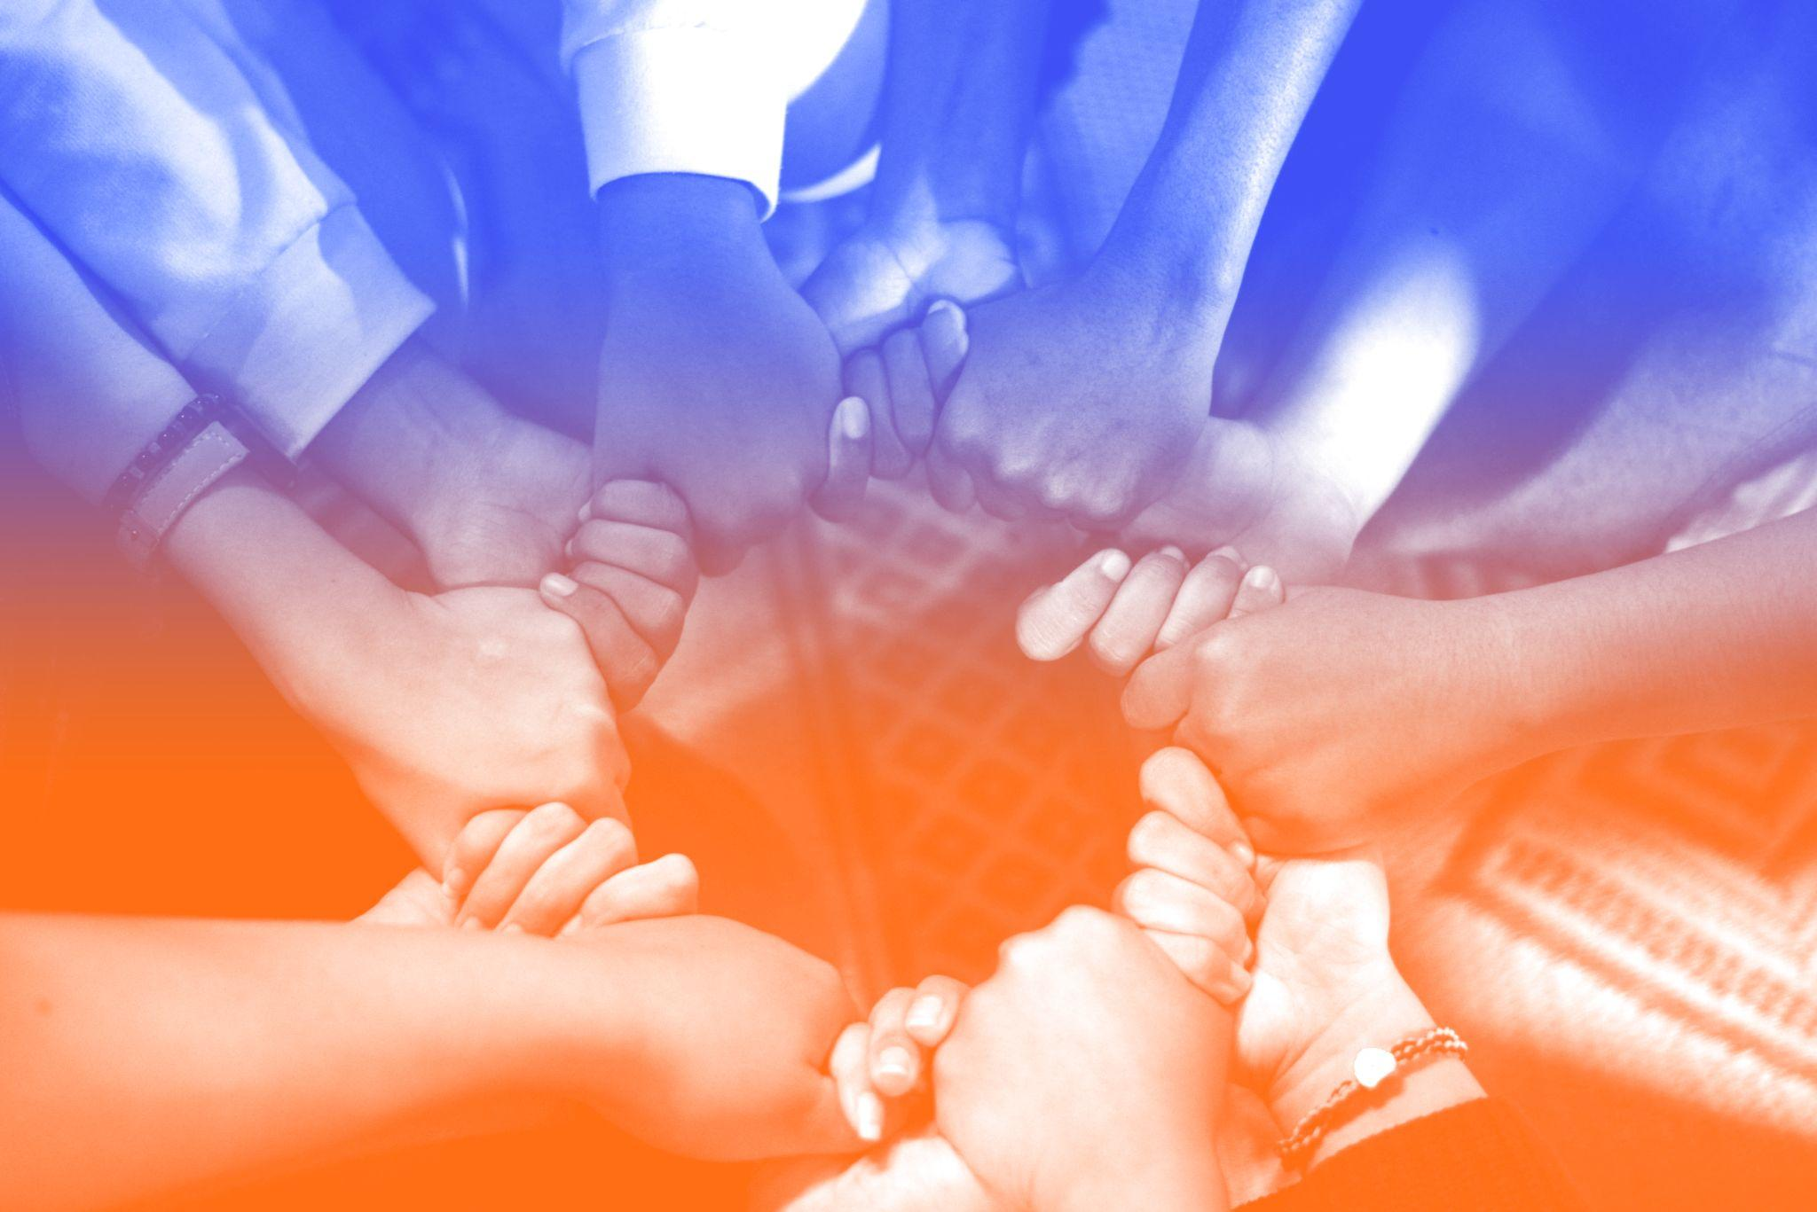
What Is Advocacy?
PHOTO BY WYLLY SUHENDRA ON UNSPLASH
Notes:
First, let’s review some basic concepts from the previous modules.
[Ask:] What is the definition of advocacy? Who remembers what we discussed all the way back in Unit 1.1? [Generate responses.]

Slide 4

Advocacy…
Is the act or process of supporting a cause or principle (Merriam-Webster)
Issue advocacy: Attempting to fix a problem by attracting enough attention to it
Policy advocacy: Attempting to fix a problem through policy or legislation
PHOTO: PRB
Notes:
The dictionary definition of advocacy is “the act or process of supporting a cause or proposal.” Many different actions and activities can be involved in “supporting” a cause, from telling people about it to writing a letter to the editor of your local paper explaining its importance to organizing an entire campaign to push for positive change.
Earlier we mentioned two different types of advocacy: issue advocacy and policy advocacy. With issue advocacy, you notice a problem or issue and you do everything you can to raise awareness of the problem. You assume that if enough people know about the problem and agree it is a problem, the problem will be fixed.
With policy advocacy, you notice a problem and do everything you can to pressure policymakers and power-holders to change or create policy so the problem is addressed at a high level. Policy advocacy may involve some awareness raising activities, but it goes beyond simply raising awareness, instead requiring action from the audience.

Slide 5




Advocacy Is
Different From…
SERVICE DELIVERY
EDUCATION
ACTIVISM
Example: Distributing food aid to orphans is a service, not advocacy
Example: Holding a meeting with peers to educate
them on reproductive health is peer education,
not advocacy
Example: Attending a demonstration or protest is activism, not advocacy
Notes:
Now that we know what advocacy is, let’s discuss what advocacy is not.
First, advocacy is not service delivery. For example, distributing food aid to orphans is a service, not advocacy. But urging community leaders to provide better social service support for orphans is advocacy. Can you think of an example from your personal work where service delivery and advocacy work occur separately but as part of a larger effort?
Second, advocacy targets decisionmakers rather than the general public. Information, education, and communication efforts that target community members to increase their knowledge or change behavior are not advocacy. Advocacy target decisionmakers or policymakers for large-scale change.
Third, advocacy is different from activism. Peaceful public demonstrations can raise awareness of a problem and focus policymakers’ attention on an issue, However, this is activism, which is different from evidence-based advocacy. Activism is focused on making people listen, and advocacy does that too, but it also goes beyond that. Advocacy involves proposing solutions and inviting people to listen to each other’s problems.

Slide 6
Advocacy
Is Not Oppositional
Advocacy takes time and patience
Advocates should build allies, not opponents
Lasting change does not happen overnight
PHOTO BY WYLLY SUHENDRA ON UNSPLASH
Notes:
Advocacy is also not oppositional or conflict-based. Advocacy can be confrontational, at times, but good advocacy builds allies, not opponents.
Lasting change takes time, so your advocacy efforts should be rooted in patience and understanding of the issues. Successful advocacy initiatives search for and find common ground among diverse groups and unite them.

Slide 7




Components of an Advocacy Plan
GOAL
OBJECTIVES
ACTIONS
Notes:
Ok, now that we are clear on what advocacy is meant to do, let’s talk about how to develop an advocacy plan. First, what should an advocacy plan include? Well, an advocacy plan should be structured around three components: a goal, an objective, and a set of actions.
We discussed this a little bit in some of our early sessions, but here we will get into a bit more depth about how to develop these and to ensure they work together.

Slide 8
Defining Your Advocacy Goal
GOAL
A long-term outcome that describes the overall mission of your effort
Usually supported by several objectives
Example: Greater financial commitment from the government to ensure Mozambican youth can access a wide range of family planning methods nationwide
Notes:
A goal is a long-term outcome that describes the overall mission of your advocacy. Remember how we discussed “desired outcome” in the previous session? An advocacy goal is basically the same thing. It should be a broad statement that provides overall focus, vision, and direction for your plan and activities.
Individual goals are usually supported by several potential objectives.
[Ask:] May I have a volunteer to read the “example goal” from the slide? [Volunteer reads example.]

Slide 9


How Do Advocacy Goals Differ From Program Goals?
PRB BCAI
Notes:
An advocacy goal is different from a programmatic goal, which many of us are more accustomed to seeing.
[Ask:] Do you know the difference? How would you define an advocacy goal? And how would you define a program goal? [Generate responses.]

Slide 10
Advocacy Goal vs. Program Goal
Advocacy Goal
Program Goal
Systematic changes that apply to many people at once
Changes in behaviors and indicators
Example: All youth have access to comprehensive family planning services
Example: Decrease the rate of adolescent pregnancy by 20 percent
Notes:
Let’s look at the differences. As we have said, with an advocacy goal, you’re trying to bring about a systematic change that will apply to a large group of people at once. An example of an advocacy goal could be ensuring that all young people in a community have access to respectful, comprehensive, youth-friendly family planning information and services.
[Ask:] Can someone give another example of an advocacy goal? [Generate responses.]
On the other hand, program goals aim to bring about changes related to the problem itself, such as in people’s behavior, in order to impact indicators. For example: Within five years, decrease the number of births to adolescents by 20 percent.
[Ask:] Now, can someone come up with another example of a program goal? [Generate responses.]
[Ask:] Who can summarize the difference between these two types of goals? [Generate responses.]
So you want to be sure your advocacy goal is clear and directed at achieving political or systemic change. Once you have established your goal, you can move on to outlining your objectives.

Slide 11

Determining Your Policy Objectives
Roadmap to help you achieve the goal you are working toward
Should address a gap or weakness in the existing policy landscape and provide an evidence-based solution
Represent the change you want to see happen
PHOTO BY JAVIER ALLEGUE BARROS ON UNSPLASH
Notes:
It will take time to reach your advocacy goal, and there will likely be many intermediate steps that must happen before you get there. These intermediate steps are basically your policy objectives.
An objective is a brief statement of intent describing a desired outcome. Each objective contributes to your overall goal. Objectives are usually accomplished within a defined time period, whereas your goal will often be more of a long-term endeavor.
Policy objectives are unique because they seek to address an issue by fixing a gap or a weakness in the policy environment. Your policy objective names the specific policy change you want to achieve. Ideally, the rationale for that change should be supported by strong evidence.

Slide 12
Policy Objectives Should Also Contain…
1
2
3
A POLICY ACTOR OR DECISIONMAKER
A POLICY ACTION
OR DECISION
A TIMELINE
FOR CHANGE
The person(s) or decision-making body with the power to make your desired change a reality
The specific action you want them to take or decision you want them to make
The date by when you want them to act or decide
Notes:
Your policy objectives should also always contain three key items:
A policy “actor” or decision-maker–the person(s) or decision-making body with the power to make your desired change a reality. This might be a Member of Parliament, minister, relevant parliamentary committee, subnational legislature, or ministerial office. (These people are also the “primary audience” for your messages, as we discussed earlier.)
A policy “action” or decision–the specific action you want them to take or the decision you want them to make. For example: Enact, amend or repeal a policy; allocate funds; or issue a mandate to effect change.
A timeline for change–the date by when you want them to act or decide. For example: the day, month, project quarter, or year.

Slide 13
Policy Objective: An Example
OBJECTIVE
GOAL
Kampala Resident City Commissioner signs ordinance to schedule fixed days for waste pick-up in a Central Kampala neighborhood by April 11
To have a safe, clean space for children to play outside
Notes:
Here is an example of an advocacy goal and a related policy objective. [Read slide.]
Part of having a safe, clean space for children to play outside is to have trash picked up regularly. If the trash is not being picked up regularly because there is no policy in place that requires it, our policy objective might be for the city commissioner to create such a policy. But even when the trash is picked up, the area might still be unsafe for children. Getting the trash picked up is one objective on the way to the overall goal.

Slide 14
Be SMART About Your Objectives
PHOTO: BRIDGE CONNECT AFRICA INITIATIVE
Notes:
Your objectives should be SMART.
[Ask:] Does anyone know what SMART in this context stands for? [Generate responses. Correct answer: Specific. Measurable. Action-oriented (and achievable). Realistic. Time bound.]

Slide 15
Setting SMART Policy Objectives
SPECIFIC
Indicates what will be achieved and by what means
MEASURABLE
You can clearly see when/
if it is achieved
ATTAINABLE
Is within reach
What are we trying to accomplish and what can we do now?
Contributes to the overall goal of your advocacy efforts
RELEVANT
TIME-BOUND
Sets a specific date for achievement
Notes:
Here is what we mean by “SMART.” [Read slide.]

Slide 16
Many Objectives to Reach One Goal
NOW
Children in Central Kampala neighborhood have no safe, clean space to play outside
GOAL
Children in Central Kampala neighborhood have a safe, clean space to play outside
OBJECTIVE 1
Kampala Resident City Commissioner signs ordinance to schedule fixed days for waste pick-up in Central Kampala division
OBJECTIVE 2
Neighborhood association organizes volunteer brigade to convert existing space into a playground for young children over two weekends
OBJECTIVE 3
Division Councilor for Central Kampala signs order releasing funds for speed bumps and one-way conversion of neighborhood streets
OBJECTIVE 4
Local sporting goods store provides sports equipment and supplies to neighborhood association
OBJECTIVE 5
Kampala Resident City Commissioner signs ordinance to enable neighborhood association to use land for team sports for older children
Notes:
Often, many objectives are needed to reach the broad policy goal. You can see in this example that advocates came up with five objectives related to their single goal. The trash should be picked up, yes, but they are also requesting speed bumps to slow down traffic and sports equipment for children to use.
[Ask:] Are these objectives SMART? Why or why not? [Generate responses.]
These objectives are SMART, and they should help the Ugandan activists properly structure the activities of their advocacy plan.
Remember to select your policy objectives carefully and ensure they are all contributing toward achieving your policy goal. Once that is done, you can move on to planning your actions.

Slide 17
Preparing for Action
Advocacy actions should be concrete and tangible and should contribute toward meeting your objectives and goal
Also known as “activities”
Notes:
Your advocacy actions are what’s really going on. They are also sometimes called “activities.” Advocacy actions are what you will specifically do to meet your objectives and reach your goal. They are tangible—something that can be seen, heard, or read—and they can be small or large. Actions are what outsiders notice about your campaign.

Slide 18

Multiple Streams and Policy Change
GLOBAL POLITICAL CONTEXT
POLICY COMMUNITY STRENGTHENING
POLICY LEARNING
Political environment
WINDOW OF OPPORTUNITY
Problems Solutions
ATTENTION FOCUSING
Notes:
[Ask:] Remember the Multiple Streams Framework? Who can describe it? [Generate responses.]
This framework shows how three streams of activity may be going on concurrently—problems, solutions, and political environment—and when the streams converge, they create a window of opportunity to make policy change. And we can help bring the streams together through policy learning, attention focusing, and policy community strengthening.

Slide 19



Three Advocacy Approaches to Influence Policy Change
1
2
3
POLICY
LEARNING
ATTENTION
FOCUSING
POLICY COMMUNITY STRENGTHENING
Notes:
Policy learning refers to how decisionmakers learn about new information, data, or findings.
Attention focusing is a way that youth leaders (and other advocates) can influence which issues have the attention of policymakers and the public. Use of compelling evidence can be a good strategy for focusing attention!
Policy community strengthening builds or strengthens coalitions, alliances, communication, and relationships within the policy community.
Now, let’s look at some examples of activities that fit under these three umbrellas.

Slide 20
Sample Advocacy Plan (Simplified)
OBJECTIVE
Convince district health officials to dedicate funds in the next fiscal year to training nurses on the provision of youth-friendly services
ACTIONS
Draft policy memo on the current status of youth-friendly service provision in the district. (Policy learning)
Hold three meetings in August 2018 to educate district health officials on the need for youth-friendly services and ask for a budget allocation to train nurses. (Attention focusing)
ACTIONS
GOAL
Increase access to youth-friendly sexual and reproductive health services
Notes:
Here is a simplified advocacy plan that lays out a goal, an objective, and some actions. As you can see, the goal is to increase access to youth-friendly sexual and reproductive health services. As we have discussed, a good advocacy plan will have a few different SMART objectives, here we see one: convince district health officials to dedicate funds to training nurses on the provision of youth-friendly services. Makes sense, right? We can see how achieving that objective will bring the advocates closer to their goal.
What actions are they planning? Looks like they selected one policy learning action and one attention focusing action.
[Ask:] Will someone volunteer to read the advocacy actions? [Volunteer reads.]
[Ask:] What do you think about these planned actions? What other activities would help them to achieving their advocacy objective? [Generate responses.]

Slide 21
What Will You Need to Ensure Success?
1
Allocate necessary financial and human resources
Anticipate what could go wrong
Think through what will be needed and when
Gather and use data effectively
Identify and work alongside allies and champions
Be ready to adjust if necessary
2
3
4
5
6
Notes:
Ok, we are almost ready to get to work on designing our advocacy campaign plans. How can we set ourselves up for success? Here are some steps:
First, understand that each of your advocacy actions or activities will require certain financial or human resources. Knowing what resources you‘ll need to accomplish your actions is critical. Plan in advance and make sure you have what you need to be successful.
Next, consider the critical assumptions you are making and try to brainstorm, ahead of time, what could go wrong. Try to think through some ways that your planned actions could be disrupted or thrown off course. Preparing for things that could go wrong will allow you to be more responsive and nimble in the moment.
Also, when planning, think through what will be needed for time, money, staffing, and other considerations—as well as when in your process you’ll need them.
Next, as we’ve emphasized throughout this training, use information and data! No matter what type of advocacy action you are planning, data will make it stronger and more effective.
Don’t work in isolation. To be successful, leaders identify and work alongside allies and champions.
Next, learn as you go and adjust if necessary! It can be helpful to plot out some decision points in the process in advance—places where you can stop, evaluate how you are doing, and adjust course or change your plan, if needed.

Slide 22
A Key to Success: Building Partnerships
& Coalitions
Advocacy efforts don’t happen in isolation
Join coalitions and share information freely with other advocates
Membership in coalitions will help you find common ground with others
Notes:
To emphasize the importance of working together with allies and champions, remember that building and leveraging partnerships and coalitions are crucial to successful advocacy.
We can all agree that effective advocacy efforts don’t happen in isolation.
If you recall our earlier definition of advocacy, bringing people together to work toward a common cause is a key component. Your advocacy efforts will be more powerful if you are connected to a broader group of actors. Membership in diverse coalitions helps to build your knowledge base of different efforts and how they relate to one another.
Being a part of coalitions also helps you find common ground with others who might have different agendas or opinions. We will talk more about building coalitions in our next session.

Slide 23


Special Considerations
In some countries, advocacy may not be well received
Maintaining your safety as a youth leader is critical
Notes:
Lastly, there are some special considerations for youth-led advocacy efforts in particular settings. It’s worth noting that in some countries or communities, “advocacy” can have a bad reputation or negative connotation. In some places, organizations or individuals who engage in advocacy activities are branded as “opponents” by the government, rather than as positive change agents. If where you work is like this, then you may want to proceed with your activities in a way that makes sense within the local context.
Maintaining your safety as a youth leader is critical. Advocates in some countries, particularly those who speak out publicly against the status quo, may become targets of violence or harassment. Sadly, this kind of backlash is especially common for female youth leaders. Know your context and develop an advocacy plan that factors in your right to safety alongside your desire to make a difference.

Slide 24


Do the Work!
In small groups, brainstorm some policy learning, community strengthening, and attention focusing activities to effectively address a given problem.
Notes:
Now, we will practice what we have learned with an exercise. You will receive a problem statement and a bit of context on a policy environment. Read your problem statement, then brainstorm at least one activity that fits in each of the three categories of advocacy action you have learned: policy learning, attention focusing, and policy community strengthening. Write these down on your worksheet. Ensure the activities you design are SMART–that is, specific, measurable, action-oriented and achievable, realistic, and time bound.
After you work in groups for a few minutes, we will come back together as a full group and share what we came up with.
[Facilitator instructions: Participants should form small groups (3-5 people per group) to complete this exercise. Distribute one Exercise 3.1 Worksheet to each group. If training is virtual, distribute the problem statements and worksheet over email and assign a small group of participants to review a specific statement. NOTE: There are four different problem statements available, each small group should only work through one of them. If you have multiple groups, each one can work through a different problem statement.
Group members will discuss the problem and the policy environment together. They will also brainstorm potential advocacy actions to use to change the identified weakness in the policy environment based on three advocacy approaches: policy learning, community strengthening, and attention focusing.
Once worksheets have been completed, participants may present their plans to the larger group. The facilitator can then wrap up the activity with a full group discussion. Sample questions include:
Did you feel like you wanted additional information to create effective advocacy actions? If so, what more did you want to know?
Did you consider who the audience might be for your group’s advocacy actions?
Did you wonder what other policy barriers might exist in the policy environment?
Was it difficult to ensure your activities were SMART?]

Slide 25


Learn More
Prue Breitrose, “Chapter 30: Principles of Advocacy,” in Organizing for Effective Advocacy, The Community Tool Box
(Center for Community Health and Development at the University of Kansas).
Craig Grella, “Advocacy | A Rundown of the Basics With Real-World Examples,” SalsaLabs, July 23, 2021.
Notes:
SOURCES FOR 3.1:

