Slide 1

Unit 3.2
Coalition
Building
1
IMAGE: SHUTTERSTOCK
Notes:
In this presentation, we will explore an important facet of advocacy: coalition building. One person acting alone isn’t the most effective way to motivate others and influence policy, so it’s helpful for youth leaders to understand how to create and maintain a coalition.
This session defines a coalition, describes how coalitions can effect policy change, and offers tips for establishing a coalition. Next, we’ll review a short case study from Malawi, written by a youth leader, and complete an exercise based on this real-life example of a youth-led coalition. Our session will then explore in greater depth the strategies for coalition building and maintenance, both online and in person.
Throughout the session, I invite you to share your own experiences with coalition building.

Slide 2

What Is a Coalition?
A coalition is a type
of policy community
A group of individuals/ organizations working together toward the same goal
Notes:
Let’s get started with a definition. A coalition is a type of policy community. It is a group of organizations and/or individuals with shared interests that come together to gain more influence and power than they could on their own to effect policy change.
All sorts of coalitions exist! Coalitions can be permanent or temporary, single or multi-issue, geographically defined, limited to certain constituencies (such as a coalition of youth groups), or any combination of the above. As you think through the structure of your coalition, remember that a coalition’s definition is flexible.
Sometimes a group functions as a coalition but goes by another name, such as a “network” or “alliance.” Although small differences can be found in the definition of these terms, they are often used interchangeably. Remember: The key element of a coalition is a group with a shared interest coming together to take action.
[Ask:] Can you name any examples of coalitions in your community or country? [Generate responses.]

Slide 3
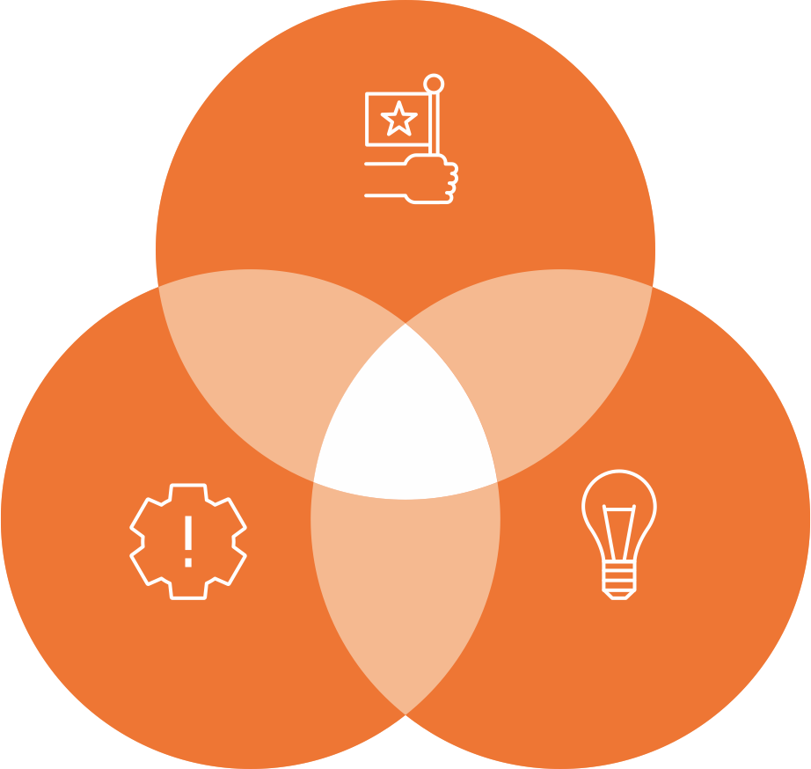

A Coalition Can Influence Policy Change
Political environment
WINDOW OF OPPORTUNITY
Problems
Solutions
Notes:
How can coalitions effect policy change? Well, let’s go back to the Multiple Streams Framework we discussed in earlier sessions.
Remember, the three streams of policy activity—problems, solutions, and political environment—are going on at the same time. When these streams move together, they create a window of opportunity for program or policy change. This intersection rarely just happens—people have to work to make it happen. This is where coalitions can help.
Coalitions allow organizations to work in unison to highlight and define a problem, suggest and determine a solution to that problem, and recognize and monitor when a development in the political environment can lead to new political priorities that might include their solution.
By working together, a coalition can make your voice louder and your actions more strategic.

Slide 4
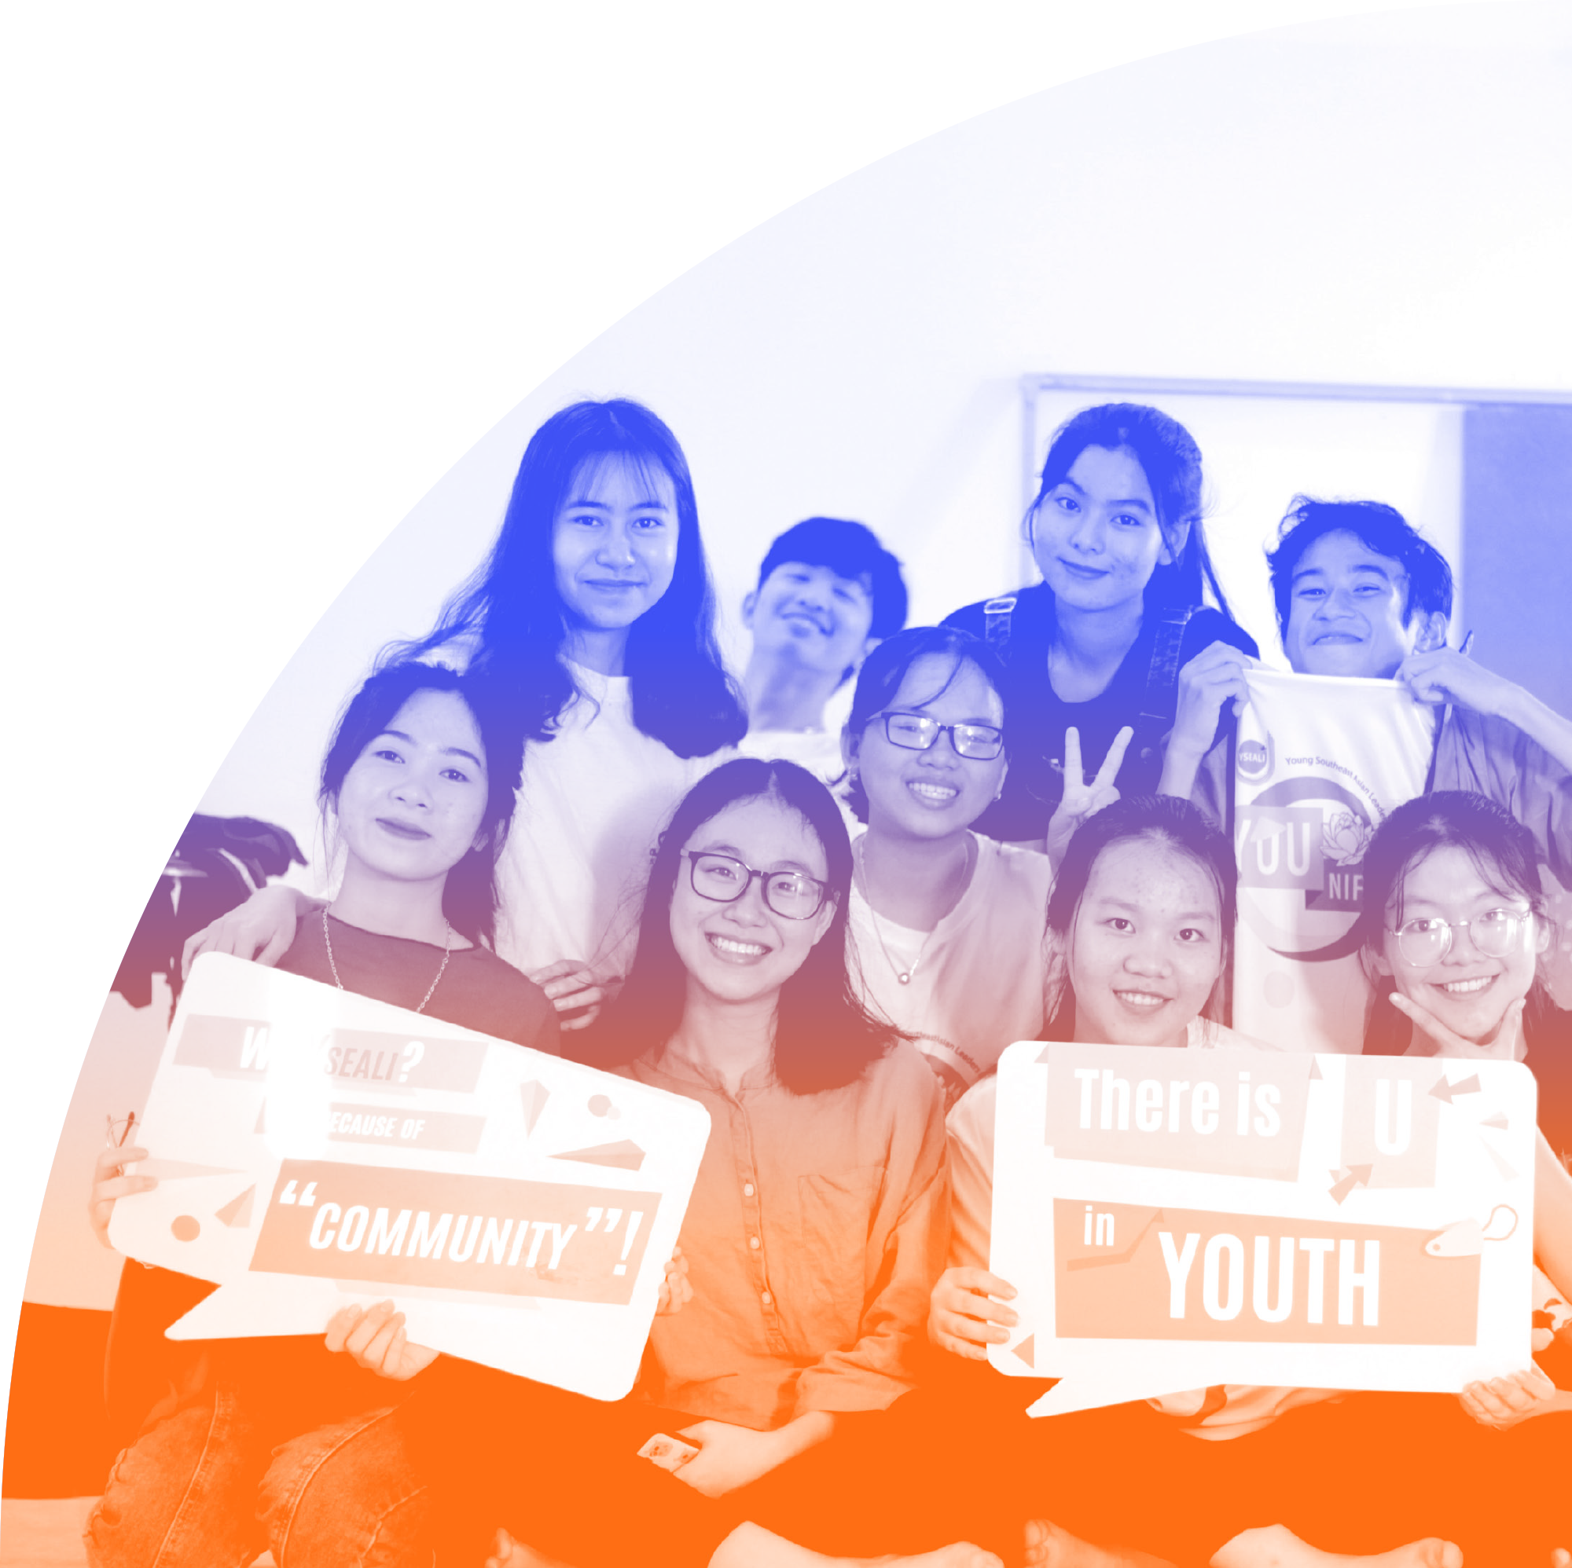
Why
Work in Coalitions?
PHOTO: DIEU HUYEN HOANG ON UNSPLASH
Notes:
Let’s think about some of the advantages of a coalition.
[Ask:] Why is it good to join others in coalitions? What are some of the benefits of working together? [Generate responses.]

Slide 5

Coalition Membership Provides Many Advantages
Strength in numbers
Support member organizations
Increase and share resources
Broaden scope for member organizations
Learn and acquire new skills
Overcome past differences
PHOTO BY FAUXELS FROM PEXELS
Notes:
Working in a coalition offers many advantages, some more obvious than others. Here are some examples of how working in a coalition can benefit both a member organization and individuals:
First, the most obvious benefit of being part of a coalition is that there is strength in numbers. The more people who work together, the better! When many people and resources are dedicated to a complex issue, achieving a goal is more feasible; a coalition can facilitate that.
Next, if a coalition works effectively, then being a member should enhance the member organization’s own work. Coalitions can provide technical, logistical, or financial support to members. Any support offered by the coalition will make the member organization stronger.
Coalitions also increase and share resources. A coalition can support members through skill building, knowledge sharing, and by providing members with direct funding opportunities. Coalition members, if they have the same goals, might choose to share resources and energy to overcome any barriers or shortcomings they are facing. They may also use the coalition as a space to share opportunities for funding and project support. Being a coalition member increases the member’s network, expanding their potential connections to resource opportunities.
In addition, a coalition might encourage member organizations to expand the scope of their work, either convincing them to work on related issues or expand the target populations they work with. If an organization works only on local or community issues, joining a coalition might encourage them to expand to national or international target audiences, increasing the scope and impact of the member organization’s work.
By participating in a coalition, members can also learn from others in the group and acquire new knowledge and skills. An organization’s coalition membership will encourage an expansion in the understanding and experience of the issues they work on. It will also provide opportunities for leaders within the organization to develop their skills by participating in coalition activities and, perhaps, accessing training opportunities that they would not otherwise have.
One advantage of coalitions that you might not have considered is that they can help members overcome past differences or barriers to communication between organizations. A successful coalition can forge new partnerships and understanding among organizations and constituencies, ones that might have previously had a history of stressful interactions or of simply working in isolation. Coalitions focus on uniting over a common goal and a shared problem, making them a fertile place to overcome past differences.
By now, I hope you are convinced that coalitions are important and can offer distinct advantages to member organizations and propel policy change.
The rest of the presentation will describe HOW to form and maintain an effective coalition, as well as some pitfalls to avoid.

Slide 6


Establishing New Coalitions
PHOTO: CYTONN PHOTOGRAPHY ON UNSPLASH
Notes:
[Ask:] What key factors would you consider when establishing a coalition? What should members of a coalition agree on? [Generate responses.]

Slide 7







Establishing a Coalition: Key Factors to Consider
A common framing
of the issue
that brings
groups together
Trust and belief that peers have a commitment to the common goal
Shared incentive and benefit
to participation
Inclusive membership
Ability to mobilize
Notes:
If you decide to form a coalition, you must thoughtfully consider who to invite to join.
Members of a coalition should agree on the framing of the issue they are coming together to address. Not only why the identified problem is bad, but also what should be done to solve it. For example, many groups may be concerned about adolescent pregnancy, but they each have different reasons for why it’s a concern and thoughts on how it should be addressed. As you set up your coalition, you need to explore the identified problem and build consensus on the reasons why the issue is a concern. The coalition’s members may differ in their ideal approach to addressing the problems at hand, but establishing a consensus on why the issue is a concern is key to developing a strong coalition. When building consensus, it is common for many people to need to compromise a bit to find a solution that everyone can be satisfied with. As a youth leader taking part in coalition efforts, you may also want to consider for yourself what things you are willing to compromise on and what is a nonnegotiable for you. We’ll talk more about consensus building in a little while.
Second, coalition members must trust in one another’s commitment to the issue. They must feel that all members are willing to share efforts and discuss opportunities and challenges transparently. To do so, a coalition should establish members’ trust in their commitment to the common goal.
Next, all members should benefit from participation in the coalition. If it seems like one member stands to gain more than the others, then less incentive exists for other members to commit to the cause.
Also, when establishing a coalition, it’s important to be inclusive. Inclusivity ensures diversity and legitimacy. If a prospective coalition member has demonstrated a shared understanding of the problem and the reasons why the problem exists, this should be reason enough to accept them into the coalition. Discrimination must be avoided, regardless of how membership might impact consensus building.
If coalition members can mobilize other advocates into joining the coalition to create policy or institutional change, a coalition is more likely to succeed. Two of the biggest problems coalitions face are lack member retention and lack of funding. If members are good at mobilizing, then these problems are more likely to be successfully addressed.

Slide 8
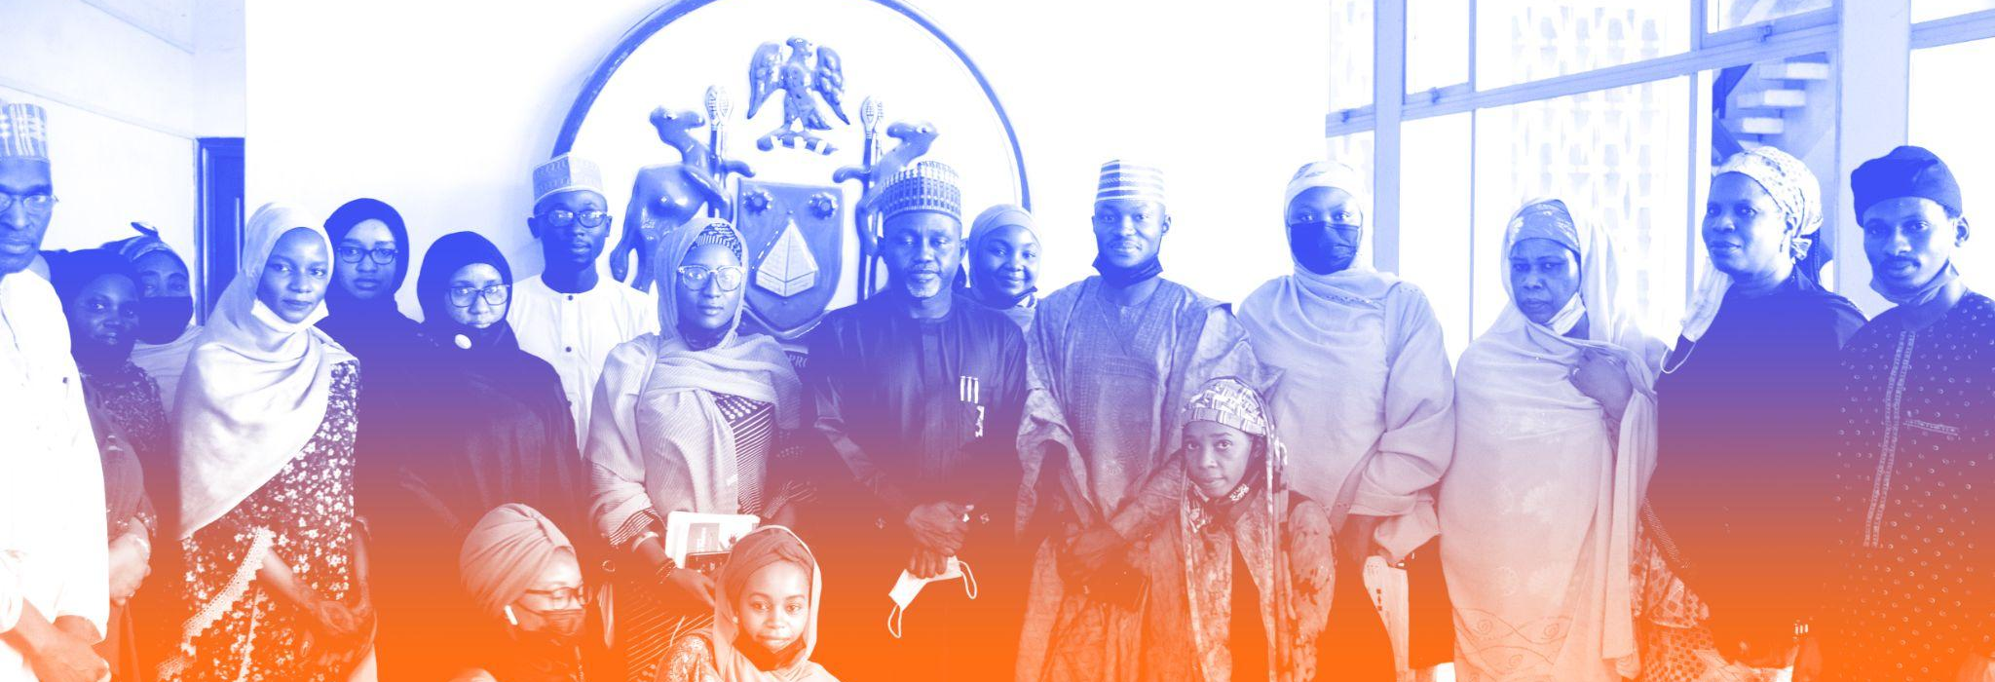
Part 1
Features of a Successful Coalition
Experienced staff
Realistic budgets
Structure
Communication
Common agenda
PHOTO: BRIDGE CONNECT AFRICA INITIATIVE
Notes:
You also must consider how the coalition will operate. Several strategies can increase the likelihood that a coalition will succeed.
Put someone in charge. A staff member or volunteer needs to take responsibility for the smooth operation of the whole coalition, and that person needs to be an impartial, experienced, and savvy organizer. Remember that a strong coalition requires members to experience equal treatment within the coalition, including in the coalition’s leadership. Sometimes coalition leadership can be granted on a rotating basis, creating a balanced distribution of power. Whichever mechanism for leadership is determined to be best, someone (or a small group) should take responsibility for the coalition’s operation and be available to members as a go-to person when questions or issues arise.
Also, develop a realistic coalition budget during initial meetings. The coalition budget should include staff time contributed by each organization, so that the real costs of campaigns and activities are understood. In-kind support (or nonfinancial contributions) should also be included, such as use of computers or printers, meeting space, or website hosting. The budget must be determined through contributions from all members to ensure transparency and manage expectations.
Next, be sure to establish a clear structure. The coalition needs to be clear about who will make decisions and how decisions will be made. The structure should also include lines of communication and how roles and responsibilities will be divided among members. An unstructured coalition will quickly lead to disarray and ineffective strategies.
In addition, to maintain cohesiveness, make sure there is frequent, meaningful communication among coalition members. Communication can happen in person, on the phone, through print materials, by email or text, and through social media. Using a variety of forms of communication is valuable.
Coalition members won’t agree on all issues. However, it is important that members recognize a common agenda from the beginning and are comfortable with the coalition’s mission, vision, and objectives. On issues tangential to this shared agenda, members must agree to disagree. Focus on your common agenda and avoid the issues on which you know members won’t agree. In other words, focus on one common issue—one on which all members can agree—and consensus can be built. Though overlapping agendas may exist among members, coalition meetings are not the space for members to work on their separate agendas or issues.

Slide 9
Part 2
Features of a Successful Coalition
Member autonomy
Recognition and appreciation of varied contributions
Feedback
PHOTO: BRIDGE CONNECT AFRICA INITIATIVE
Notes:
Next, allow for autonomy in tactics. Deciding on the strategies your coalition might use usually requires compromise. Not all members will want to do the same thing, so there should be openness to and acceptance of individual organizations acting independently. Members might utilize more aggressive lobbying or advocacy tactics, according to their individual organization's strategy, and should be allowed to do so, so long as they do not do so in the name of the coalition.
Then, recognize that contributions vary. As the coalition forms, members should have an honest discussion about what each organization is able to contribute and recognize that, although contributions may vary, every member is essential to the coalition’s success. Distribute credit fairly. Members will be more motivated to participate if they feel their work is appreciated. Make sure organizations—and individuals—receive the credit they deserve, so they feel appreciated and supported by the coalition.
Finally, create a formal space for feedback. Coalitions can adopt a formal review process to assess how they measure up to their goals as a group. A successful coalition ensures that members benefit from their membership and feel confident that results are being achieved.

Slide 10
Common Coalition Pitfalls
IMAGE: SHUTTERSTOCK
Notes:
[Ask:] Have you ever been a member of a coalition that dissolved? Why do you think it didn’t work out? [Generate responses.]
Coalitions fall apart all the time due to avoidable problems. Let’s consider some common pitfalls for coalitions and how to avoid them.

Slide 11


Coalition Pitfalls
Ineffective management
No clear sense of direction
No clear and identifiable
mission and goals
Insufficient maintenance
Not well-organized or structured
Notes:
The primary reason coalitions are not successful is a lack of a clear, identifiable mission and goals. Without those, the coalition’s efforts are not focused, and members can easily become discouraged, leading to a lack of impact.
Unless your coalition has a clear, identifiable mission and goals, is well organized and maintained, and has a clear sense of direction, the number of members attending your meetings will dwindle by the third gathering.
Another reason for a failing coalition is ineffective management caused by one person taking complete responsibility. An individual may be excited and energized to take on all leadership responsibilities at first, but when this happens two things inevitably occur: 1) burnout, and 2) a lack of accountability and investment in the other members.
These developments will lead to a decline in participation and attendance.

Slide 12

What Is Consensus and Why Is It Important?
Consensus is based on the principle that every voice is worth hearing and every concern is justified
Strategies for building consensus are critical skills for youth leaders
Consensus is a participatory model of group decision-making
It is not always the fastest way to make a decision
PHOTO: FAUXELS FROM PEXELS
Notes:
Let’s get into more detail about effective coalition building. We have already said that communication and agreement among coalition members are key.
When you are making decisions as a coalition, all members should be engaged in the process. One strategy for group decision-making is by consensus. Although not all coalitions make decisions based on consensus, many do, making it an important skill to master.
In consensus decision-making, making a decision is a goal, but the process of getting there matters. A “majority rules” approach is likely the speediest way to make decisions and move the agenda forward; however building consensus can be a way of ensuring participation and equality in decisionmaking, and, many would argue, results in stronger decisions. Consensus is based on the principle that every voice is worth hearing, and every concern is justified. If a proposal makes a few people or even one person deeply unhappy, a consensus approach recognizes that a valid reason for that unhappiness exists. If the group ignores this reason, they are likely to be less effective as a coalition.
Strategies for building consensus are critical skills for youth leaders and a facet of any effective coalition.

Slide 13




Membership and Recruitment
Consider the
ideal membership for your coalition
Put together
a core group
Recruit
Hold regular meetings
Notes:
[Ask:] Have you ever tried to get someone to join a club or group that you started? Or even your organization? What kinds of methods did you use to try to recruit them? [Generate responses.]
Here are some things to think about before you start recruiting for your coalition:
First, consider the ideal members of your coalition. Who will help you achieve your coalition’s goals? Most coalitions should have diverse membership. Diversity makes a coalition better at understanding other factors that might contribute to a problem. Once you’ve identified the coalition’s ideal members, begin identifying organizations that fit that type. You can look for specific organizations, but also look broadly for other organizations that should be involved. Consider those who have influence, those who will be supportive, and even those who might make your job harder. Should important civil society organizations or government ministries be included?
Many coalitions include individuals in their membership. If you think your coalition would benefit from including individuals as members, consider the kind of individuals who would contribute productively. Individual members may be community members, community leaders, or people who have direct experience with the problem. Individuals can be helpful to a coalition because often they can do things that an organization isn't able to.
Once you have identified which organizations to invite, you should next decide on who to ask from each organization to serve as their representative. Directors usually make the coalition more credible, have valuable experience to contribute and a wider network to connect with, and are more effective at making policy decisions. On the other hand, lower-level staff are sometimes more committed, enthusiastic, and available than higher-level leaders. If lower-level staff will participate, then it is important for directors to appoint them to represent their organization.
Once you have decided who your members will be, it’s time to identify a core group for your coalition. A core group is formed from individuals or organizations that are the most heavily involved in or affected by the topic you’ll be working on. Members of the core group should be trusted partners and willing and available to participate.
You can start a core group in a few ways. You can begin with the people and organizations you know who are working on your coalition’s issue. Or use your contacts to brainstorm who would be ideal core group members. Other contacts to reach out to are members of organizations who are most affected by your issue, such as those directly advocating for changes in national policy.
Next, recruit your members. Use the network of your core group to begin recruiting, keeping in mind the ideal members you have thought about. As you recruit, it is also important to consider the ideal size of your coalition. Your recruitment strategy will be informed by the desired number of organizations and diversity of membership. Keep in mind your most important, or strategic, potential members when selecting organizations to approach about joining.
Some of the many ways to contact people and organizations include:
Face-to-face meetings.
Phone calls.
Email.
Personal letters.
Mass mailings.
Ads in the media.
Flyers and posters.
Social media outreach.
Finally, once you have reached out to potential members and asked them to join the coalition, you must then hold your first meeting, and then regular meetings after that.
The agenda for your meetings will depend on your coalition’s particular issue and purposes, and on the needs of your community.

Slide 14

Strategies for In-Person Coalition Building
Remember…
Make sure coalition activities contribute productively to coalition goals
Make sure members feel like their contributions are productive
Possible in-person coalition activities
Regular coalition meetings
Advocacy activities (for example, themed events or campaigns)
PHOTO: MONSTERA FROM PEXELS
Notes:
There are many things you can do to build your coalition in person. Encouraging member investment, including of their time, and generating new member interest are key to building your coalition’s strength. This encouragement can occur through regular coalition meetings, as well as through your advocacy activities and the activities you do as a coalition.
Remember: To boost member investment and interest, it is first important to make sure members feel that they are productively contributing to the coalition itself. Your meetings and any in-person convenings must be planned and structured to reinforce this feeling.

Slide 15

Strategies for Building Online Networks
Online networks are versatile tools
Consider the network platform
WhatsApp, Facebook, Twitter, YouTube, and others
Newsletters
Before you begin developing an online network, first make sure you know what networks already exist
IMAGE: PIXABAY
Notes:
Online networks are versatile tools that can have many different uses for public participation. An online network can help coalition members work together; it can be useful for sustaining engagement; and it can provide a long-term structure for collaboration, communication, and community building.
Online networks can also expand the coalition’s reach to new audiences and potential members. Remembering our definition of a coalition, it’s possible for this group of organizations and individuals with shared interests to come together solely online rather than in person. Whether virtual or physical space is used for organizing depends on the coalition’s membership, shared interests, and goals. We would argue that, in most cases, effective coalitions use a combination of in-person and online communication to reach their goals.
Before building a new online network, you should first find out what kinds of networks already exist―identify both those in your region and those that your colleagues and allies are familiar with.
In addition, consider the network platform—they all have their advantages and disadvantages, and many are complementary to one another. For example:
WhatsApp groups are an informal way to keep steady communication and strategizing going—for example, to keep up conversation between in-person meetings.
Facebook groups are good for gathering and informing people quickly, but they may not be very effective for long-term communication because of the way posts are sequenced.
Twitter hashtags are useful for spontaneous, fast, and direct communication, but might not be effective at making audiences feel like they are a member of a community or network.
Newsletters can be useful for sharing updates, reminding members of their community, and encouraging them to share news with each other. Newsletters must be regular, however, and are not guaranteed to ensure attention.
In general, online networks will not do well if the technology behind them is hard to use or if outstanding issues or conflicts keep people from wanting to interact. The strength of members’ internet connection may also affect the likelihood of their connecting through online platforms.
Once the platform is decided, you must gather your members’ and prospective members’ contact information. Depending on the platform, this might include email addresses, social media profiles, or cell phone numbers.

Slide 16
Considerations for Online Networks
Members should be engaged regularly
Network moderation is vital
Rules and boundaries help set expectations
Fresh, evidence-
based content enhances engagement
IMAGE: PIXABAY
Notes:
Here are some important factors to consider when managing an online network:
First, good moderation is vital. Moderation is a role that should be filled by a coalition member. This role includes posting content, replying to comments from members or engaging with them in other ways, and removing posts from members (or others) that may be irrelevant or inappropriate.
Next, establishing rules and boundaries will help maintaining active participation. When setting up the online network, think about boundaries for the group, develop rules for behavior, and clarify roles and expectations.
Keep in mind that the content posted on the network is very important. Leaders need to make sure that the network is regularly fed with new information, especially information that members care about. Think about new tools, news from members, questions, and other items to post frequently.
Finally, the way you engage with network members is also important. Commenting on posts or responding to questions, even if not directed to you, can be very effective. Social media users are on these platforms because they are looking for others to engage with—so reach out and respond to them! Generating more responses will increase your visibility, which could lead to growing member interest. Repost and retweet others’ posts so that they, in turn, will support yours. If someone directs a question or comment to you, reply to show you value their perspective. A positive social media presence is important for any network.

Slide 17

How to Structure a Coalition Meeting
Ensure members understand the meeting’s purpose in advance so everyone can prepare
Have an agenda and clearly defined goals, with an assigned notetaker and strong facilitators to lead discussions
Time your meetings appropriately
Consider rotating members who host meetings to encourage everyone to take responsibility
PHOTO: MATHEUS BERTELLI FROM PEXELS
Notes:
Now, a few tips on how to make sure your meetings are structured productively:
Make sure your meetings are appropriately timed according to what you hope to accomplish.
Next, it can be productive to ask that meetings are hosted by members on a rotating basis, encouraging all members to take responsibility for their success.
Also, ensure that everyone understands the meeting’s purpose before it takes place, so that everyone is prepared. Send out the agenda ahead of time if possible.
Every meeting should have an agenda and clearly defined goals, with strong facilitators assigned to lead discussions. Facilitators should ensure that all attendees are heard and have the opportunity to participate fully.
During the meeting, make sure the agenda is followed, and allow time and space for members to talk to each other and build relationships. Also ensure that the meeting ends productively, with members reminded of their responsibilities and clear plans in place for follow-up activities.

Slide 18
Summary
1
2
3
Coalitions can contribute to impressive and valuable change
Many factors must be considered to develop and maintain an effective coalition, including:
A coalition relies on its members to achieve a shared agenda
A clear, shared vision
Strong leadership and structure
Good communication
Active recruitment
Notes:
In this session, we’ve gone into a lot of detail about how to create and maintain effective coalitions that make an impact. In summary, coalitions can achieve real results.
We’ve also learned about some of the many factors to consider when working to develop and maintain an effective coalition. Some of the factors we discussed include a clear, shared vision; strong leadership and structure; good communication; and active recruitment.
[Ask:] Can anyone tell me other strategies for an effective coalition that we discussed today? [Generate responses.]
Lastly, a coalition’s strength is in its collective power―a coalition relies on its members, whether they are organizations or individuals, to achieve a shared agenda.

Slide 19
Case Study:
The Youth Act Alliance of Malawi
Vision: Safeguard children and young people in maternal health, newborn health, sexual and reproductive health and rights, and HIV programs in Malawi through advocacy
Do the Work!
Read the case study, then form groups of three to five people to complete the exercise.
Started in 2014
Positive relationship with the National AIDS Commission and United Nations agencies
Notes:
Now we are going to review a case study that will hopefully help us to pull all these concepts together.
The Youth Act Alliance was started in Malawi in 2014. As you’ll learn in the case study, written by youth advocate Dezio Macheso, this coalition is a good example of a youth-led alliance that has both strengths and challenges.
Please read the case study, form groups of three to five people, and complete the short exercise. We aren’t trying to be critical of this particular coalition but we want to learn from their experiences.
[Distribute Exercise 3.2 Case Study and Exercise 3.2 Worksheet. Note to facilitator: This exercise encourages participation and critical thinking. Some participants may find that they do not have enough information in the case study to fully identify the coalition’s strengths and weaknesses. If that is the case, please encourage them to identify what additional information they would like to have.]

Slide 20


Learn More
Cynthia Ahumada et al, Youth-led Organizations and SRHR: A Step-by-Step Guide to Creating Sustainable Youth-led Organizations Working on Sexual and Reproductive Health and Rights
(Youth Coalition, 2009).
Asia-Pacific Leadership and Policy Dialogue for Women’s and Children’s Health, Building Advocacy Coalitions for Greater Action and Accountability, November 2012.
David Campbell and Nancy Erbstein, “Benefits and Challenges in Building a Community Youth Development Coalition,” REACH Issue Brief Series, November 2010.
Katherine West Slevin and Cynthia Green, Networking and Coalition Building for Health Advocacy (United States Agency for International Development, April 2013).
Western Organization of Resource Councils, How to Work in Coalitions, 2010.

