Slide 1
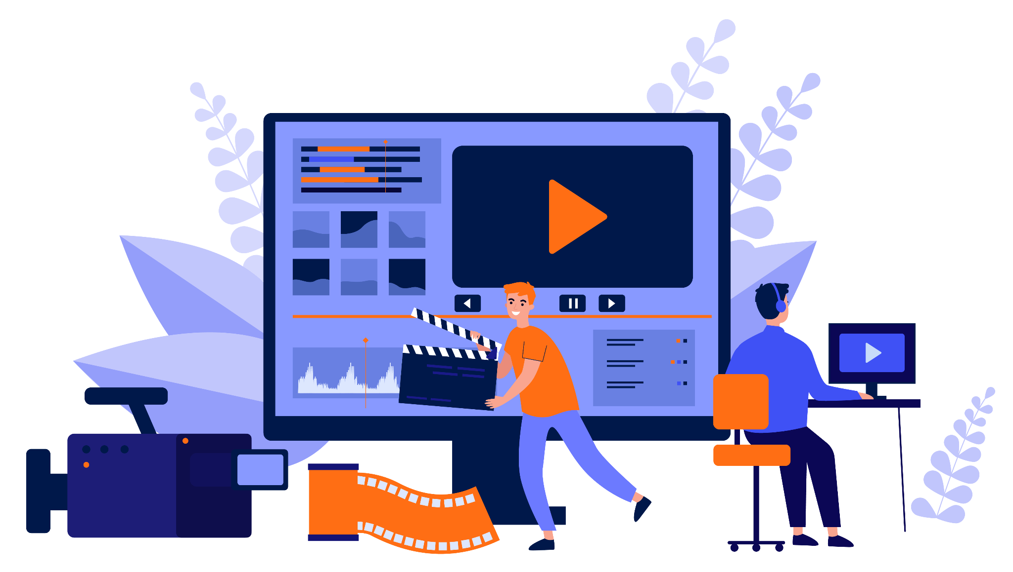
Unit 3.4
Making Magic
with
Multimedia
1
IMAGE: SHUTTERSTOCK
Notes:
Hello and welcome back! In this session, we will talk about how to use multimedia effectively to enhance your advocacy efforts. We will start with a quick review of the storytelling concepts we covered in module two, and then we will provide a basic overview of the different multimedia elements available, when you might want to use them, and what equipment and skills you need to get started producing your own multimedia products.
When you are planning your advocacy campaign, you should decide what communication products you will develop and when. Timing is important! If you want to host video screenings to mobilize your audience to take action, obviously, the video must be finalized before you can do that. However, if you want to make a video to show to policymakers demonstrating that your issue has great community support, you may want to record video of your advocacy activities and then put it together near the end of your campaign. Some advance planning will ensure you have the right products ready to go at the right time.
It is not possible, of course, to teach you everything you need to know about photography or video-making or podcast production in one session like this one, so if you truly want to master these skills, you will have to research, read or watch tutorials, talk to experts, and certainly spend many hours practicing on your own.

Slide 2
Review: Storytelling Considerations
Structure: Narrative arc
Audiences: Primary and secondary
Messages: Problem, solution, evidence
Desired outcome
Show, don’t just tell!
Notes:
First, let’s review some important aspects of storytelling that we covered in previous sessions.
[Ask:] Who can tell me about the narrative arc? [Generate responses.]
A narrative arc is the general progression of every good story. The beginning is calm, but at some point, something happens to create tension (called “the inciting incident”). The tension and character conflict continue to rise until the climax of the story, where it peaks, and then resolves. Any stories we share should follow the narrative arc.
We have talked about audiences in nearly every session so far, so I expect you have a great grasp of this concept by now.
[Ask:] Who can tell me about primary and secondary audiences? [Generate responses.]
With policy advocacy, your primary audience is whoever has the power to make the change you want to see—usually a policymaker or a group of legislators. Your secondary audience is anyone who can influence your primary audience to act. We must keep our primary and secondary audiences in mind from the beginning and ensure our messages will reach them and resonate with them.
And because this is advocacy, our goal is to create change, not just to make people sad or mad or to raise awareness of an issue. Our messages must be organized, compelling, and memorable. We should be able to summarize the problem, propose a solution, and use data and evidence to make our case clearly. Everything we communicate should be designed to get us closer to our desired outcome—the change we want to see.
One way we can ensure our messages are compelling and memorable is to use strong visuals. As much as possible, we want to show our audience the problem, solution, and desired outcome, rather than simply telling them about it.
[Ask:] Have we missed any important storytelling concepts we should review before moving on? [Generate responses.]

Slide 3


Multimedia Elements
Photos
Video
Graphics
Audio
Animations
IMAGE: PIXABAY
Notes:
Here are some of the most common multimedia elements you might use for policy communication and advocacy, and what we will look at in this session. [Read slide.]
You might choose to focus on one of these elements, or to use several. All require some specialized software or equipment, and while there are a lot of free tools available, quality production equipment is not cheap! It is best to practice on free or inexpensive equipment as you build up your skills and decide which elements you want to prioritize for your advocacy efforts.

Slide 4
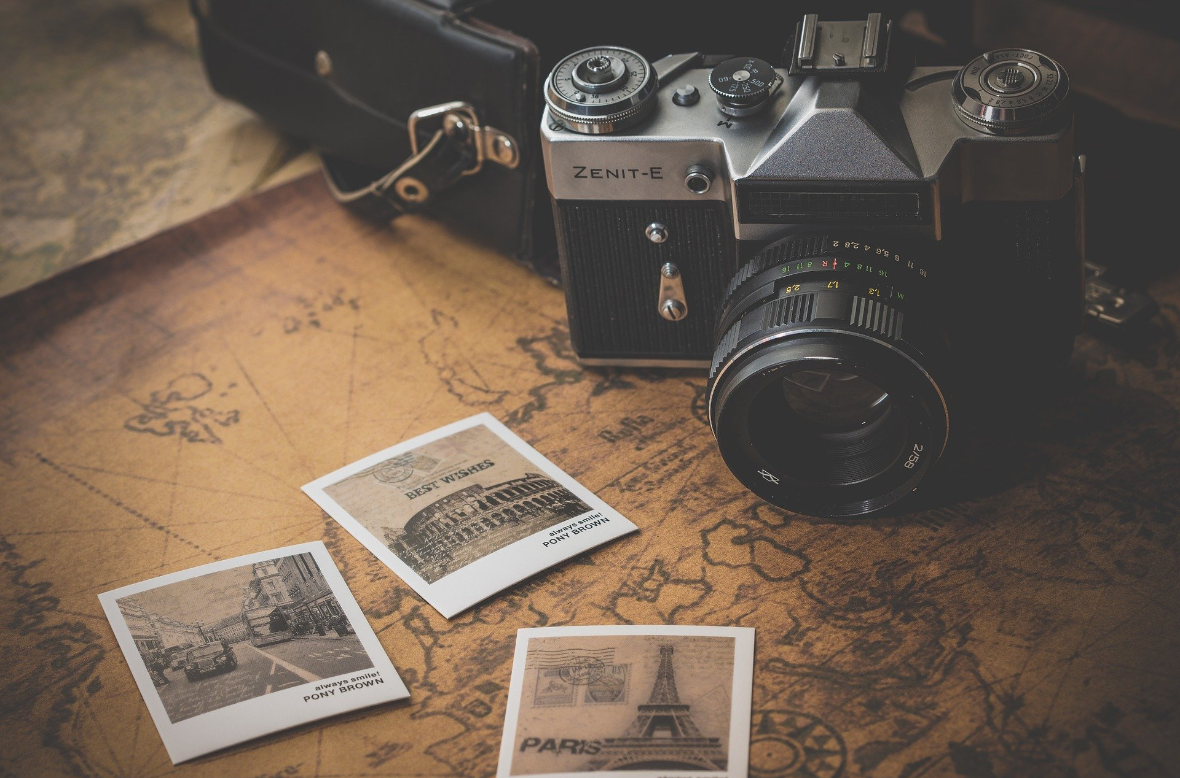
Still Photography
PHOTO: PEXELS
Notes:
First, let’s talk about still photography.
[Ask:] Have any of you used photographs to enhance your advocacy? How did you use them, and what value did they add to your messages? [Generate responses.]

Slide 5
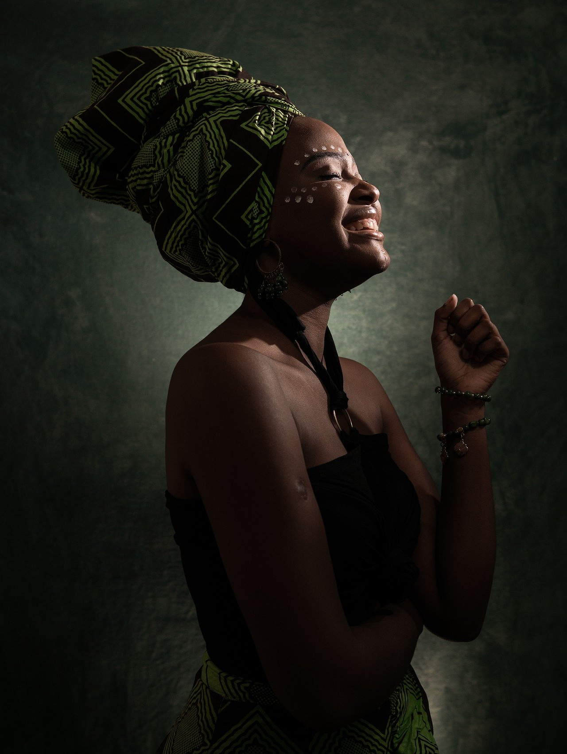
Set the Mood With Still Photos
Still photos are most effective for emphasizing a strong emotion or for creating a particular mood
Use photos in printed materials, on websites, and on social media
You may choose to include photo elements in videos or within graphics
Notes:
You may have heard the quote “a picture is worth a thousand words.”
[Ask:] What does that mean? [Generate responses.]
The general meaning behind this saying is that pictures can be more effective than words at telling a story—that is, one photo can convey as much information as 1,000 words. Still photos are great at conveying emotions. Because photos don’t move like video does, your audience can look at them for a while and really take them in.
[Ask:] What emotions are being conveyed through the photo on this slide? [Generate responses.]
Photos are versatile and can be used in basically any multimedia product, from a policy brief or flyer to a promotional graphic or even a video. Online photo essays—where a series of photos on the same topic or subject are shared with descriptive captions—can effectively get your message across and are relatively quick to produce.

Slide 6

PHOTO: PIXABAY
Notes:
Let’s look at some different types of photos and consider how you might use them to communicate your message. This is a landscape photo featuring some beautiful mountains, green grass, and a small lake.
[Ask:] What story is this image telling? [Generate responses.]
[Ask:] Would you use this photo in an advocacy product? Why or why not—and how would you use it? [Generate responses.]

Slide 7
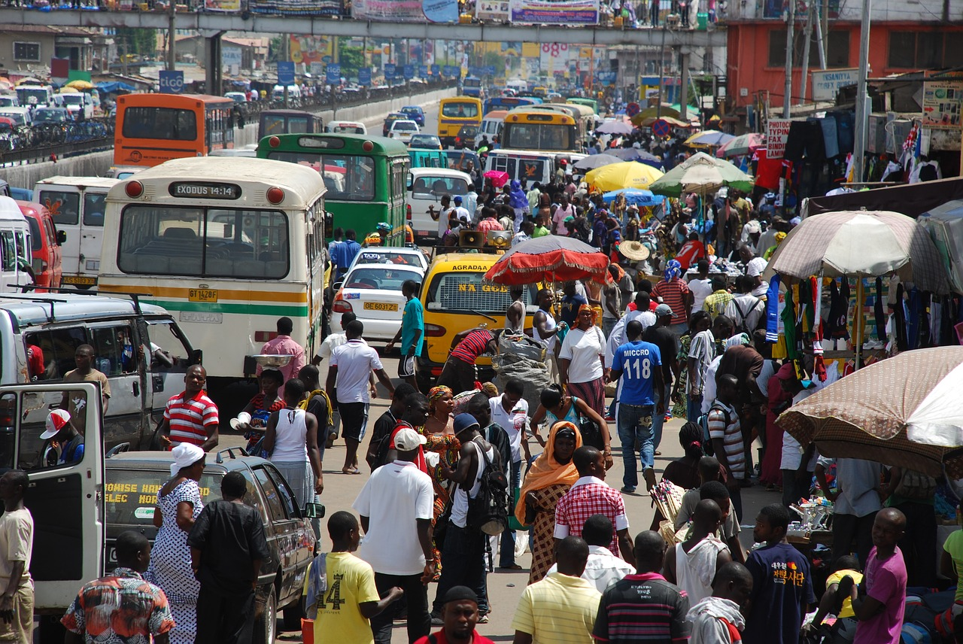
PHOTO: PIXABAY
Notes:
This photo was clearly taken on a busy city street with a lot of people and traffic.
[Ask:] What story is this image telling? [Generate responses.]
[Ask:] Would you use this photo in an advocacy product? [Generate responses, asking participants to elaborate on why/why not and how.]

Slide 8
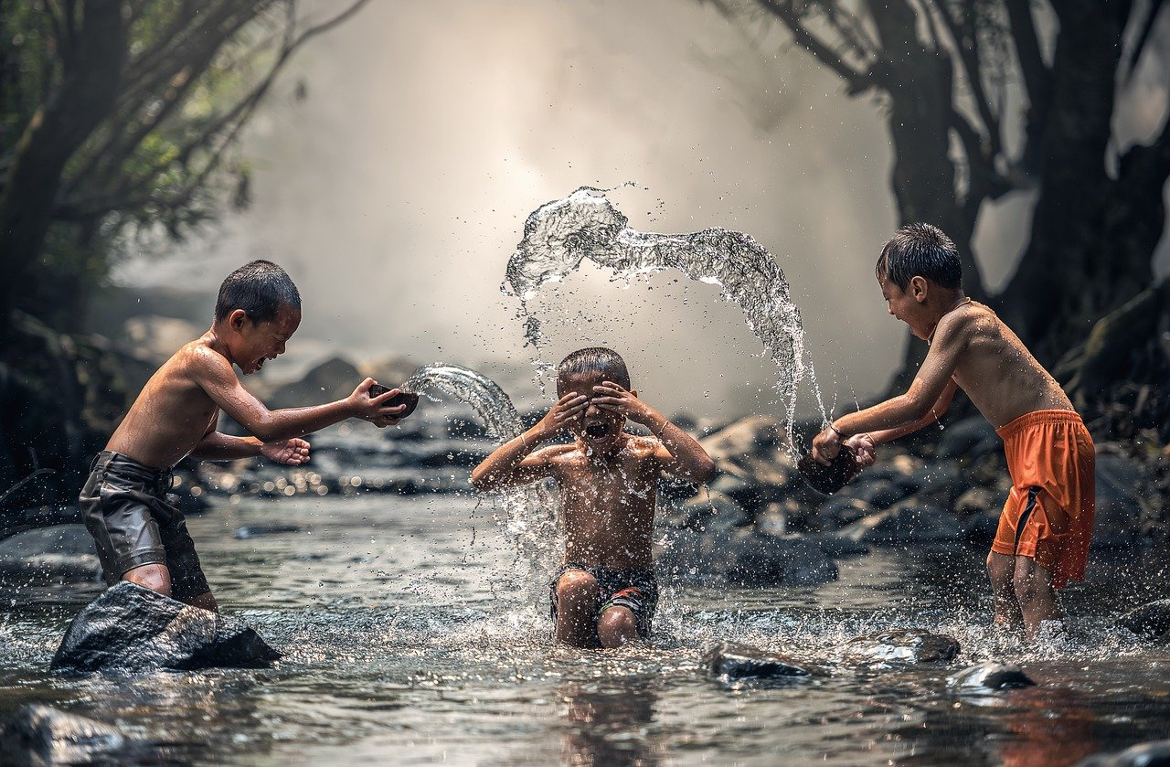
PHOTO: PIXABAY
Notes:
Here we have an action shot with three kids playing in a river.
[Ask:] What emotion do you get from this image? [Generate responses.]
[Ask:] Would you use this photo in an advocacy product? [Generate responses, asking them to elaborate on why/why not and how.]

Slide 9
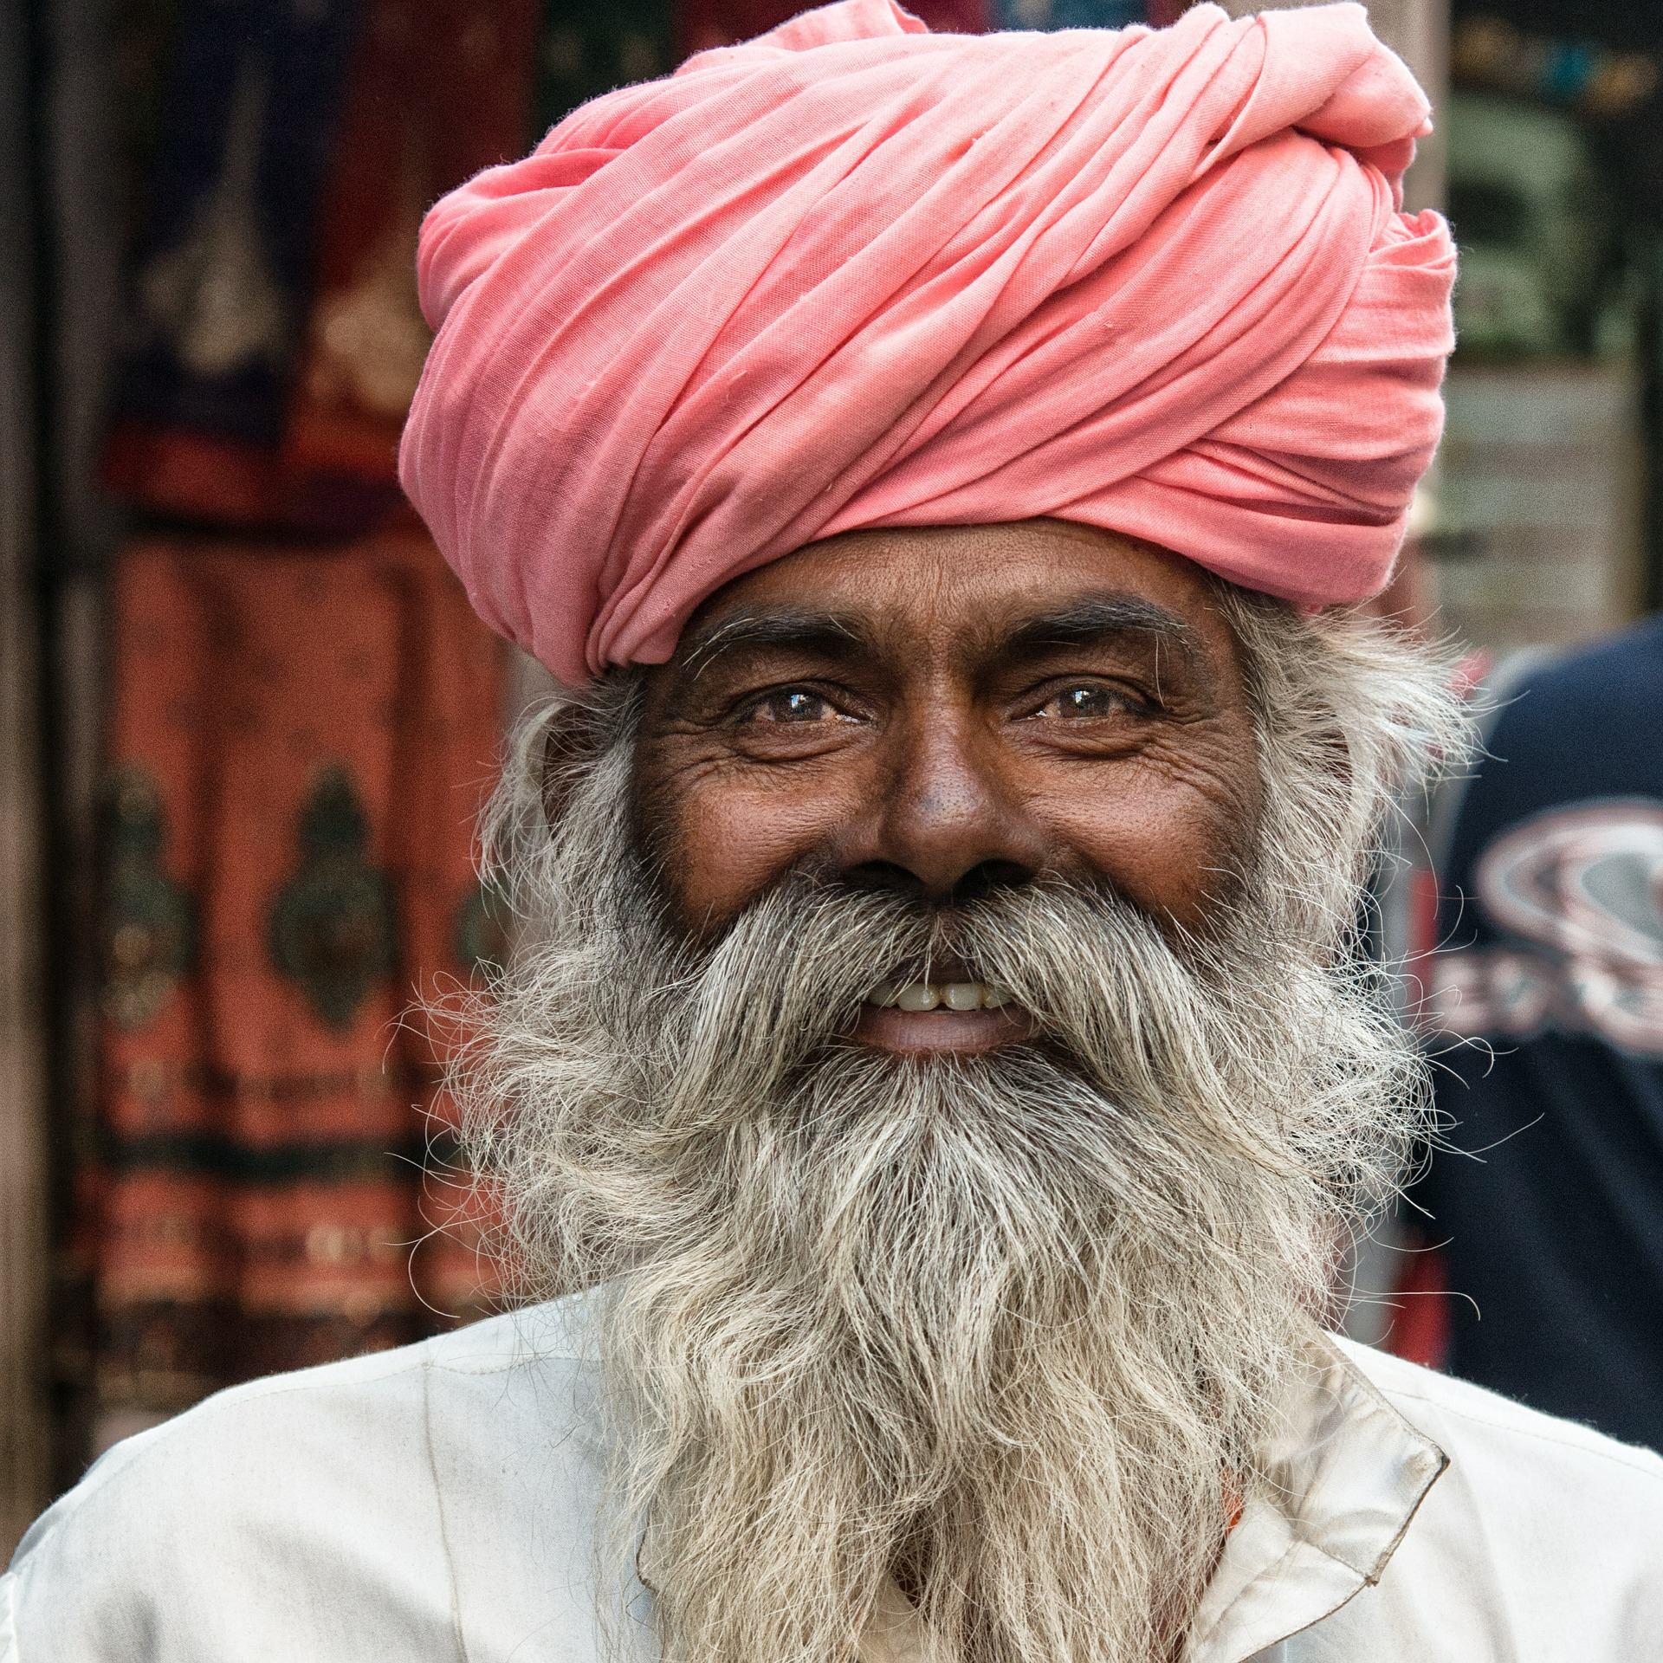
PHOTO: PIXABAY
Notes:
Now we are going to look at a couple of portraits.
[Ask:] What emotions are being conveyed here? [Generate responses.]

Slide 10
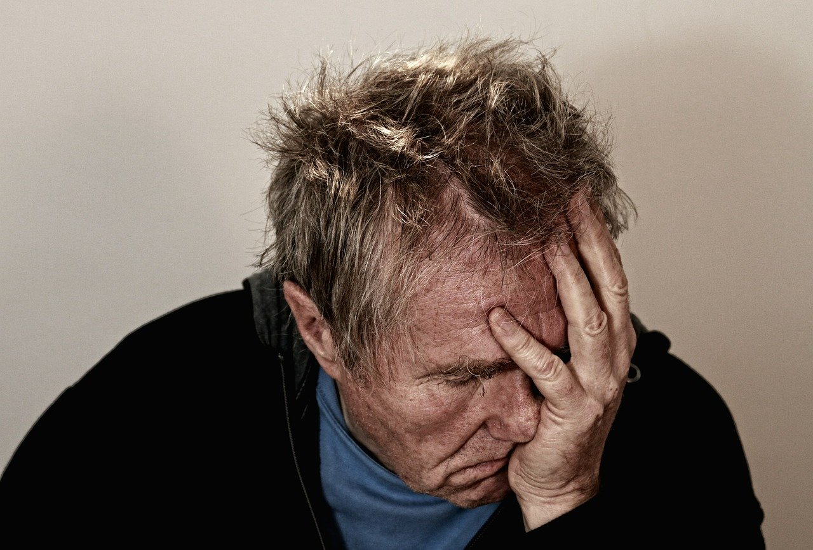
PHOTO: PIXABAY
Notes:
[Ask:] What emotions are being conveyed here? [Generate responses.]
[Ask:] Would you use either of these photos in an advocacy product? [Generate responses, asking them to elaborate on why/why not and how.]

Slide 11
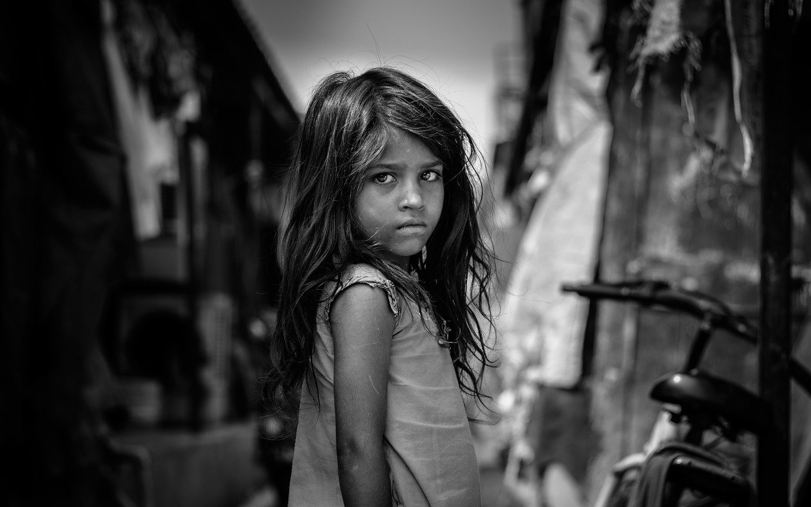
PHOTO: PIXABAY
Notes:
This is the last photo we will look at, and you can see that it features a young girl looking straight in the camera.
[Ask:] What story is this image telling? [Generate responses.]
[Ask:] Would you use this photo in an advocacy product? [Generate responses, asking them to elaborate on why/why not and how.]
[Speaker note: You may want to spend time looking at some websites with the “top photos” of the year, asking similar questions. TIME does a Top 100 Photos list every year, and National Geographic releases a Year in Pictures feature. You can find the 2021 lists here:
https://time.com/6123078/top-100-photos-2021/
https://www.nationalgeographic.com/pages/topic/best-of-2021 ]

Slide 12

Set the Mood With Still Photos
EQUIPMENT
NEEDED
REQUIRED SKILLS/KNOWLEDGE
PHOTOGRAPHY
BASICS
Camera, lens(es), memory cards
Optional extras: Tripod/stand, lighting, reflectors, filters
Or, you can start with a smartphone and/or free stock images online
Framing and composition
Lighting
Depth of field
Editing
How to use equipment
Photography basics are easy to learn, but telling good stories with photography takes practice
Notes:
Millions of people have a camera on their phone these days, and you can take high-quality photographs with many newer smartphones. However, you will have more control over the details of your photo with a digital SLR or other standalone camera. You may also wish to use different lenses and to have a tripod or stand for your camera, depending on what you are photographing and how much light is available. If you need high-quality photos but do not have the time or equipment to take them yourself, you may be able to find images to fit your purpose on a stock photo website. Be careful when using pictures from the internet, though! Ensure they are free to take and reuse, because you may get in trouble for using images that belong to other photographers or organizations without permission.
If you do want to be a good photographer, though, you will need to study and research topics like framing and composition, lighting, depth of field, and photo editing, and of course you will need to know how to use all the equipment you have on hand. Different cameras have different settings, so you may need to read the operating manual to figure out everything you can do.
Taking a photo is easy, but taking a really good photo is hard. You will certainly need to spend many hours practicing to get good at capturing photos with emotional impact that tell a story.

Slide 13

Graphics
IMAGE: PIXABAY
Notes:
Next, let’s talk about graphics. Graphics may be icons, illustrations, charts, or graphs.
[Ask:] Have any of you used graphics to enhance your advocacy? What kind of graphics did you use, and how did you use them? What value did they add to your messages? [Generate responses.]

Slide 14

Use Graphics to Illustrate Important Points
GRAPHICS
INFOGRAPHICS
Graphics can help the audience understand complex or abstract information.
Infographics organize information, usually combining two or more graphical elements
Maps
Graphs
Charts
Illustrations
Icons
GIFs
USAGE
Use graphics in printed materials, on websites, and on social media
IMAGE: PIXABAY
Notes:
Graphics are typically used in visual communication products to organize information or to help the audience visualize and understand complex or abstract information. Maps, of course, provide perspective on where places are located, and charts and graphs help us to put data into context, comparing it to other data. Illustrations and icons, even animated graphics like GIFs, may be used on a product simply to add visual interest.
Infographics are larger products that typically combine several graphics to tell a story in a logical way. We will look at some examples of infographics next.

Slide 15
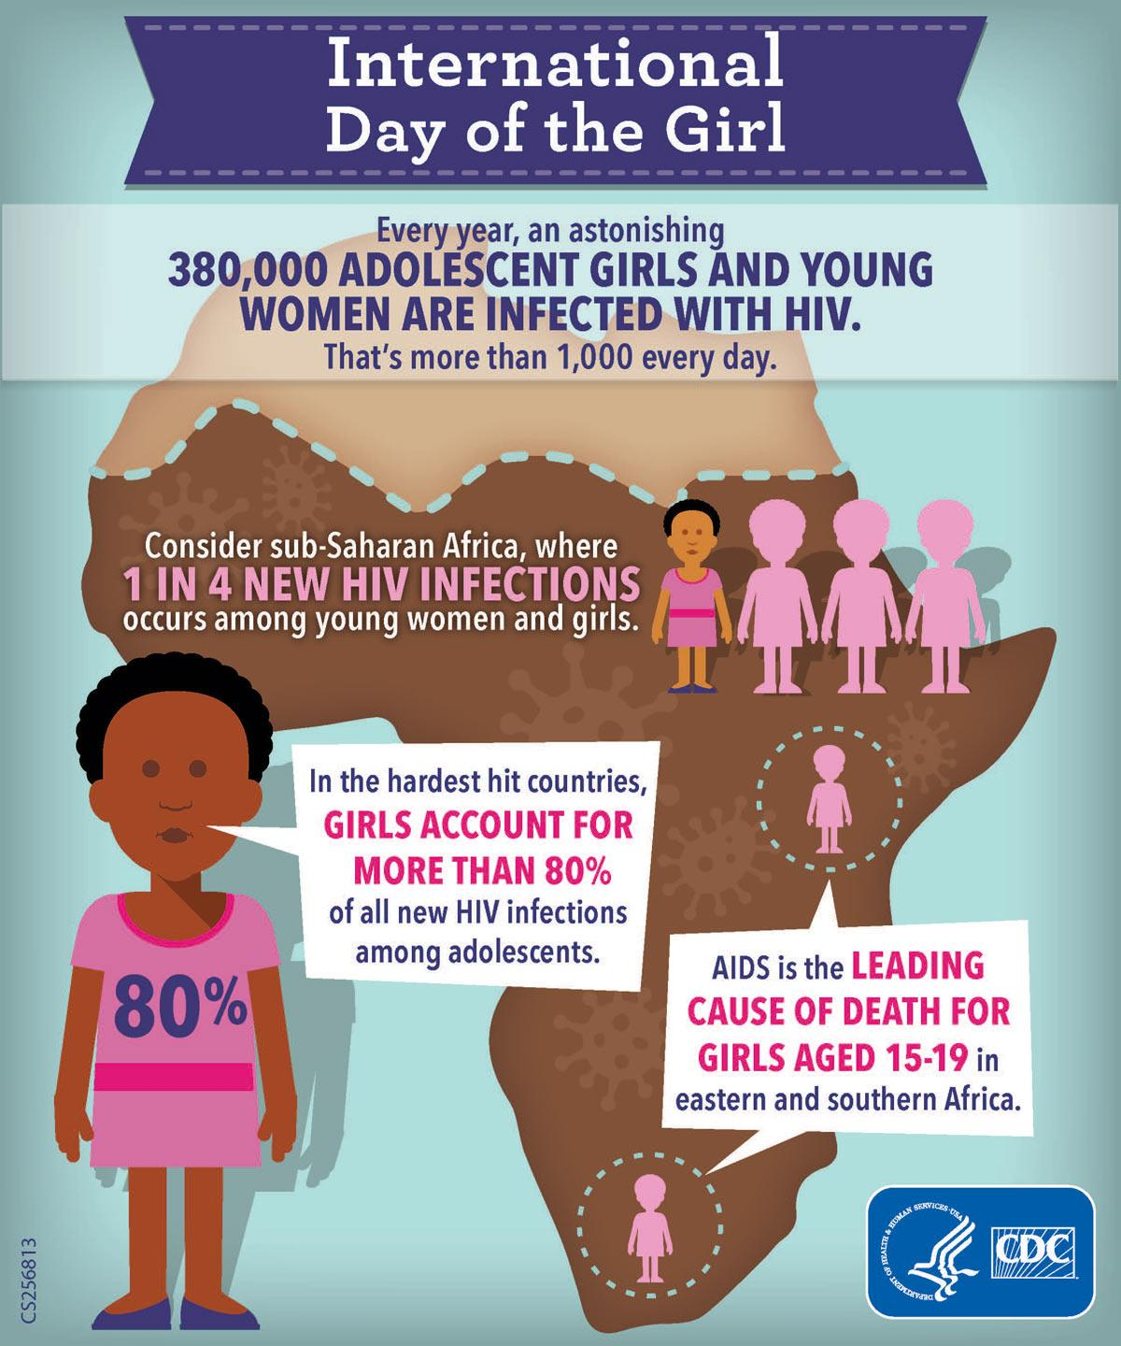

Use Graphics to Illustrate Important Points
IMAGE: CDC
Notes:
The U.S. Centers for Disease Control and Prevention (CDC) created this infographic to distribute around the International Day of the Girl, explaining how HIV is affecting girls in sub-Saharan Africa. They brought in several different elements here, including illustrated characters, icons, a rough outline of Africa, and obviously some text, with strategic use of contrasting colors and sizes for emphasis.
[Ask:] What do you think about this infographic? Is it communicating effectively? Do you find it compelling? [Generate responses.]
[Facilitator note: This graphic was cropped to fit on the slide. The full-sized version can be found online: https://www.cdc.gov/globalhealth/infographics/uncategorized/dayofthegirl2015.html]
Next, we will look at a simpler infographic, also created by the CDC.

Slide 16
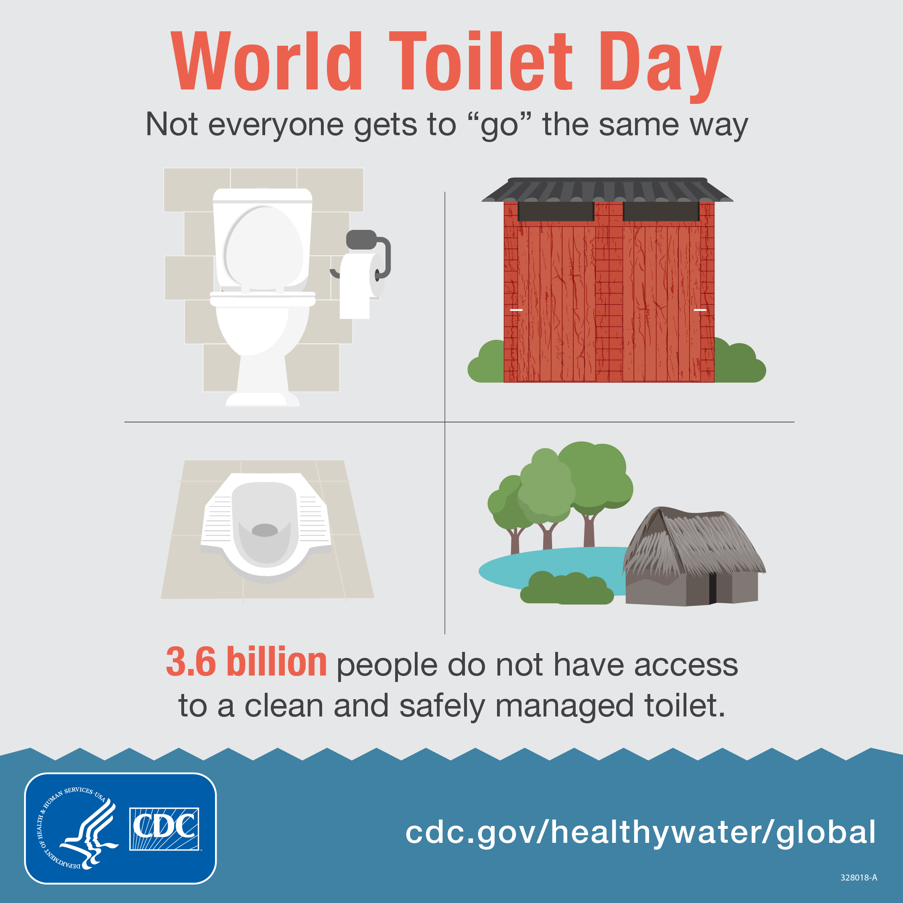
Use Graphics to Illustrate Important Points
IMAGE: CDC
Notes:
As you can see, this infographic is about toilets.
[Ask:] What do you think about this infographic? Is it communicating effectively? [Generate responses.]
[Facilitator note: The source of this infographic is https://www.cdc.gov/globalhealth/infographics/pdf/world-toilet-day.pdf.
Here are links to other infographics you may want to review during this session or share with participants afterward:
https://www.prb.org/resources/global-migration-trends-infographic/
https://www.env-health.org/category/publications/infographics/
https://www.unwomen.org/en/digital-library/multimedia/2015/9/infographic-gender-equality-where-are-we-today ]

Slide 17
Use Graphics to Illustrate Important Points
EQUIPMENT
NEEDED
REQUIRED SKILLS/
KNOWLEDGE
GRAPHIC DESIGN
BASICS
SPECIAL CONSIDERATIONS
Computer, design application (such as Canva, Adobe Illustrator, Adobe Photoshop, Adobe Creative Cloud Express, Lunacy, Adobe After Effects, or Mockitt for motion graphics)
“Good eye” for design, colors, and typography; creativity; command of design application(s)
Some design applications supply templates that can be modified and are better for novices (Canva is a great free option); others require you to start from scratch (Illustrator)
Graphic design is difficult to master, but many free templates and tools are available to make it easier
IMAGE: PIXABAY
Notes:
Designing graphics from scratch is difficult, but fortunately there are many tools around that provide templates and other elements that you can customize to your needs. If you want to create your own graphics, you will need at least a computer or tablet and some software or an application for design. There are many, many options available, and new ones are coming out all the time, so you may want to do some online research to help you decide which one is right for you.
Many professionals use the Adobe Creative Suite programs, including Illustrator, Photoshop, and After Effects. These are powerful tools, but they are expensive, and they may not be easy to use when you are just beginning. Canva is a popular and free online design platform with hundreds of templates to choose from for flyers, social media graphics, event invitations, and basically anything else you would want to create, but it may not be the best option if you want to design something original.
While templates and tools are great, to be a good designer you must have a good design eye so you can choose colors that go together and organize your elements in an attractive and logical order. Graphic design is a skill that is difficult to master, but with study and practice it can be done, and it will come in handy for the rest of your life, as every product can benefit from improved design.

Slide 18
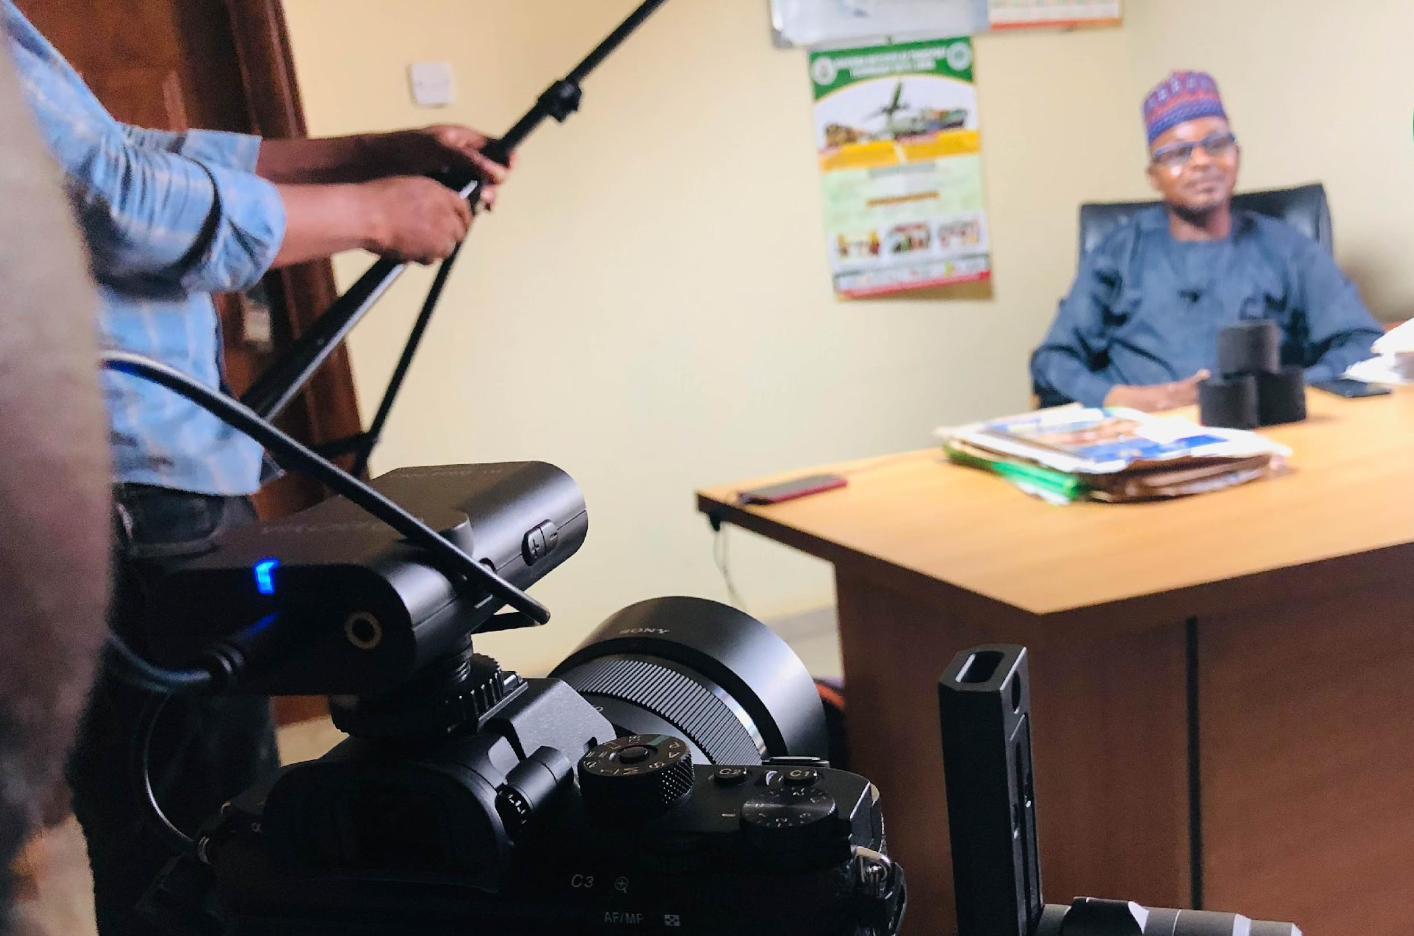
Audio
& Video
IMAGE: BREAK FREE FROM PLASTIC AWARENESS INITIATIVE
Notes:
Now, we are going to shift to talking about audio and video storytelling.
[Ask:] Have any of you ever produced videos or scripted radio shows or podcasts? Tell us about what you did, and what your goal was. [Generate responses.]

Slide 19
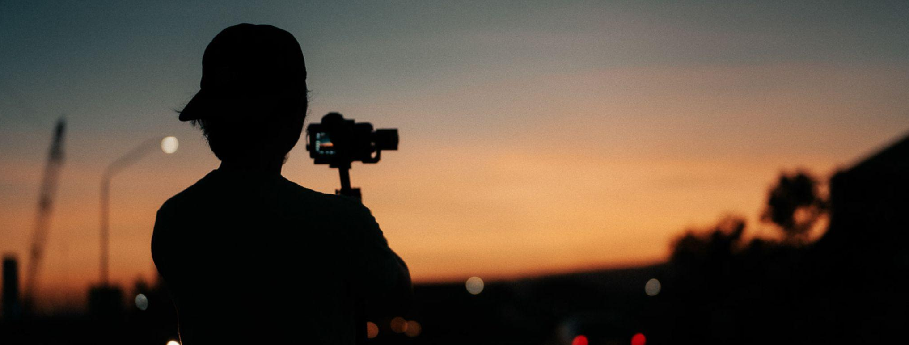
Immerse the Audience in Audio & Video
Video and sounds take your audience into the action
Distribute audio-visual stories online, hold in-person screenings, or use mass-media platforms (radio, television)
Format might be short-form or long-form, episodic or standalone
PHOTO: JOHN ALVIN MERIN ON UNSPLASH
Notes:
Video and audio help your audience feel like they are part of the story. They are somewhat less versatile than photos and graphics because they must be distributed through screens or speakers rather than static or printed materials, but they can be very effective as long as they can reach your audience.
Online dissemination of videos and audio stories is quite common now, but if your audience does not have internet access, you can come to them and host a screening or listening party in their community. You could also consider broadcasting your story on television or on the radio. You may choose to produce a short story or something longer (like a feature film), or even a series of stories that you release over time.
Now, let’s take a look at some examples of advocacy videos.

Slide 20
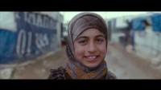
Notes:
ADRA, an international non-governmental organization (NGO) based in the United States, produced this short video for their “Every Child Everywhere” education campaign. Let’s watch it.
[Click to play video.]
[After watching, facilitate a brief discussion. Ask questions like:
What did you think of this video?
Who is the target audience?
What was the call to action?
Was the message communicated effectively? What would you have done differently if you were the producer?]
[Video source: https://www.youtube.com/watch?v=YPi01hBmuUc]

Slide 21
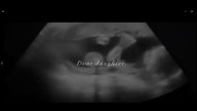
Notes:
Now, we are going to watch one more video. This one was produced by Lisa Russell, an Asian-American filmmaker, using mainly stock footage rather than anything she shot herself.
[Click to play video.]
[After watching, facilitate a brief discussion. Ask questions like:
What did you think of this video?
Who is the target audience?
What was the call to action?
Was the message communicated effectively? What would you have done differently if you were the producer?]
[Video source: https://www.youtube.com/watch?v=KV6sQg9_S0k]

Slide 22



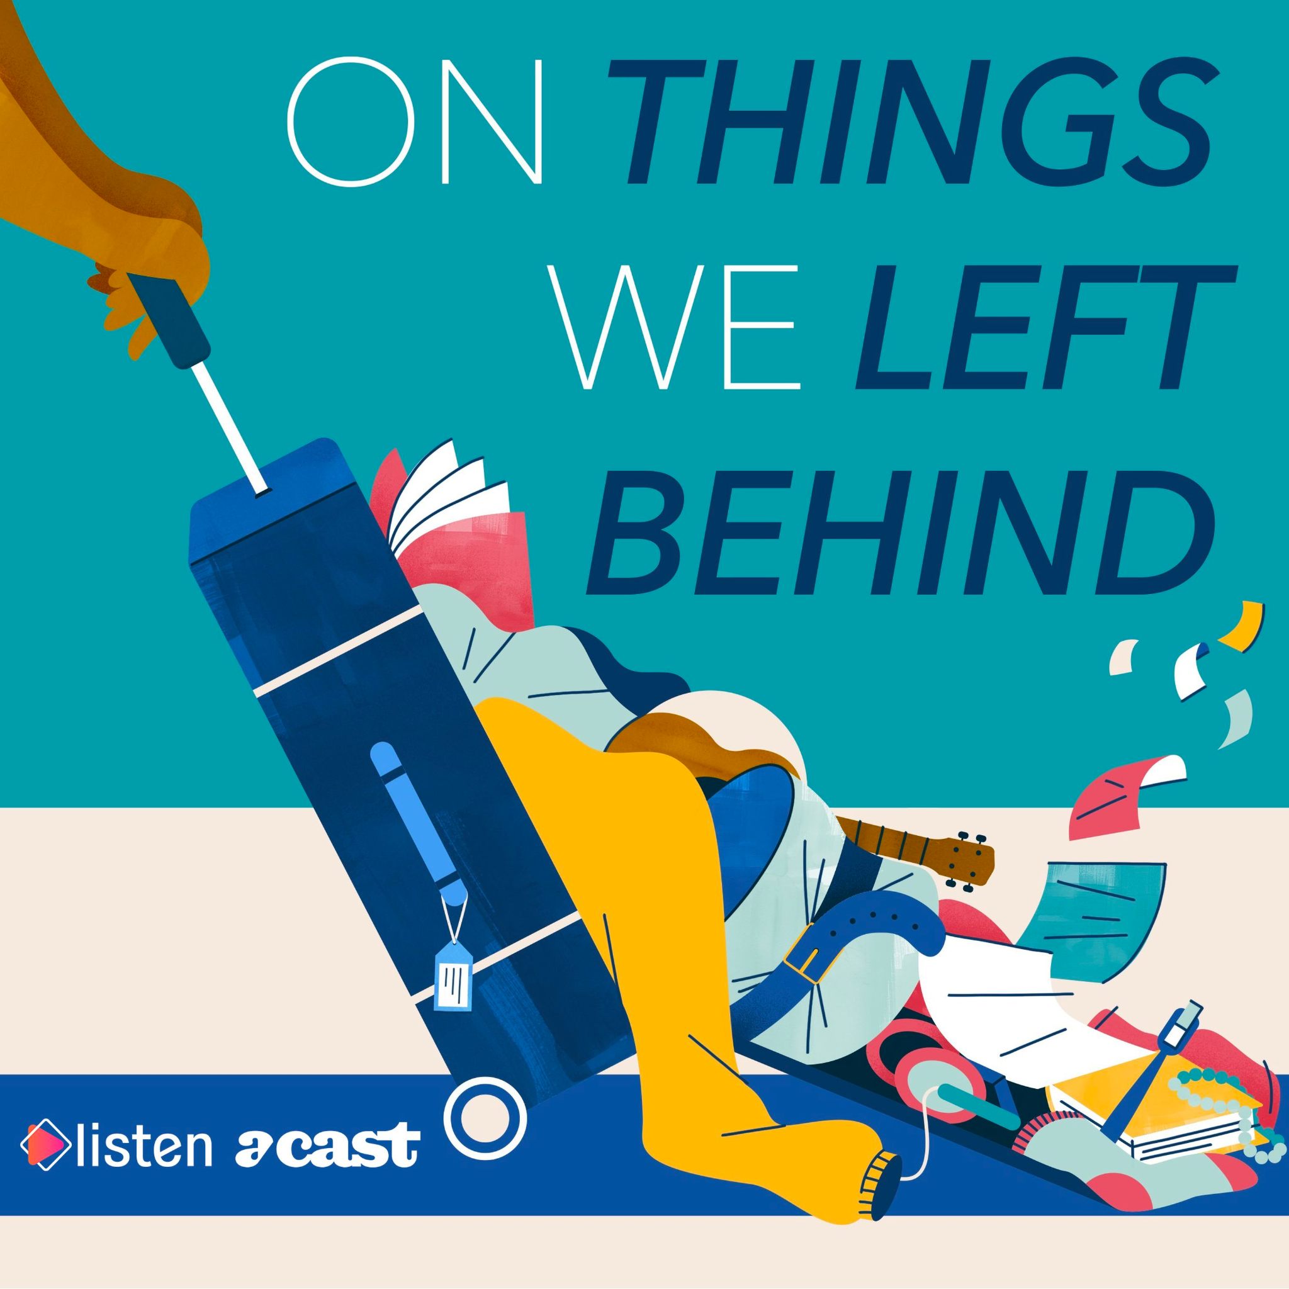

Audio Storytelling Examples
PODCASTS
Radiolab
(United States, English)
This
American Life
(United States, English)
Pontes
(Mozambique, Portuguese)
Kill Switch
(South Africa, English)
On Things We Left Behind
(Somalia/
Canada, English)
Notes:
Now, let’s talk about storytelling using audio. Most of us have heard stories or dramas over the radio. Podcasts are newer media, but they are essentially radio shows distributed over the internet, in some cases attracting listeners all over the world. Here are just a handful of podcasts you can listen to with strong storytelling elements. If you are interested in producing audio stories, you may want to start here for inspiration.
[Facilitator note: If you have time, you may want to pull up an episode of one of these shows (or others) ahead of time so you can listen to a clip with participants.]

Slide 23
Immerse the Audience in Audio and Video
EQUIPMENT
NEEDED
REQUIRED SKILLS/
KNOWLEDGE
Camera, lens(es), memory cards, tripod/stand, lighting, monitors, microphones, editing software
Framing and composition, lighting, video editing, how to use equipment, sound capture
FOR VIDEO PRODUCTION
FOR AUDIO PRODUCTION
Audio recorders, editing software
Sound capture, how to use equipment
Notes:
Video and audio stories, when done well, can be inspiring and immersive for your audience, moving them to compassion and action. However, depending on the story you want to tell, they can also be very time consuming and expensive to produce. You need a lot of equipment, especially for video production, and you must know how to use it well for your story to be convincing. Capturing clean, clear audio is not easy. You need good microphones and recorders, and wherever you are recording needs to be quiet enough that you can hear the story dialogue or the natural sounds you may be trying to capture. You typically cannot use external microphones or recorders when recording with smartphones, so it can be especially difficult to capture good sound with them.
The skills you need to be a good videographer are much the same as the ones you need to be a good photographer. You should understand framing and composition and be able to use natural and artificial light effectively. It is more important when capturing video that you have a tripod or stand so your footage is steady and not shaky. Proper sound equipment is needed for video as well as audio production, and of course you need to know how to use your equipment.
There are also many stock footage and sound sites where you can download video or sound clips for your own use, like we saw in the “Dear Daughter” video we watched a few minutes ago. These can come in handy—but if you want to show a specific community, character, or individual, you will have to capture it yourself.

Slide 24

Keep in Mind…
The story is the priority
Appeal to your audience
Give your story credibility with data and evidence
Include a call to action
Practice, practice, practice!
PHOTO: STARTUP STOCK PHOTOS ON PEXELS
Notes:
Whether you decide to create a video, podcast, animation, infographic, or photo series, do not forget these foundational points:
First, the story should always be the priority. When you start planning your content development, it is easy to get distracted by the details and logistics. All these tools and products are only useful in that they help you to tell the story you want to tell to the audience who needs to hear it.
Next, as we have said repeatedly in this session and others, you should only use techniques that will resonate with your audience. They are the ones you are trying to reach. Develop your materials to inform them about what they need to know.
Also, your story should include data and evidence to give it credibility. Don’t go overboard with a lot of statistics, but if you can share a few compelling points to drive the importance of the issue home, it will go a long way.
Next, be sure to give your audience something to DO with your information. Include a call to action at the end of your story.
And finally, practice—a lot. Storytelling and media production are skills that require time and experience to develop. Do not expect to get everything right on the first try. Build in plenty of time to learn and make mistakes. And try not to get frustrated with yourself or others as you learn.

Slide 25

Do the Work!
Review the story you created during the storytelling session (Exercise 2.1). Do you want to make any revisions to strengthen it? If so, please do. Once you are happy with your story, consider how you would present it using multimedia.
Notes:
So, now you’ve learned some multimedia production basics. Let’s go back to the story we drafted after our session on storytelling and think about how we might turn that into a multimedia product.
[Hand out stories drafted during Unit 2.1 (or have participants retrieve them if they held onto them)].
First, review your story from Unit 2.1 and see if you still like it. Do you want to change anything? If so, do it! Once you are happy with your story, think about what multimedia product would be best for presenting your story to your target audience. How would you adapt what you have written to fit the format you chose? Create a list of steps you would need to follow.
We’ll spend 20-30 minutes on this exercise, then, if we have time, we’ll come back together and share some thoughts.
[Hand out Exercise 3.4 Worksheet and ask participants to complete the worksheet based on the story they drafted in Unit 2.1. After 20-30 minutes, if time allows, invite volunteers to share with the larger group.]

Slide 26

Learn More
Health Communication Capacity Collaborative (HC3), The FP INFOcus Guide: A ‘For Youth, By Youth’ Approach to Using Digital Storytelling to Share Family Planning Information (Johns Hopkins Center for Communication Programs (CCP), 2017).
Jane Stevens, “Multimedia Storytelling: Learn the Secrets From Experts” (Berkeley Advanced Media Institute, 2020).
Notes:
OTHER USEFUL RESOURCES FOR MULTIMEDIA STORYTELLING:
Canva (easy-to-use and customizable templates for graphics, video, etc.)
Adobe Creative Cloud Express (tool for creating websites and videos)
Pull My Focus (YouTube channel)
AnimationMentor (online courses on animation)
Camera Basics for Beginners (Photography Talk blog)

